Slide 1
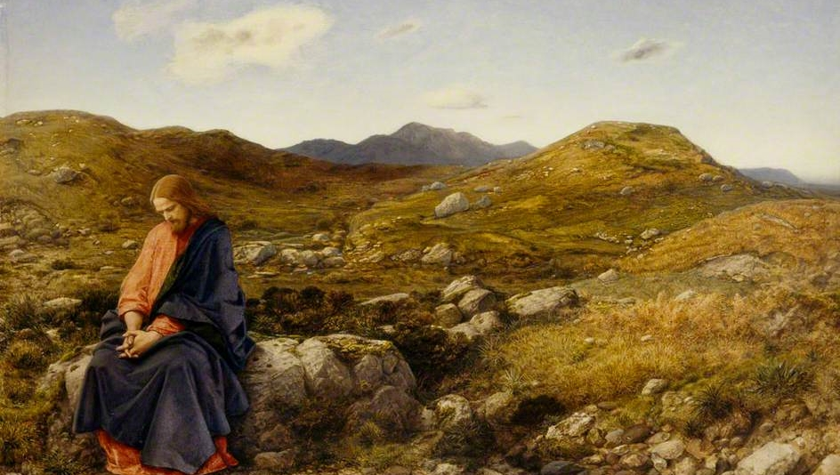
FAMILIES FORMING DISCIPLES
^{Lesson 6 – Week 1}

Slide 2
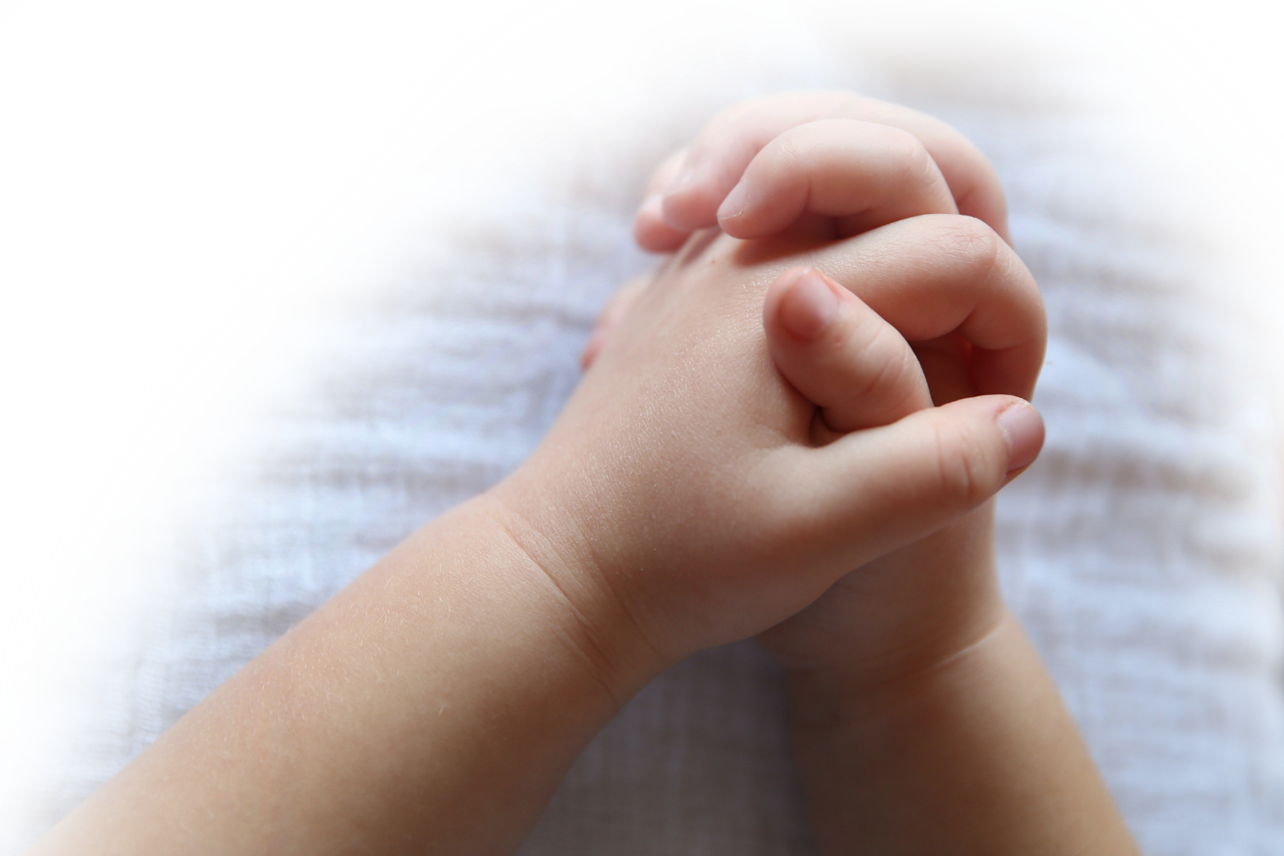
^{Opening Prayer}
Come, Spirit of Piety, and bless all children, young people and their parents so that they can withstand the temptations that lead them away from a holy and happy life. May they have good examples in their homes, schools, and society, and become true witnesses to the love of God in the world.
^{Hail Mary…}
(adapted from Catholics For Family Peace)

Slide 3
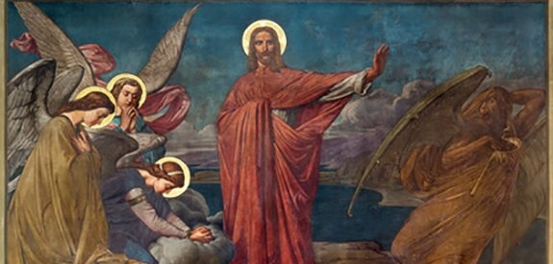
Goals
Families will reflect on how Jesus spiritually prepared/trained to begin His mission during His time in the desert.
Families will reflect on the power of uniting our sacrifices with Jesus’ sacrifice.
Families will make their Family Lenten Plans to prepare spiritually/train themselves for the mission God has given to them through their practice of praying, fasting, and almsgiving.

Slide 4
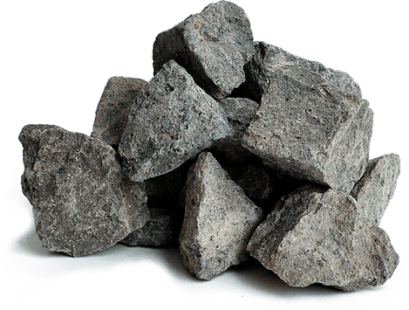
Materials
^{Bibles, crucifix (for Week 1)}
Rocks & Sharpie markers (for Week 3)

Slide 5
Ice Breaker
If you could choose one superpower,
^{what would it be and why?}

Slide 6
When you think of the term “Lent,”
^{what two words come to mind?}

Slide 7
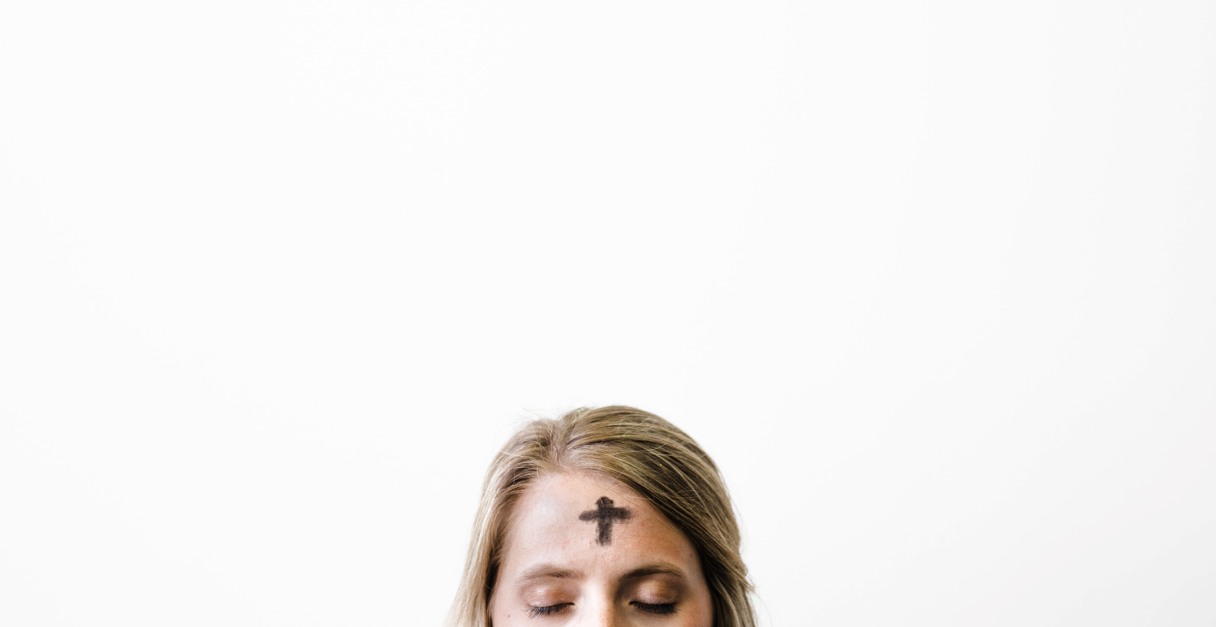
Topics
Lent is a time when we prepare our hearts to remember the redemptive suffering and Death of our Lord, Jesus Christ, and we prepare to celebrate His Resurrection. Today we will begin to reflect on our Lenten practices and decide what our Family Lenten Plans will be.

Slide 8
Family Sharing
a. (For Parents) When you were growing up, how did your family prepare for Easter during Lent?
b. (For whole family) What are your favorite things to do during Lent?

Slide 9
Content
So, what exactly is Lent?

Slide 10
Content

Slide 11
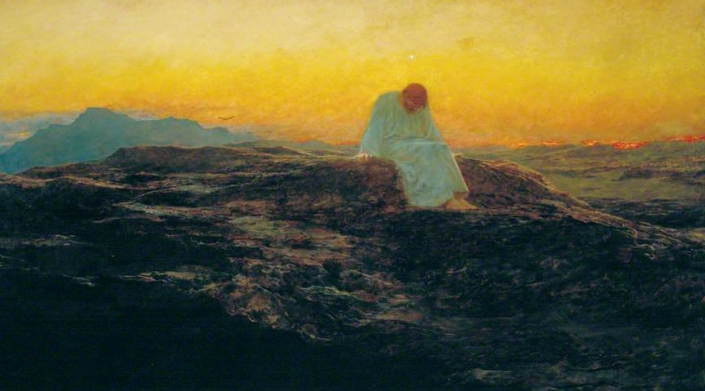
Mk 1:12-13
The Spirit drove Jesus out into the desert,
and he remained in the desert for forty days,
^{tempted by Satan.}
^{He was among wild beasts,}
and the angels ministered to him.

Slide 12
Family Sharing
Has your family experienced any of the ways that the time of COVID-19 has been like a desert? If yes, what are they?
What are some of the little and/or great challenges your family has faced during the pandemic?
What are some good things that have happened during this time?
What good have you gained from going through this experience together as a family, as a faith community?
Do you think your family has grown closer to one another and/or to God?

Slide 13
What are you giving up for Lent?

Slide 14
Mission & Close in Prayer

