Slide 1
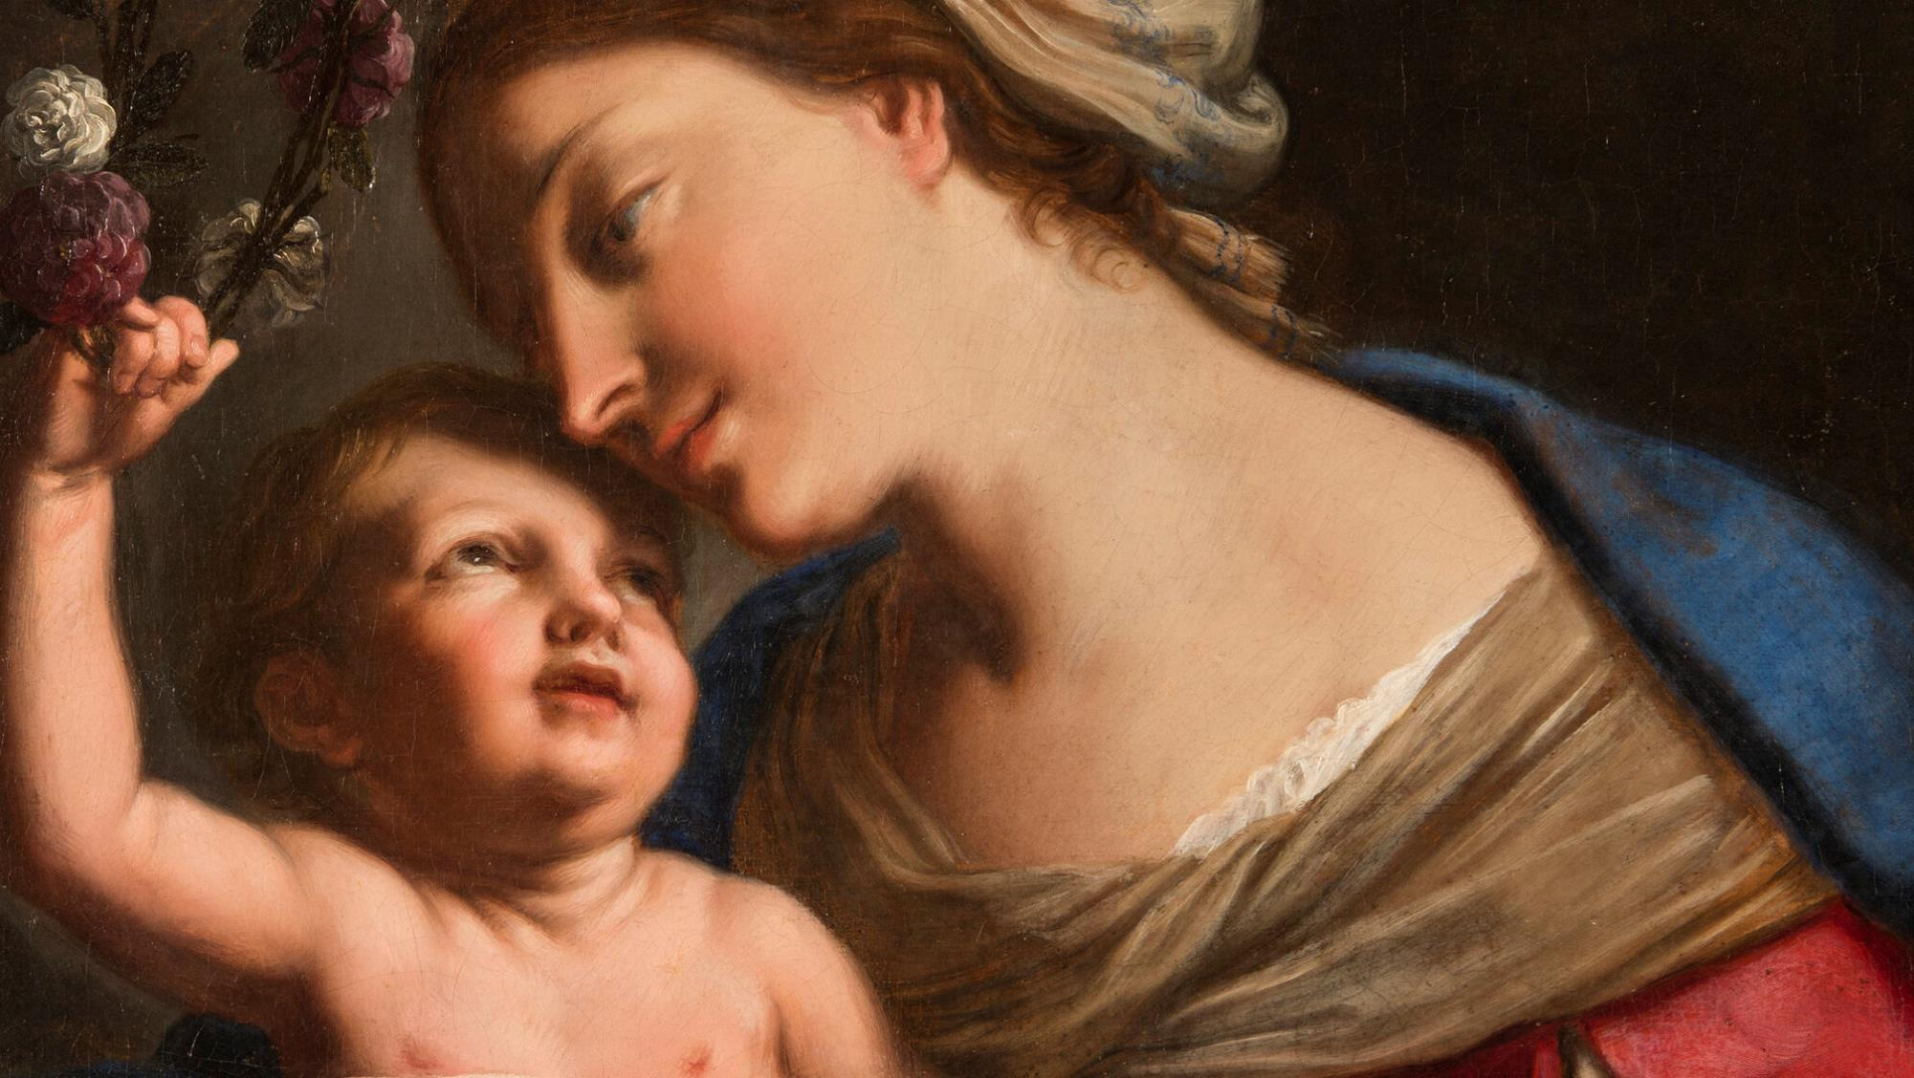
GOD’S SAVING LOVE FOR US:
LITURGY AND THE SEVEN SACRAMENTS
TOPIC: MARY, OUR MOTHER AND OUR QUEEN!

Slide 2
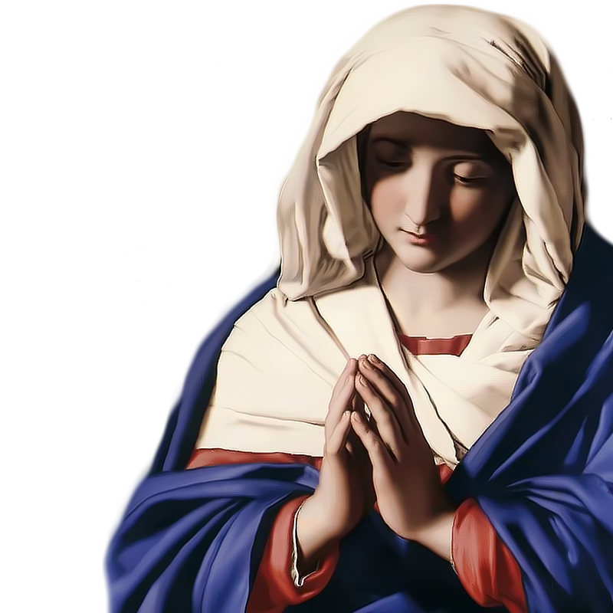
^{Opening Prayer}
Lord Jesus Christ, We entrust our family to You and ask for Your blessing and protection.
We love You Lord Jesus with all our hearts, and we ask that You help our family to become more like the Holy Family.
Help us to be kind, loving, and patient with
one another.
Give us all the grace we need to become saints and Your faithful disciples. Amen.

Slide 3
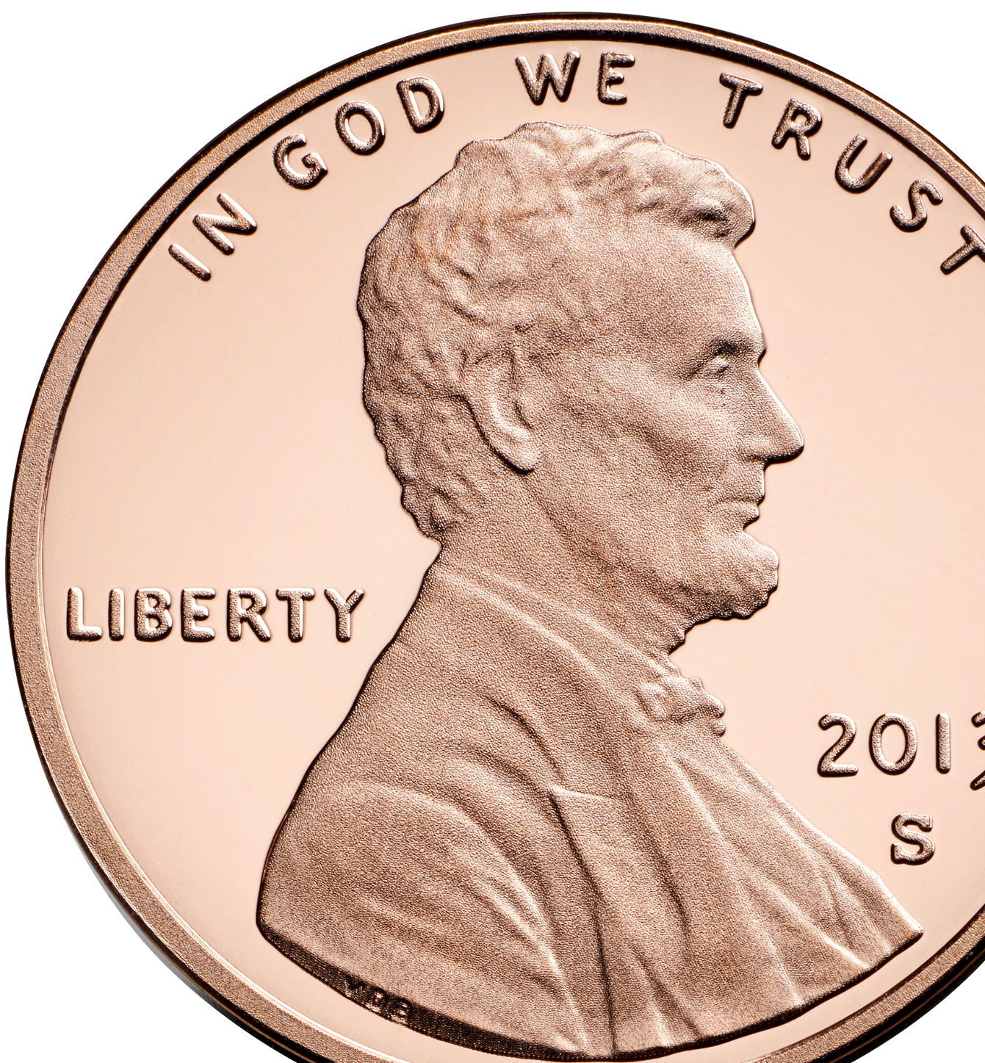
PENNY FOR YOUR THOUGHTS
How to Play:
Each participant gets a coin.
When it is your turn, share something significant that happened to you in the year in which the coin was made.
TIP: Make sure to check that the dates of the coins are not before the kids were born!
Parents can assist younger children.
Adapted from https://youthgroupgames.com.au

Slide 4
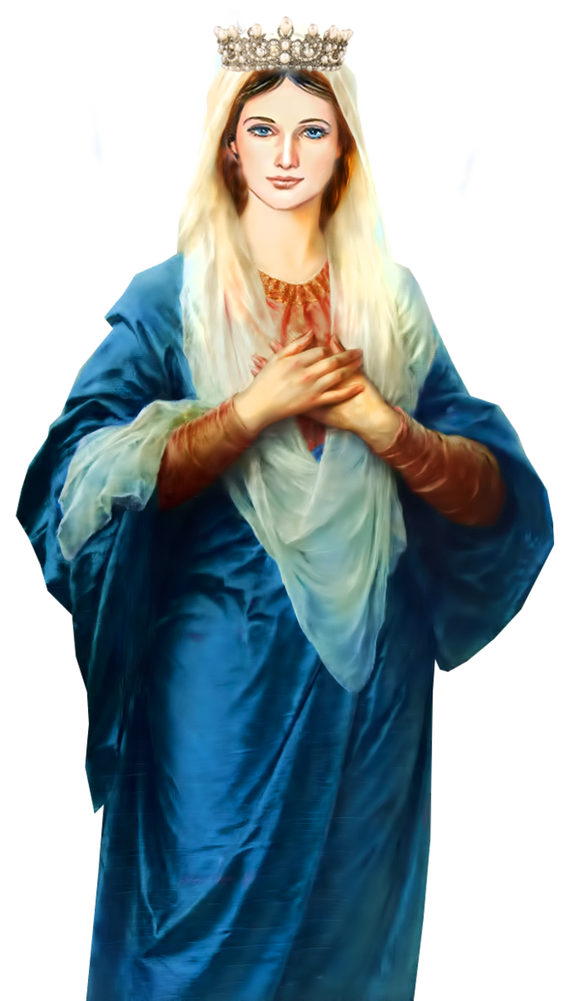
MAIN CONCEPTS
Reviewing this year’s theme,
the Seven Sacraments as God’s saving love poured out for us,
and Mary, Our Mother and Our Queen!

Slide 5
CONTENT
Understanding the Seven Sacraments of the Catholic Church
https://youtu.be/vzSZ7igpx20?si=0z1wJQG8gFDfK70m

Slide 6
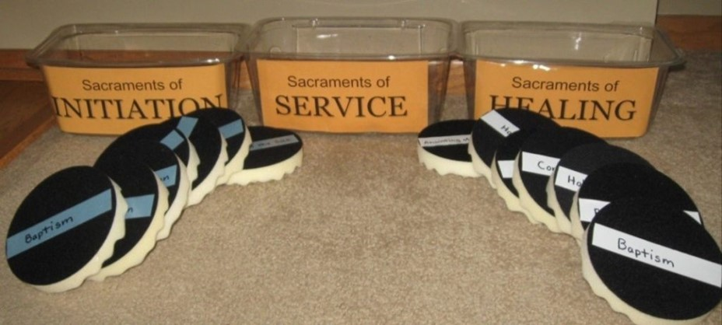
FAMILY ACTIVITY
To review all the 7 Sacraments, play the Sacrament Sort Toss Game!
“This is a fun cooperative learning game. Teams race to toss foam disks labeled with the 7 sacraments into the appropriate containers.
Can you make the appropriate target?”

Slide 7
WHAT IS DOGMA?
A dogma is a truth
that the Church defines or teaches
to be revealed by God,
and which all the faithful are called to believe.
This Photo by Unknown Author is licensed under CC BY-SA-NC

Slide 8
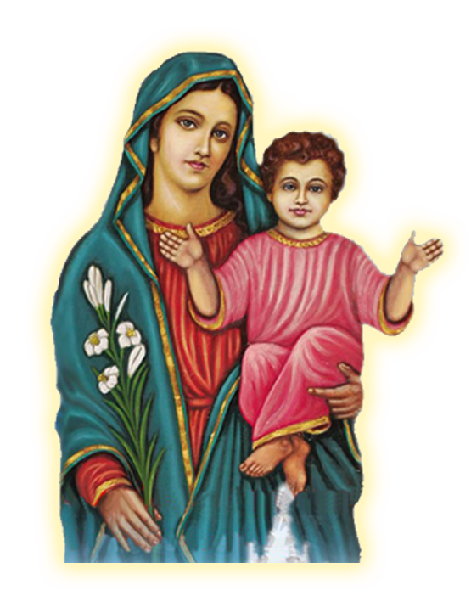
MAY IS THE MONTH OF MARY
Since May is the month in which the Catholic Church traditionally honors
Mary, our Mother and our Queen,
we will learn about the dogmas (or doctrines) that the Catholic Church teaches have been revealed
by God about Mary.
As we learn about Mary, we will make
Mary, Our Mother and Queen Crowns to take home and place on our home altars.
Begin by wrapping the green tissue paper around the wire to be the “leaves”.

Slide 9
Read Luke 1:26-33 or Watch
https://youtu.be/Hpph7nwpZN8?si=22HTE5PkewiVFwu6
The blue flowers represent Mary’s becoming the mother of her baby boy, Jesus, the Son of God.
Families crumple the blue tissue paper into flowers, and then glue the flowers to their crowns.

Slide 10
Watch: Mary: Immaculate Conception
httpThe yellow flowers represent the grace of Mary’s Immaculate Conception.
Families crumple the yellow tissue paper into flowers, and then glue the flowers to their crowns.

Slide 11
Watch: Mary: Perpetual Virginity
htThe white flowers represent Mary’s purity and Perpetual Virginity.
Families crumple the white tissue paper into flowers, and then glue the flowers to their crowns.

Slide 12
Watch: Mary: The Assumption
https://youtu.be/xVA9uy0mg7E?si=1i7wPEtIDbwSzlI4
When Mary was assumed into heaven, she was crowned the Queen of Heaven and Earth!
The purple flowers represent Mary’s royalty.
Families crumple the purple tissue paper into flowers, and then glue the flowers to their crowns.

Slide 13
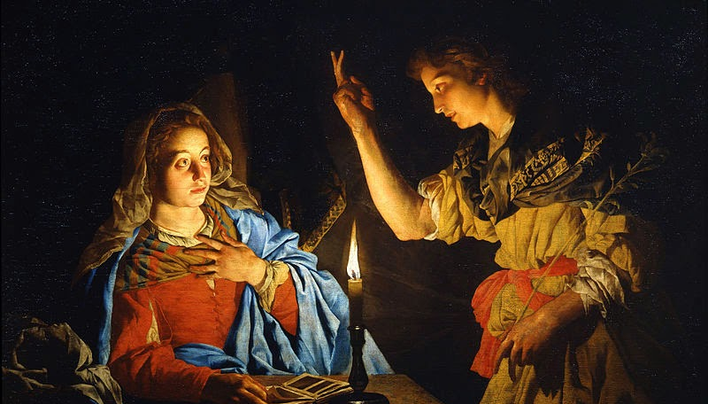
FAMILY CONVERSATION
Take a moment to reflect on your favorite story about Mary. Is it the Annunciation, Mary’s visit to Elizabeth, the Wedding at Cana, or another story?
Share why it is your favorite story about Mary.

Slide 14
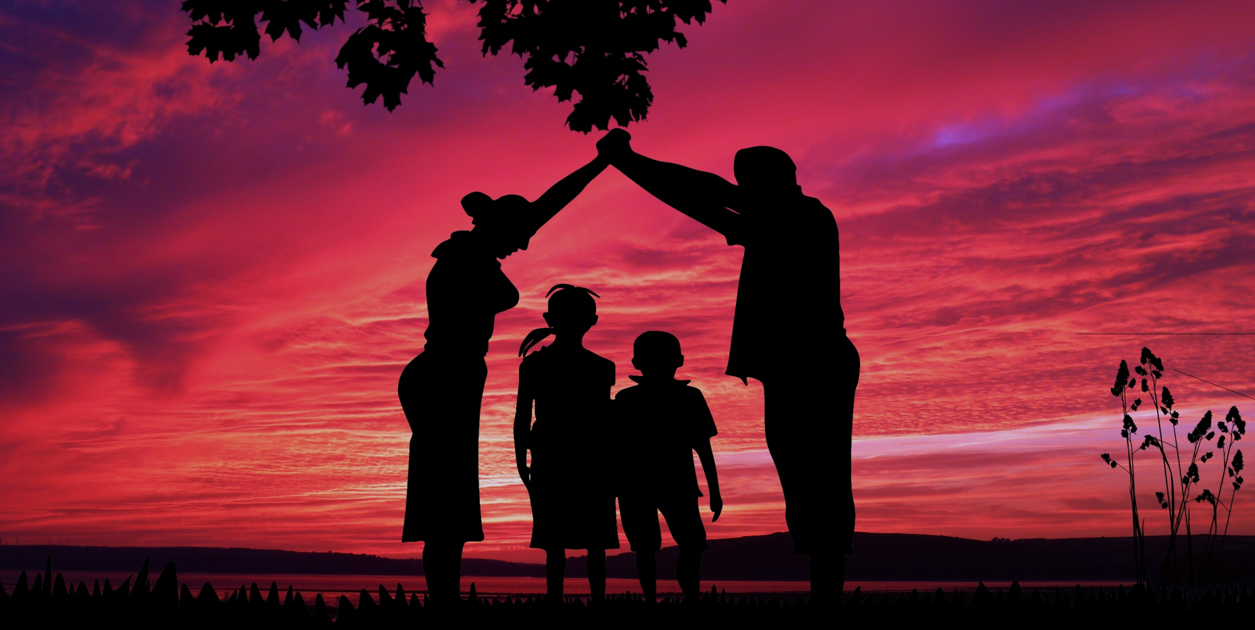
FAMILY AT-HOME MISSION
Watch the videos to review what we learned this year about the Seven Sacraments, as well as the videos about Mary.
Review Ideas for Parents to Honor Mary with their Children during the month of May!
Place your Mary, Our Mother and Queen Crown on your home altar, gather around and pray a decade of the Rosary asking Mary to pray for your family.
Lastly, please complete the Families Forming Disciples Family Survey (if you haven’t already ).

Slide 15
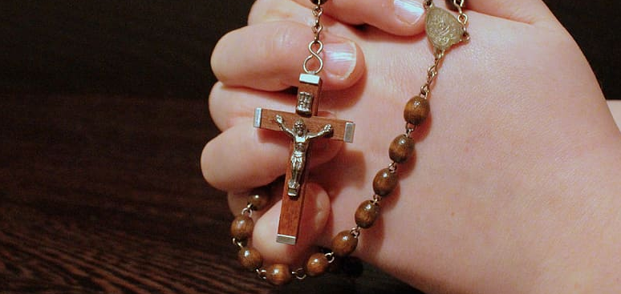
CLOSING PRAYER
1. Set the Mary Statue on an altar/table where it can be seen.
2. Place the candle in front of it and light the candle.
3. Families share any intentions for which they would like everyone to pray.
4. Pray a decade of the Rosary together for those intentions.

