Slide 1
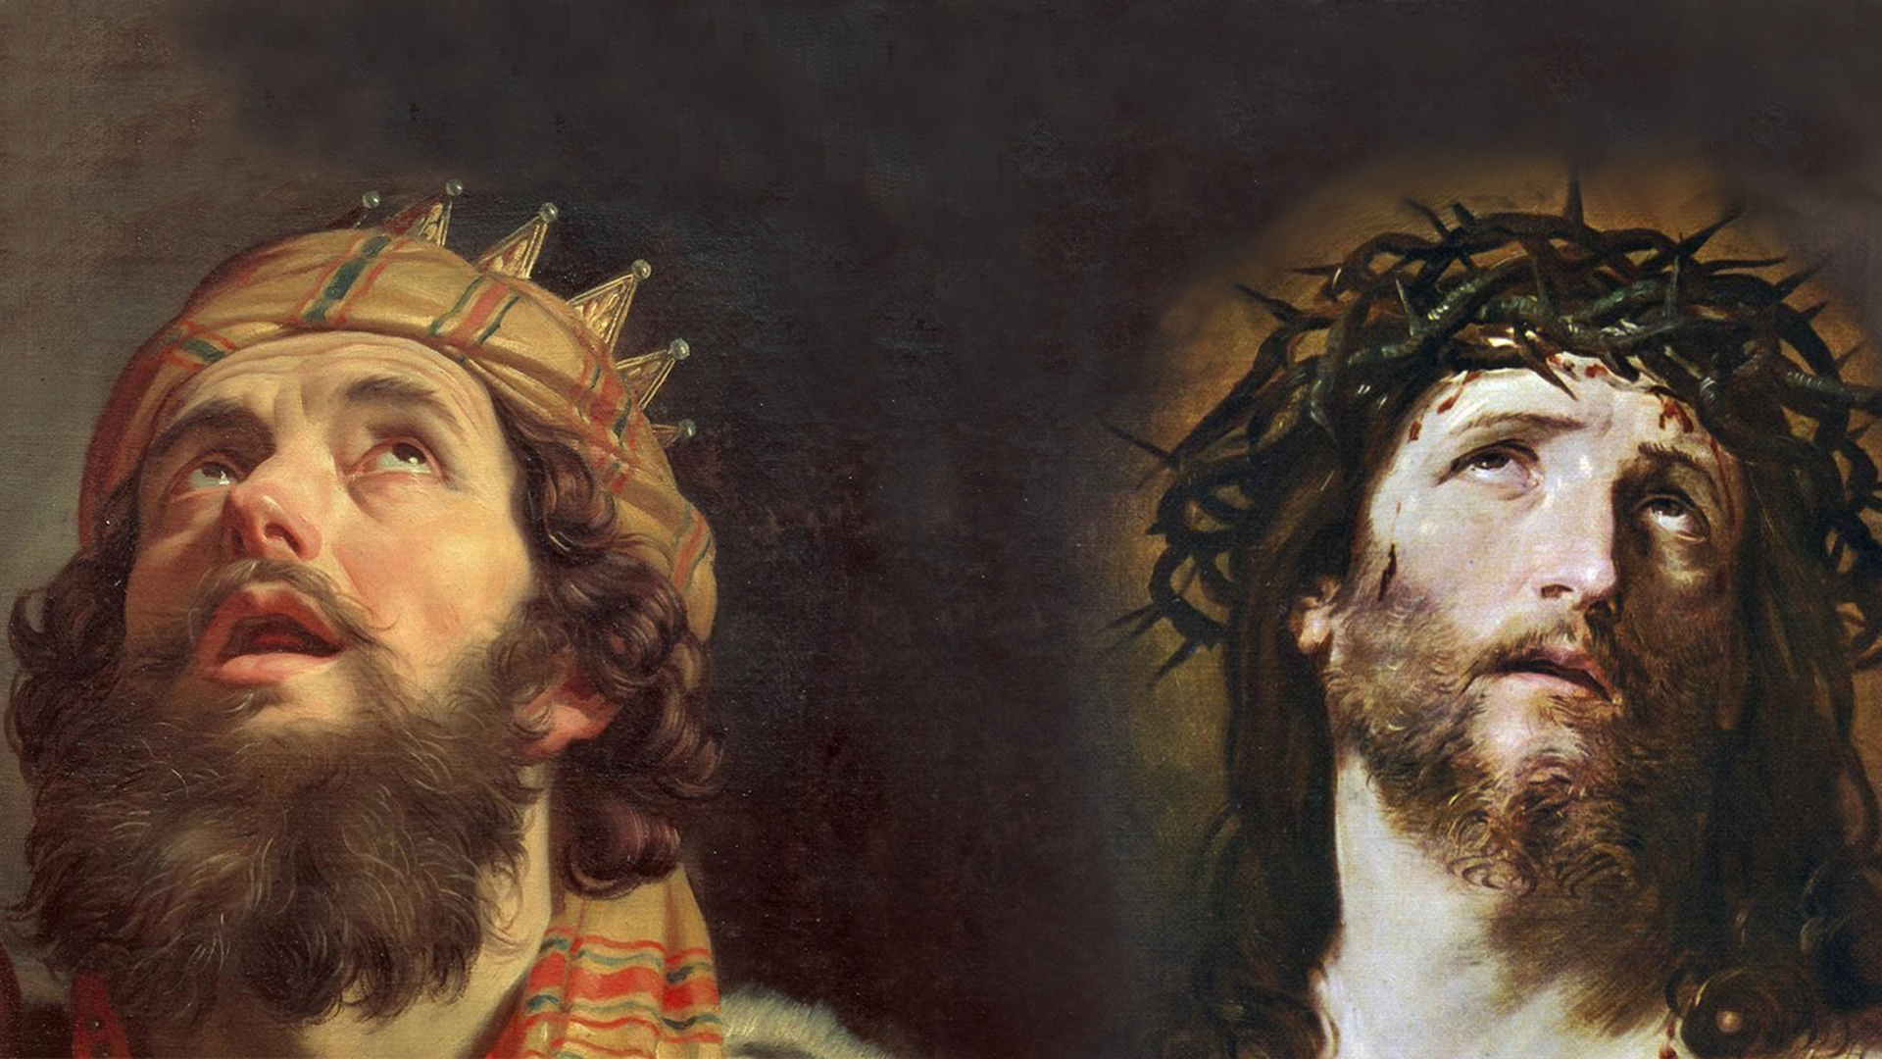
FAMILIES FORMING DISCIPLES
GOD’S COVENANT WITH DAVID

Slide 2
^{Opening Prayer}
Lord Jesus Christ,
We entrust our family to You and ask for Your blessing and protection. We love You Lord Jesus with all our hearts and we ask that You help our family become more like the Holy Family. Help us to be kind, loving, and patient with one another. Give us all the grace we need to become saints and Your faithful disciples.
Amen.

Slide 3
^{Ice Breaker}
Roll the Dice – Break the Ice
#1 What is your favorite hobby?
#2 What is your favorite book & why?
#3 If you could go anywhere in the world, where would you go and why?
#4 What would you take if you were going somewhere where no one had ever been before?
#5 If you were an animal, what kind would you be?
#6 What's the best thing that has ever happened to you?

Slide 4
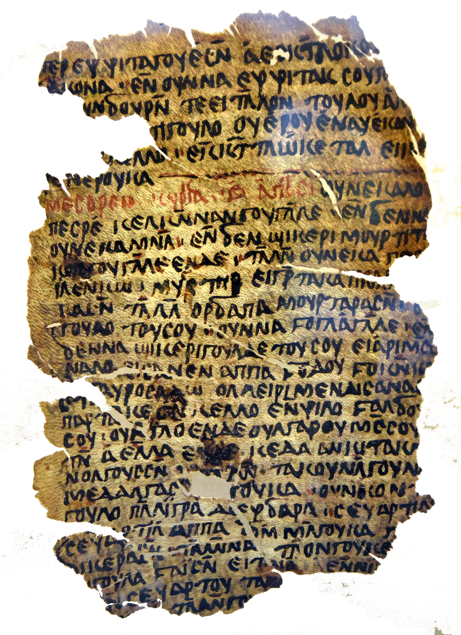
Who is credited with writing the Pentateuch?

Slide 5
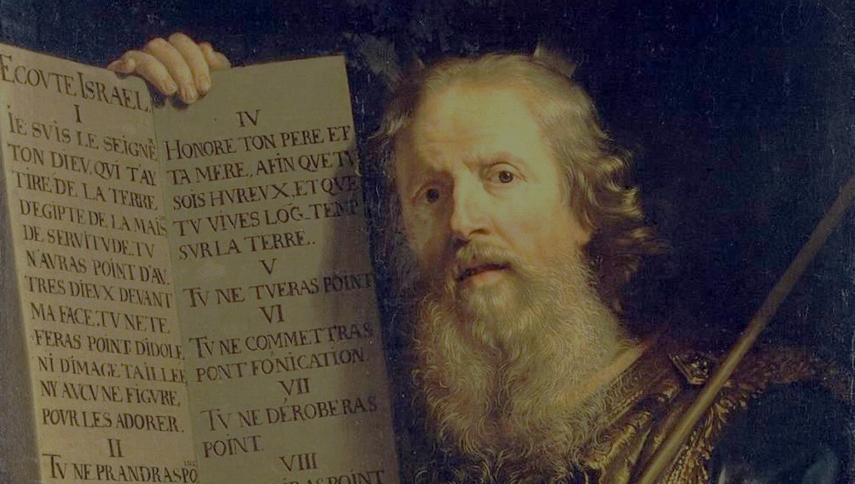
Answer
MOSES

Slide 6
Watch: First 5 Books of the Bible | Catholic Central 5
https://youtu.be/z-WuGfhcCDA

Slide 7
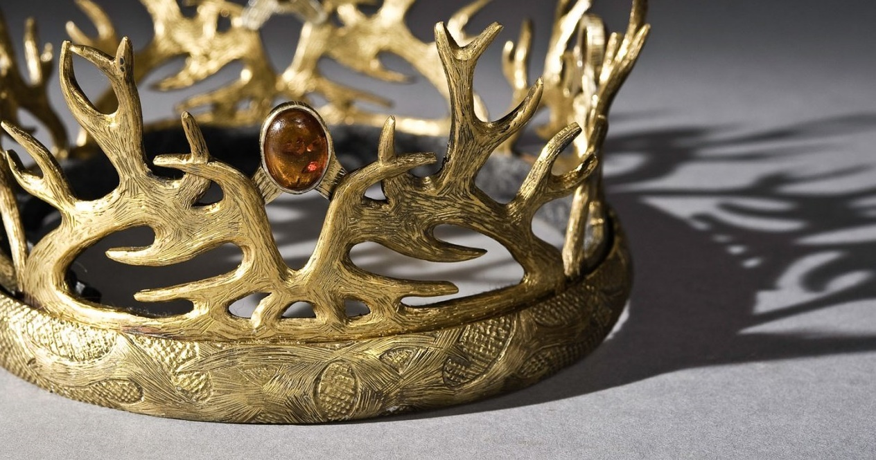
READ: 1 SAMUEL 8:1-22
And the Lord said
to Samuel,
“Obey the voice of the people
in all that they say to you,
for they have not
rejected you,
but they have rejected me
from being king over them.”
1 Samuel 8:7

Slide 8
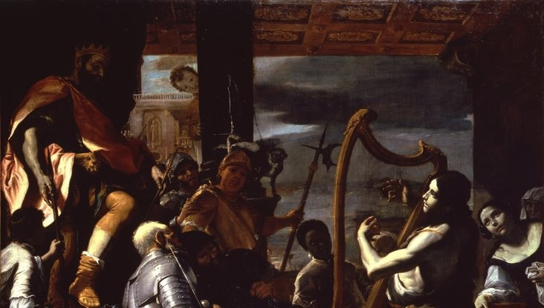
READ: 1 SAMUEL 16:1-13

Slide 9
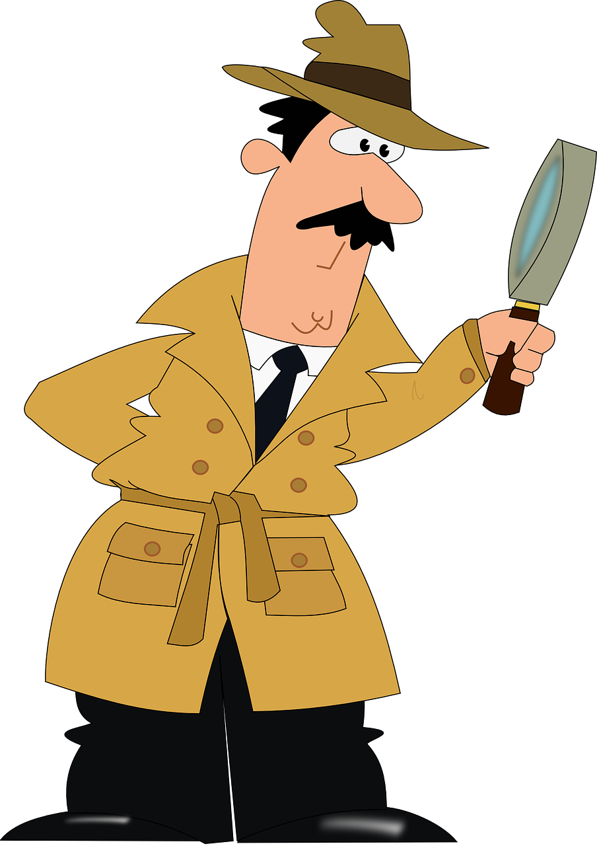
BE A BIBLE DETECTIVE & LOOK FOR THE CLUES!

Slide 10
Watch: David & Goliath (Movie!)
Let’s read the Bible!
(For Younger Children)
https://youtu.be/A95_5URGWUo
(For Tweens & Teens)
https://youtu.be/olpEyn5ZVbI

Slide 11
Did you find the clues that tell us how
David foreshadows Jesus?

Slide 12
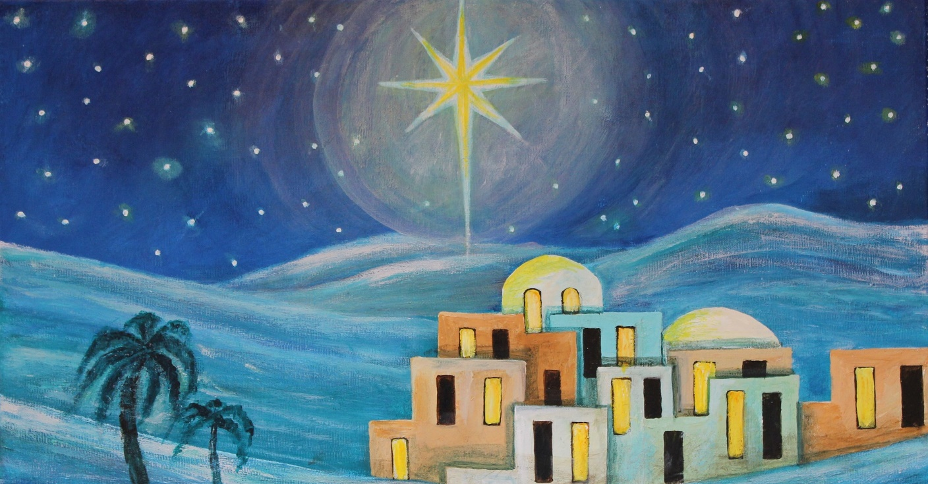
1.Both Jesus and David were born in Bethlehem

Slide 13
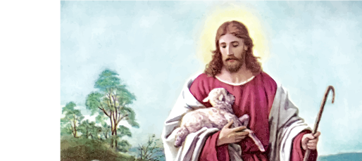
2. David was a shepherd, Jesus is the Good Shepherd
(John 10:1-18)

Slide 14
3. David was made a king, Jesus is the King of kings

Slide 15
FAMILY CONVERSATION
David was a youth, but he had more faith in God than all of the men in the Israelite army. Fighting Goliath seemed like an impossible challenge to them, but David knew that God would be with him. Though we may not always know the outcome, our faith tells us that God will be with us through every trial. Most of the time, God does not take our challenges away from us, but instead His presence at our side is the strength that carries us through them.
• What are the biggest challenges in your life right now?
• What goal seems so impossible that you feel you
cannot achieve it by yourself?
• In what ways do you see that God is at your
side giving you the strength to get through?

Slide 16
FAMILY MISSION
1. Introduce Mission Activity
2. Explain Activity:
i. Read from the Book of Psalms and find your favorite Psalms to share at the Week 3 gathering of families.
ii. Review the Easter and Divine Mercy resources and
make your Living-the-Easter-Season Family Plan.
iii. Gather as a family and pray the Divine Mercy Chaplet around your home altar/prayer space.
iv. Complete the Families Forming Disciples Family Survey

Slide 17
