Slide 1
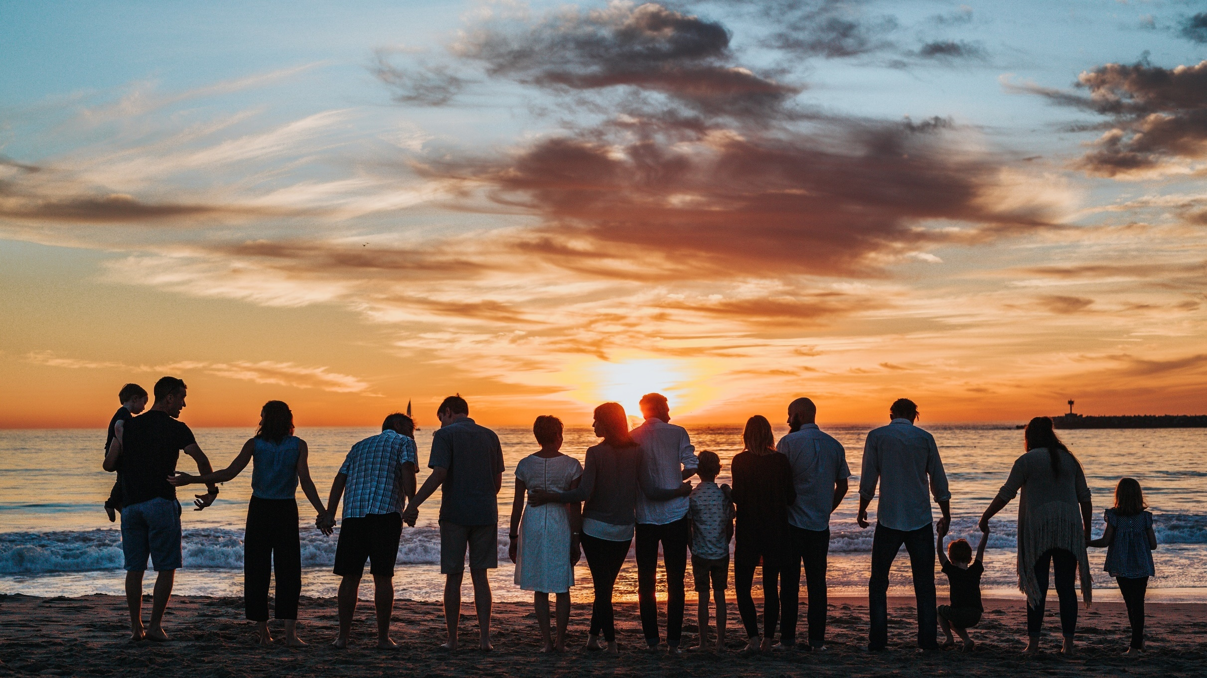
^{Families Forming Disciples}
Introduction

Slide 2
Topic: Introducing Families Forming Disciples (FFD) to Parents
REFERENCES:
GOALS:
Welcome and prepare parents to participate in FFD; affirm their role as primary educators in the faith and reassure the support of the parish
^{Acts 16: 31-34}
^{CCC: 2223-2226}

Slide 3
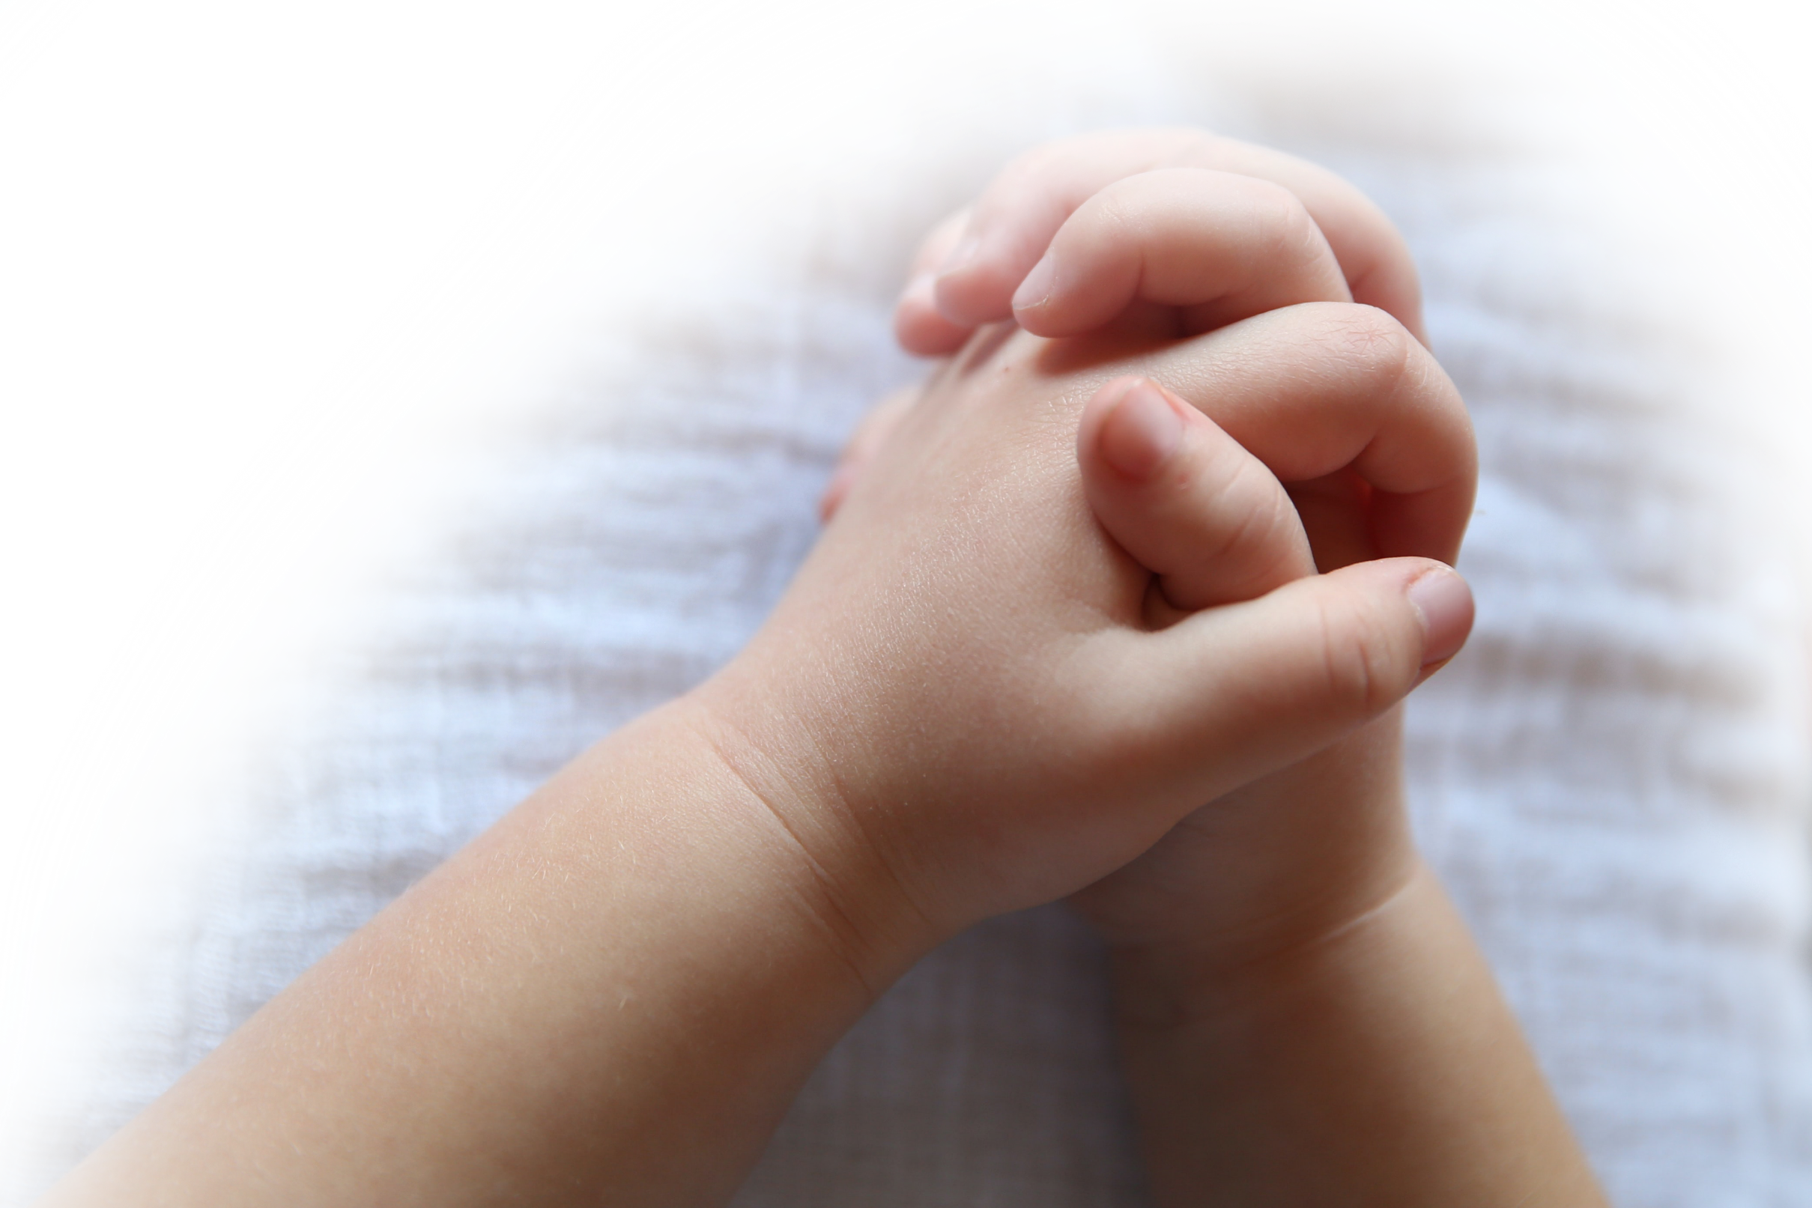
^{Opening Prayer}
“And they said, ‘Believe in the Lord Jesus and you and your household will be saved.’ So they spoke the word of the Lord to him and to everyone in his house. He took them in at that hour of the night and bathed their wounds; then he and all his family were baptized at once. He brought them up into his house and provided a meal and with his household rejoiced at having come to faith in God.”
– Acts 16:31-34 (NABRE)
Recite the Lord’s Prayer together

Slide 4
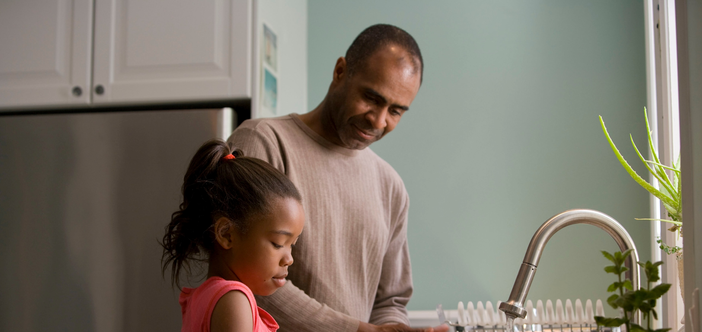
^{Ice Breaker}
Everyone introduces themselves (how many children you have and what grades they are in).
Question for parents: What is the best parenting advice you have ever been given or wish you had been given?

Slide 5
Introduction Video from Archbishop Hartmayer

Slide 6
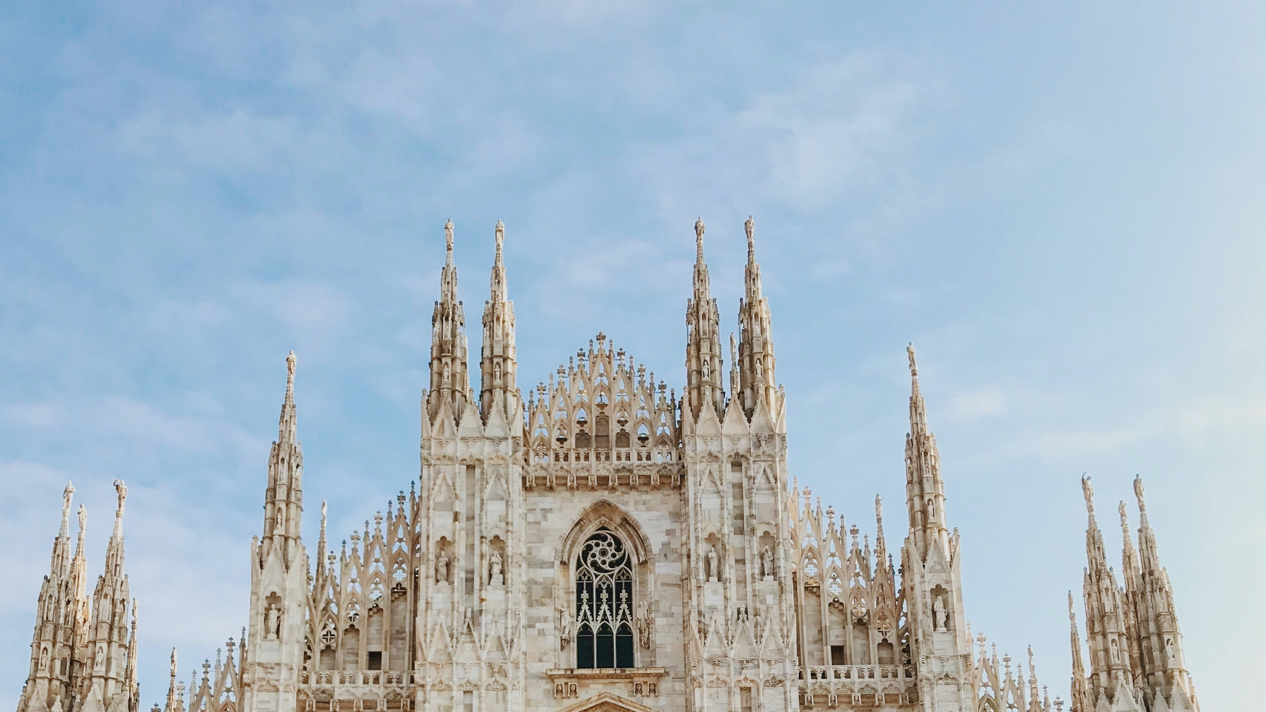
Our Topic for today
Preparing for Families Forming Disciples Program

Slide 7
^{Content}
Review Format for Weeks 1, 2 & 3
Four Keys for Practicing Faith (handout)
Share Guidelines for FFD Etiquette during Virtual Gatherings :
Don’t expect perfection
Put away and /or turn off any distractions
Keep pets in another room
All family members should be appropriately and modestly dressed
Talk to children about the importance of watching for when to listen and when to share
Practice good manners with the words we choose, as well as our actions
This is a Family Program, therefore children are not to attend a virtual session with any catechist without parent involvement

Slide 8
Conversation
Questions?

Slide 9
Mission
1
2
3
Introduce Mission Activities
Parents will prepare their family for virtual gatherings
Explain
Activity
Parents will share the above Guidelines for FFD Etiquette during Virtual Gatherings with their families before next meeting
Model for
Parents
Explain to parents how you have followed the guidelines to prepare your own home for today’s meeting

Slide 10
^{Review & Close in Prayer}
Review key point and close in prayer

