Slide 1
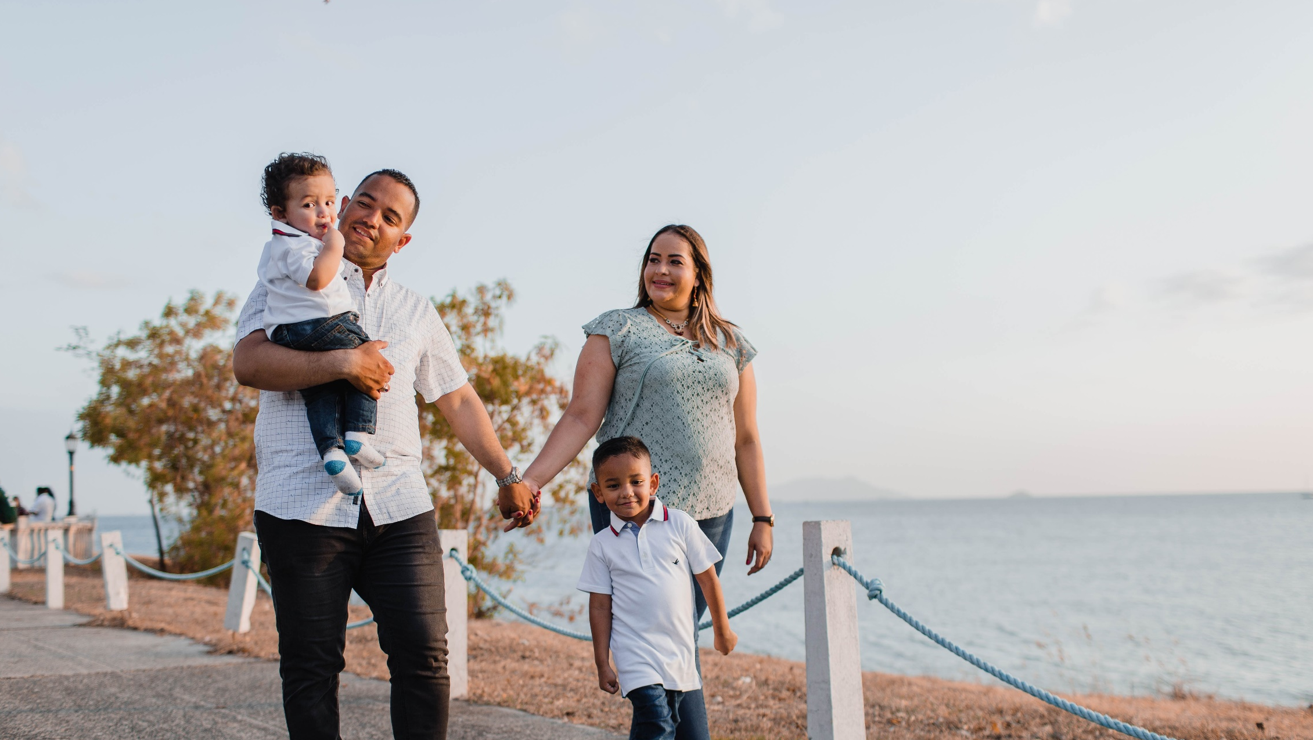
^{Families Forming Disciples}
Lesson 2 – Week 1

Slide 2
Topic: The Family Rosary as praying with Mary, looking to Jesus with her; Preparing for All Saints Day & All Souls Day
REFERENCES:
GOALS:
• To introduce the Family Rosary
• To learn about the assistance the saints in Heaven give to us
• To encourage families to pray for one another and for their loved ones who have died
^{CCC: 971, 2674, 2683}
^{Lk 1:28, 42}
^{Jn 19:26-27}
^{Acts 2:42}

Slide 3
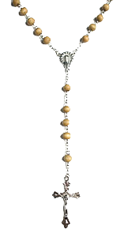
MATERIALS
Parishes provide 1 pamphlet or booklet per family (or offer an online resource that could be printed)
Parishes may provide a rosary kit to be completed during the Week 2 At-Home Mission Activity, or ask families to provide their own rosaries

Slide 4
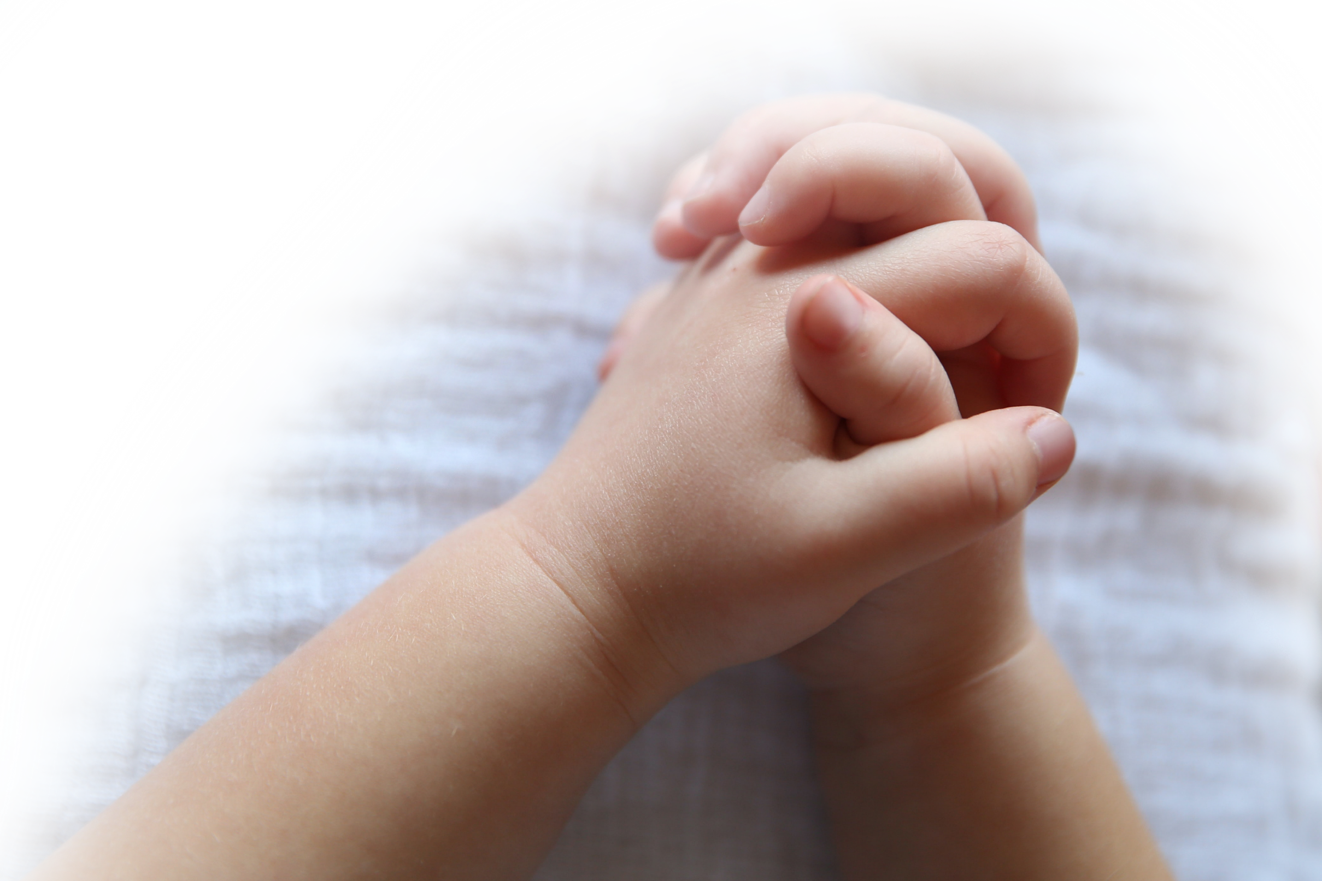
^{Opening Prayer}
Come, Holy Spirit, Lord of Life, bless us and grant us the grace of loving our families, as Jesus calls us to do. Help us to build peace in our hearts, in our homes, and in our world.
^{Our Father…}
(adapted from Catholics For Family Peace)

Slide 5
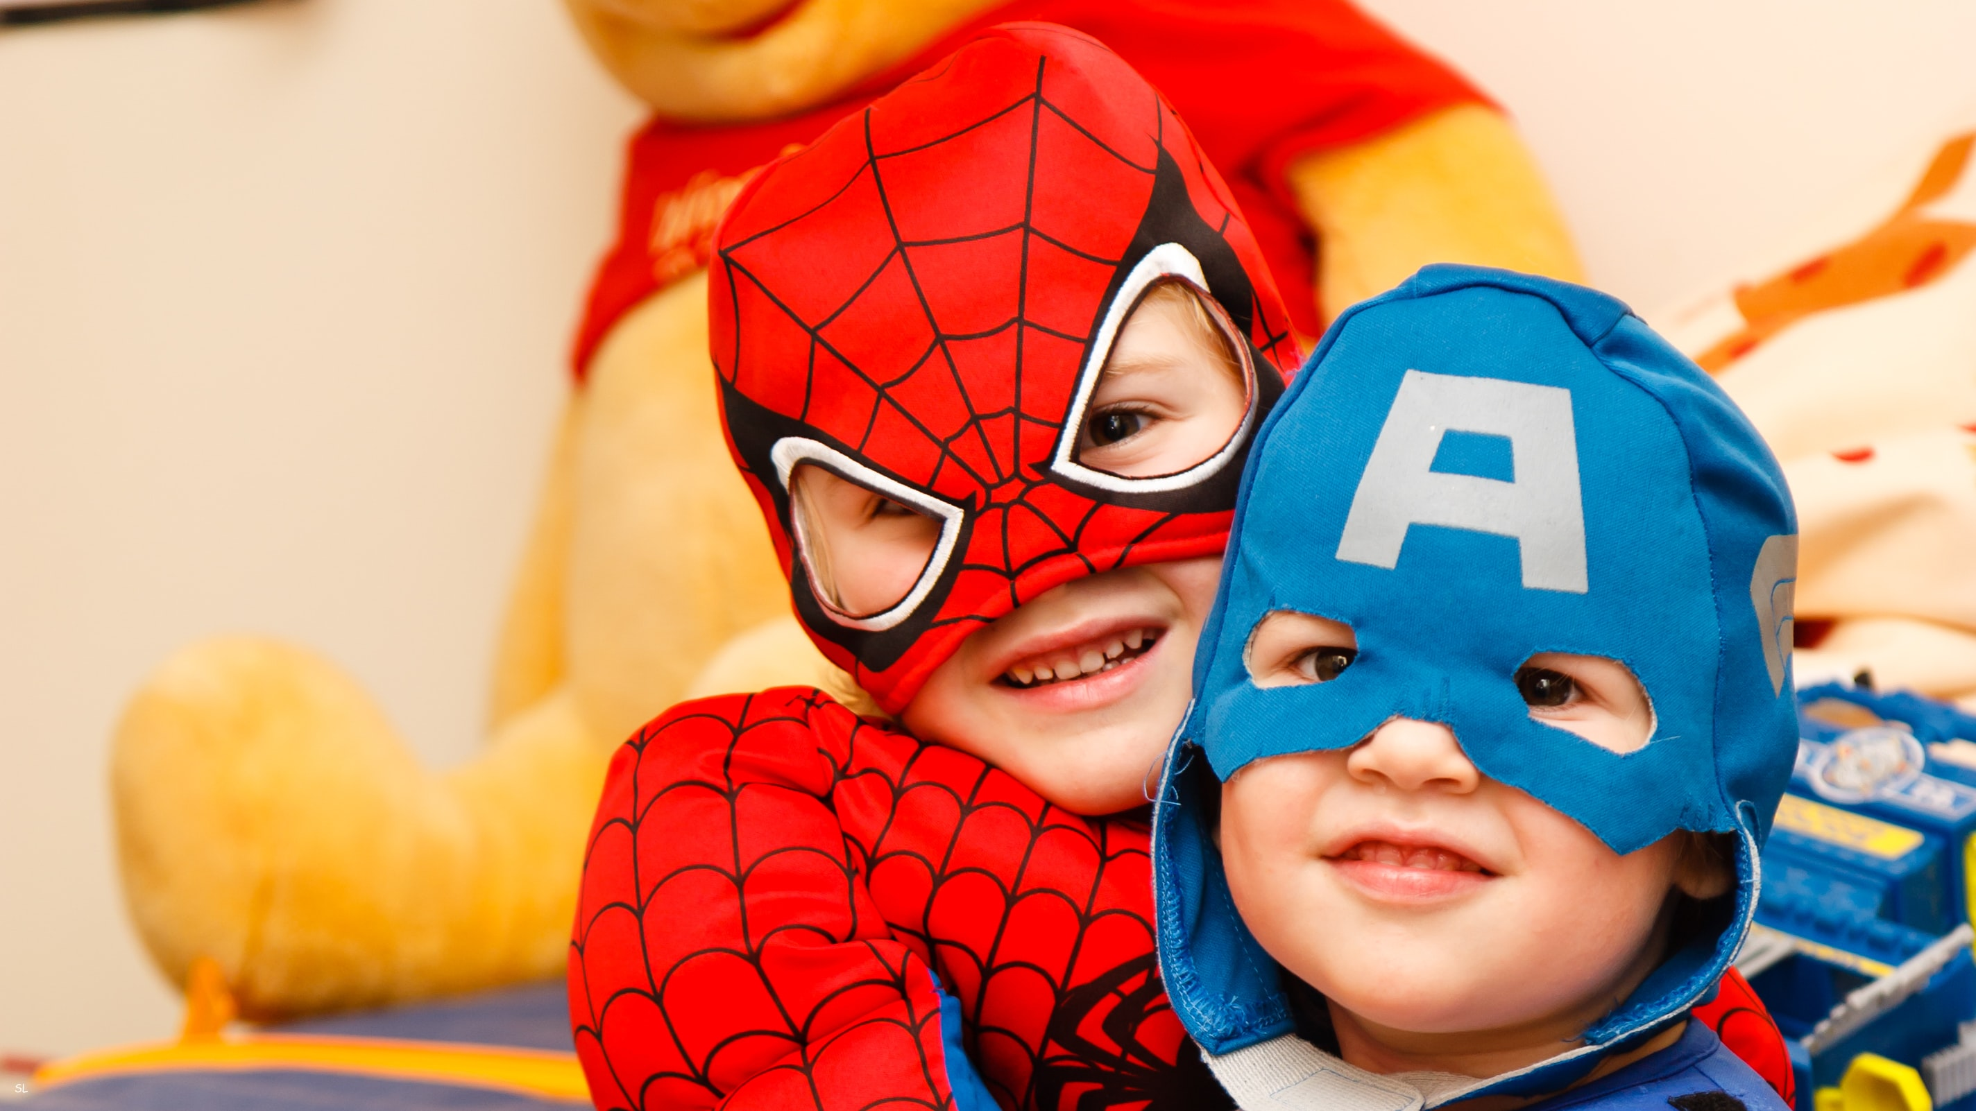
^{Ice Breaker}
Who do you think is the best superhero and why?

Slide 6
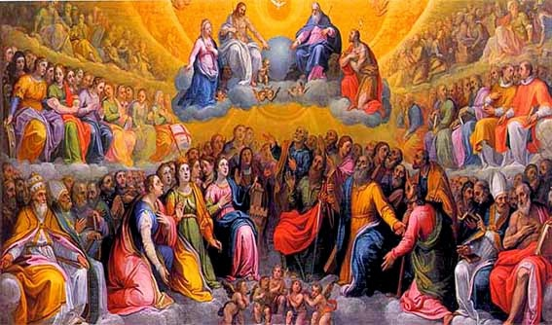
Name two things that you know about saints.

Slide 7
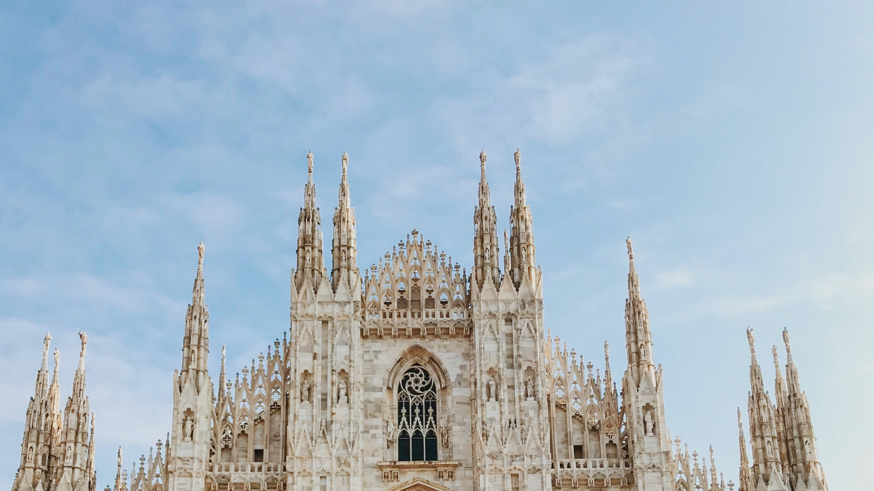
Our Topic for today
Saints are people in Heaven who are praying for us so we can get to Heaven too. Mother Mary is the Queen of all the Saints, and her prayers for us are extremely powerful.

Slide 8
^{Content}
What is a Saint? Simply put, a saint is someone who is in Heaven with God our Father. He/she can be a famous person to whom the Catholic Church gives special recognition and celebrates (canonizes), but most saints are not famous. Rather, they are ordinary people who loved the Lord and who fully accepted His love as beloved daughters and sons. They gave their whole lives to Jesus. They got to know Him really well and they relied on the Holy Spirit.

Slide 9
What is a Saint?

Slide 10
Family Sharing
Who is your favorite saint? Why?
When the saints lived on earth were they always perfect?
Can you name any saints whom you know at one time were sinners?

Slide 11
^{Content Continued}
Almost every single one of the saints made mistakes and sinned. Some even made huge mistakes, but what made the difference was that, because they knew God and loved Him, they were sorry for their sins and asked God’s forgiveness. God our Father can never resist a heart that is truly sorry.
However, there is one saint that we know for certain was perfect and never sinned, because God gave her a special grace. He needed someone who was immaculate, meaning without any sin, so she could carry Jesus within her.

Slide 12
Do you know who this person is?
Does anyone know what that prayer is called?
Have you ever prayed the Rosary? If yes, when?

Slide 13
Mission
1
2
3
Introduce Mission Activities
Mission Activities are to be done at home during Week 2 and to be shared at the gathering of families on Week 3.
Explain
Activity
a. During Week 2 you will choose your favorite rosaries (or, if your parish has provided a kit, make your own family rosary together) and place them on your home altar to show at the Week 3 gathering.
b. Together you will review the Rosary booklet and prayers.
c. Next, find a picture of a family member or friend of the family who has died that you would like us all to pray for during Week 3, or draw a picture of the person if you don’t have a photo. Place the photo or picture on your home altar. Be ready to share about who the person is, and why he/she is important to your family. Also, did that special person have a favorite saint?
d. Gather around your prayer altar as a family, take a moment to be silent with God together, and then say a prayer for your family member and for one another.
Model for
Parents
Show them your home altar and telling them about the rosary you have placed there, as well as the picture of a special person you would like to pray for at the Week 3 gathering.

Slide 14
^{Review & Close in Prayer}
Review key point and close in prayer

