Slide 1
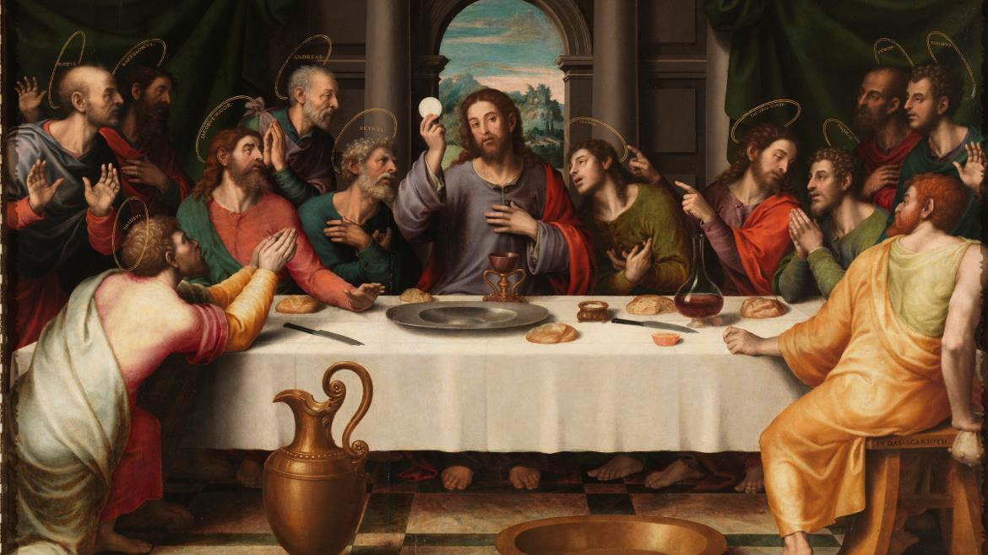
THE LIFE OF CHRIST: THE LUMINOUS MYSTERIES
THE INSTITUTION OF THE EUCHARIST, THE AGONY IN THE GARDEN

Slide 2
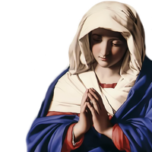
^{Opening Prayer}
Lord Jesus Christ, we entrust our family to You and ask for Your blessing and protection. We love You Lord Jesus with all our hearts and we ask that You help our family become more like the Holy Family. Help us to be kind, loving, and patient with one another. Give us all the grace we need to become saints and Your faithful disciples.
Amen.

Slide 3
^{Ice Breaker}
A GREAT WIND BLOWS

Slide 4
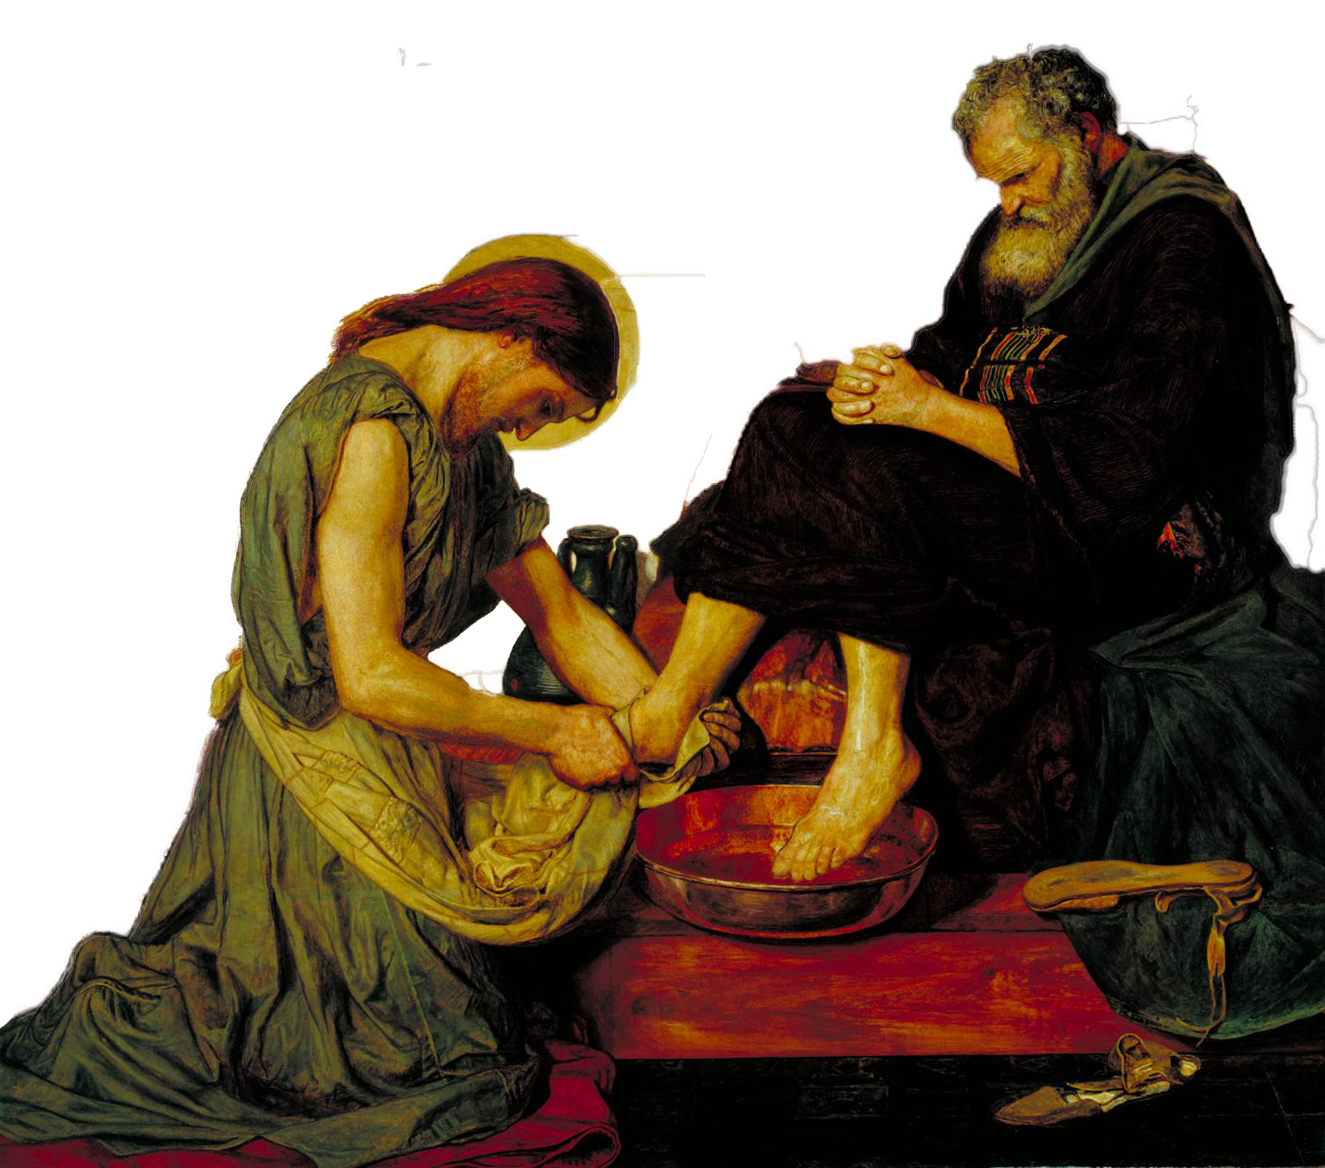
FAMILY SHARING
Your Family At-Home Mission after reading the Washing of the Disciples’ Feet in the Gospel of John was to accomplish your plans to serve one another as Jesus calls us to do. Share your Serving One Another Experience!
What did you do to show God’s love alive within you by serving the members of your family?

Slide 5
The Institution of the Eucharist, and the Agony in the Garden

Slide 6
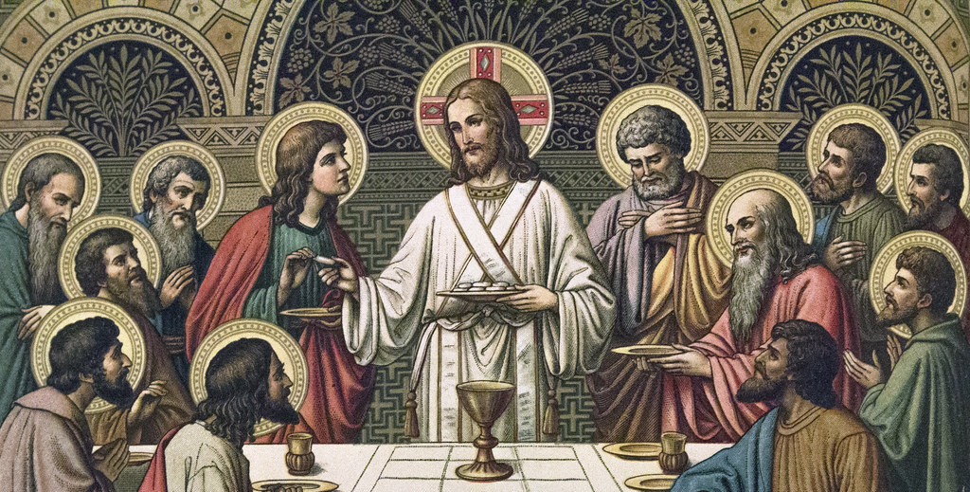
THE LAST SUPPER

Slide 7
THE LAST SUPPER
https://youtu.be/c8bkJ-4NMbU

Slide 8
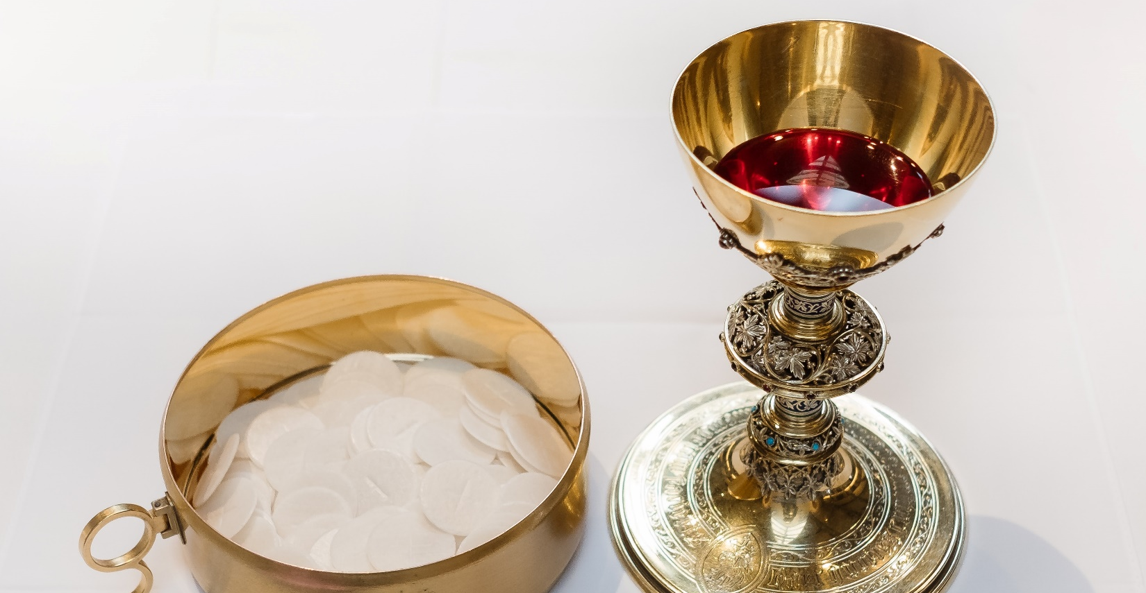
FAMILY CONVERSATION
What did Jesus say and do in the video that is the same as what the priest says and does at Mass?

Slide 9
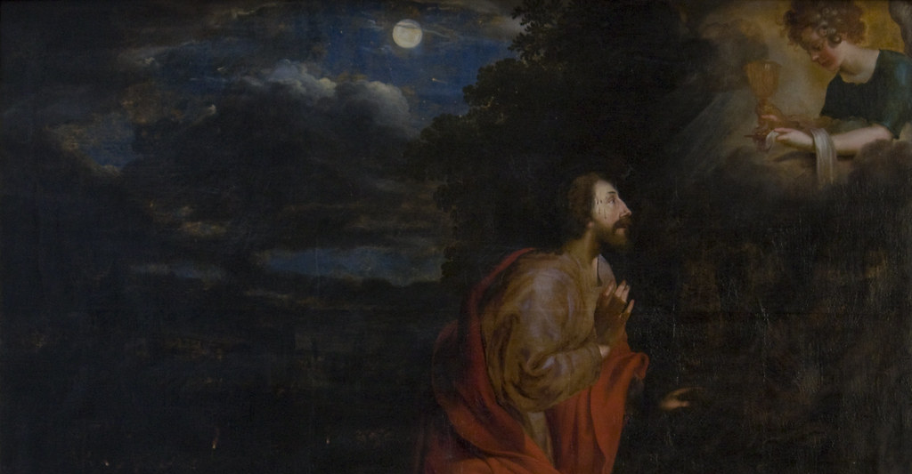
AGONY IN THE GARDEN

Slide 10
EUCHARISTIC ADORATION
https://www.youtube.com/watch?v=0enG2NHd0Ag
https://www.youtube.com/watch?v=4-phBIppLyE

Slide 11
FAMILY ACTIVITY & CONVERSATION
ADORATION
Name a way that you pray where you feel the presence of God. Have you been to Eucharistic Adoration? How would you describe it? Do you want to try going to Eucharistic Adoration?

Slide 12
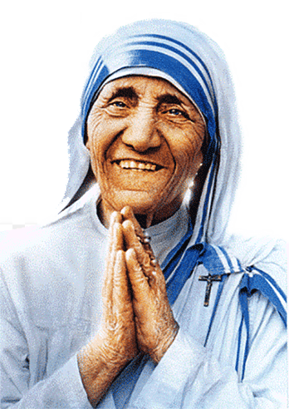
CLOSING PRAYER
Parents, please lay your hands on your children as you pray this prayer written by St. Mother Teresa of Calcutta:
Heavenly Father,
you have given us the model of life in the Holy Family of Nazareth. Help us, O Loving Father, to make our family another Nazareth where love, peace and joy reign. May it be deeply contemplative, intensely Eucharistic, revived with joy.
Help us to stay together in joy and sorrow in family prayer. Teach us to see Jesus in the members of our families, especially in their distressing disguise. May the Eucharistic heart of Jesus make our hearts humble like his and help us to carry out our family duties in a holy way.
May we love one another as God loves each one of us, more and more each day, and forgive each other's faults as you forgive our sins. Help us, O Loving Father, to take whatever you give and give whatever you take with a big smile.
Immaculate Heart of Mary, cause of our joy, pray for us.
St. Joseph, pray for us.
Holy Guardian Angels, be always with us, guide and protect us.
Amen.

