Slide 1
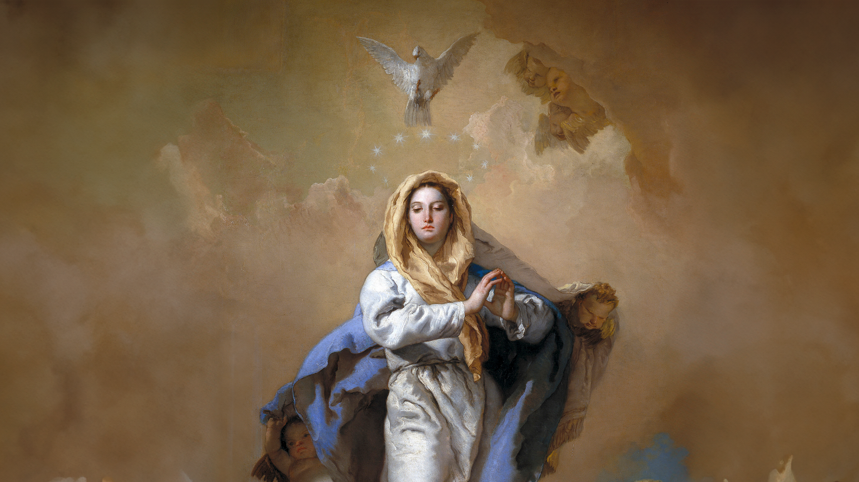
CALLED TO LOVE: THE ADVENTURE OF LIFE IN CHRIST
Topic: God’s Plan to Save Us!
The Chosen People - Immaculate Conception - God’s Rescue Mission

Slide 2
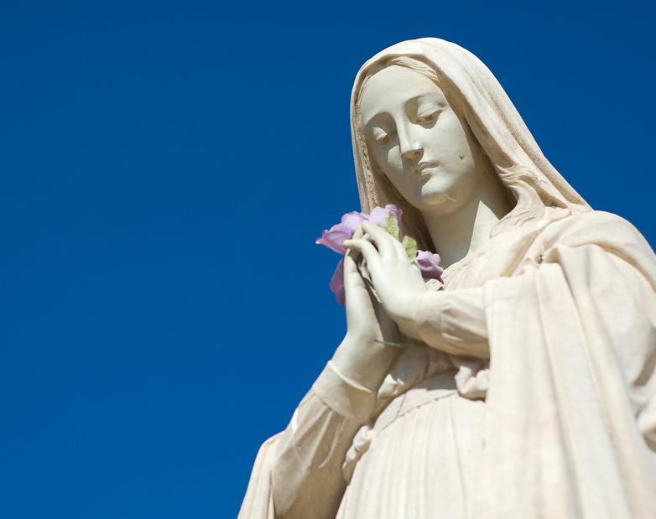
^{Opening Prayer}
Lord Jesus Christ, we entrust our family to You and ask for Your blessing and protection.
We love You Lord Jesus with all our hearts, and we ask that You help our family to become more like the Holy Family.
Help us to be kind, loving, and patient with one another.
Give us all the grace we need to become saints and Your faithful disciples. Amen.
This Photo by Unknown Author is licensed under CC BY-SA-NC

Slide 3
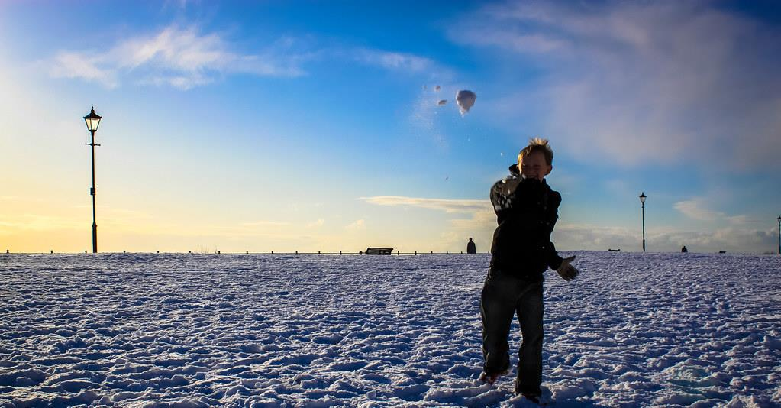
^{Ice Breaker}
Snowball Blessings Toss
Family members write a blessing, positive quote from the Bible, word of encouragement, or younger children can draw a positive picture on a white piece of paper.
Each person crumples up his/her own sheet to make a “snowball blessing.”
Then, ready … aim … FIRE! Everyone throws the paper snowball and then watch the blessings fly across the room both figuratively and literally.
After a minute or two, stop the chaos and have each person pick up one random “snowball.”
Families sit in a circle to open and read the notes out loud.
Take them home so families can reference them when they need a joyful blessing!
Adapted from www.weareteachers.com
This Photo by Unknown Author is licensed under CC BY

Slide 4
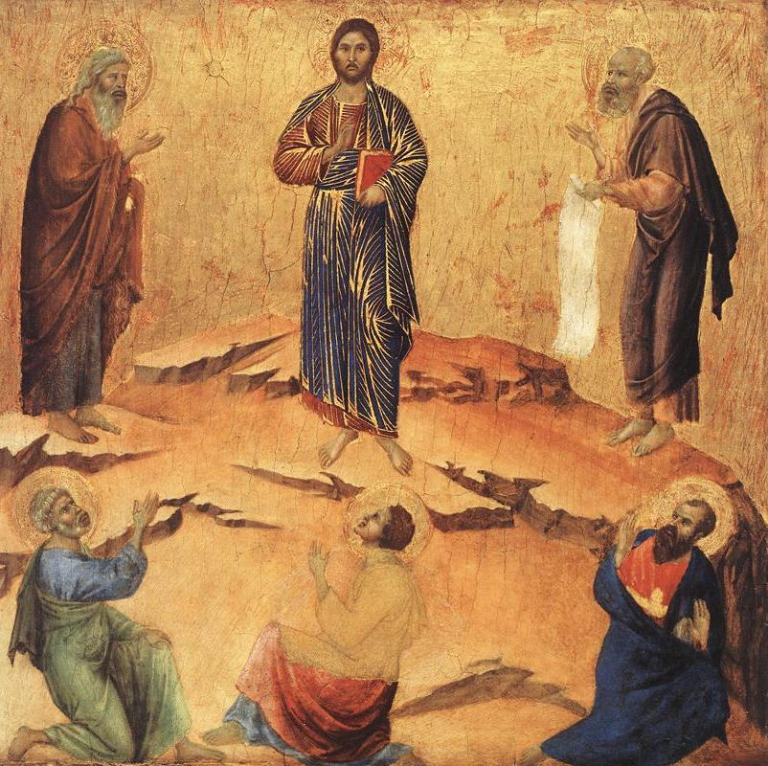
REVIEW
We are going to review what the Old Testament teaches about God’s promise to send a Savior to rescue us and bring us fully back into His Family!
We will begin by making our own Timeline of the Family of God.

Slide 5
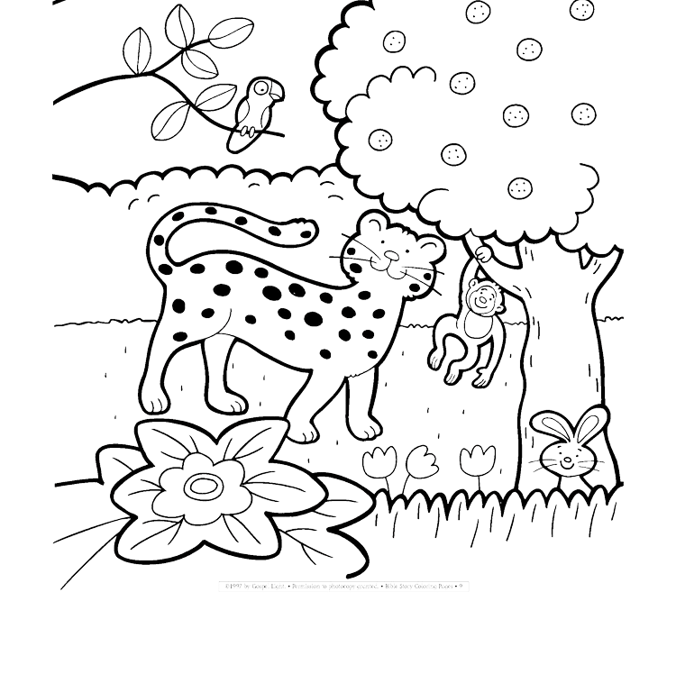
Timeline of the Family of God
The first story from the Bible that we learned about this year was God Created the Heavens and the Earth.
So that is where we are going to begin our Timeline of the Family of God.
https://ministryspark.com/52-bible-coloring-pages/

Slide 6
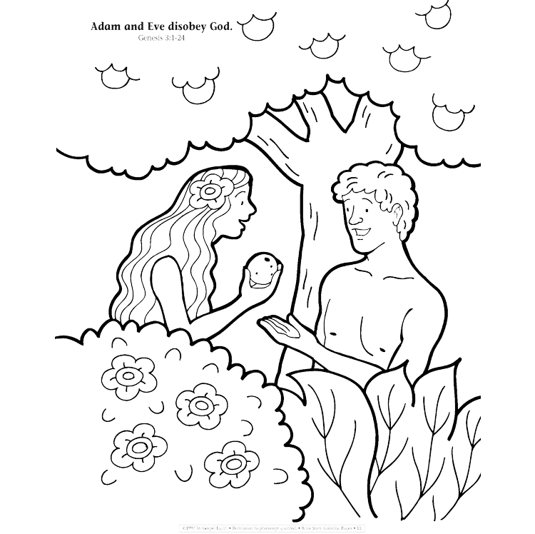
Timeline of the Family of God
Last month we talked about the Fall of Adam and Eve and how they were expelled from the Garden of Eden.
What are some things that you remember about that story and the lessons God was teaching Adam and Eve?
We also said that before God expelled Adam and Eve from the Garden of Eden, He promised He would send us a Savior, so that we all could live as one with God again.
https://ministryspark.com/52-bible-coloring-pages/

Slide 7
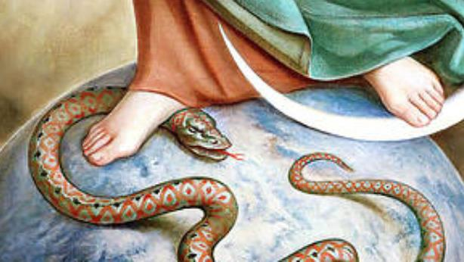
When you look at the picture of the statue of Mary crushing the serpent’s head
and read Genesis 3:15,
what are your thoughts about who God is promising would come to rescue us?
Jesus is the offspring, or son of Mary, who will come and crush Satan.
Mary will cooperate with God to bring Jesus to us by conceiving Him through the Holy Spirit and giving birth to Him.
To bite at a heel is painful and a nuisance, but to crush a head inflicts death and defeat.

Slide 8
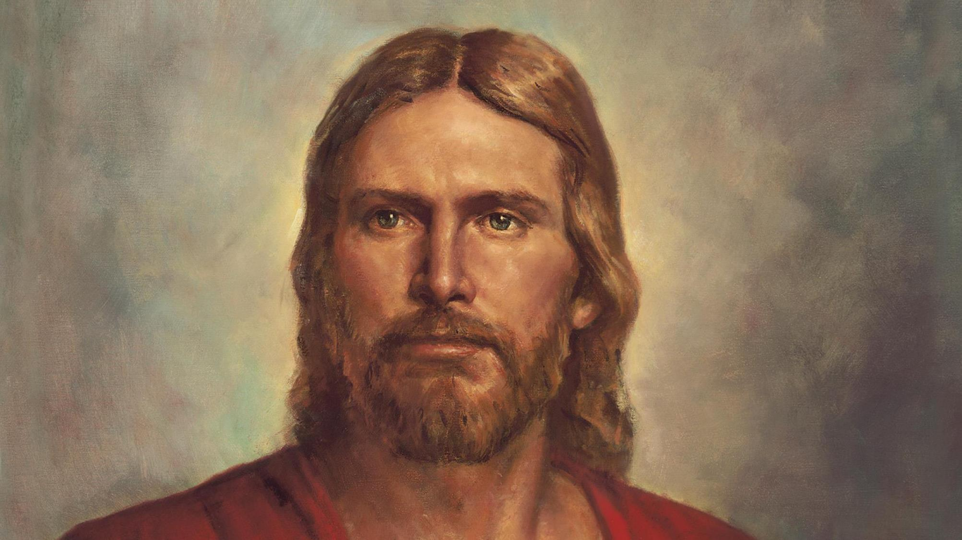
How did Jesus defeat Satan?

Slide 9
THE IMMACULATE CONCEPTION | HOW DO YOU EXPLAIN
IMMACULATE CONCEPTION TO KIDS?
https://www.youtube.com/watch?v=AfTuZeUQ8lw

Slide 10
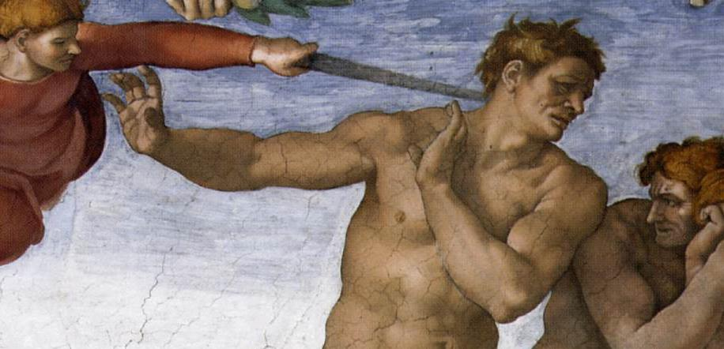
Genesis 4:1
Adam and Eve left the Garden of Eden and started a family.

Slide 11
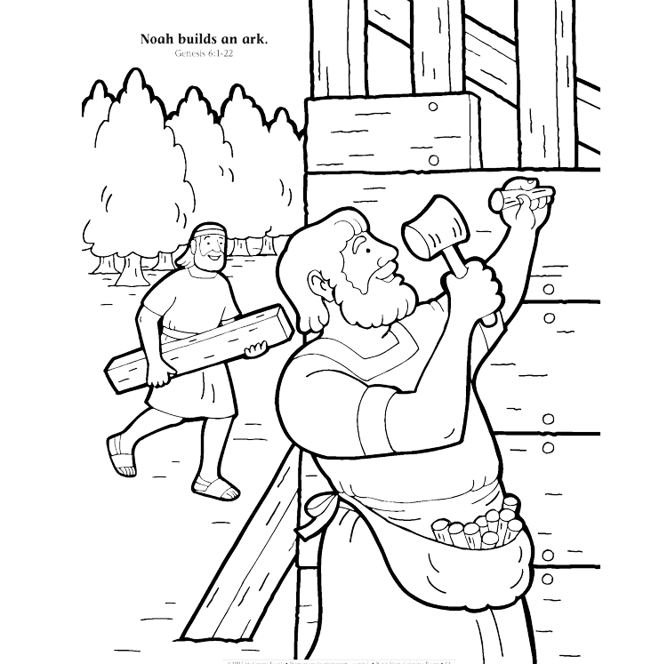
Timeline of the Family of God
To prevent all His children from being washed way, God saved one man and his family because they were the only ones left who still loved and obeyed Him.
Who was this man?
Noah
https://ministryspark.com/52-bible-coloring-pages/

Slide 12
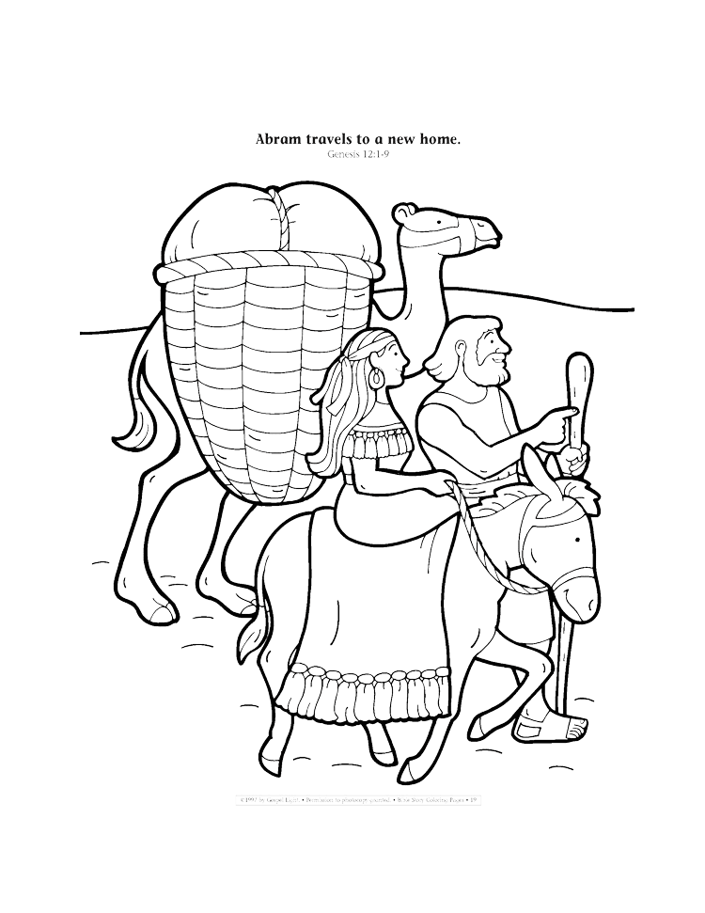
Timeline of the Family of God
Even after the great flood, people kept choosing to turn away from God and even invented false gods to worship instead of their loving Divine Father. Yet, God was very patient.
Finally, after many generations had come and gone, God chose to speak to a man called Abram. Abram’s family would be special to God. God would call them His Chosen People.
Read: Genesis 12:1-3
https://ministryspark.com/52-bible-coloring-pages/

Slide 13
Mission Activity
Your Family At-Home Mission is to:
Get ready to share about your family’s plan to celebrate the Birth of Christ on Christmas Day and during the whole Christmas Season at Week 3’s gathering of families.
Have a Family Movie Night!
Watch the videos about the Immaculate Conception & Christmas.
Bring in food or small gifts items for the homeless, elderly or another ministry such as Walking with Moms in Need.
Gather around your home altar and pray a decade of the Rosary together, meditating on the Third Joyful Mystery, The Birth of Our Lord

Slide 14
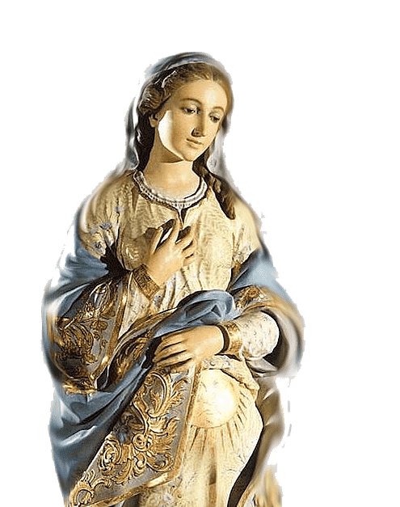
ADVENT FAMILY PRAYER
God of Love, Your Son, Jesus, is your greatest gift to us.
He is a sign of Your love.
Help us walk in that love during the weeks of Advent, as we wait and prepare for His coming.
We pray in the name of Jesus, our Savior.
O Mary conceived without sin, pray for us who have recourse to thee.
In the Name of the Father,…

