Slide 1
GOD’S SAVING LOVE FOR US:
LITURGY AND THE SEVEN SACRAMENTS
SACRAMENTS OF HEALING: RECONCILIATION & PENANCE

Slide 2
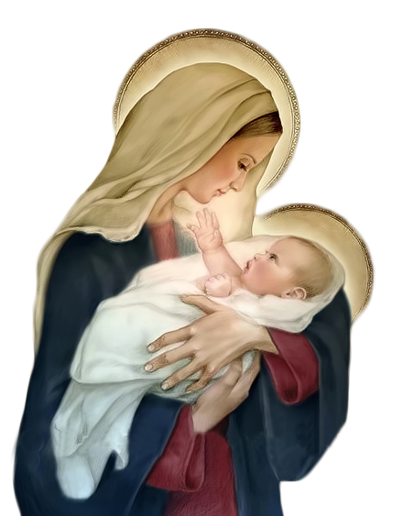
^{Opening Prayer}
Lord Jesus Christ, we entrust our family to You and ask for Your blessing and protection.
We love You Lord Jesus with all our hearts, and we ask that You help our family to become more like the Holy Family.
Help us to be kind, loving, and patient with one another.
Give us all the grace we need to become saints and Your faithful disciples. Amen.

Slide 3
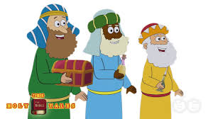
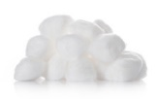
ICE BREAKER: Three Wisemen Race!
For this fun relay game, divide into teams of “three wisemen.”
Each person smears Vaseline on the bottom of his/her face, runs across the room and sticks his/ her face into a plate of cotton balls trying to stick as many as possible without using his/her hands, then runs to the other end and peels them off into a bowl before tagging the next person to start the process.
The first team to get the highest number of cotton balls in 7 minutes (have leaders keep count) wins!
Take some pictures to remember the Epiphany fun!
Adapted from www.signupgenius.com.

Slide 4
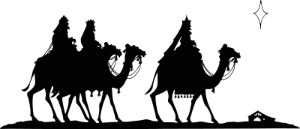
FAMILY EPIPHANY BLESSING SHARING!
Show pictures of your blessed front doors.
How would you describe your experience?
How did it make you feel about your family, your home, yourselves?
What do think of when you walk through the front door of your home?
What does the blessing mean to you?

Slide 5
WATCH
The Sacrament of Reconciliation Explained or A Kid’s Guide To The Sacrament Of Penance
https://youtu.be/pfZkq7BABJM?si=9a4OsomF0p70uvBR
https://www.youtube.com/watch?v=NHSFUlf3fkc

Slide 6
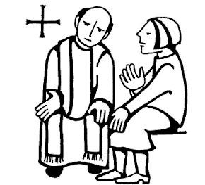
MAIN CONCEPT
From the time of Jesus, people haven’t changed much.
We still commit the same sins as the people did back then, and we need God’s forgiveness just as much.
Jesus is not walking the earth in the same way that He did 2000 years ago, but He is calling us, asking us to let Him heal us through His sacraments.
Today, it is still Jesus who is forgiving people, but now He forgives us through the priest.
The priest acts in the person of Jesus Christ, as Jesus is forgiving us in the Sacrament of Reconciliation, because only God can forgive our sins.

Slide 7
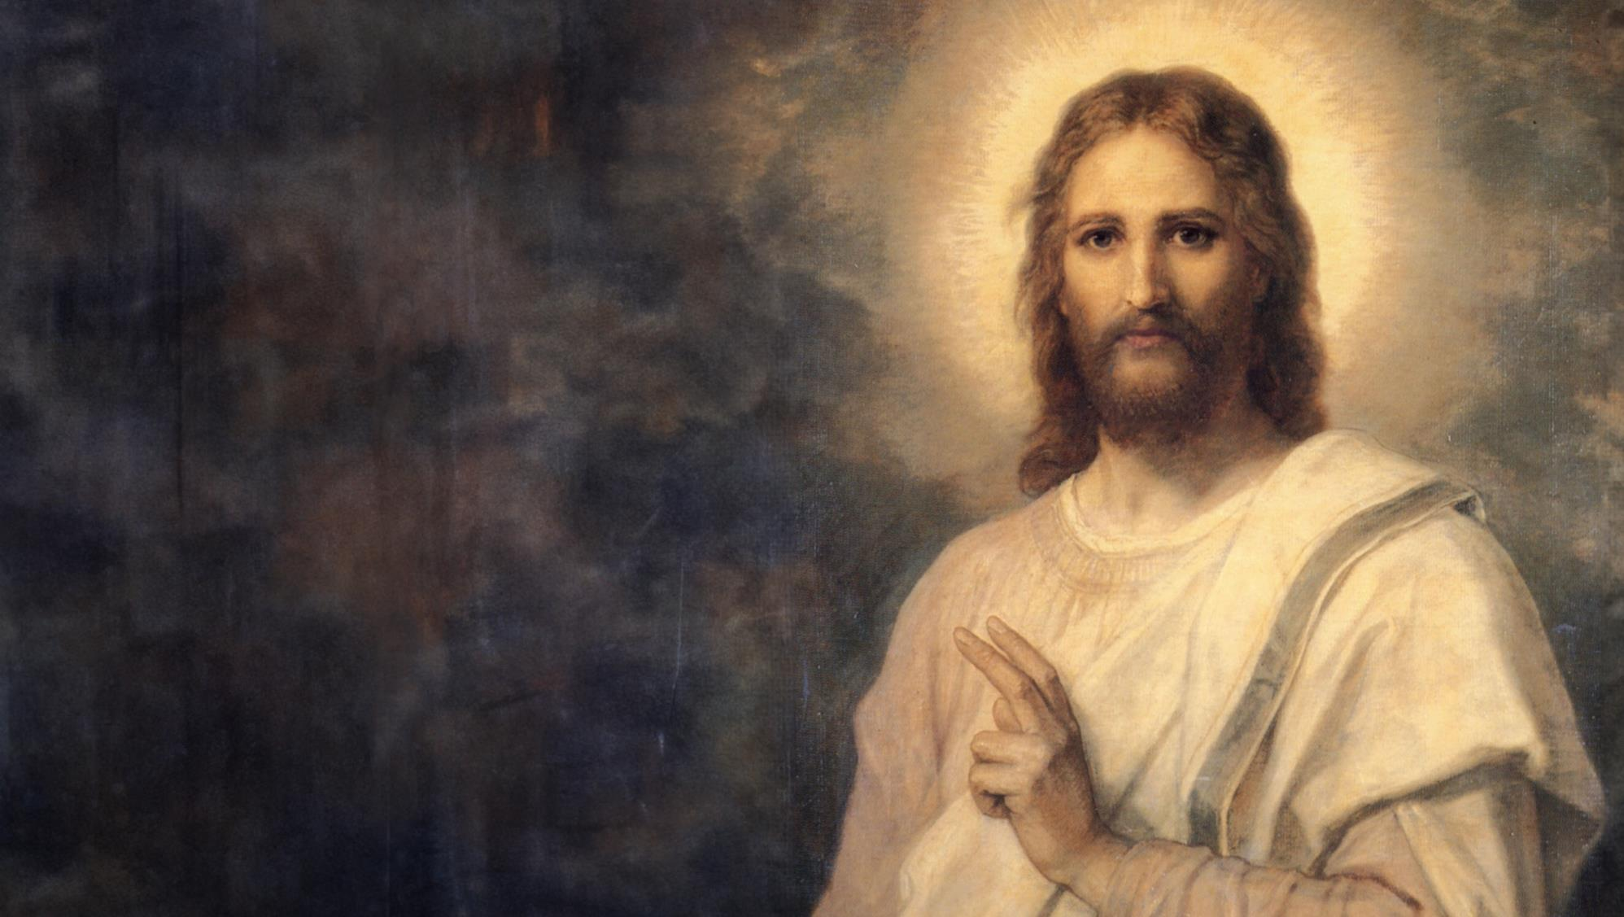
Jesus, Who am I?
You’re my little child, the one I love so much,
the one whose tears I’ve wiped away with my forgiving touch.
You’re the one who chases rainbows and runs away from Me.
But you’re the one I love so much, so I wait patiently.
You’re the lost sheep that I found, whom I guided home.
You’re the woman in the street, whom I wouldn’t let them stone.
You’re the blind man that I healed, and the girl I raised from the dead.
You’re the one I love so much, for you my blood was shed.
And then there comes that moment when you’re the one that makes me smile, it’s when you stop your rainbow chasing and rest in my arms for a while.
You ask me, “Jesus, who am I?”
You’re the one I’ve loved for all time.
I have called you by name.
Child, you are Mine!

Slide 8
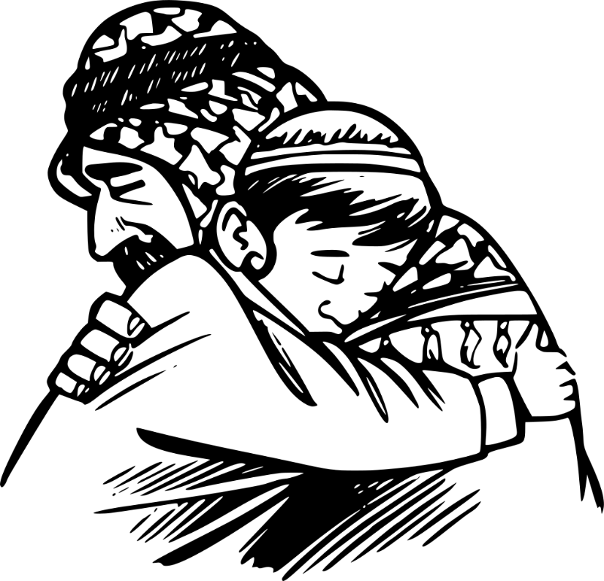
FAMILY CONVERSATION
What is your favorite story
of forgiveness
in the
bible?

Slide 9
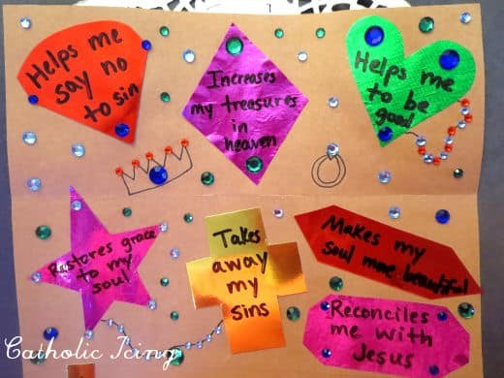
FAMILY ACTIVITY
The Sacrament of Reconciliation is a
beautiful gift from God!
Examples of the Treasures of the Sacrament of Reconciliation:
Increases my treasures in Heaven
Helps me say no to sin
Makes my soul more beautiful
Takes away my sins
Restores grace to my soul
Helps me to be good
Unites me to God again
Makes God happy
Makes me happy

Slide 10
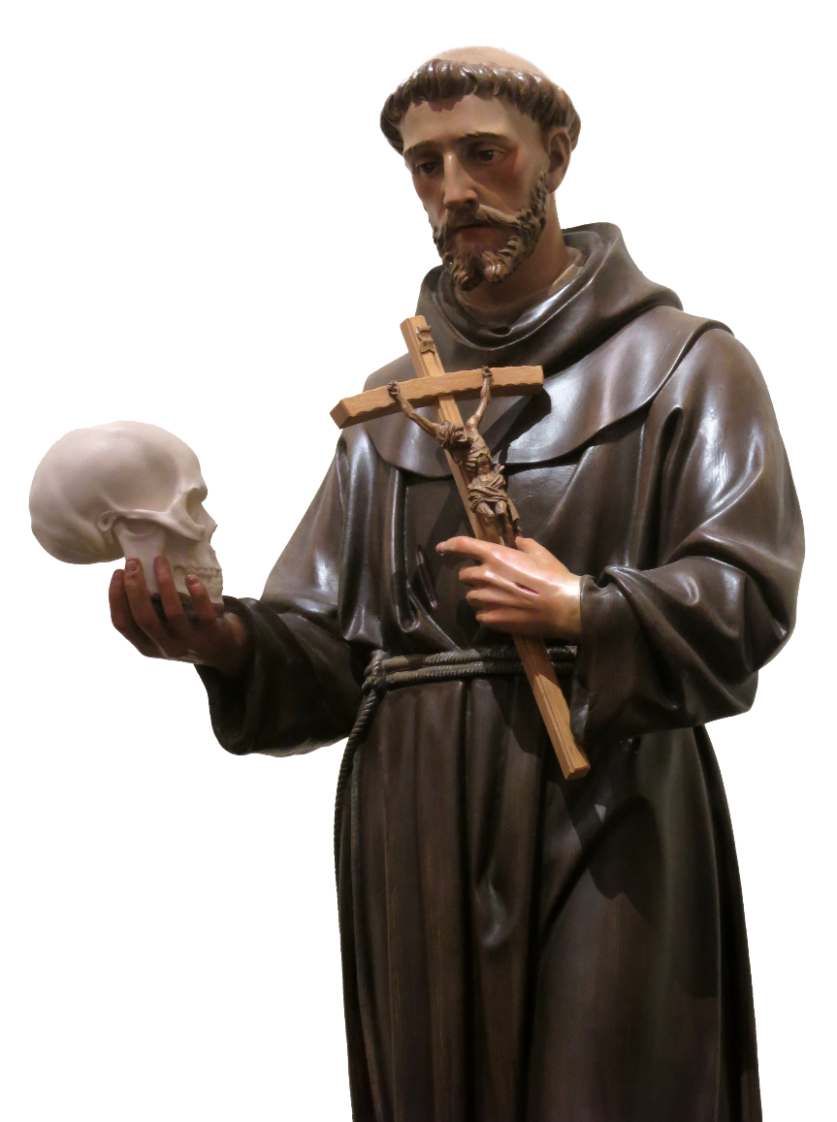
CLOSING PRAYER
Prayer of St. Francis
Lord, make me an instrument of your peace:
where there is hatred, let me sow love;
where there is injury, pardon;
where there is doubt, faith;
where there is despair, hope;
where there is darkness, light;
where there is sadness, joy.
O divine Master,
grant that I may not so much seek to be consoled as to console,
to be understood as to understand,
to be loved as to love.
For it is in giving that we receive,
it is in pardoning that we are pardoned,
and it is in dying that we are born to eternal life. Amen.

