Slide 1
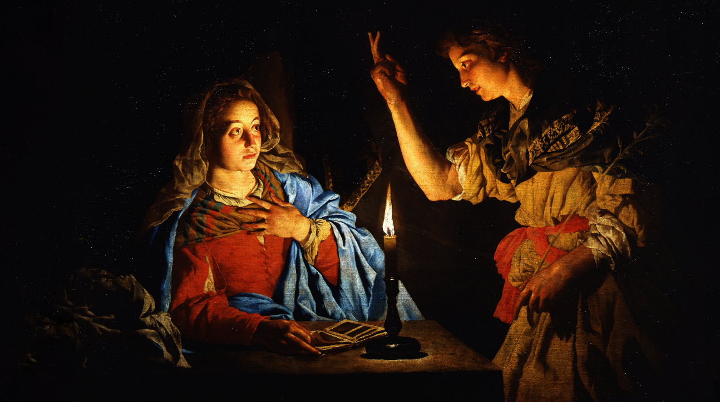
FAMILIES FORMING DISCIPLES
MARY & ISREAL

Slide 2
^{Opening Prayer}
Lord God,
Lord Jesus Christ, we entrust our family to You and ask for Your blessing and protection.
We love You Lord Jesus with all our hearts and we ask that You help our family become more like the Holy Family.
Help us to be kind, loving, and patient with one another.
Give us all the grace we need to become saints and Your faithful disciples.
Amen.

Slide 3
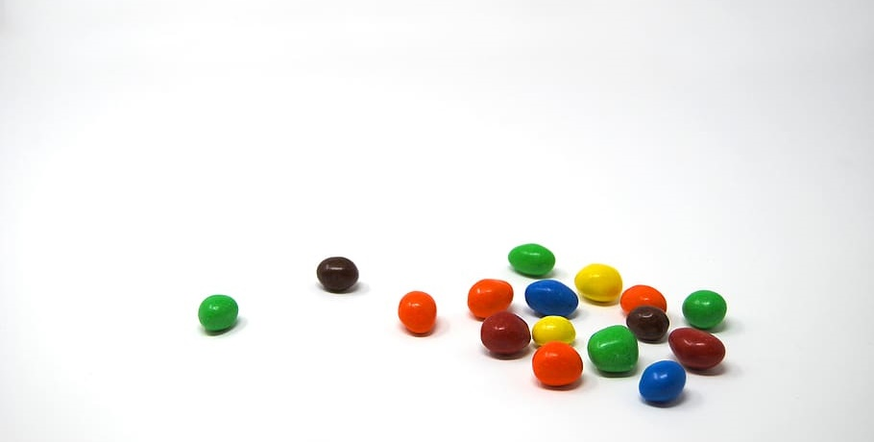
^{Ice Breaker}
^{Blue = Family}
^{Green = Church}
^{Yellow = Friends}
^{Red = School}
^{Brown = Favorite Easter Candy}

Slide 5
FAMILY CONVERSATION
Name your favorite story or favorite person of the Old Testament? Why?
Name two new things that you learned this year at Families Forming Disciples.

Slide 6
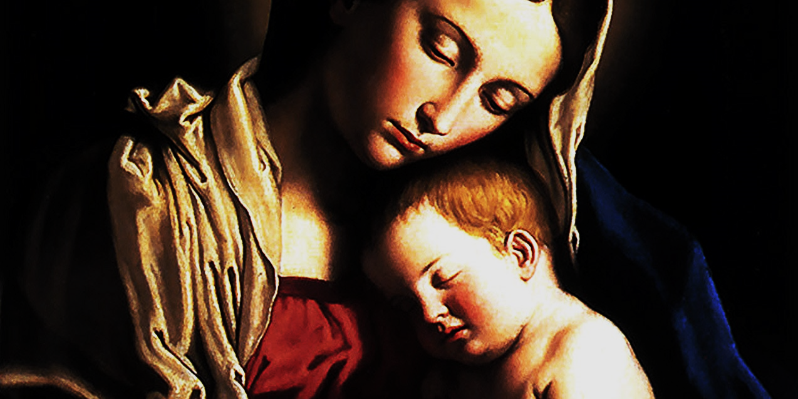
REVIEW MAIN CONCEPTS
MARY’S “YES” FULFILLING THE PROPHETS’ CALL TO OBEY GOD
NEW COVENANT
IN AND THROUGH JESUS

Slide 7
OPEN MIC!
Time to hear from YOU!
1. How did learning about Sacred Scripture and living the faith together as a family,
and with other families, impact your relationship with God?
2. How did it impact your relationship with one another?
3. How did it impact your relationship with your church community?

Slide 8
Why do Catholics honor Mary?
^{https://youtu.be/UylfGgKygqs}

Slide 9
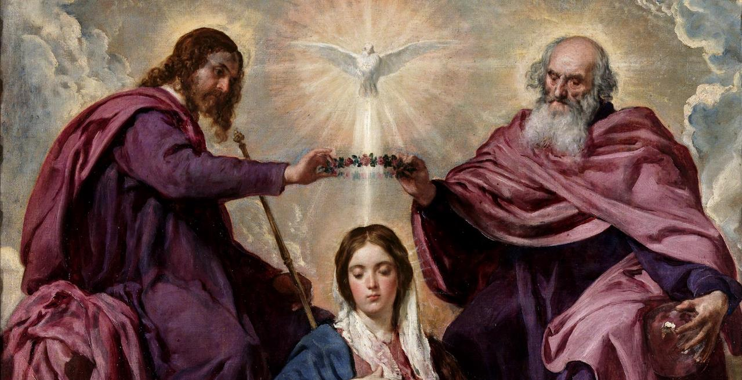
MAY CROWNING

Slide 10
CELEBRATE!

