Slide 1
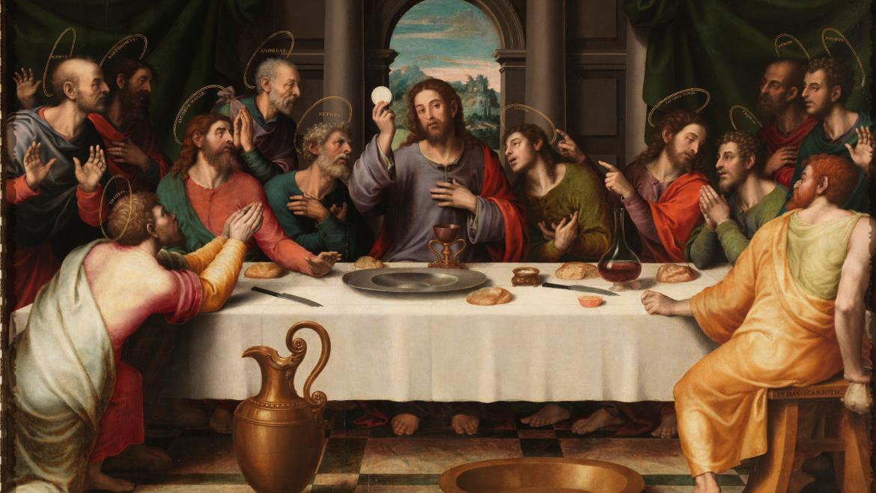
THE LIFE OF CHRIST: THE LUMINOUS MYSTERIES
THE INSTITUTION OF THE EUCHARIST

Slide 2
^{Opening Prayer}
Lord Jesus Christ, we entrust our family to You and ask for Your blessing and protection. We love You Lord Jesus with all our hearts and we ask that You help our family become more like the Holy Family. Help us to be kind, loving, and patient with one another. Give us all the grace we need to become saints and Your faithful disciples.
Amen.

Slide 3
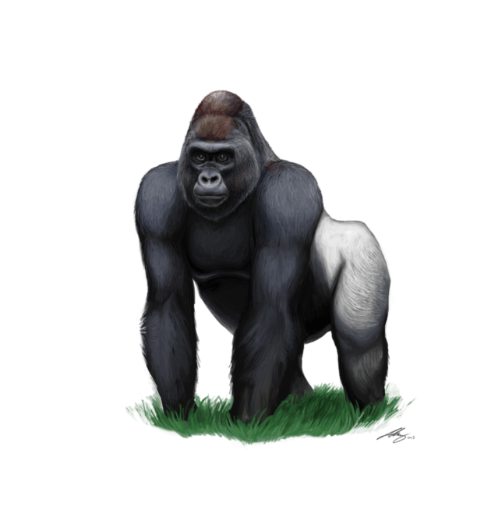
^{Ice Breaker}
GORILLA, MAN, NET
GORILLA roars while beating his/her hands on their chest.
MAN stands with his/her head facing up and hands and arms folded proudly.
NET pretends to throw a net on his/her partner.

Slide 4
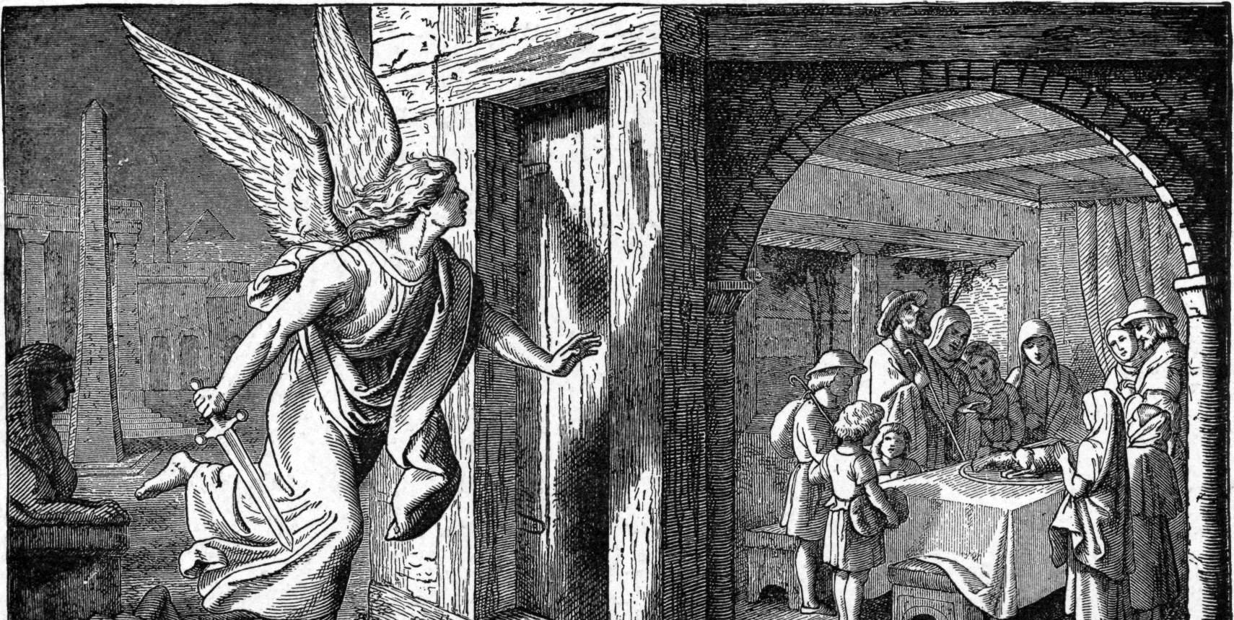
THE PASSOVER FOR SEDER

Slide 5
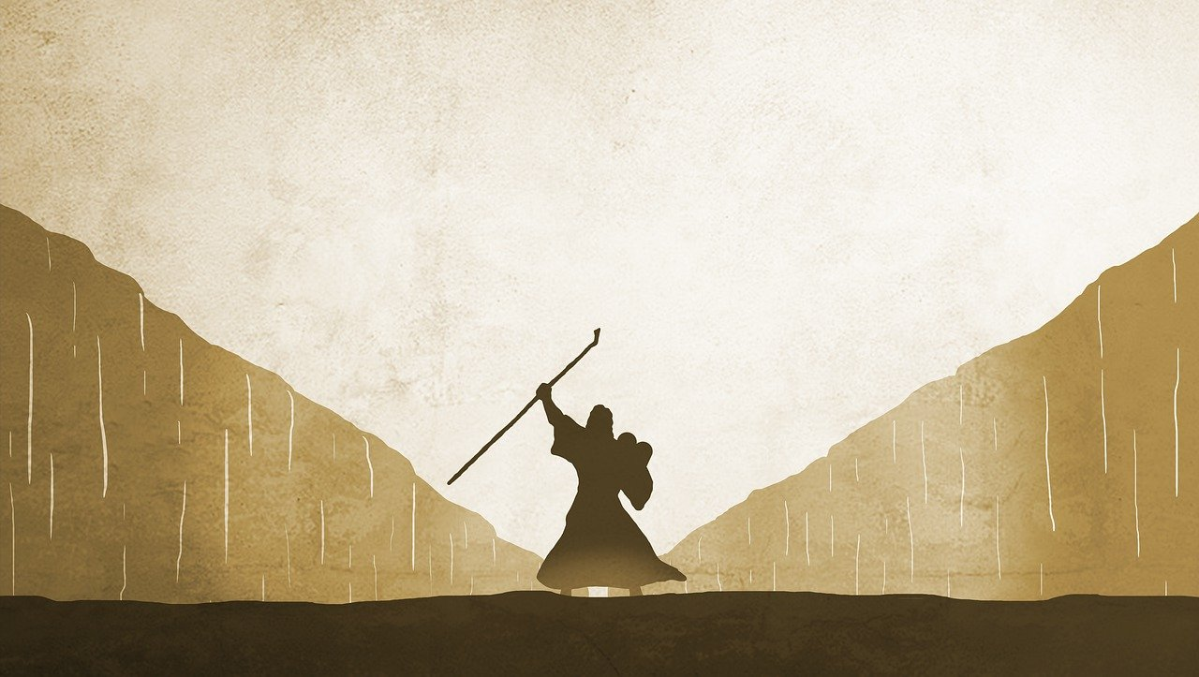
In Year 2 of Families Forming Disciples, we talked about how God foreshadowed or left clues in the Old Testament about what would happen when His Son Jesus came to make the New Covenant.
We also learned about God’s covenant with the Israelites and how He saved them from slavery in Egypt.

Slide 6
EXODUS 12:21-28
“Go and procure lambs for your families, and slaughter the Passover victims. ²²
Then take a bunch of hyssop, and dipping it in the blood that is in the basin, apply some of this blood to the lintel and the two doorposts. And none of you shall go outdoors until morning. ²³
For when the Lord goes by to strike down the Egyptians, seeing the blood on the lintel and the two doorposts, the Lord will pass over that door and not let the destroyer come into your houses to strike you down.”

Slide 7
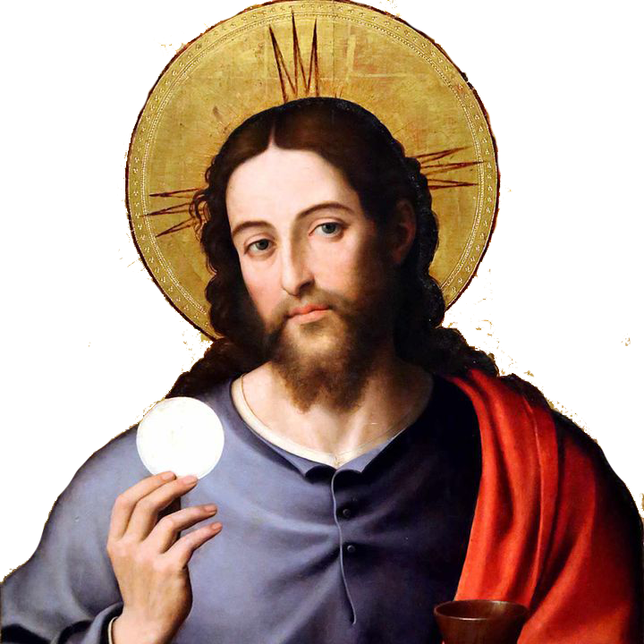
John 6:68
“To whom shall we go Lord? You have the words of eternal life. We have come to believe and are convinced that you are the Holy One of God.”

Slide 8
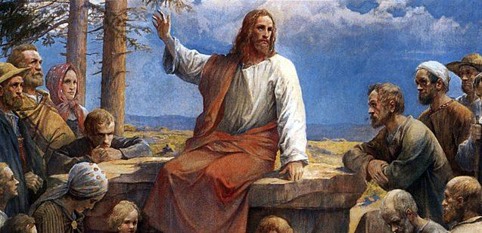
If you were there when Jesus was talking about eating His Body and drinking His Blood, what would you have done?
Why do you believe in the mysteries of our faith and the teachings of Jesus and His Church?
Is it because you know and have a relationship with Him?
Are you a disciple trying to learn from Jesus, or an admirer watching Him from a distance?
Do you think any of the same disciples that walked away later changed their mind and went back Jesus to be part of the Christian community?
FAMILY CONVERSATION

Slide 9
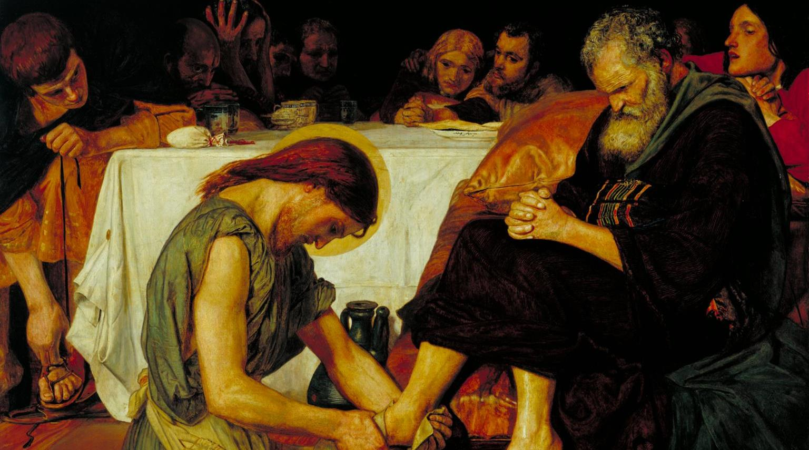
John 13:1-20
LECTIO DIVINA

Slide 10
FAMILY ACTIVITY
Name something each of you can do to
show love
and
to serve
his/her family this week.

Slide 11
FAMILY MISSION
Your At-Home Family Mission is to watch the videos and to accomplish your plans to serve one another, as you just discussed after you read about
Jesus' Washing of the Disciples’ Feet.
Be ready to share your
Serving One Another Experience
at the Week 3 gathering.

Slide 12
CLOSING PRAYER
God our Father,
You have brought us here together so that we can give You thanks and praise for all the wonderful things You have done.
We thank You for all that is beautiful in the world and for the happiness You have given us.
We praise You for daylight and for Your word which lights up our minds.
Glory be to the Father, and to the Son, and to the Holy Spirit, as it was in the beginning, is now, and ever shall be, world without end. Amen.
Adapted from Eucharistic Prayers for Children I-III, 1975 edition

