Slide 1
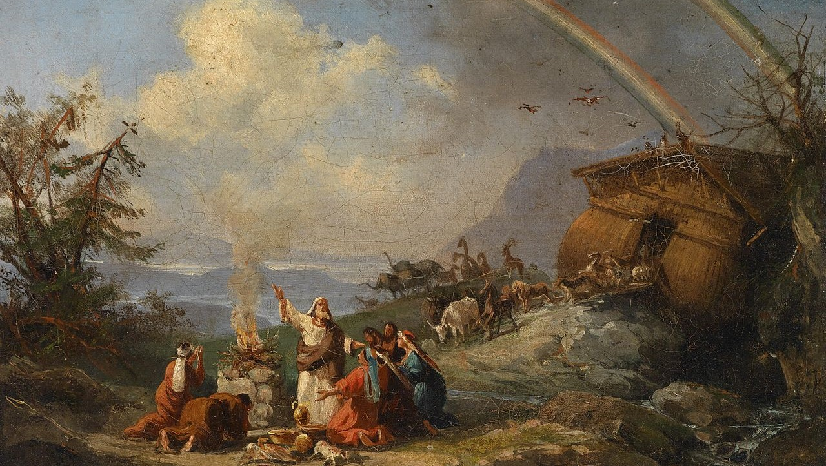
^{Families Forming Disciples}
Covenants and Sacraments

Slide 2
^{Opening Prayer}
Lord Jesus Christ,
We entrust our family to you and ask for
your blessing and protection. We love
you Lord Jesus with all our hearts and we
ask that you help our family become more
like the Holy Family. Help us to be kind,
loving, and patient with one another. Give
us all the grace we need to become saints
and your faithful disciples.
Amen.

Slide 3
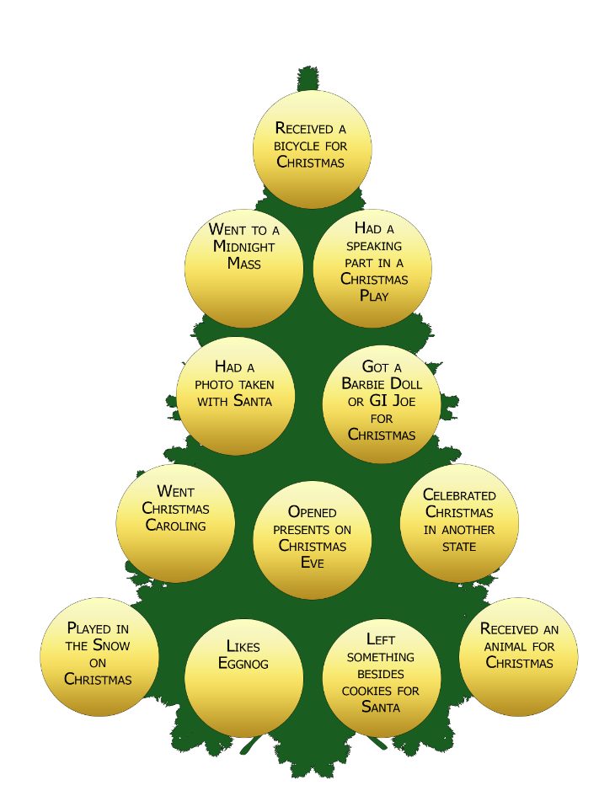
^{Ice Breaker}
Christmas Past Game
Get the most initials to Win!

Slide 4
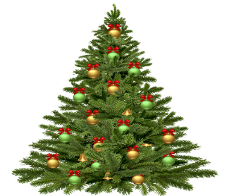
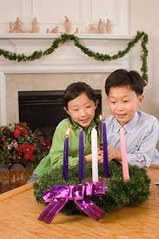
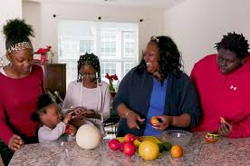
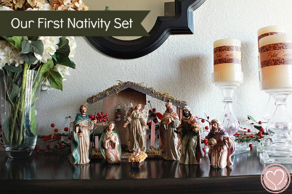
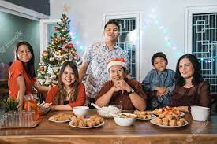
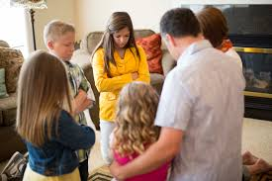
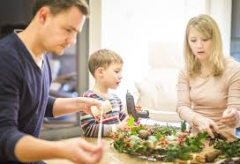
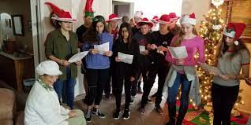
^{Families share YOUR photos!}
1. Each family shares a photo of themselves around their home altar or prayer space practicing their favorite Advent or Christmas tradition
2. They explain why it is their favorite tradition
3. And how they will celebrate the Birth of Christ on Christmas Day and during the whole Christmas Season

Slide 5
God Keeps His Promises!
Review Main Concept

Slide 6
Lectio Divina: Read Luke 2:1-10

Slide 7
Family Sharing
Family Sharing: Give families time to share privately

Slide 8
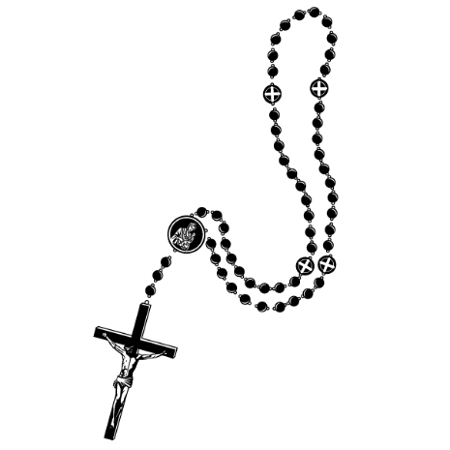
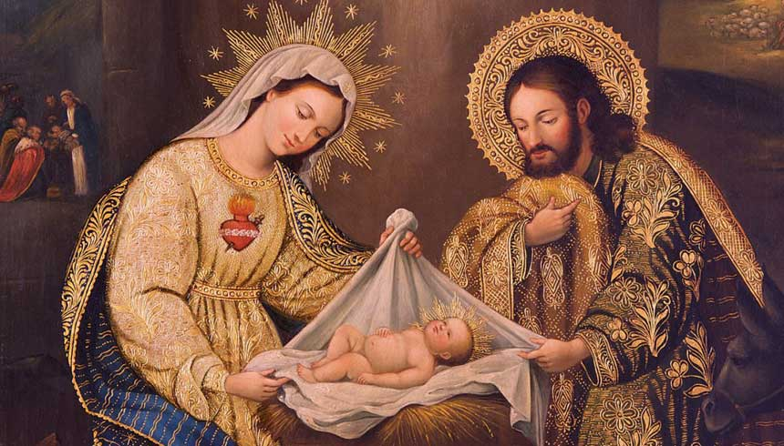
^{Closing Prayer:} Third Joyful Mystery, the Nativity of Our Lord

Slide 9
Reminder of next meeting

