Slide 1
THE LIFE OF CHRIST: THE GLORIOUS MYSTERIES
THE ASSUMPTION OF MARY
THE CROWNING OF MARY AS QUEEN OF HEAVEN AND EARTH

Slide 2
^{Opening Prayer}
Lord Jesus Christ,
We entrust our family to You and ask for Your blessing and protection.
We love You Lord Jesus with all our hearts and we ask that You help our family to become more like the
Holy Family.
Help us to be kind, loving, and patient with one another.
Give us all the grace we need to become saints and Your faithful disciples.
Amen.

Slide 3
ICE BREAKER
Where would you fly if you had wings?

Slide 4
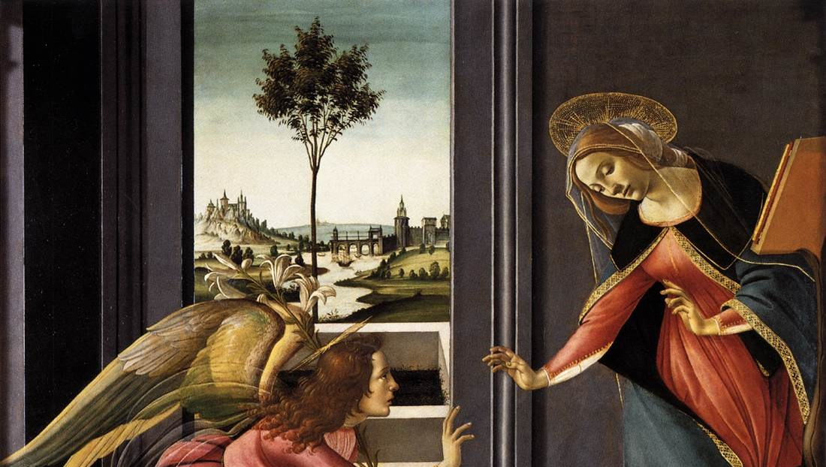
ANNUNCIATION

Slide 5
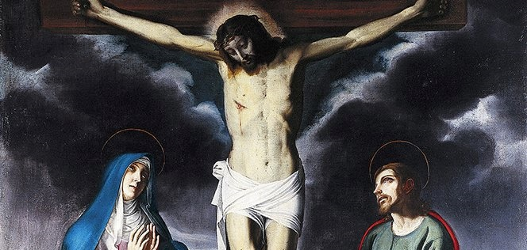
“BEHOLD YOUR MOTHER”

Slide 7
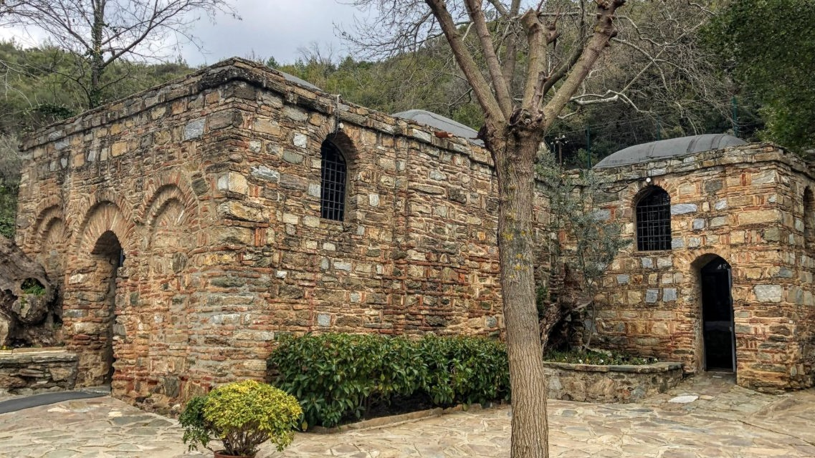

Slide 8
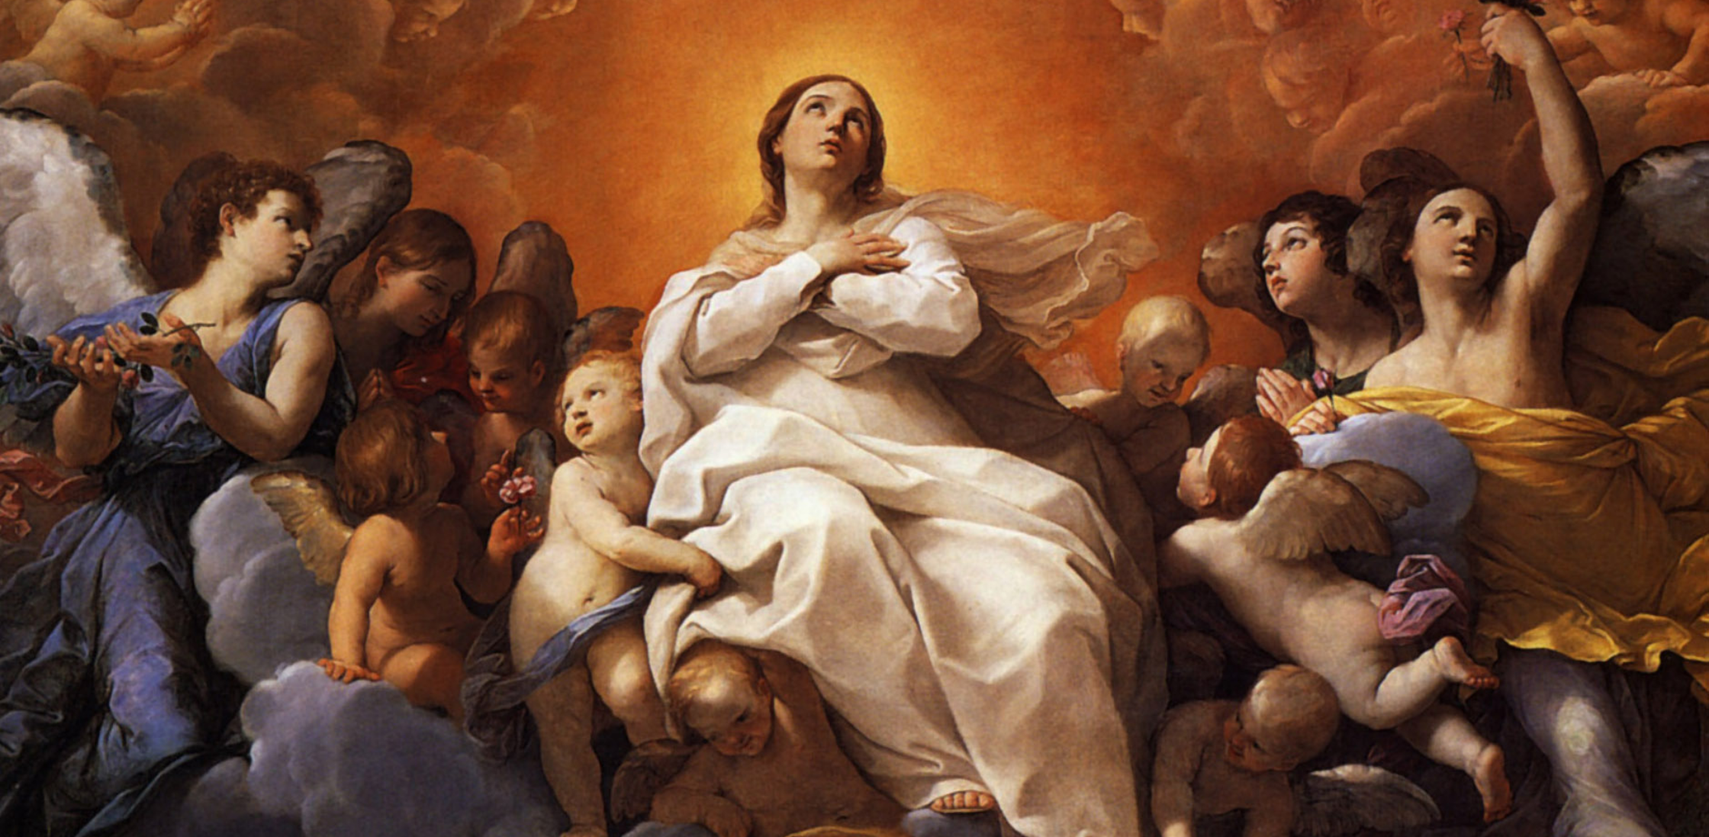
MARY’S ASSUMPTION
“When Mary was assumed into Heaven,
she was crowned Queen of Heaven and Earth.”

Slide 9
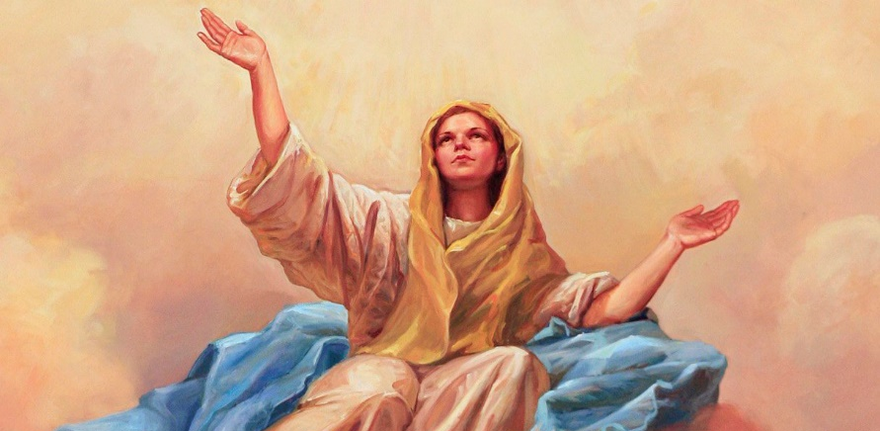
FAMILY SHARING
What do you love most about Mary our Mother?
What do you think was the most important thing you learned this year in Families Forming Disciples (FFD)?

Slide 10
OPEN MIC!
How did learning and living the faith together as a family,
and with other families, impact you?

Slide 11
THE MYSTERIES OF THE ROSARY
This year we learned about the life of Jesus through the Mysteries of the Rosary.
These are Mary’s memories of the life of her Son that she wants to share with us.
Mary wants us to know how very blessed we are to have such a generous, merciful, and all loving God!

Slide 12
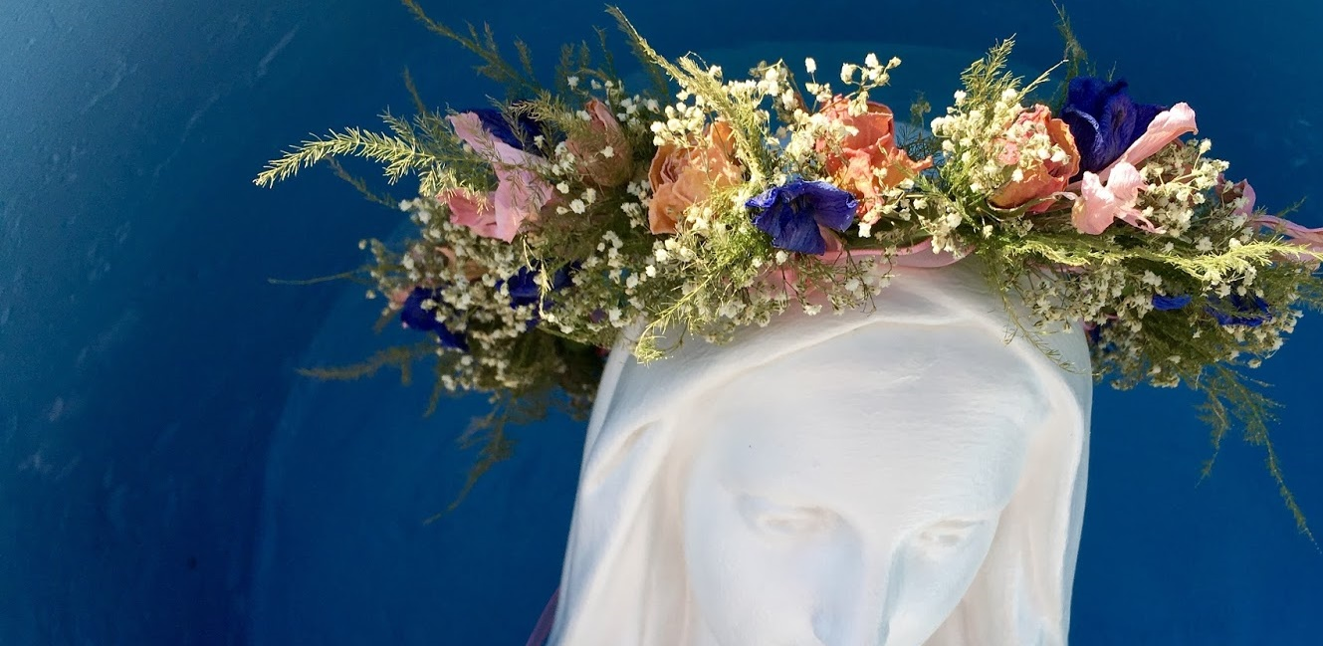
MAY CROWNING
Mary is the Spouse of the Holy Spirit!
During the month of May, we honor Mary as Queen of Heaven and Earth.
Her Son, Jesus, is our King, so therefore His Mother is our Queen!
A May Crowning is a special way in which we honor Mary Our Queen during the Month of May.

Slide 13
Time to Celebrate!
Celebrate the Families Forming Disciples Year,
all the gifts God has blessed us with,
and His unending love!

