Slide 1
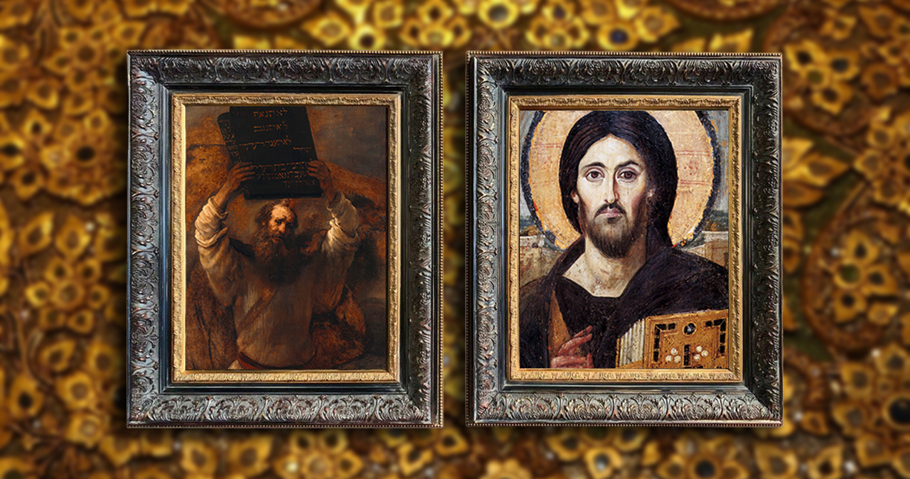
FAMILIES FORMING DISCIPLES
Jesus:
The New Moses,
The Rescuer

Slide 2
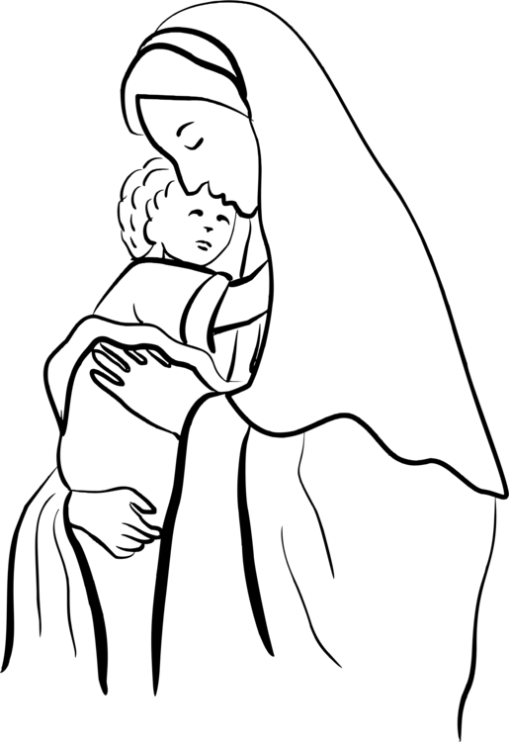
^{TOPICS}
COVENANT AT SINAI
10 COMMANDMENTS
MARY, ARK OF THE NEW COVENANT

Slide 3
^{Opening Prayer}
Lord Jesus Christ,
We entrust our family to You and ask for Your blessing and protection. We love You Lord Jesus with all our hearts and we ask that You help our family become more like the Holy Family. Help us to be kind, loving, and patient with one another. Give us all the grace we need to become saints and Your faithful disciples.
Amen.

Slide 4
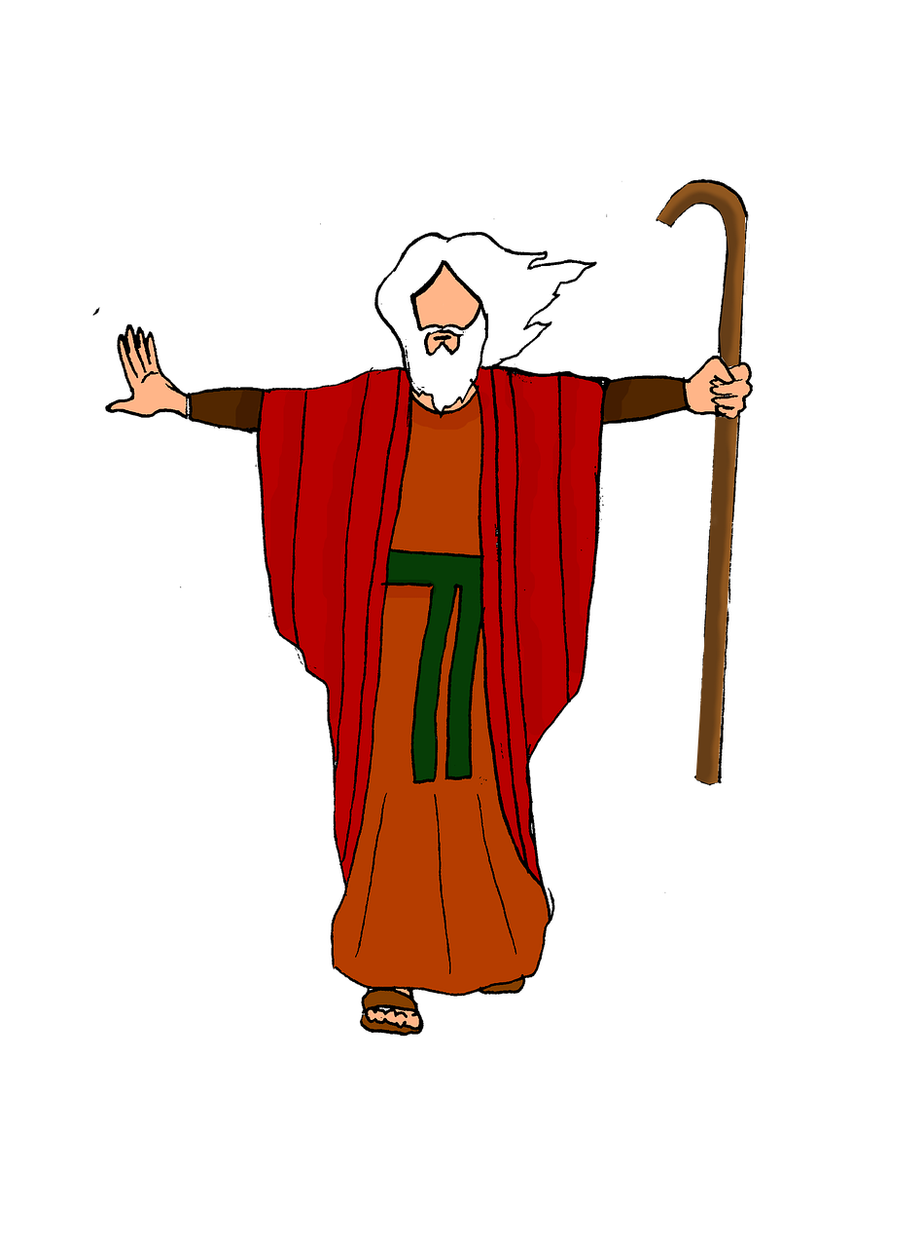
^{Ice Breaker}
Moses Says

Slide 5
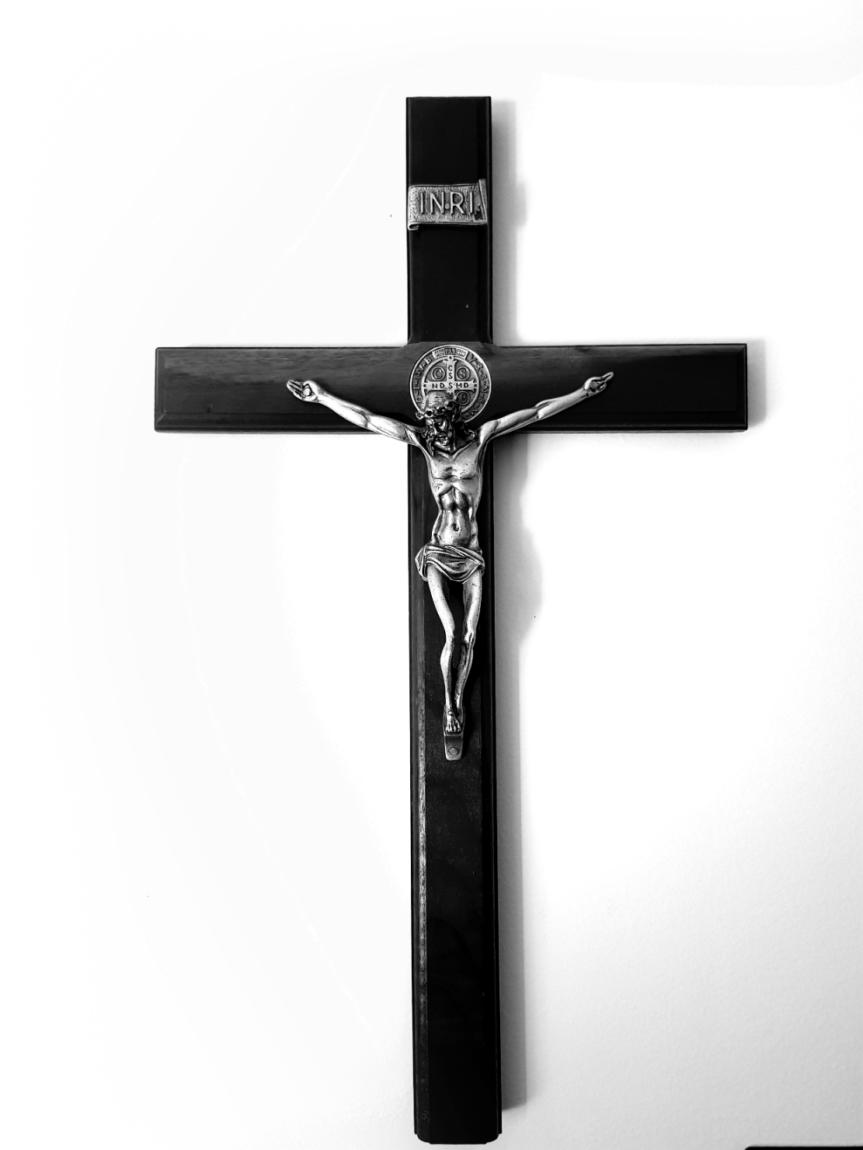
FAMILY SHARING
The Week 2 At-Home Mission included
many ideas and reflections on Holy Week.
As we are getting closer to Easter,
what is your favorite Holy Week Tradition?
Why is it your favorite?

Slide 6
REVIEW MAIN CONCEPT
The story of Moses making a covenant with God foreshadows Jesus and the New Covenant.

Slide 7
HOW?
How did the Israelites see God leading them during the day?
How did the Israelites see God leading them at night?

Slide 8
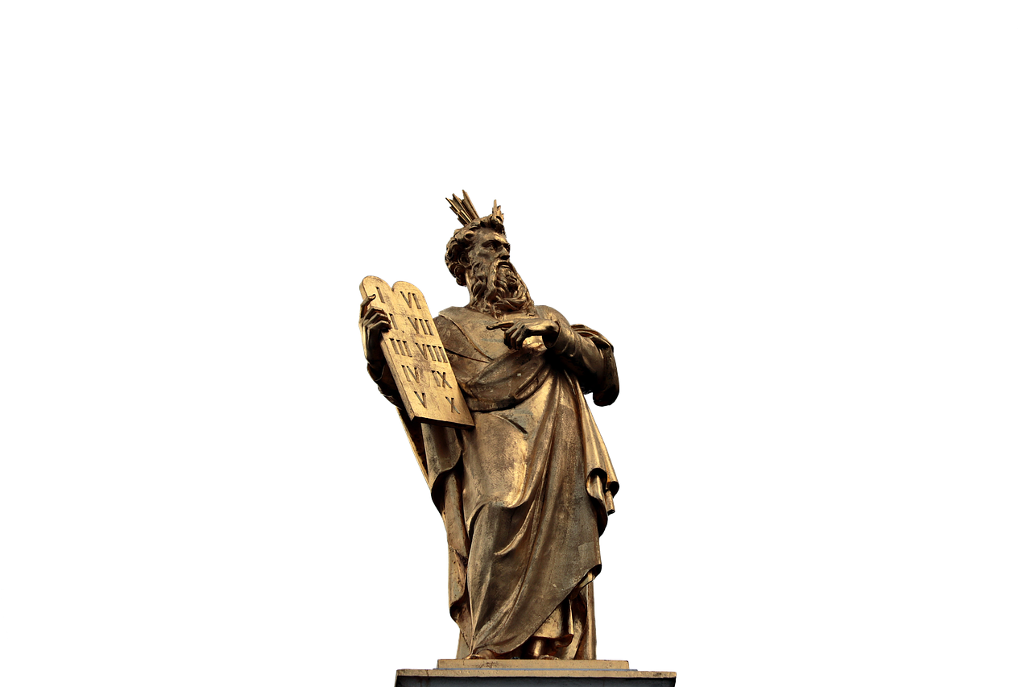
MOSES & THE 10 COMMANDMENTS

Slide 9
What do the 10 Commandments REALLY Command?
https://www.youtube.com/watch?v=NQK54vGZoA8

Slide 10
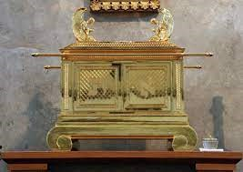
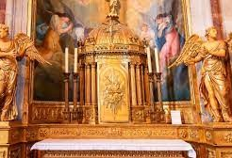
FAMILY CONVERSATION
God leaves clues in the Old Testament that point us to the New Testament. This time the clues point us to both Jesus and Mary.
Why do you think Mary is called
the Ark of the Covenant and the Holy Tabernacle?

Slide 11
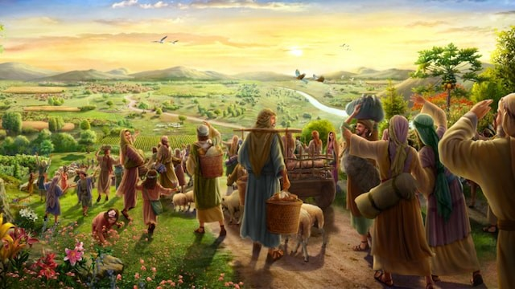
God always keeps his promises!

Slide 12
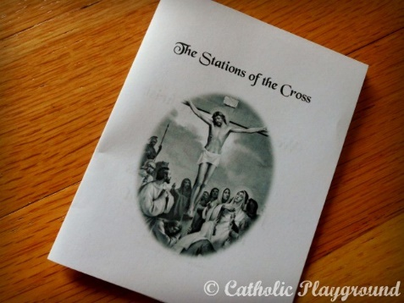
Closing Prayer
Pray the Stations of the Cross
using the
Stations of the Cross Mini Coloring booklets.

