Slide 1
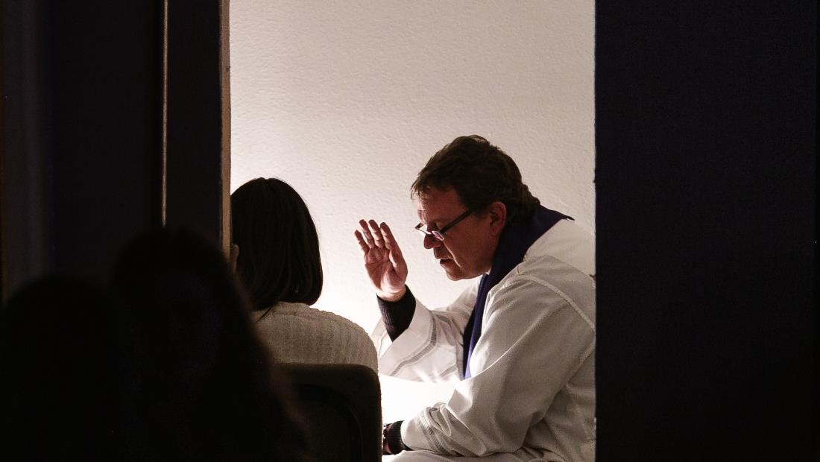
GOD’S SAVING LOVE FOR US:
LITURGY AND THE SEVEN SACRAMENTS
SACRAMENTS OF HEALING: PENANCE & RECONCILIATION

Slide 2
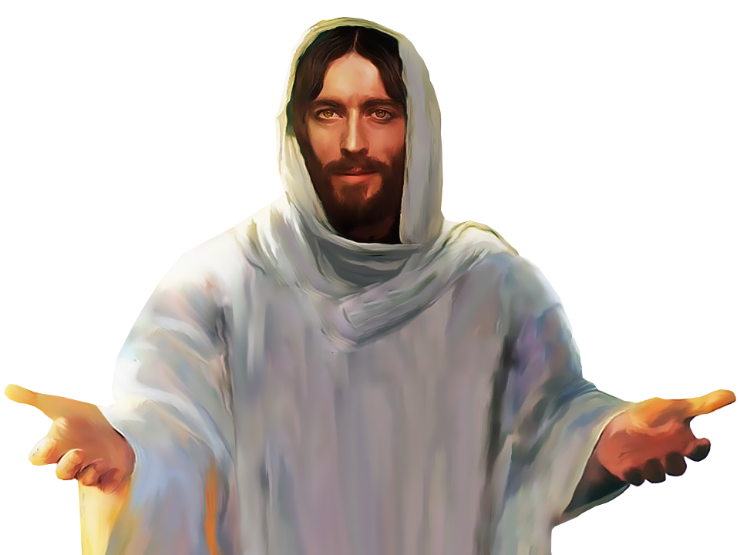
^{Opening Prayer}
Lord Jesus Christ, We entrust our family to You and ask for Your blessing and protection.
We love You Lord Jesus with all our hearts, and we ask that You help our family to become more like the Holy Family.
Help us to be kind, loving, and patient with
one another.
Give us all the grace we need to become saints and Your faithful disciples. Amen.

Slide 3
ICE BREAKER – HOT POTATO
Families sit in a circle, so that there are a minimum of 4 players in each group.
Start the music, and while the music plays, toss the hot potato from player to player around the circle as quickly as possible.
Once the music stops playing, the person holding the item must say a fun, quirky, or unique fact about themselves.
Then begin the music again until everyone has had a chance to have a turn.
Adapted from www.connectusfund.com.

Slide 4
Kids Explain the Sacrament of Reconciliation
https://www.youtube.com/watch?v=V-YuMPnbVHw

Slide 5
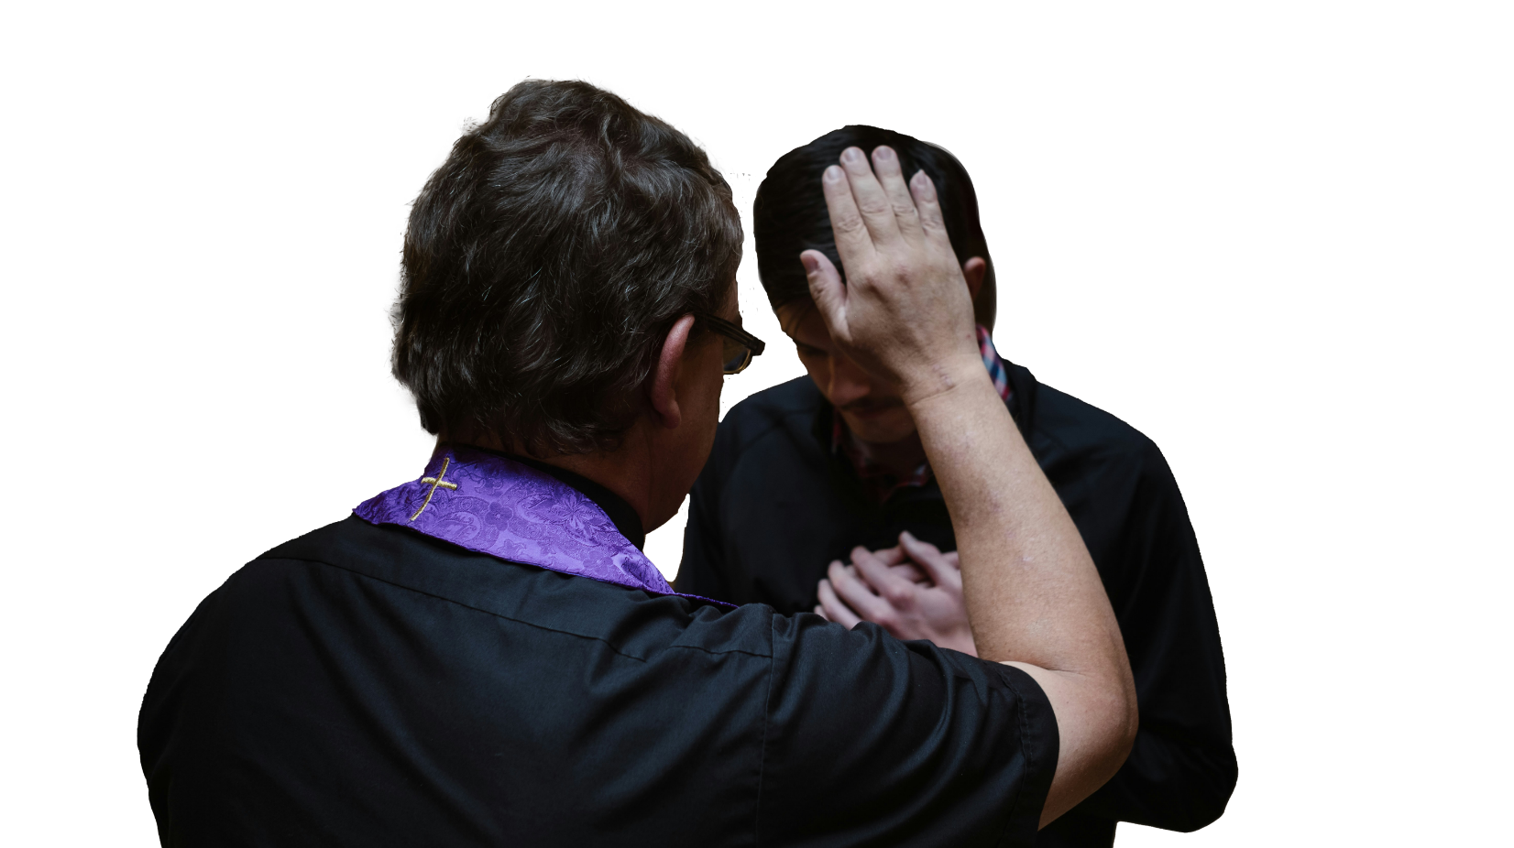
TOPIC
Today,
we will focus
on the Sacrament of Reconciliation.

Slide 6
Can you name the
three
Sacraments of Initiation?

Slide 7
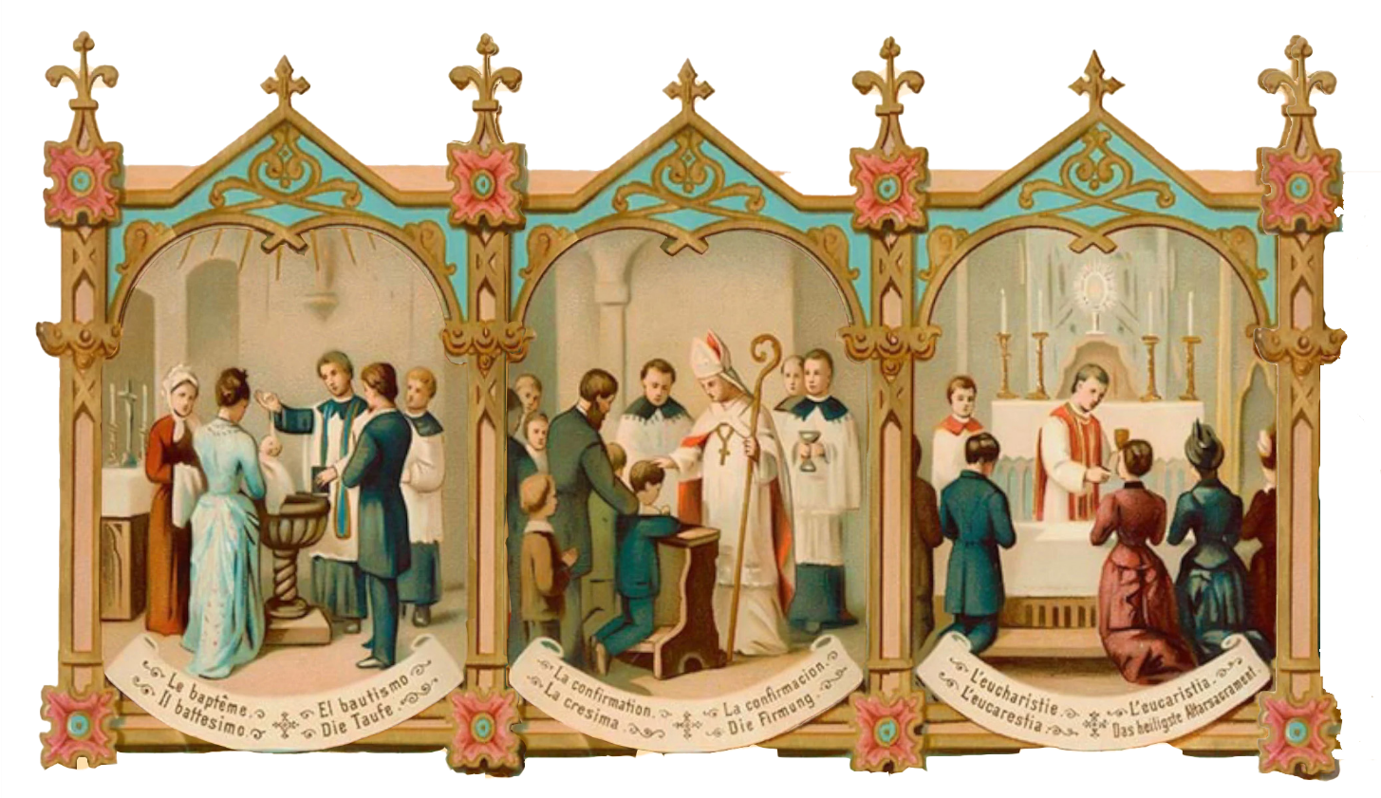
Sacraments of Initiation
Baptism Confirmation Holy Eucharist

Slide 8
Which of these three Sacraments of Initiation cleanses us of the Original Sin that we inherited from our first parents, Adam and Eve?
Baptism!

Slide 9
BAPTISM
After we are baptized, and our souls are washed clean of the stain of Original Sin...
Do people still sin?

Slide 10
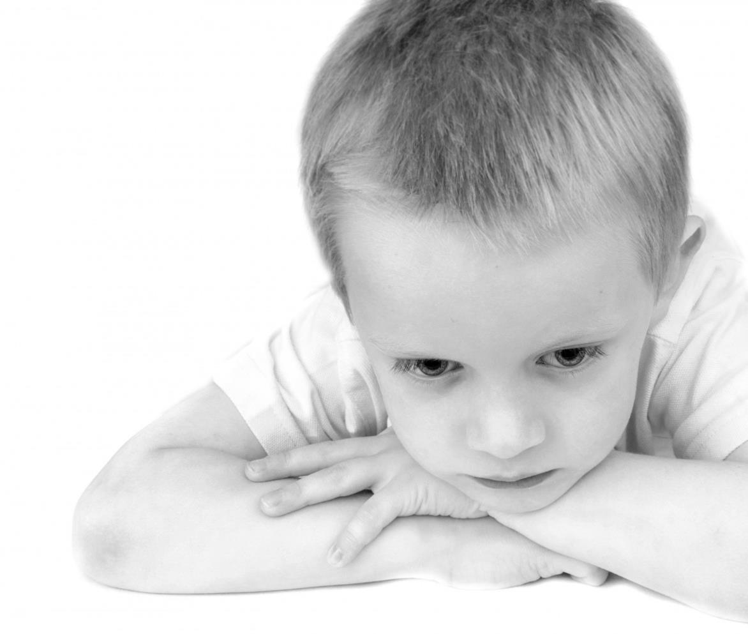
FAMILY CONVERSATION
God knew that even after our baptism,
we would all still sin.
Romans 3:23 says,
“All have sinned and fallen short of the glory of God”,
1 John 1:8 says,
“If any man says he has no sin
he is a liar and the truth is not in him.”

Slide 11
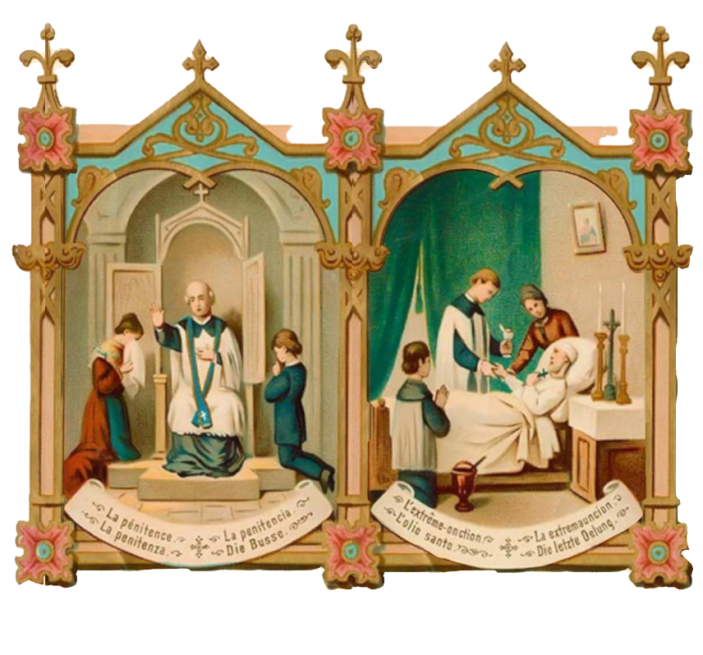
There are Two Sacraments of Healing.
The first is called the Sacrament of Reconciliation, or Confession.
The second is called the
Anointing of the Sick.

Slide 12
MORTAL vs VENIAL SIN
https://www.youtube.com/watch?v=FpQz6AuKPlw
https://youtu.be/eGghX65-9Zg?si=uejgIu9-7tMgjnT6

Slide 13
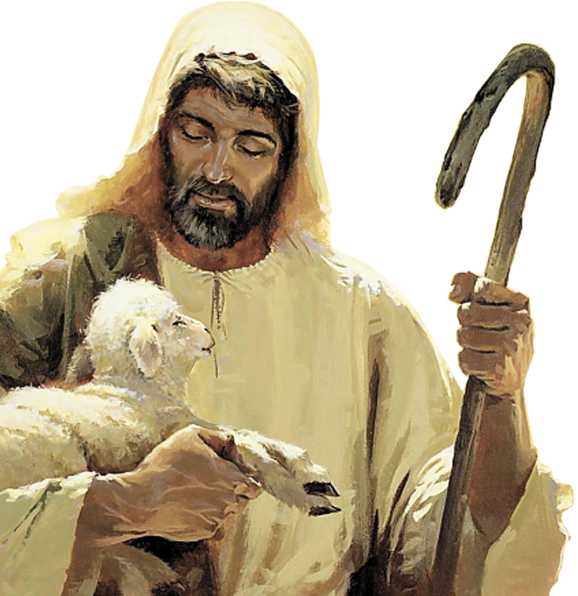
Luke 15:1-10
What man among you having a hundred sheep and losing one of them,
would not leave the ninety-nine in the desert, and go after the lost one
until he finds it?

Slide 14
What did Jesus say happens in Heaven when we confess our sins?
Jesus said that when even one person confesses his/her sins,
says he/she is sorry and turns back to God,
everyone in Heaven, including God Himself, is filled with so much joy,
it is overflowing and there are no earthly words to describe it!

Slide 15
Family Conversation: LECTIO OR VISIO DIVINA
Read: Luke 15:11-32 or Watch: Prodigal Son Video

Slide 16
HOW DO I GO TO CONFESSION?
https://www.youtube.com/watch?v=Ib8pzvnnL20

Slide 17
FAMILY AT-HOME MISSION
Watch the videos about the Sacrament of Reconciliation.
2. Then, together as a family, mark the mantle of your front door with chalk (blessed, if possible) and pray the Family Epiphany Blessing.
3. Be ready to share your Family Epiphany Blessing experience, as well as your front door mantle (take a picture) at Week 3’s gathering of families. (Family Mission Activities adapted from Catholic Digest.)
4. Go to the Sacrament of Reconciliation or make intentional plans to go to the Sacrament of Reconciliation as a family. (When the sacrament is available at your parish?)
5. Get ready to share about your family’s plan to celebrate the Birth of Christ on Christmas Day and during the whole Christmas Season at Week 3’s gathering of families.

Slide 18
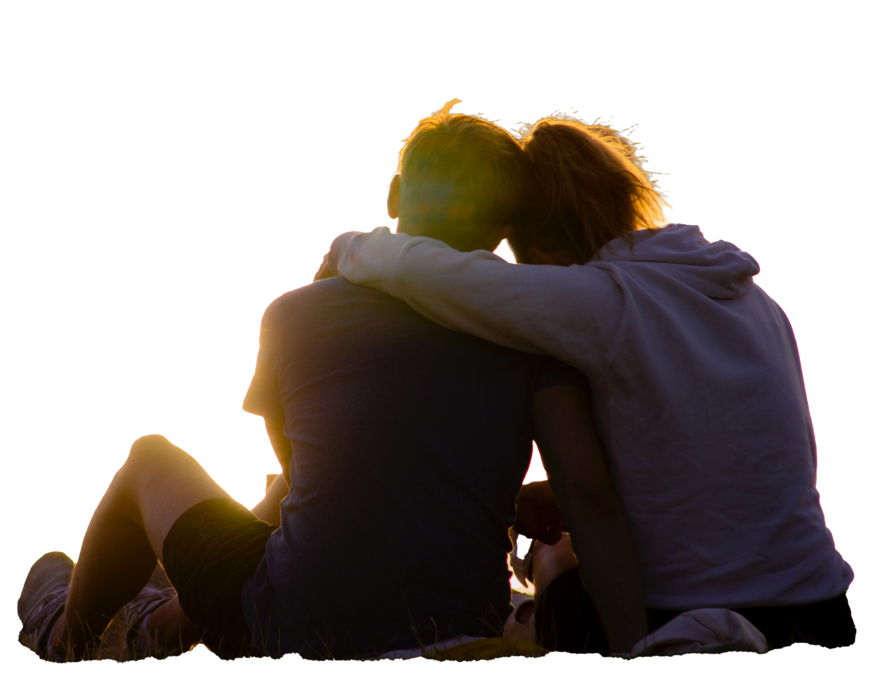
LITANY OF FORGIVENESS
Leader: Blessed are You, Lord our God. We come before You to ask Your forgiveness for all of our failings both great and small. Generous God, You give us so many gifts in life, yet sometimes we forget to share them. And so we say… All: We are sorry.
Leader: Faithful God, You are with us in one another, yet we sometimes refuse to recognize You. And so we say… All: We are sorry.
Leader: God of gentleness, You ask us to bring peace to our family and to the world, yet sometimes we spread anger and trouble. And so we say… All: We are sorry.
Leader: Gracious God, You give us a voice with which to sing, and words to speak, and yet sometimes our words are hurtful or untrue. And so we say… All: We are sorry.
Leader: Loving God, You sent your only Son to show us how to love and serve one another, and yet we sometimes are selfish and unloving. And so we say… All: We are sorry.
Leader: Merciful God, help us to ask forgiveness when we need to. Help us to forgive others who have wronged us. Let us be peacemakers in our school, our work, our church, wherever we go, and especially in our family. We thank You for the gift of Your forgiveness and love. All: Amen.

