Slide 1
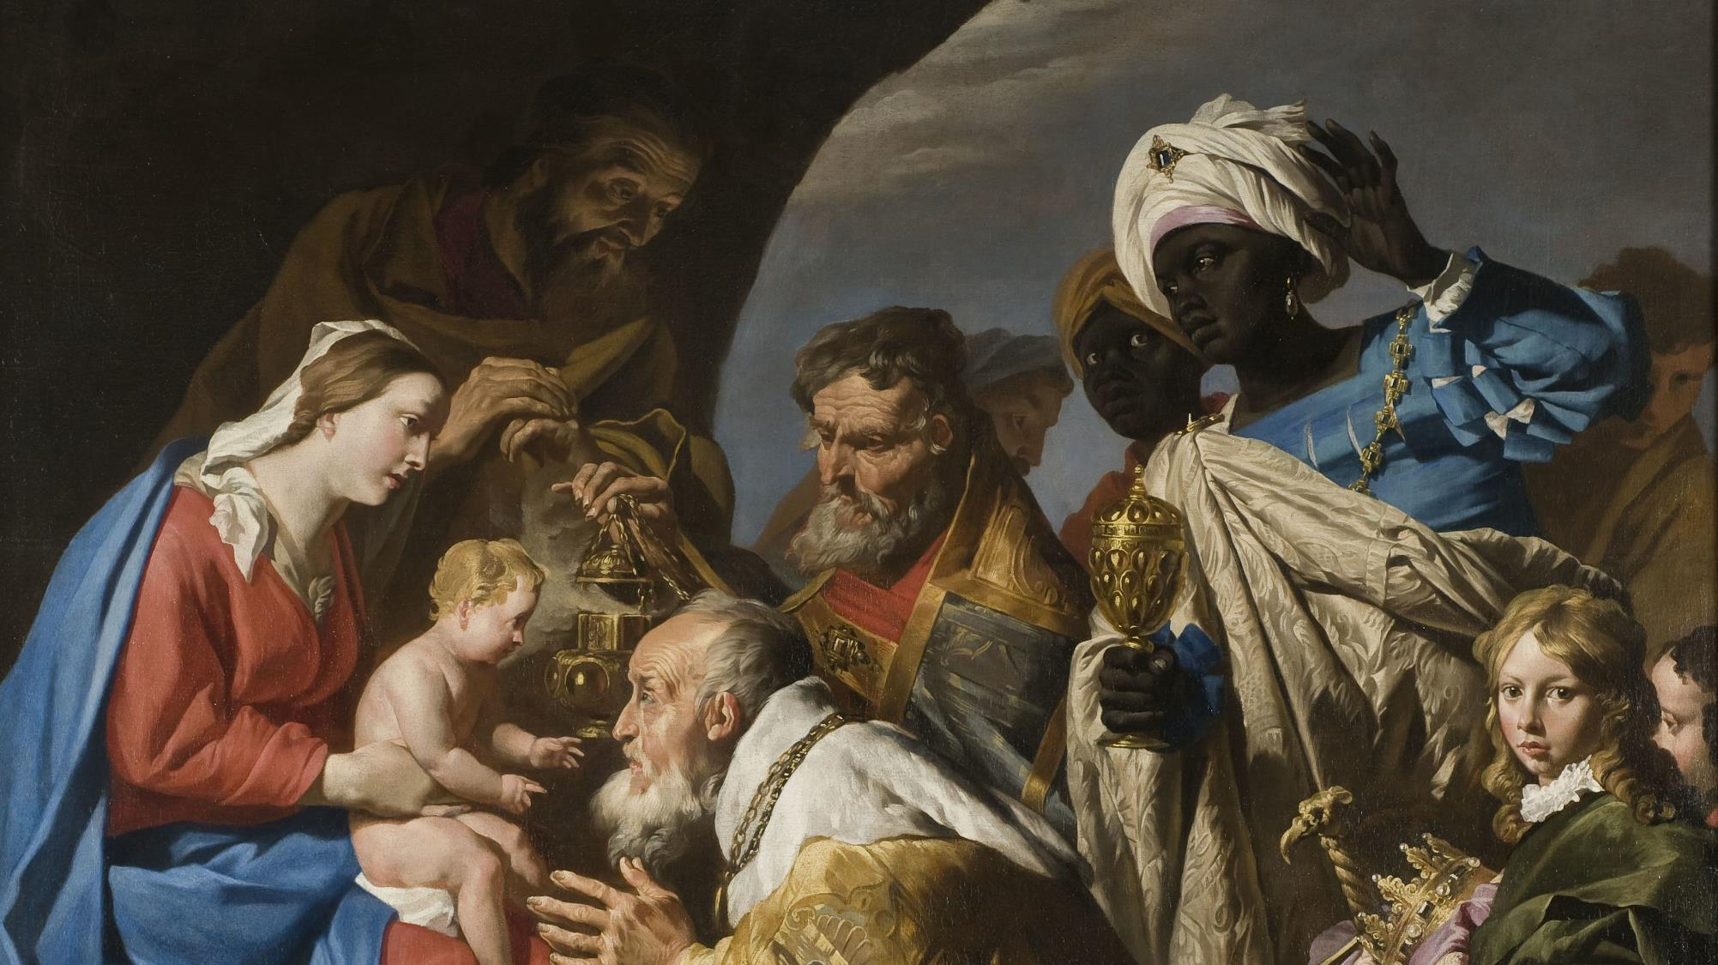
FAMILIES FORMING DISCIPLES Lesson 5 – Week 3

Slide 2
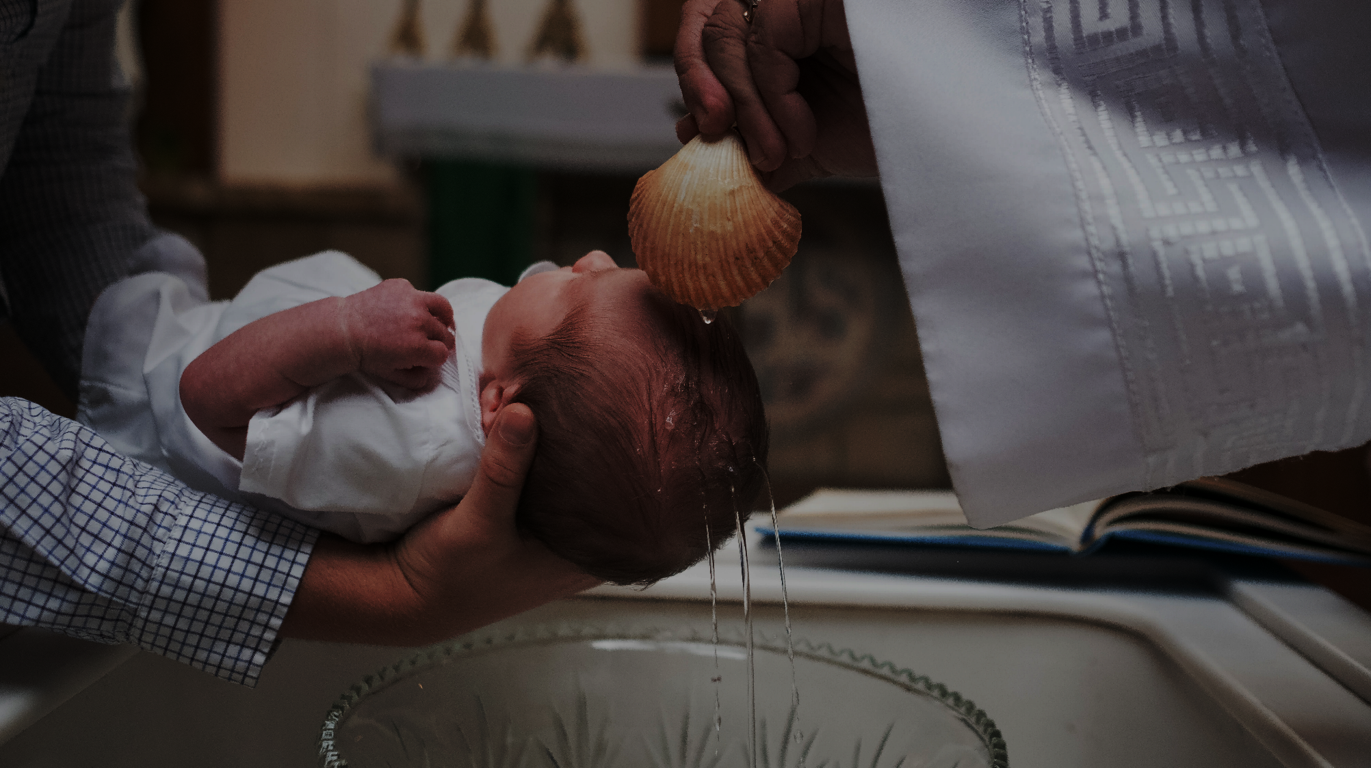
Materials
Holy Water
Baptismal candles/sacramental(s)/ clothing photos

Slide 3
Goals
• To introduce families to the Solemnity of the Epiphany of the Lord and the tradition of the Epiphany blessing/chalking the door
• To reflect on the First Luminous Mystery, the Baptism of the Lord, and on Jesus’ mission
• To explore how we answer God’s call to live our Baptism

Slide 4
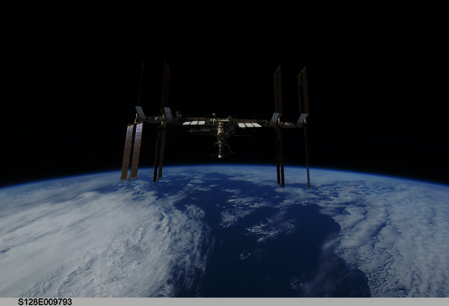
Ice Breaker
Imagine that you are living in a space station. All of a sudden, the space station malfunctions, and you have to evacuate. You are only allowed to take 3 items with you. Which items would you choose?
Participants can share verbally or post their answers in the chat box, explaining why they chose those items.

Slide 5
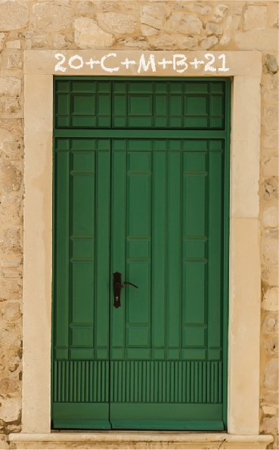
Family Sharing
Family Epiphany Blessing experience
Was this a new tradition for your family?
How did it make you feel, about your family, your home, yourselves?

Slide 6
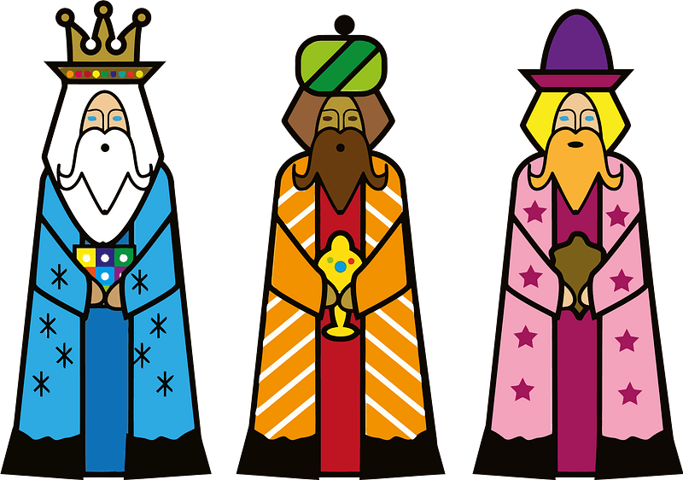
Review
Visit of the Wise Men/Magi
Blessing of the doors of our homes

Slide 7
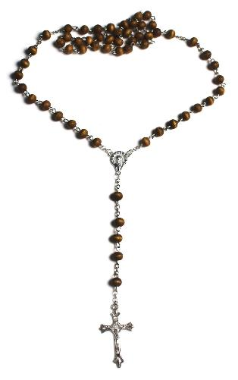
Review
First Luminous Mystery of the Rosary
The Baptism of Jesus

Slide 8
Scripture
Matthew 3:13-17
Then Jesus came from Galilee to John at the Jordan to be baptized by him.
John tried to prevent him, saying, “I need to be baptized by you, and yet you are coming to me?”
Jesus said to him in reply, “Allow it now, for thus it is fitting for us to fulfill all righteousness.” Then he allowed him.
After Jesus was baptized, he came up from the water and behold, the heavens were opened [for him], and he saw the Spirit of God descending like a dove [and] coming upon him.
And a voice came from the heavens, saying, “This is my beloved Son,*with whom I am well pleased.”

Slide 9
The Baptism of Jesus
https://youtu.be/sLBFUuPxrlQ

Slide 10
Family Sharing
Show baptismal mementos and sacramentals
Conversation
• How old were you when you were baptized?
• What do you know about your own baptism?
• If you were baptized as an adult, why did you want to be baptized?
• How do you think you are answering God’s call to live out your baptism?
• Has Jesus helped you to live out your baptism and if so, when or how?
• What do you remember about each of your children’s baptism?
• Why was it important to you that your children be baptized?
• What do you hope for your children as they answer God’s call to live out their baptism and share in Jesus’ mission in the world?
• What do you hope for your parents as they answer God’s call to live out their baptism and share in Jesus’ mission?

Slide 11
Prayer
Blessing each other with holy water
Dear Heavenly Father,
We thank you for loving us and for sending your beloved Son, Jesus, to save us from our sins. Now that we have reflected on the Baptism of Jesus as well as our own baptisms, we ask Jesus with the Holy Spirit to be in our midst. As families we come before to you as we bless one another with holy water in the name of the Father, Son and Holy Spirit.

Slide 12
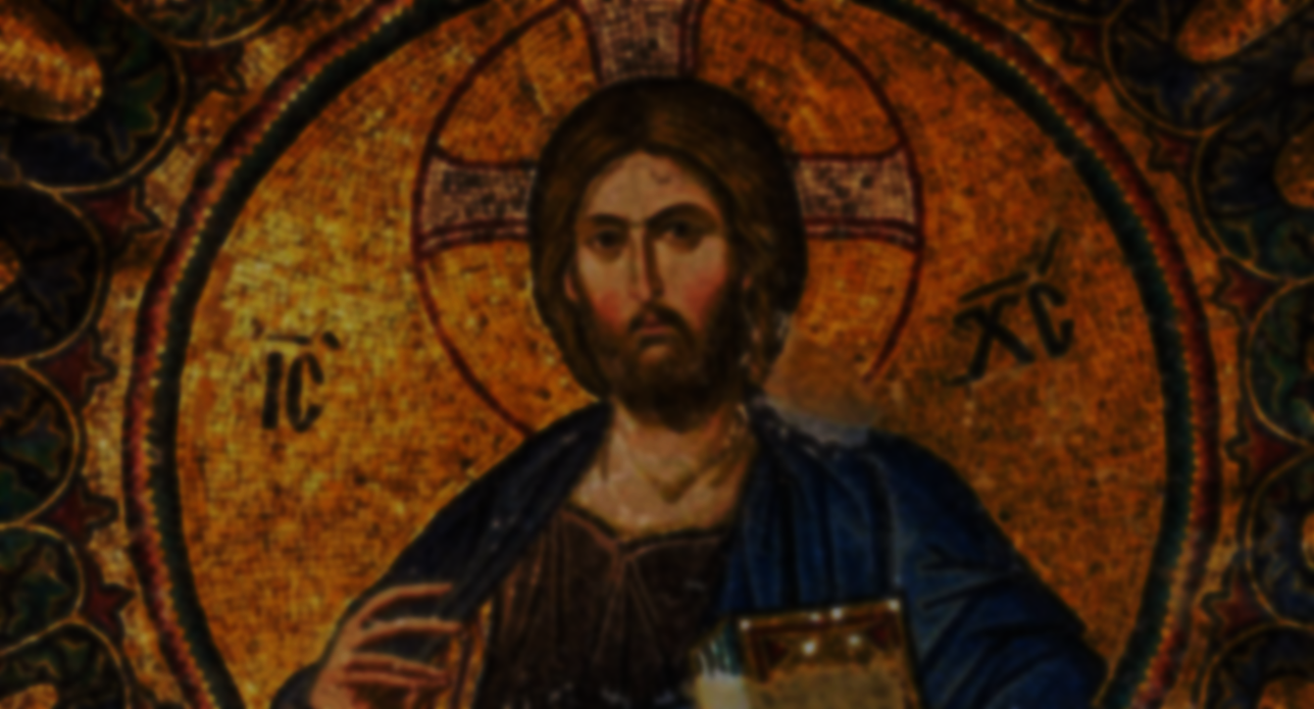
RENEWAL OF BAPTISMAL PROMISES
Leader: Do you reject Satan? R. I do.
Leader: And all his works? R. I do.
Leader: And all his empty promises? R. I do.
Leader: Do you believe in God, the Father Almighty, creator of heaven and earth? R. I do.
Leader: Do you believe in Jesus Christ, his only Son, our Lord, who was born of the Virgin Mary was crucified, died, and was buried, rose from the dead, and is now seated at the right hand of the Father? R. I do.
Leader: Do you believe in the Holy Spirit, the holy Catholic Church, the communion of saints, the forgiveness of sins, the resurrection of the body, and life everlasting? R. I do.
Leader: God, the all-powerful Father of our Lord Jesus Christ has given us a new birth by water and the Holy Spirit, and forgiven our sins. May we always remember who we truly are, God’s beloved sons and daughters in whom He is well pleased. May we live with the Trinity as children of the family of God for ever and ever. R. Amen.

Slide 13
Next Meeting

