Slide 1
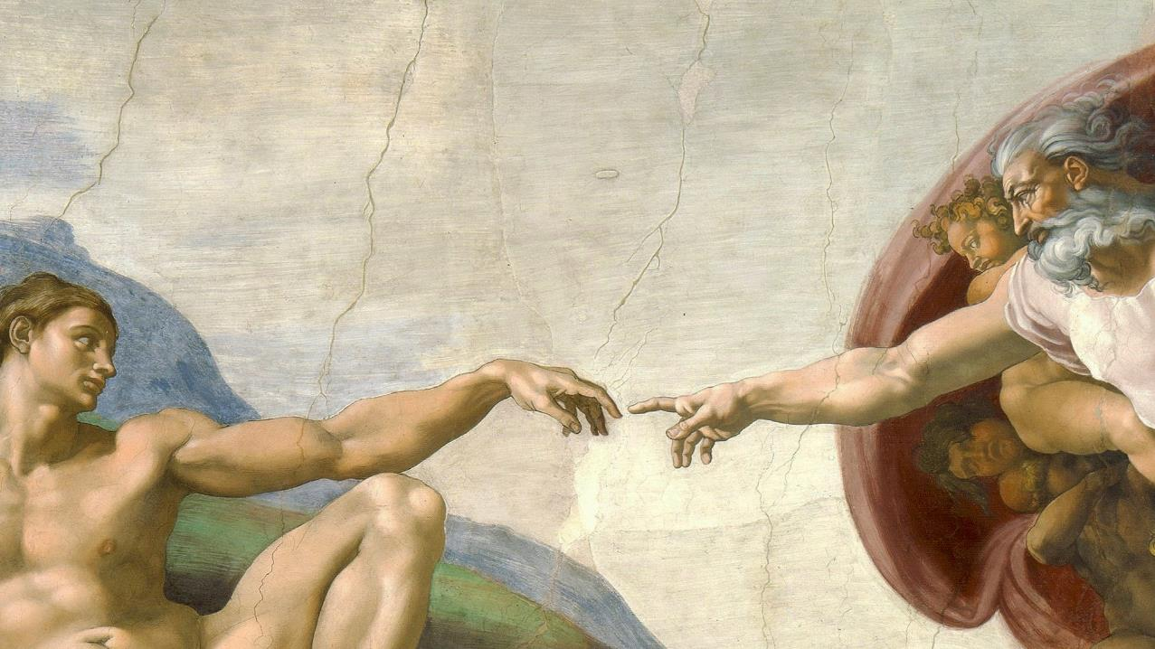
CALLED TO LOVE: THE ADVENTURE OF LIFE IN CHRIST
Topic: God Creates Order and Harmony

Slide 2
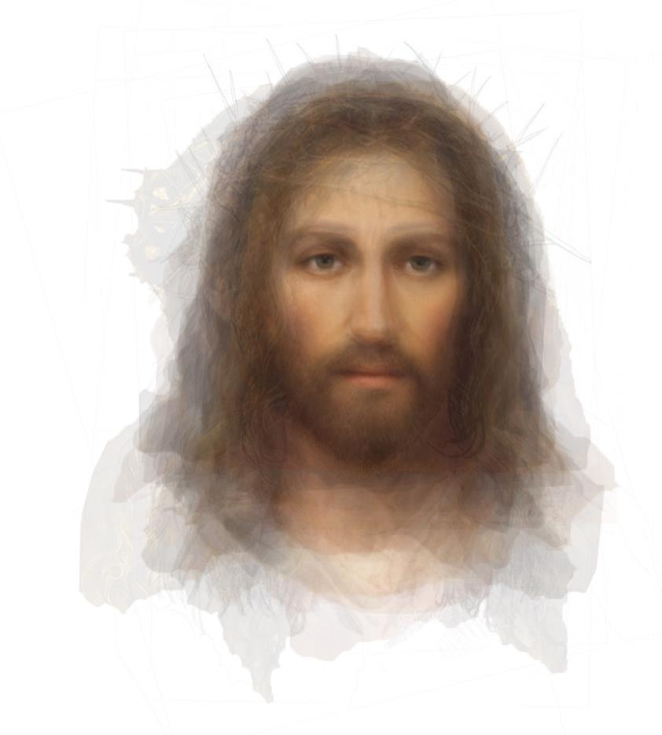
^{Opening Prayer}
Lord Jesus Christ, we entrust our family to You and ask for Your blessing and protection.
We love You Lord Jesus with all our hearts, and we ask that You help our family to become more like the Holy Family.
Help us to be kind, loving, and patient with one another.
Give us all the grace we need to become saints and Your faithful disciples. Amen.

Slide 3
^{Ice Breaker}
Creation Charades
On pieces of paper, write words that are related to the Story of Creation that we have been reading in the Bible, such as: water, plants, stars, sun, moon, man, woman, etc.
Put them in a hat.
Family members take turns drawing a word and acting it out without speaking.
The rest of the family guesses what he/she is trying to convey.

Slide 4
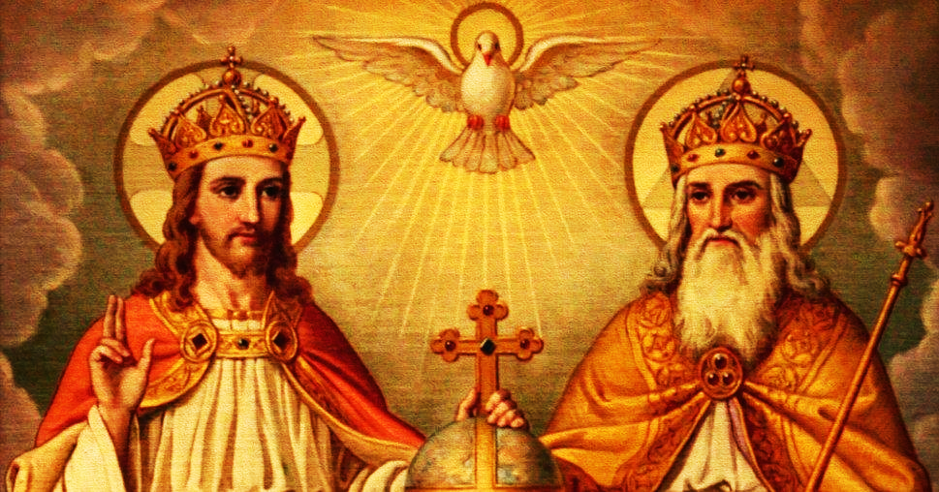
REVIEW
The Book of Genesis teaches us that, “in the beginning God created the heavens and the earth” in a beautiful and orderly way, to make it fit for us to live.
God is a God of order, and God’s order brings us peace, joy and harmony.
He knew His children would need order to live on the earth, to thrive, to be healthy and grow. In the Story of Creation, we see God creating order in the natural world as He was preparing the earth to become our home.

Slide 5
WHAT DOES IT MEAN TO BE HUMAN? | CATHOLIC CENTRAL
https://www.youtube.com/watch?v=1oYUxyNLjX4

Slide 6
FAMILY SHARING
At our last Families Forming Disciples gathering, we read
Genesis 1-2:4,
the
First Story of Creation.
What are some of the important things that happened in that story?

Slide 7
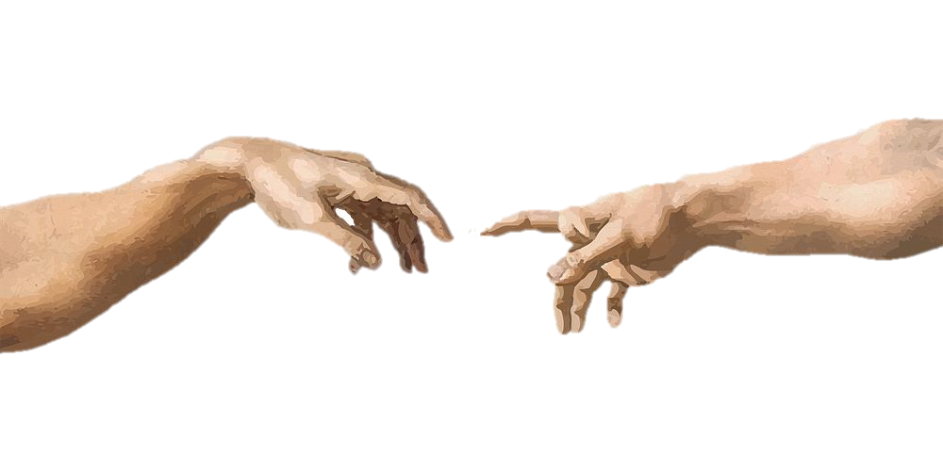
THE SECOND STORY OF CREATION GENESIS 2:4-25
“At the time when the Lord God made the earth and the heavens--while as yet there was no field shrub on earth and no grass of the field had sprouted, for the Lord God had sent no rain upon the earth and there was no man to till the soil,”
“…but a stream was welling up our of the earth and was watering all the surface of the ground—the Lord God formed man out of the clay of the ground and blew into his nostrils the breath of life, and so man became a living being.”
Verses 6 & 7 are describing how God created the first man, Adam, to begin God’s family on earth.
From what material was Adam made?
Water and soil/clay
When did Adam receive from God a soul made in the divine image and likeness of God and come to life?
When God blew into his nostrils the breath of life

Slide 8
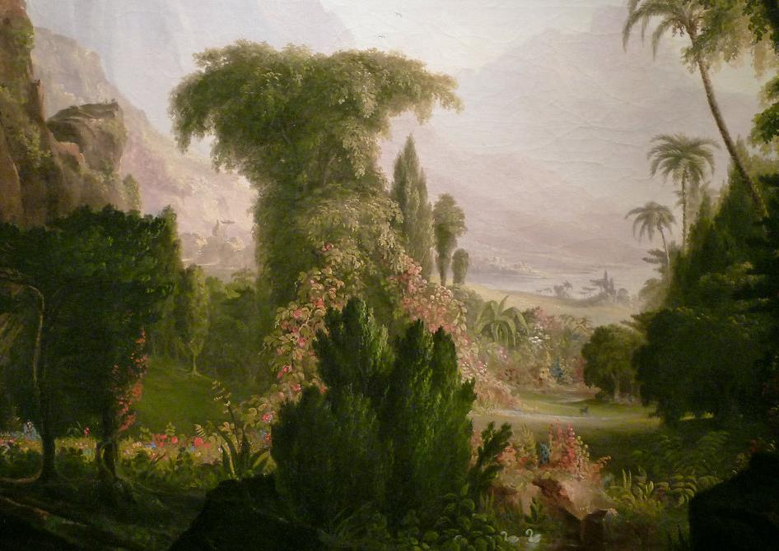
“Then the Lord God planted a garden in Eden,
in the east, and he placed there the man whom he had formed. Out of the ground the Lord God made various trees grow that were delightful to look at and good for food, with the tree of life in the middle of the garden and the tree of the knowledge of good and evil.”
God gave Adam a home, where He would be with Adam, called Eden. Eden had all kinds of trees for food.
God placed two very important trees in the middle of the Garden of Eden.
What are the names of those two trees?
The Tree of Life and the Tree of the Knowledge of Good and Evil
Because God was there, all of Eden was holy.
However, the middle of Eden, where these two trees were planted, was the holiest place in the entire garden.
This Photo by Unknown Author is licensed under CC BY-SA-NC

Slide 9
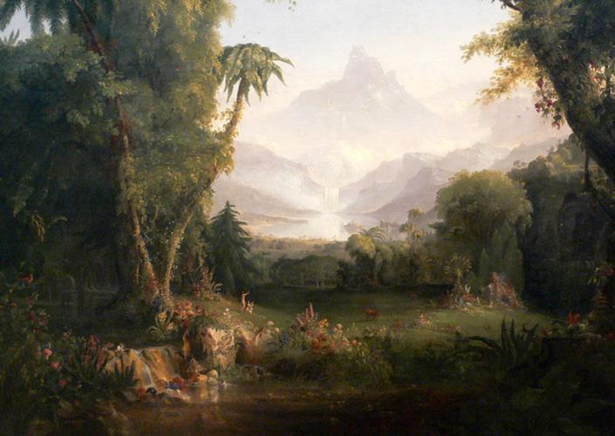
vs 15: “The Lord God then took the man and settled him in the garden of Eden, to cultivate and care for it.”
Adam was created to be the high priest of this holy place, the Garden of Eden. It was his job as high priest, to till the soil to help it to grow and to protect it, so everything and everyone in the garden would thrive according to God’s will!
vs. 16 & 17: “The Lord God gave man this order: ‘You are free to eat from any of the trees of the garden except the tree of the knowledge of good and evil. From that tree you shall not eat; the moment you eat from it you are surely doomed to die.’”
Being made in God’s image and likeness meant that Adam had a free will. He was a beloved child of God!
St. Luke writes in Lk 3: 38: “Adam, (was) the son of God.”

Slide 10
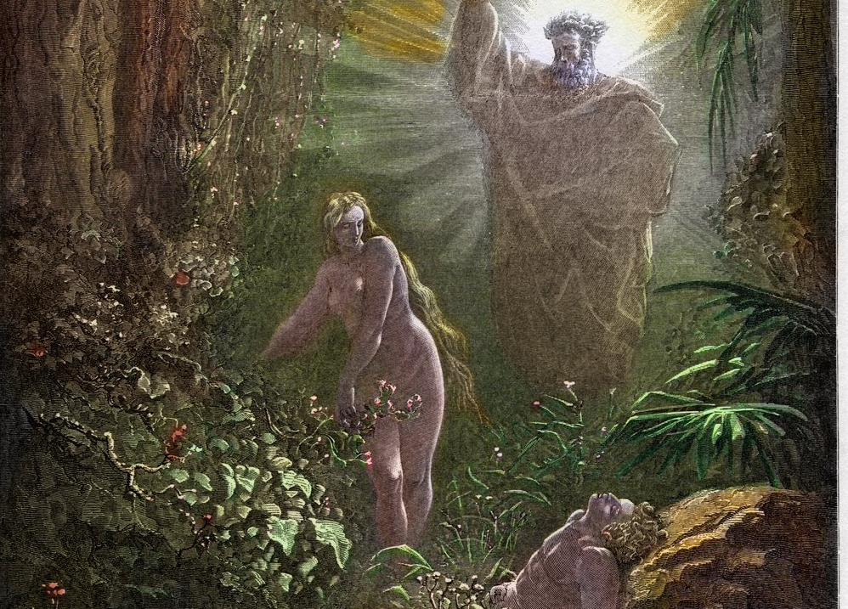
vs 18: “The Lord God said: It is not good for the man to be alone. I will make a suitable partner for him.”
What is different about this statement from God when compared to the First Story of Creation?
It’s the first time God says something is not good, not His will.
Therefore, it was not God’s will for Adam to be alone without a suitable partner. God created a woman, Eve, to be Adam’s partner.
Read vs 19-25 “That is why a man leaves his father and mother and clings to his wife, and the two of them become one body [RSVCE: one flesh].”

Slide 11
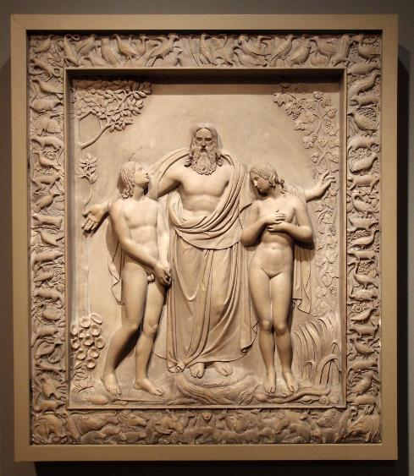
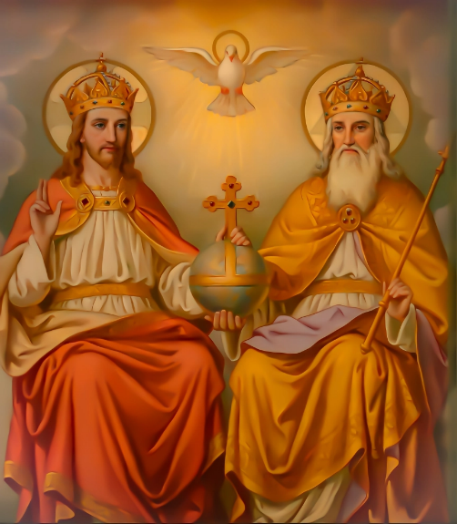
The man and the woman are two persons, but in God’s eyes that see the truth about everything, they are one flesh—two persons united in communion.
Who else have we learned about that is three Persons, but One?
The Holy Trinity
This is another way in which God’s children are created in His divine image and likeness! Male and female are made for each other, to form a communion of persons that reflects something of the communion of Divine Persons, (even though we must remember the great difference between God and everything else, including ourselves).

Slide 12
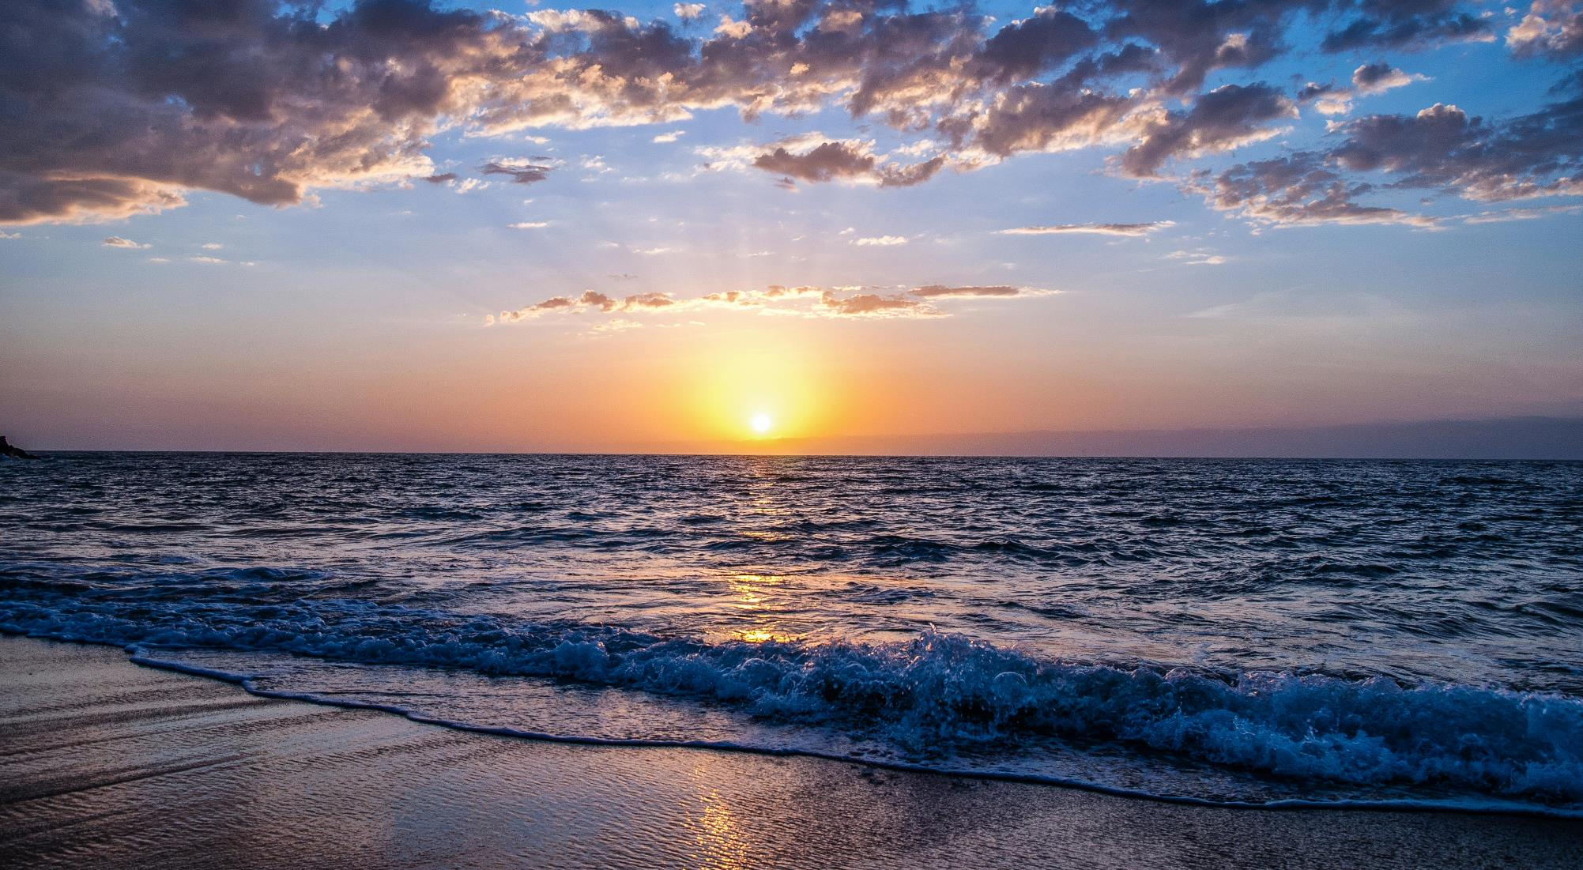
FAMILY ACTIVITY
Is My Life in God’s Order of Love?
Through the Stories of Creation, we have learned that God is a God of order
and order brings us peace, joy and harmony!
We find God’s order everywhere, in nature, the universe, seasons, etc…
Because we are God’s children created in His image, we need God’s order of Love in our lives to be happy.
This especially applies to how each one of us lives.

Slide 13
FAMILY ACTIVITY
Are we choosing to live in God’s order of love?
On a sheet of paper, write these words and put them in God’s order of Love for your vocation—who you are right now.
Prioritize them by numbering each one to show which should come first, second, third, etc.…
Recreation/ Fun/ Spouse/ Children/ Job/ God/ Extended family/ Friends/ Health/ Siblings/ School

Slide 14
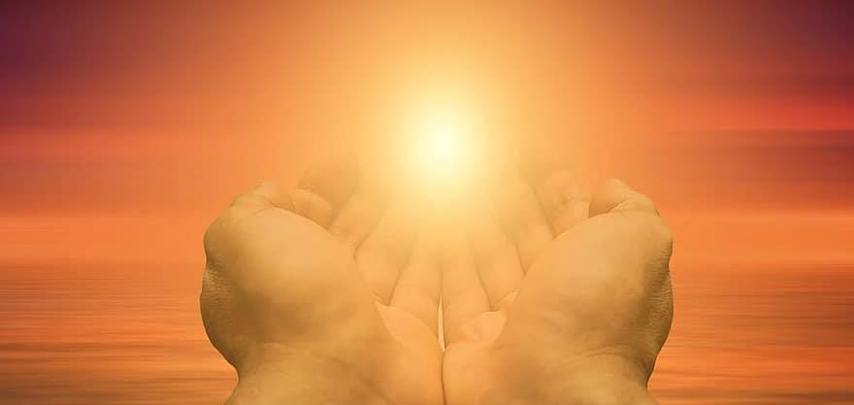
FAMILY ACTIVITY
None of us is perfect and from time to time, we all need to sit with our Lord, look at our lives, and ask God where He sees it is good, and what areas are not according to His will.
Ask yourself if the way you spend your time is in sync with God’s Order of Love on your priority list.
If so, great! If not, what could God be calling you to change?

Slide 15
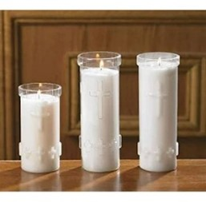
FAMILY SHARING/All Souls Day Activity

Slide 16
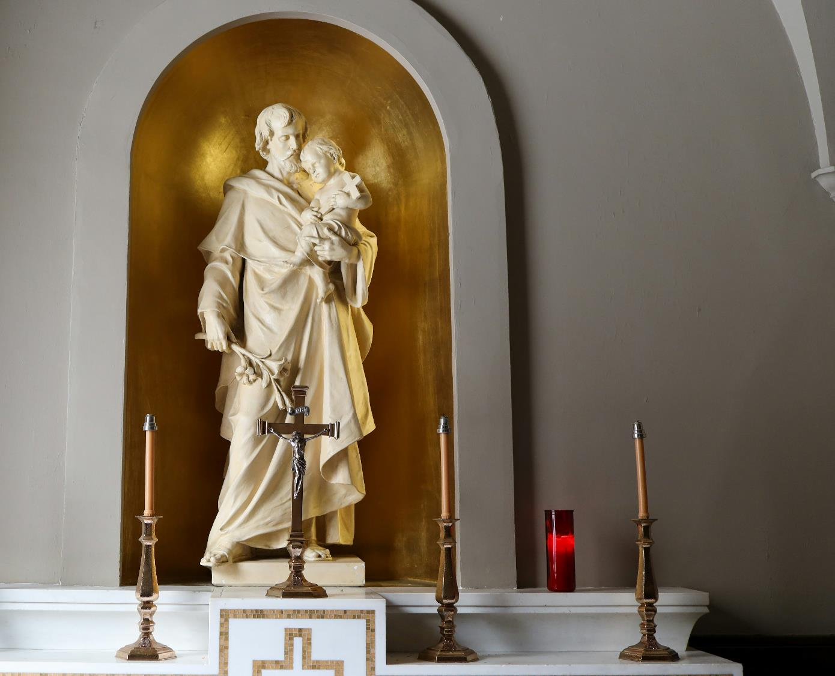
All Souls Novena to St. Joseph
O Lord God,
by the Precious Blood which Jesus,
Your divine Son,
shed upon the Cross this day,
deliver the souls in Purgatory,
particularly those souls nearest to me and for whom I should pray,
that they may come quickly into Your glory to praise and bless You forever.
Our Father . . ., Hail, Mary . . .,
Eternal rest grant to them, O Lord.
And let perpetual light shine upon them.
May their souls and the souls
of all the faithful departed,
through the mercy of God, rest in peace.
St. Joseph, patron of the dying and of the universal Church, pray for us. Amen.

