Slide 1
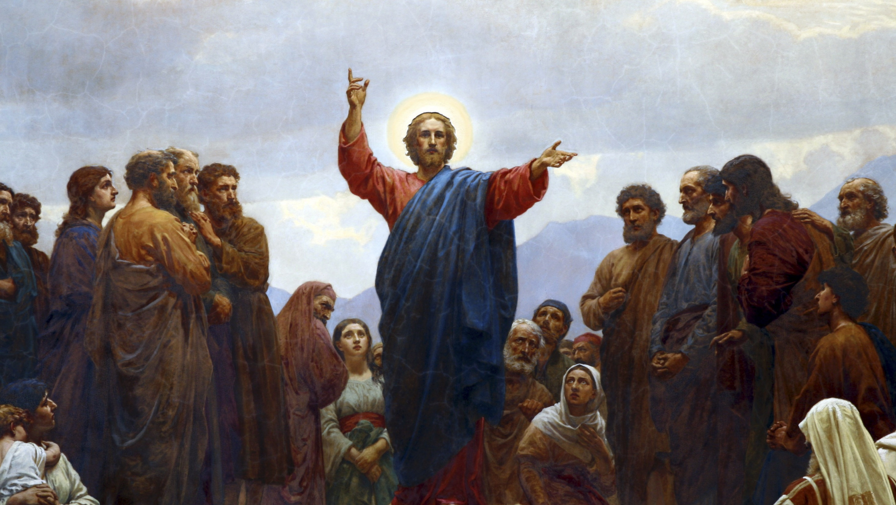
THE LIFE OF CHRIST: THE LUMINOUS MYSTERIES
THE PROCLAMATION OF THE GOSPEL

Slide 2
^{Opening Prayer}
Lord Jesus Christ, we entrust our family to You and ask for Your blessing and protection. We love You Lord Jesus with all our hearts and we ask that You help our family become more like the Holy Family. Help us to be kind, loving, and patient with one another. Give us all the grace we need to become saints and Your faithful disciples.
Amen.

Slide 3
^{Ice Breaker}
WHICH DO YOU LIKE BETTER?
Make two lines on the ground, one at either end of the room.
The families will stand in the middle of the room.
The facilitator will call out two words while pointing to each line.
The families then have to choose which category they like better and go stand on the corresponding line.

Slide 4
THE GOOD NEWS
Read Isaiah 52:7
OR Watch: Gospel of The Kingdom
(up to 4:46) https://www.youtube.com/watch?v=xmFPS0f-kzs
Think about who fulfills this passage by bringing THE Good News!
Jesus brings the good news in His words, actions, and very person. He is the Good News!

Slide 5
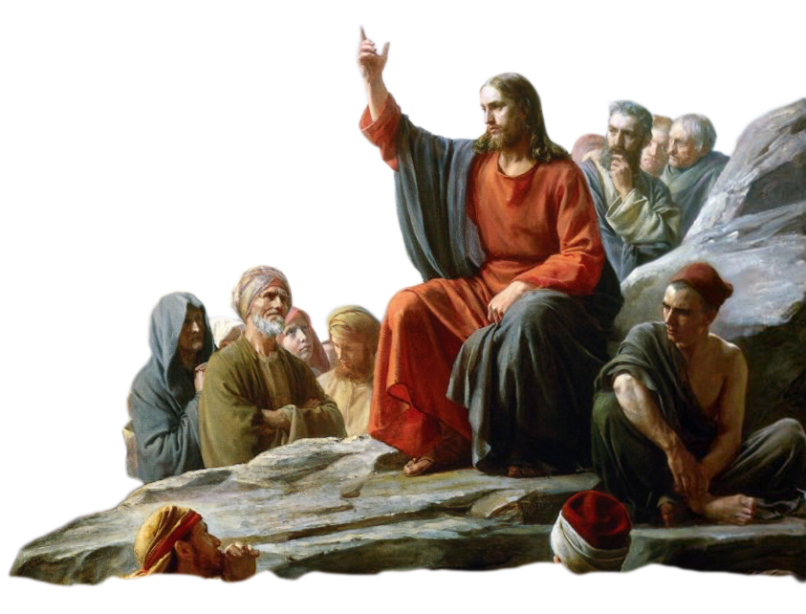
TODAY’S TOPIC
Today we will learn about the Third Luminous Mystery of the Rosary,
The Proclamation of the Kingdom of God.
We will learn about how Jesus proclaimed that the Kingdom of God is at hand, who, where and what is the Kingdom of God, and
how we can proclaim it!

Slide 6
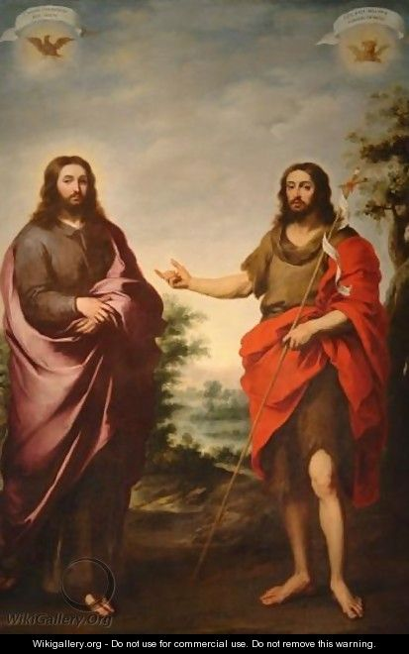
THE KINGDOM OF GOD?
Open up your bibles to Matthew 3:1-3.
Let’s read what St. John the Baptist said about the Kingdom of God.
What was John saying about how to prepare for the coming of the
Kingdom of Heaven?

Slide 7
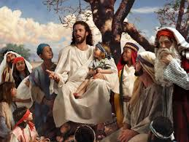
THE KINGDOM OF GOD
In the New Testament, the Kingdom of God or the Kingdom of Heaven is mentioned 120 times.
Ninety-nine times it is written about in the Gospels, which are the books of Matthew, Mark, Luke and John.
Ninety times Jesus Himself speaks about it.

Slide 8
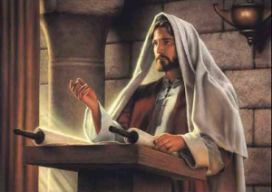
THE KINGDOM OF GOD
“The Spirit of the Lord is upon me, because he has anointed me to bring glad tidings to the poor. He has sent me to proclaim liberty to the captives and recovery of sight to the blind, to let the oppressed go free, and to proclaim a year acceptable to the Lord.”
Jesus was saying that He is the Kingdom of God!

Slide 9
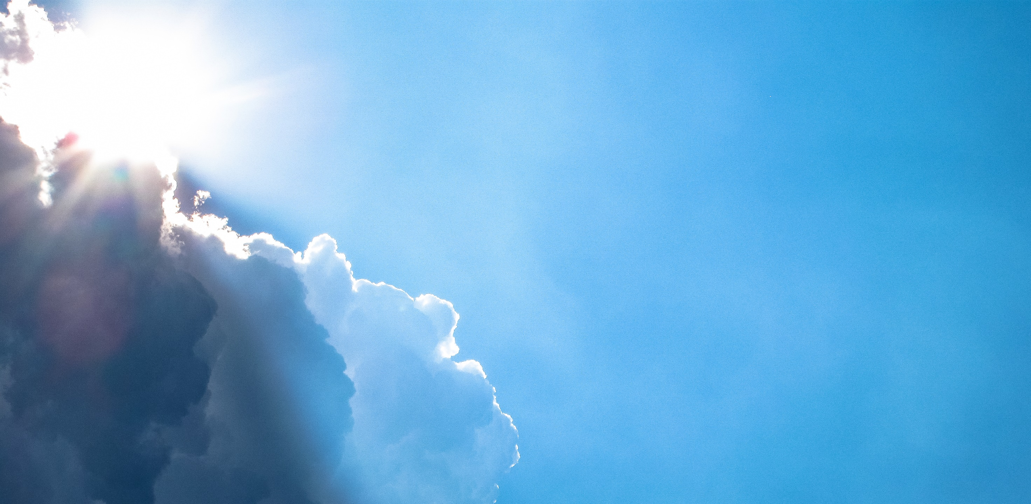
THE KINGDOM OF GOD
Who?
Where?
What?
Is the Kingdom of God?

Slide 10
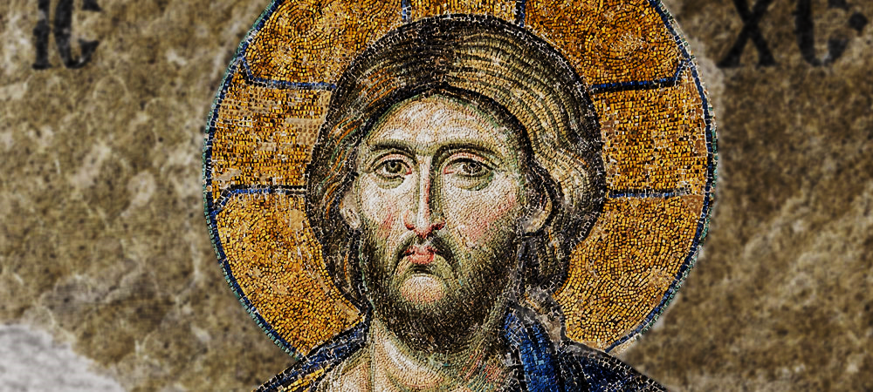
WHO?
Jesus is the Kingdom of God

Slide 11
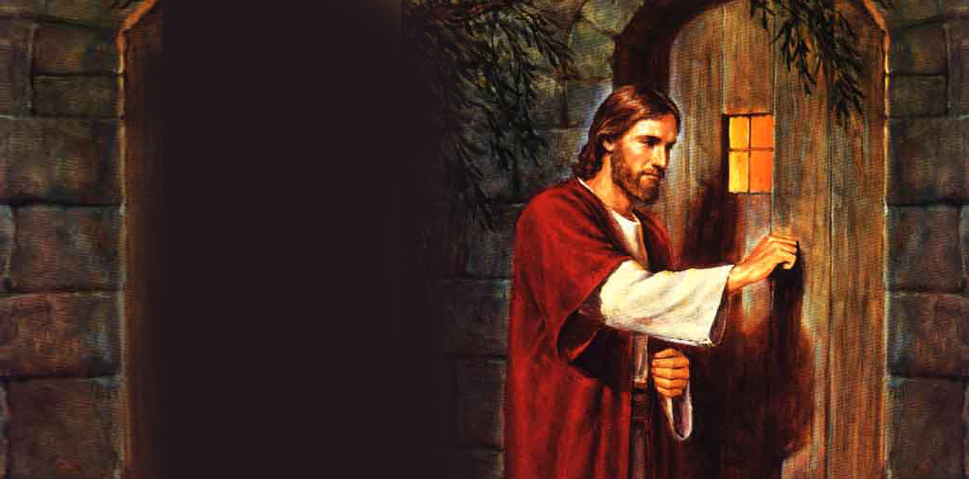
WHERE?
The Kingdom of God lives inside each one of us,
within
our hearts!

Slide 12
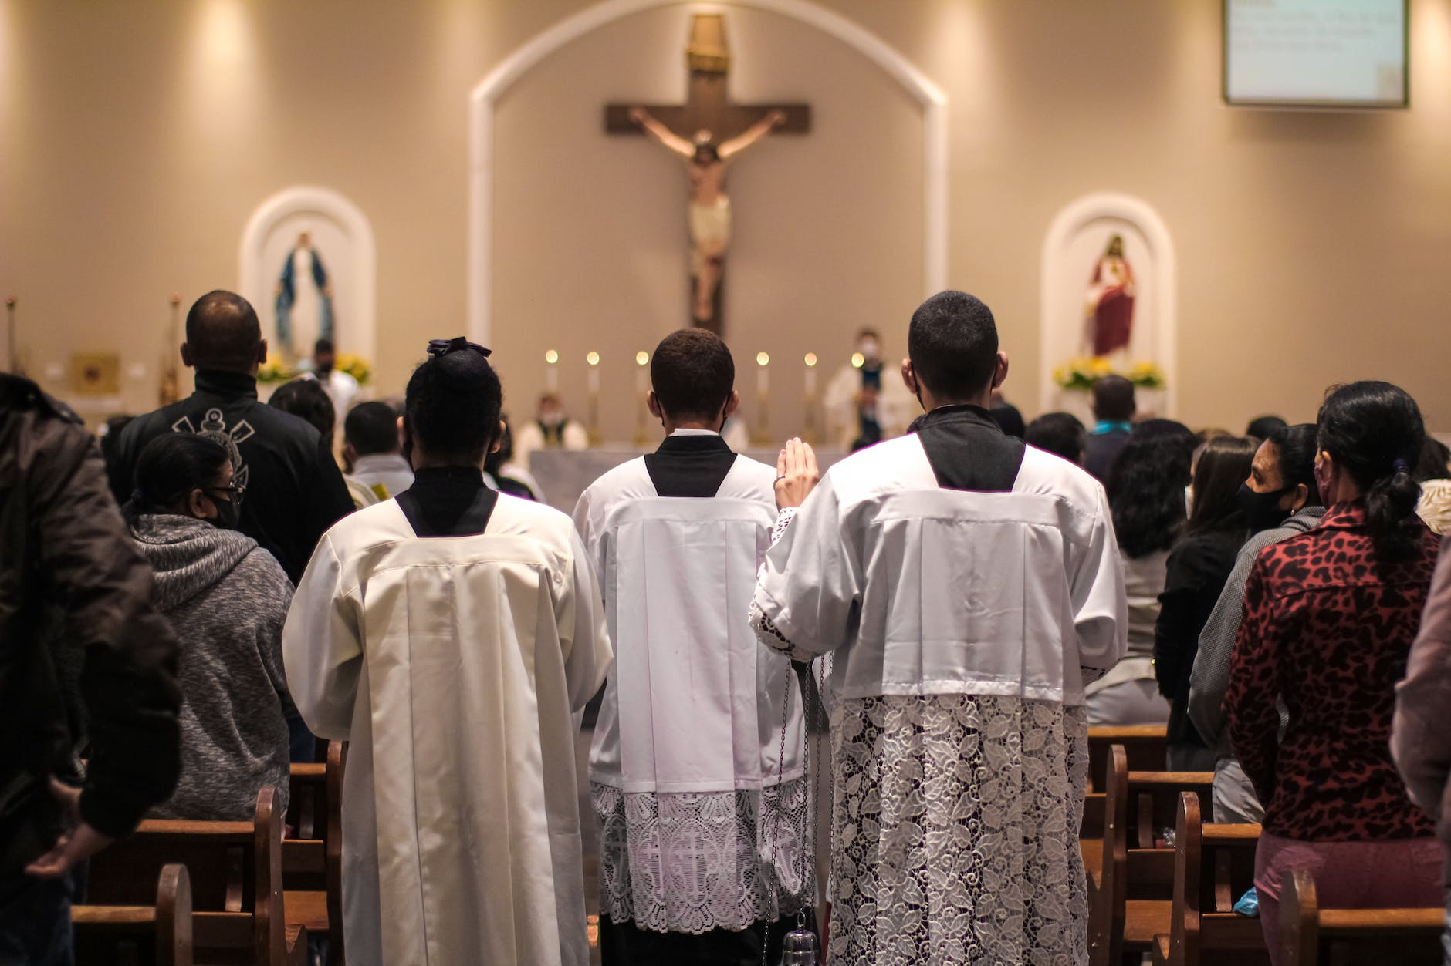
WHAT?
The Kingdom of God is in and through the Church in the here and now!
Jesus came to redeem us and save us from our sins so we could be with Him forever, in communion with the Father, Son, and Holy Spirit.
God knew that we would need to see Him, feel Him, and to be as close to Him as we possibly can get. So, He gave us a Church, the Catholic Church, which gave us the Holy Scriptures and Sacraments, as ways for us to participate in the Kingdom of Heaven while we are still on earth.
In this way, the Church is the “seed and beginning” of the Kingdom of God to be fully completed or realized at the end of time in Heaven.

Slide 13
GOD’S STORY: SERMON ON THE MOUNT
https://www.youtube.com/watch?v=Ze7w3-BL3OM

Slide 14
FAMILY CONVERSATION
The Kingdom of Heaven belongs to such as these:
Poor in spirit
Mourning
Meek
Hunger and thirst for righteousness
Merciful
Clean of heart
Peacemakers
Persecuted for the sake of righteousness
Suffer for believing in Jesus
Looking at the list of characteristics of those to whom the Kingdom of Heaven belongs:
In what ways can you see those characteristics of love and sacrifice in each member of your family?
How does your family proclaim the Kingdom of God?
What can you do this Advent to proclaim the Kingdom of God?

Slide 15
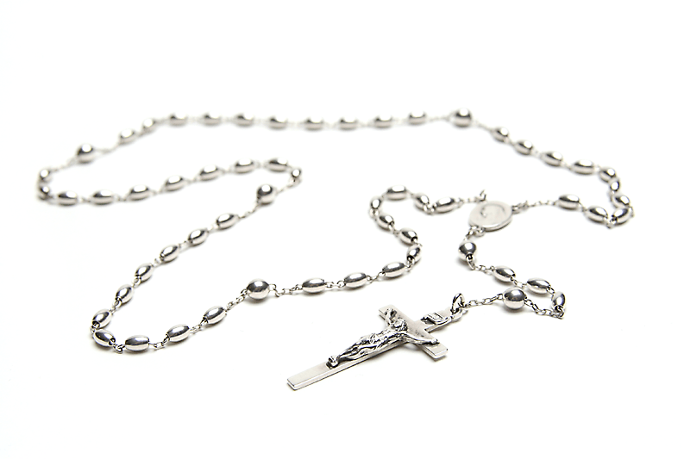
FAMILY MISSION
Your Family At-Home Mission is to: read the article,
watch the videos, and
make a plan for how your family will proclaim the Kingdom of God this Advent/ Christmas Season!
The meditating on the Third Luminous Mystery of the Rosary,
pray a decade together as a family around your home altar.

Slide 16
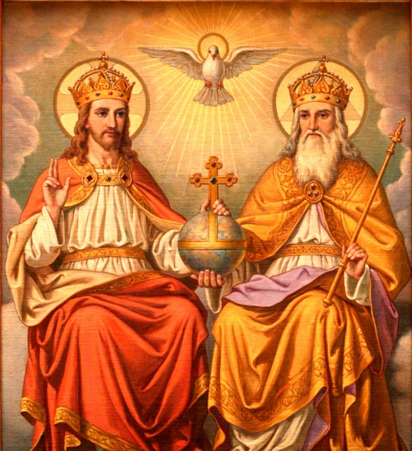
CLOSING PRAYER: The Lord’s Prayer

