Slide 1
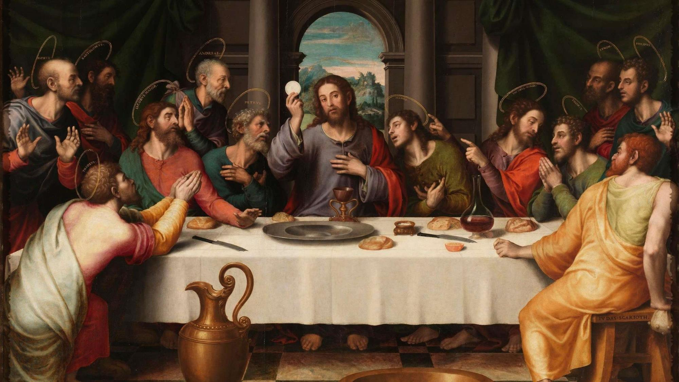
FAMILIES FORMING DISCIPLES
^{Lesson 7 – Week 3}

Slide 2
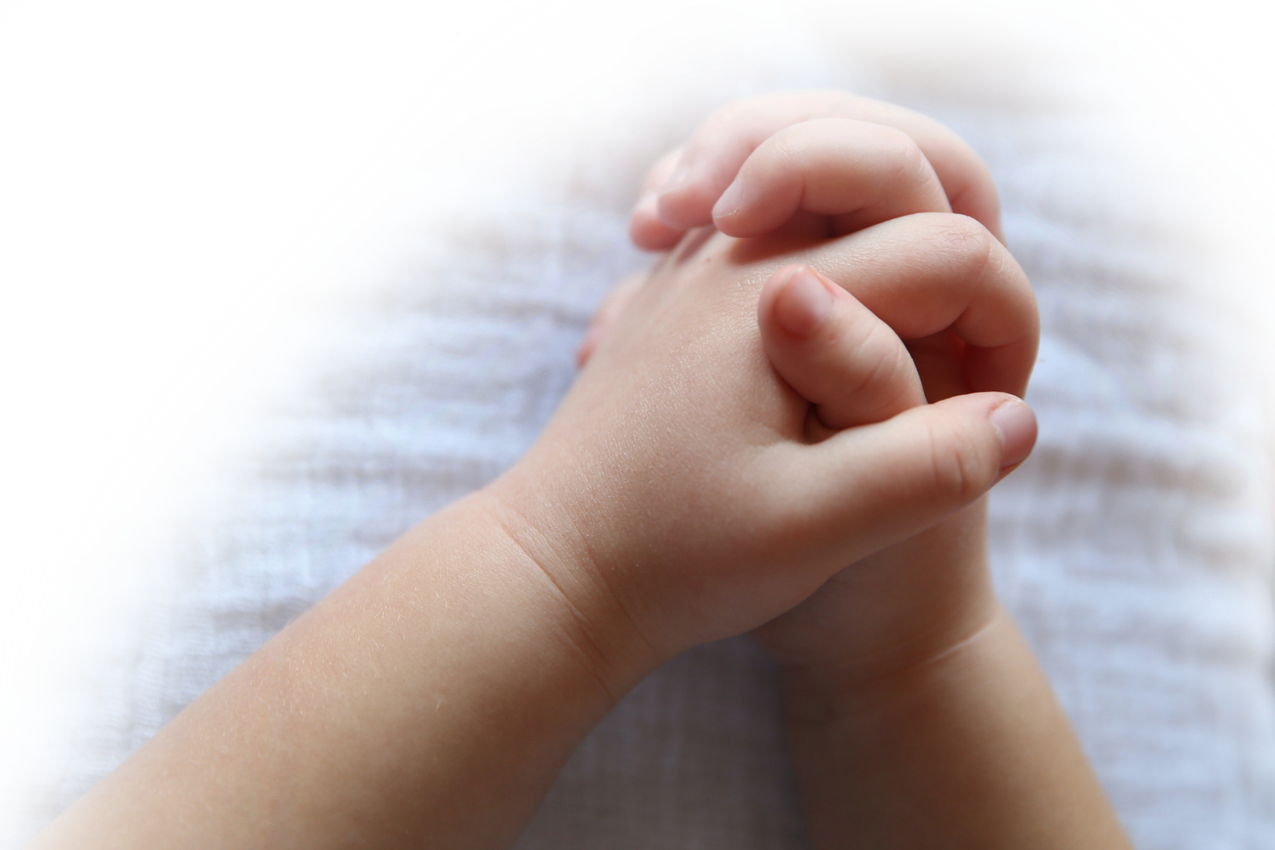
^{Opening Prayer}
Come, Holy Spirit, and be with our families as we seek to know you, learn from you and love you more. Fill us with your presence. Be our guide just as You led Jesus, for we too seek to follow in His footsteps and do the Father’s will. Be with us, O’ Holy Spirit of Peace. Glory be,…

Slide 3
Materials
4 pieces of paper and a marker per family
Sweet treats for winners and/or everyone after the Catholic Jeopardy (possibly to be eaten on a Sunday during Lent)
Stations of the Cross pamphlet

Slide 4
Ice Breaker
If you could travel to any place in the world, where would you go?

Slide 5
Family Sharing
Remember your stones where you wrote your Lenten goals in the areas of prayer, fasting, and almsgiving? How are your Family Lenten Plans going?

Slide 6
Content
The first question is:
What is so special about Holy Week?

Slide 7
Content
The second question is:
On what day does Holy Week begin?

Slide 8
Content
The third question is:
What does Sacred Triduum mean?

Slide 9
Content
The final question is:
What two important events happened at the Lord’s Last Supper on Holy Thursday?

Slide 10
Family Sharing
Please share about your
Family Holy Week Plan

Slide 11
Good Friday
Watch: Good Friday by Catholic Central
https://www.youtube.com/watch?v=h4K8tOQdbM8

Slide 12
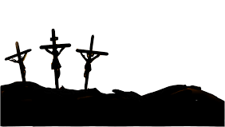
Family Sharing
Has there been a moment or difficult time in your life when you were filled with sadness or despair, and now as you look back on it, you can see that God was there?

Slide 13
Stations of the Cross
https://www.youtube.com/watch?v=3sLUphJlF7I

Slide 14
Easter Eggs in the Bible
Watch Easter Eggs in the Bible by Tweeting with God
https://youtu.be/0eF2yfYiR-k

Slide 15
Closing Prayer
Whose Feast Day we celebrate on March 17th?
In the name of the Father, and of the Son, and of the Holy Spirit. Amen
Christ be with us
Christ be within us
Christ behind us
Christ before us
Christ beside us
Christ to win us
Christ to comfort and restore us
Christ beneath us
Christ above us
Christ in quiet
Christ in danger
Christ in the hearts of all who love us
Lord, we thank you for bringing us together. We ask that you bless and keep us until we gather in your name again. Amen. Glory be…
(Adapted from St. Patrick’s Breastplate)

Slide 16
Next Meeting

