Slide 1
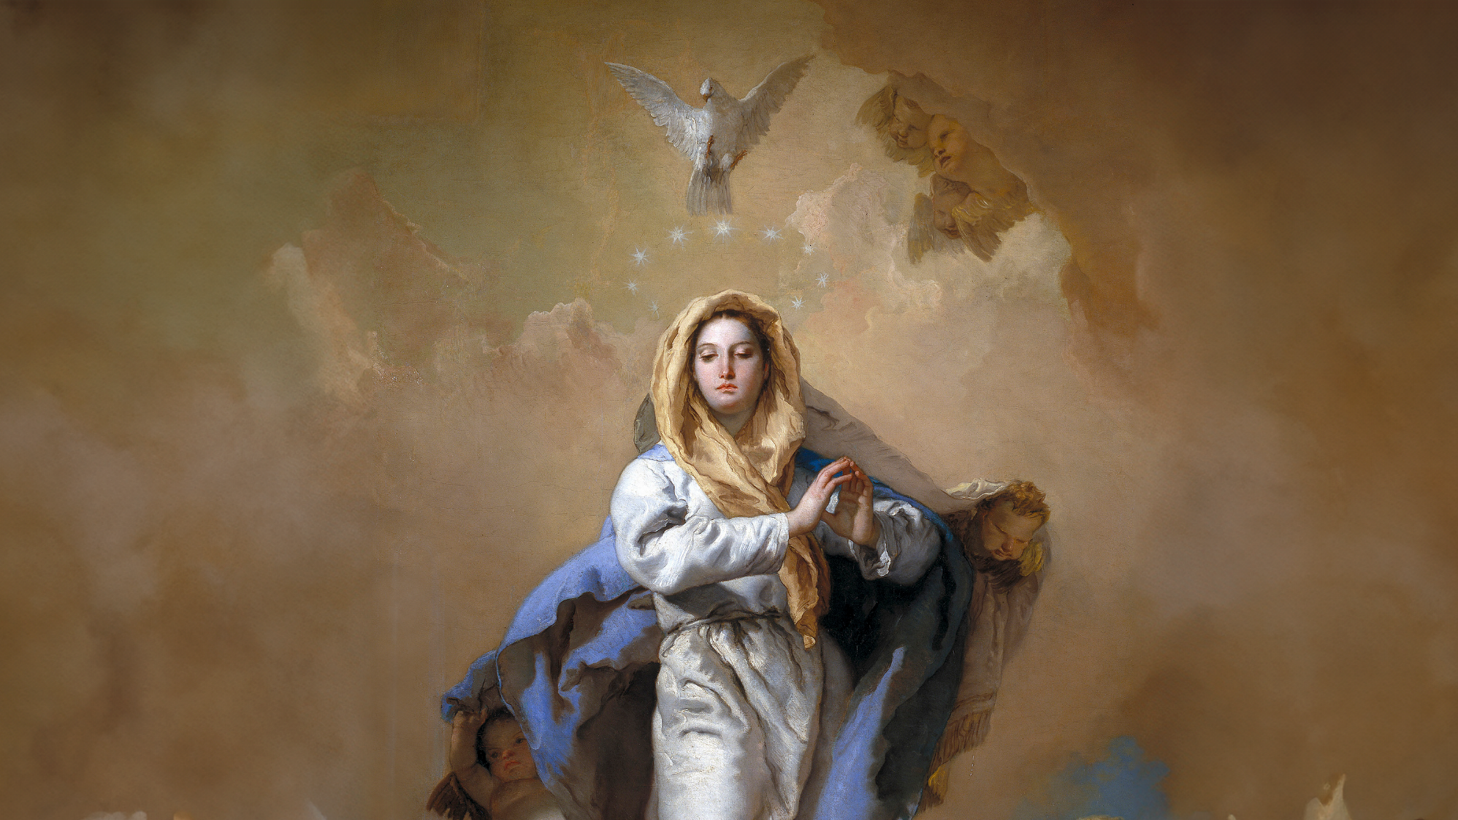
CALLED TO LOVE: THE ADVENTURE OF LIFE IN CHRIST
Topic: God’s Plan to Save Us!
The Chosen People - Immaculate Conception - God’s Rescue Mission

Slide 2
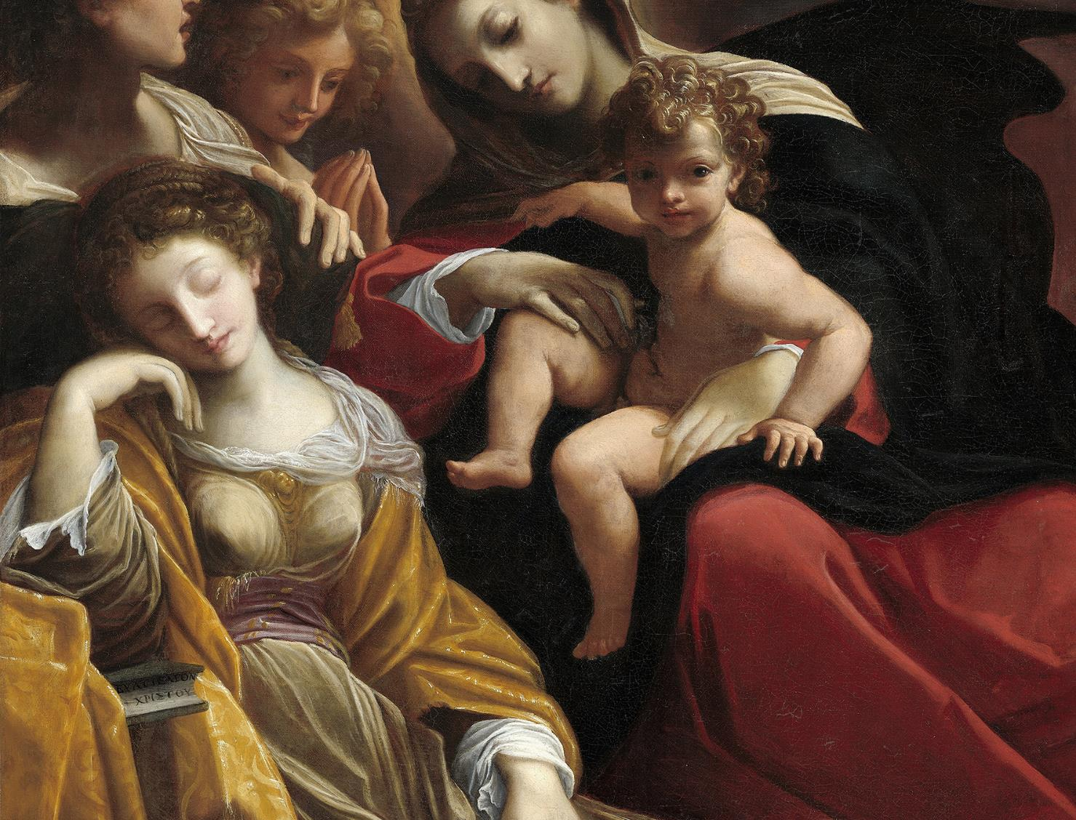
^{OPENING PRAYER}
Lord Jesus Christ, we entrust our family to You and ask for Your blessing and protection.
We love You Lord Jesus with all our hearts, and we ask that You help our family to become more like the Holy Family.
Help us to be kind, loving, and patient with one another.
Give us all the grace we need to become saints and Your faithful disciples. Amen.

Slide 3
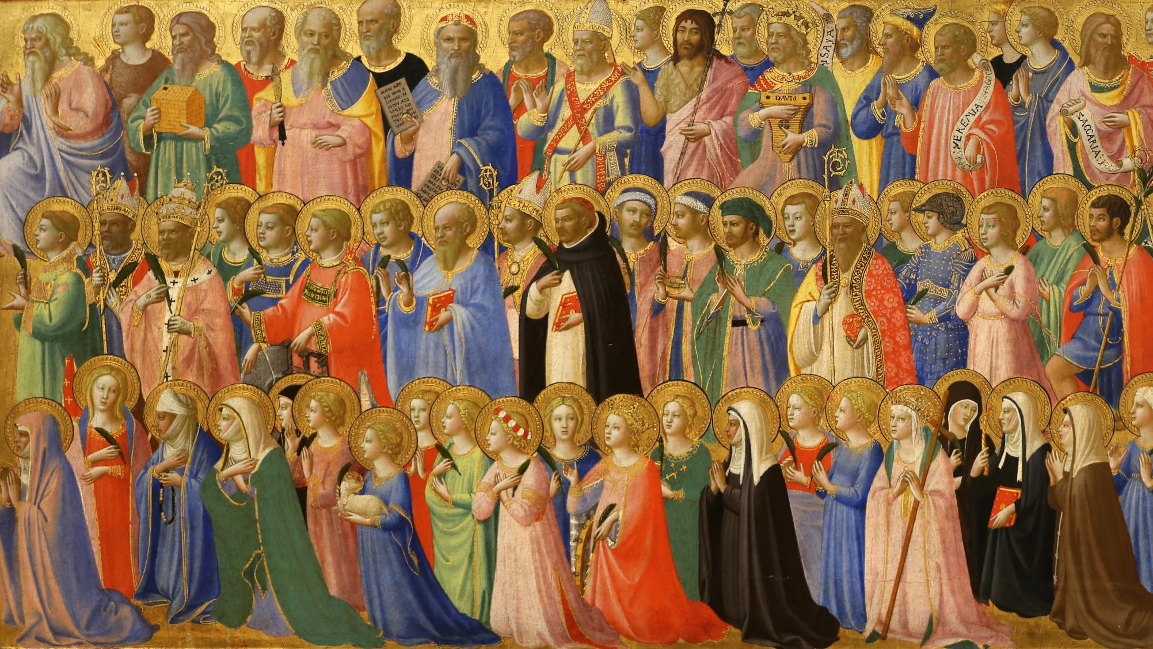
^{Ice Breaker}
ICE BREAKER
Name that Saint!
Family members take turns spelling the names of their favorite saint from Tradition or the Bible by forming shapes of the letters with their bodies.
As others call out each letter, write it on the board for all to see.
Continue until everyone has had a turn.
Adapted from www.weareteachers.com

Slide 4
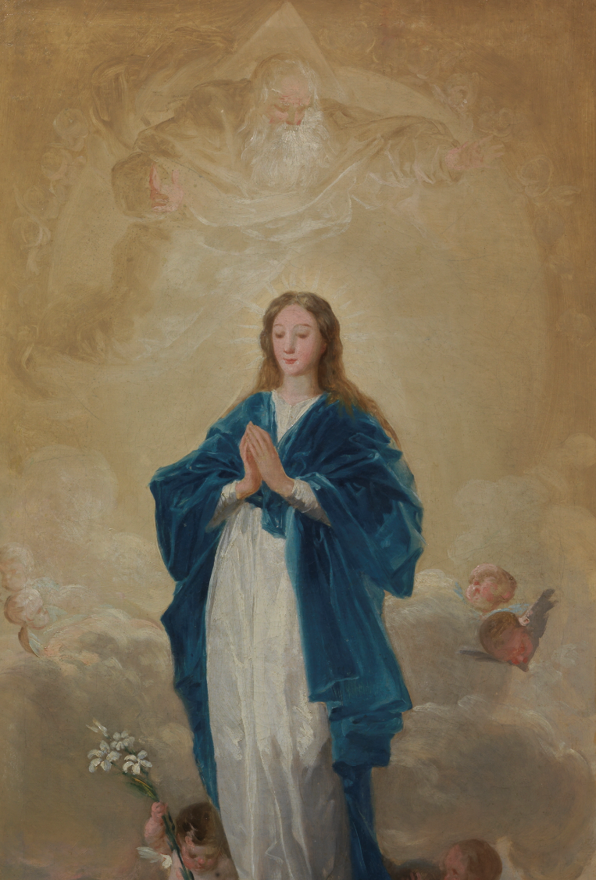
REVIEW
We are going to review what the Old Testament teaches about God’s promise to send a Savior to rescue us and bring us fully back into His Family!
The last time we were together we talked about December 8, which is when we celebrate the Immaculate Conception.
Who did we say was immaculately conceived so that she would be perfectly united to Jesus, the Son of God, when He was conceived in her womb?

Slide 5
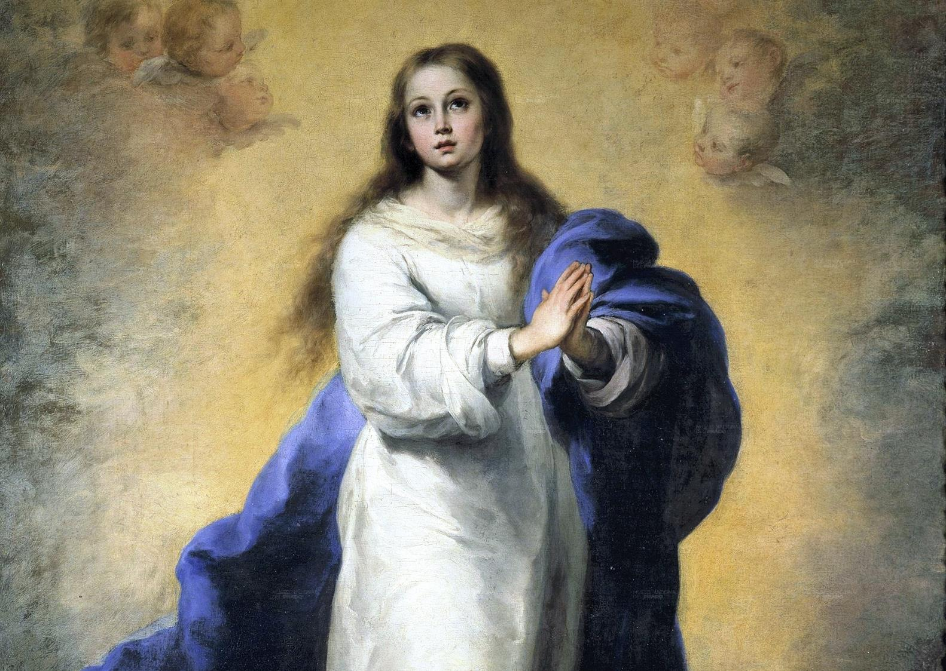
What does it mean when we say Mary was immaculately conceived?
Mary was conceived without Original Sin.
At the moment Mary was conceived, God in Christ supernaturally saved and preserved her from the wound of Original Sin (and from all sin).
Mary was filled with grace and God’s love! In her, God had created the perfect mother to bring Jesus into the world to save us!

Slide 6
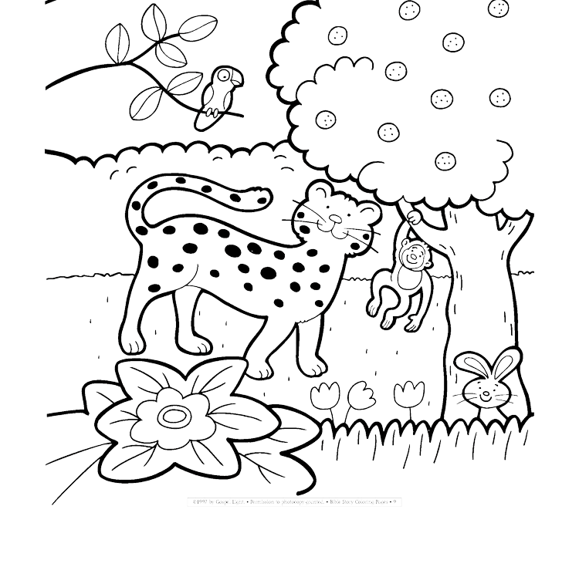
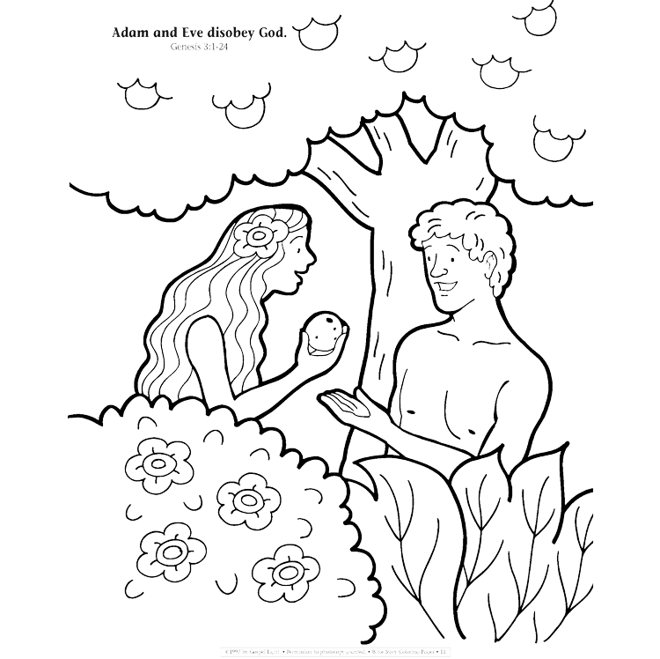
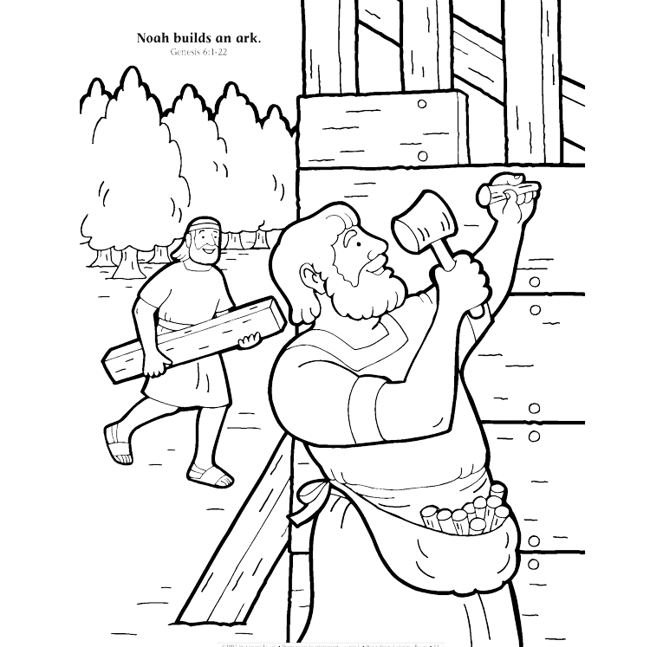
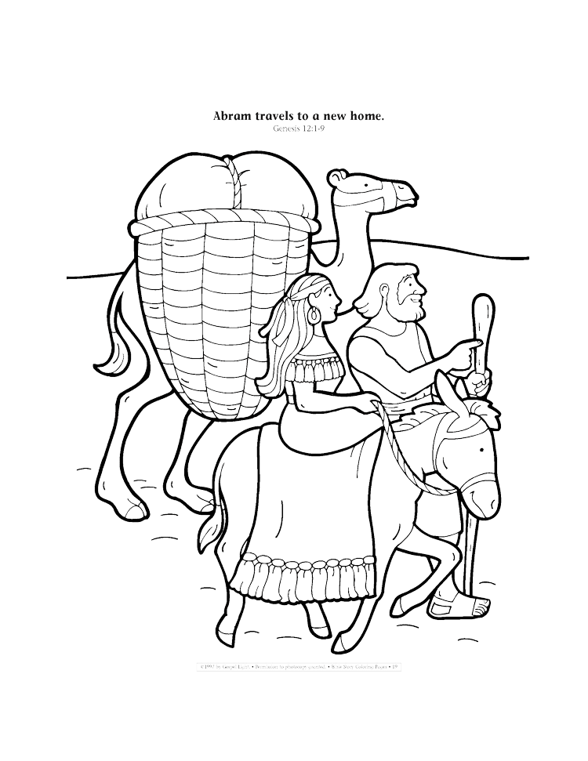
Timeline of the Family of God
Remember that we are all part of God’s family, so when we are learning about the Family of God, we are learning about our own family roots.
Starting at the beginning of God’s family on earth, what do we already have posted on our timelines?
God creates the world
Adam and Eve disobey God
Noah builds an Ark
Abram travels to a new home
https://ministryspark.com/52-bible-coloring-pages/

Slide 7
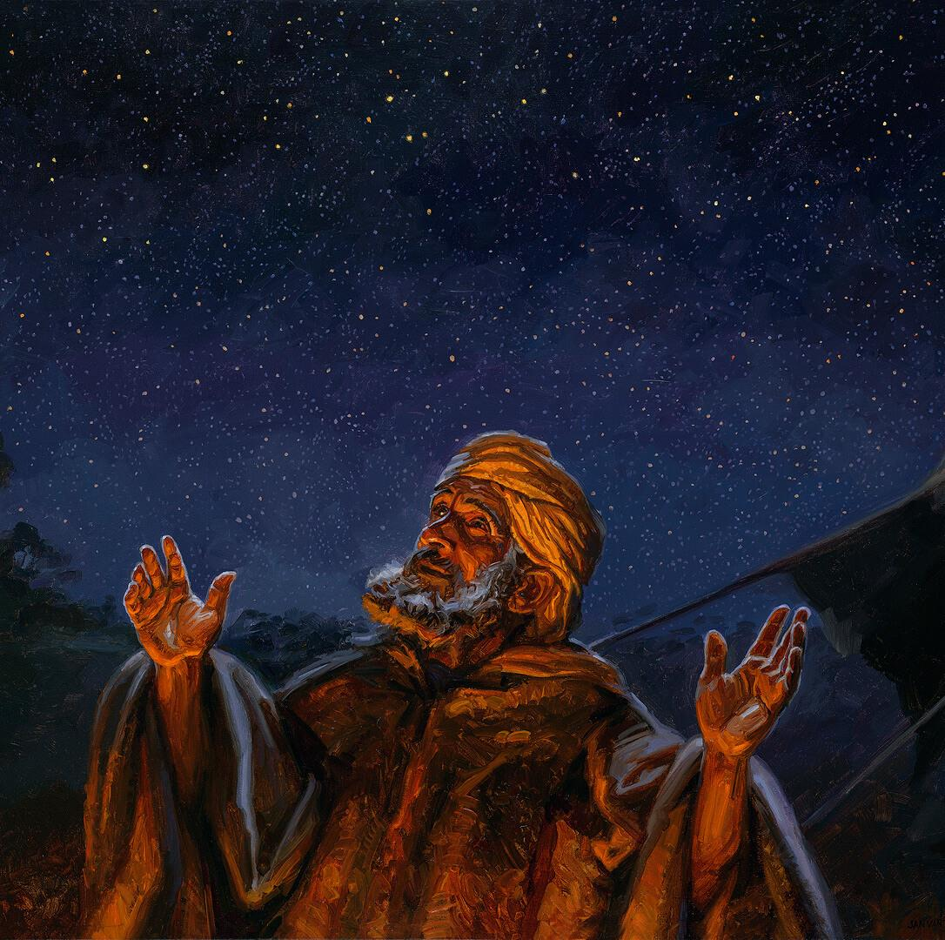
Timeline of the Family of God
Today we will begin where we left off with Abram.
Read: Genesis 12:1-3
God promised Abram three things:
Land.
To make his name great, which meant his offspring would become a royal dynasty.
From Abram’s line would come a worldwide blessing.

Slide 8
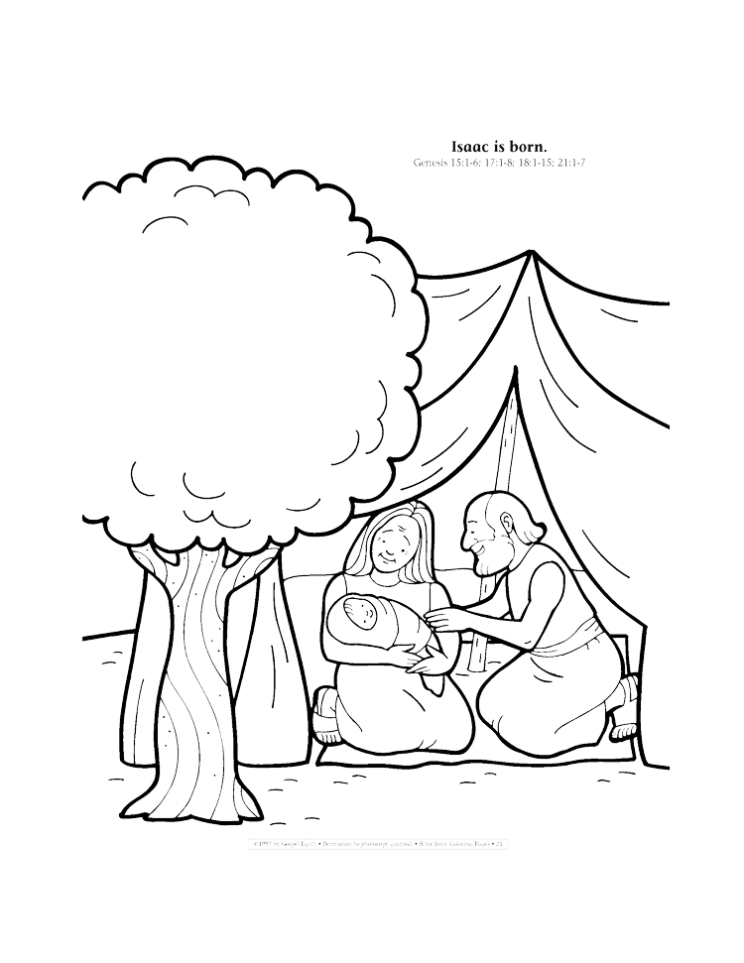
Timeline of the Family of God
When God promised Abram and Sarai these three things, they didn’t have any children, and Sarai was too old to have a baby. Yet we know that God always keeps His promises!
God made a covenant with Abram and changed his name to Abraham and Sarai’s name to Sarah.
Abraham’s family would be special to God.
God would call them His Chosen People.
It took many more years, but God did give Abraham and Sarah their own son.
His name was Isaac.
Read: Genesis 21:1-7
https://ministryspark.com/52-bible-coloring-pages/

Slide 9
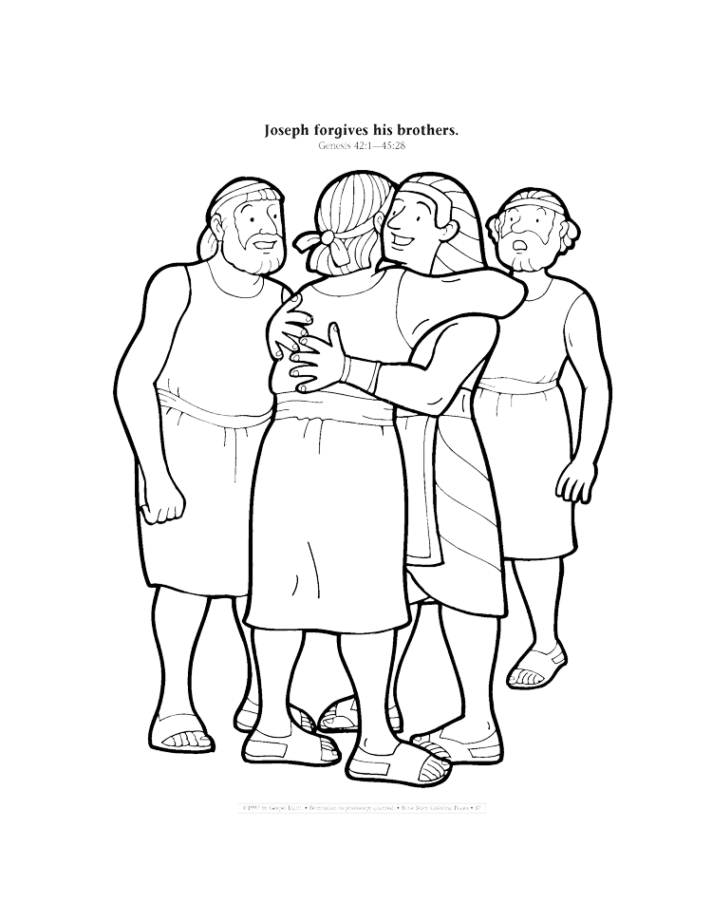
Timeline of the Family of God
When Isaac grew up and married, his wife gave birth to twin boys, Esau and Jacob. God’s Chosen People were beginning to grow in number.
Jacob followed God and when he married, he was the father of 12 sons. However, his older sons were jealous of their younger brother, Joseph, and sold him as a slave. Young Joseph was taken to Egypt.
But God was with him, and after many difficulties, Joseph rose up to be the right-hand man of Pharoah, the king of Egypt.
Soon there was a great famine and people were dying. Joseph saved his whole family by letting them settle in Egypt, where they would have food.
https://ministryspark.com/52-bible-coloring-pages/

Slide 10
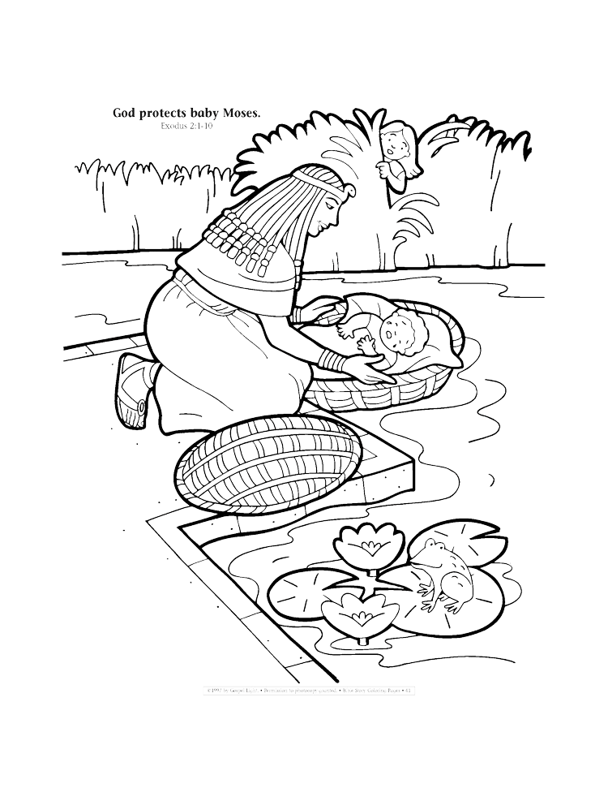
Timeline of the Family of God
Read:
Exodus 1:6-2:10
https://ministryspark.com/52-bible-coloring-pages/

Slide 11
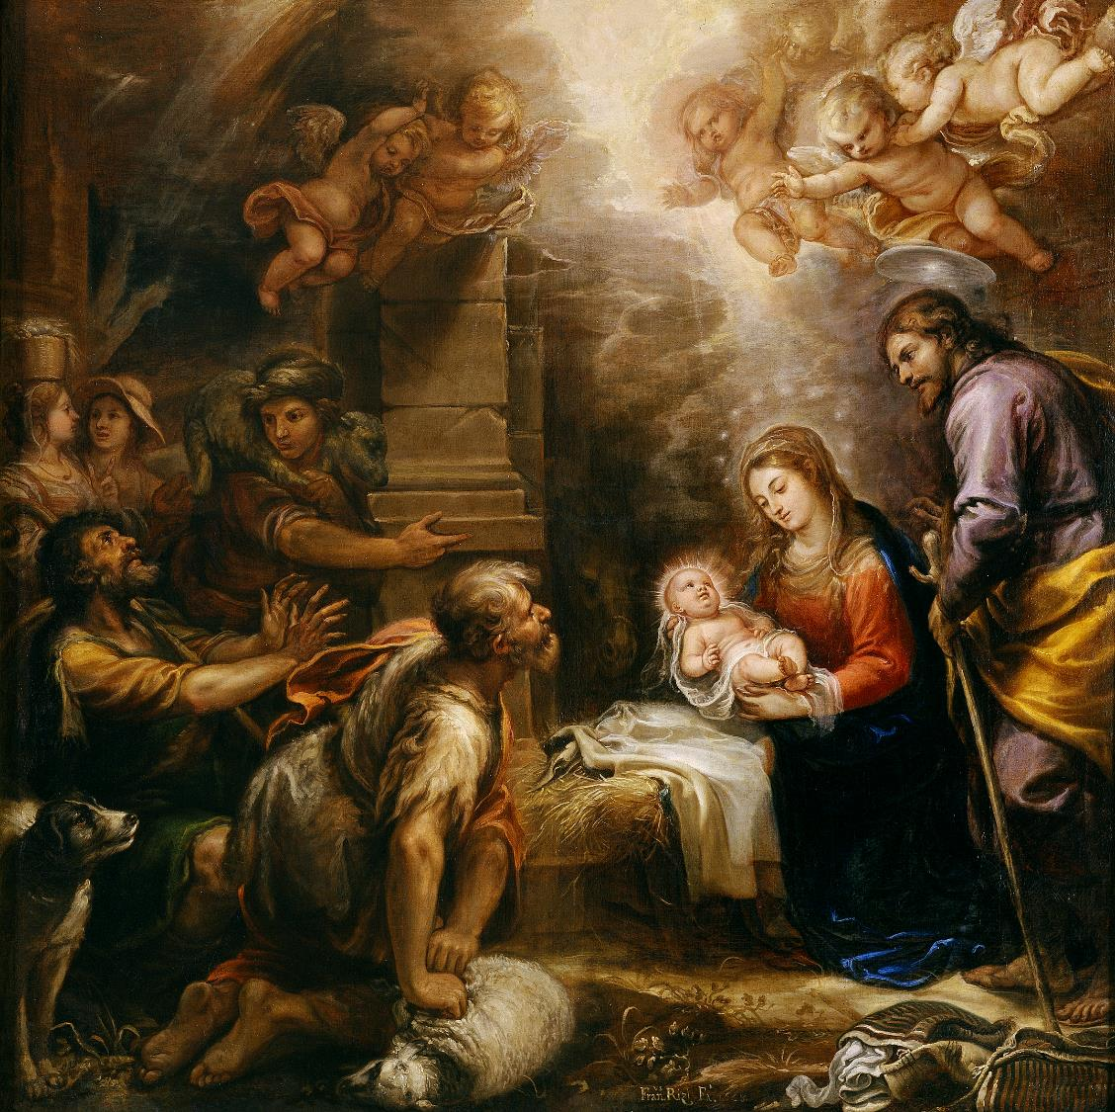
FAMILY CONVERSATION
How can your family spread the love of Jesus everywhere?
How will your family celebrate the Birth of Christ on Christmas Day and during the whole Christmas Season?

Slide 12
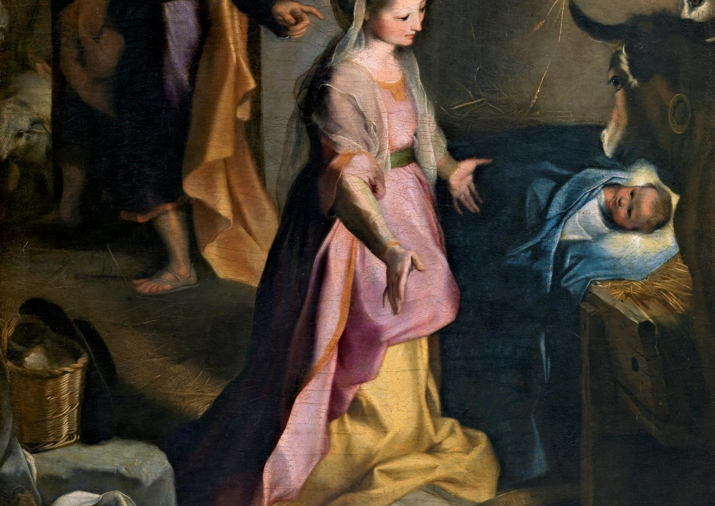
CLOSING PRAYER
Pray a decade of the Rosary meditating on the Third Joyful Mystery, the Birth of Christ
Loving God,
Heal our hearts during this season of Advent so that we can love more fully, forgive more generously, and wait more patiently for Christmas.
Thank You for the gift of each day and help us to embrace the grace You give us knowing the joy that awaits us.
In the Name of Jesus, we pray.
Amen.
Adapted from www.hallow.com

