Slide 1
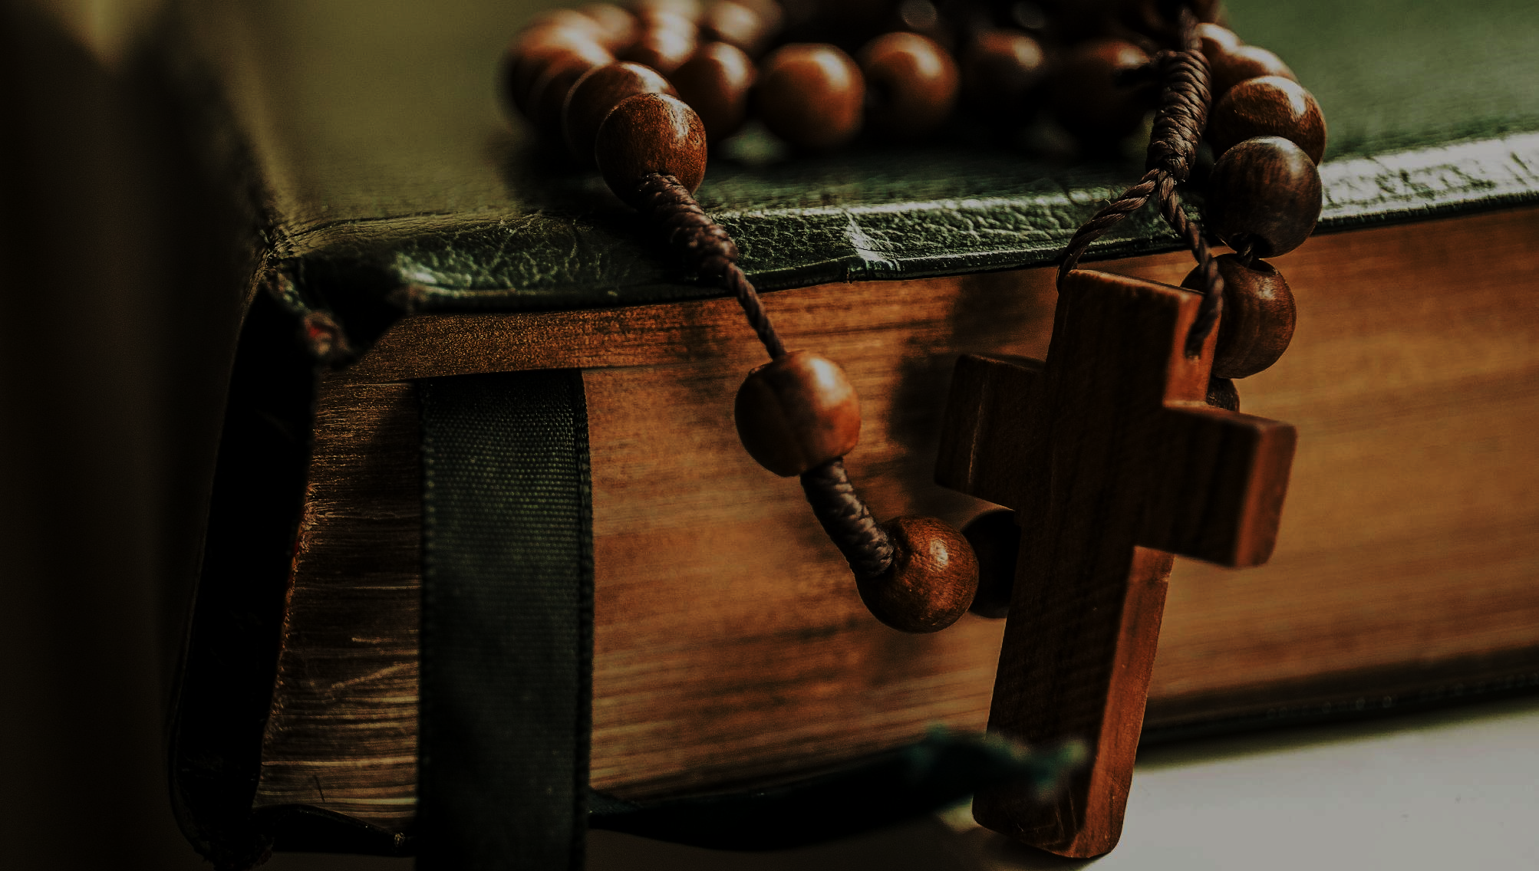
^{Families Forming Disciples}
^{Topic: The Bible}

Slide 2
^{Opening Prayer}
Lord Jesus Christ,
We entrust our family to you and ask for
your blessing and protection. We love
you Lord Jesus with all our hearts and we
ask that you help our family become more
like the Holy Family. Help us to be kind,
loving, and patient with one another. Give
us all the grace we need to become saints
and your faithful disciples.
Amen.

Slide 3
^{Ice Breaker}
Candy Color
Red
Brown
Green
Orange
Yellow
Blue
Question
Something about your childhood
Favorite movie, food, or book
Something you can’t live without
Something you learned last week
Something you do well
Something about yesterday
Adapted from www.wehavekids.com by Claudia Mitchell

Slide 4
Concept Review
• The Bible is your family’s story, too.
• Who is on your Family Faith Tree?

Slide 5
Families share their experiences
How was your experience of the At-Home Mission Week activity?

Slide 6
Review their answers to the Week 2 questions
1. Who in your family or in your life was the first person that you know,
knew or heard of, who had a strong faith in God and who handed it onto
others?
2. To whom did he or she hand on the faith? Then, to whom did that person
hand on the faith?
3. Do you have a picture of that first or second person, a sacramental or any
other special object that belonged to him/her? If so, bring this item to the
next gathering of families.
4. To whom do you want to hand on your faith?

Slide 7
Family Faith Tree
A Family Faith Tree is a diagram that shows the people that came before
you, who have handed on their faith to you.

Slide 8
Reminder of next meeting and prayer

Slide 9
^{Close in Prayer}
Lord, we ask you to receive these intentions, and we lift up all the sorrows and joys that we hold in the silence of our hearts.
We pray Philippians 4:4-7…
Rejoice in the Lord always. I will say it again: Rejoice! ... Do not be anxious about anything, but in every situation, by prayer and petition, with thanksgiving, present your requests to God. And the peace of God, which transcends all understanding, will guard your hearts and your minds in Christ Jesus.
In the name of the Father, and of the Son, and of the
Holy Spirit. Amen.

