Slide 1
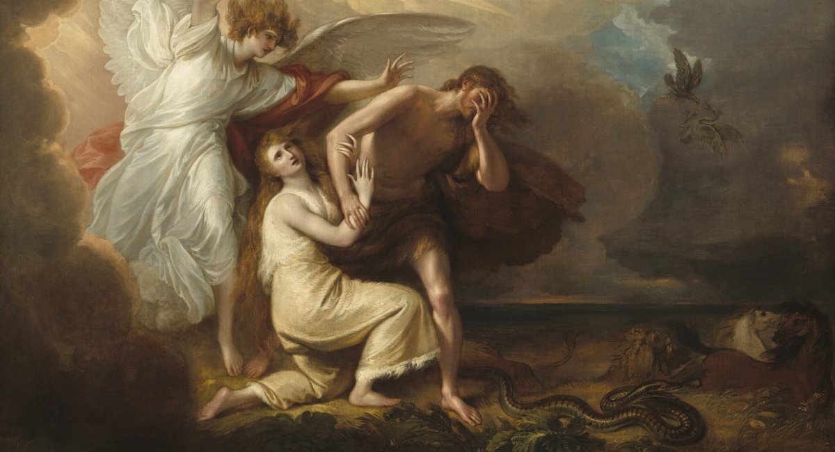
^{Families Forming Disciples}
The Fall and the Promise

Slide 2
^{Opening Prayer}
Lord Jesus Christ,
We entrust our family to you and ask for
your blessing and protection. We love
you Lord Jesus with all our hearts and we
ask that you help our family become more
like the Holy Family. Help us to be kind,
loving, and patient with one another. Give
us all the grace we need to become saints
and your faithful disciples.
Amen.

Slide 3
^{Ice Breaker}
The Line Up Game
Everyone please line up in order of your ages from oldest to the youngest.
Everyone please line up by height with the shortest first.
Everyone please line up in alphabetical order according to your first name.

Slide 4
Families share their experiences
Families share about their Senior Sharing experience by explaining whom they interviewed and what he/she shared about their favorite memories of sacrificial love in their families when they were growing up or when they were raising their own families.

Slide 5
Concept Review
The Fall of Man, Original Sin, and the Promise of Redemption
Family Advent Plans

Slide 6
Families share their Family Advent Plan

Slide 7
Content
https://www.youtube.com/embed/05YB2jdHLsY

Slide 8
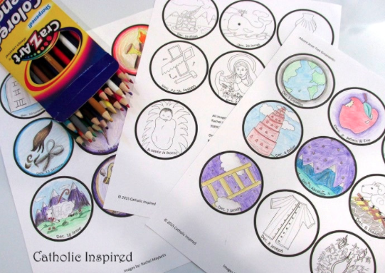
Content
^{Family Advent Activity}

Slide 9
Reminder of next meeting and prayer

Slide 10
^{Close in Prayer}
^{Glory be…}

