Slide 1
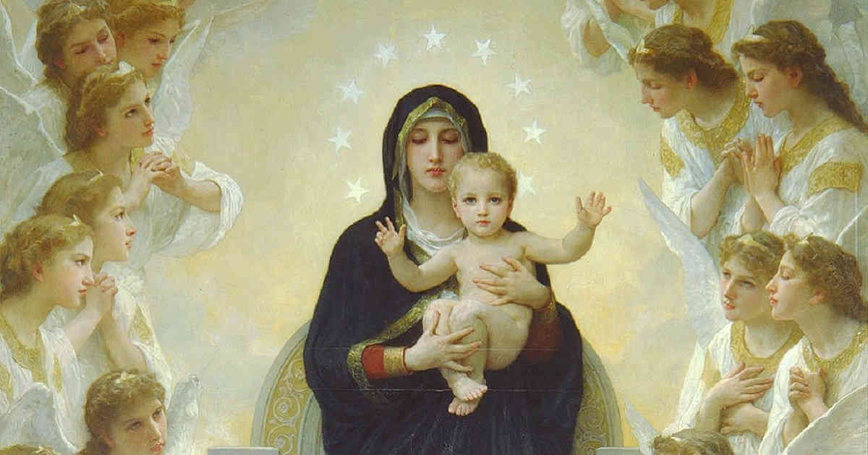
CALLED TO LOVE: THE ADVENTURE OF LIFE IN CHRIST
TOPIC: Mary & the Mission of Discipleship, Mary as Model Disciple

Slide 2
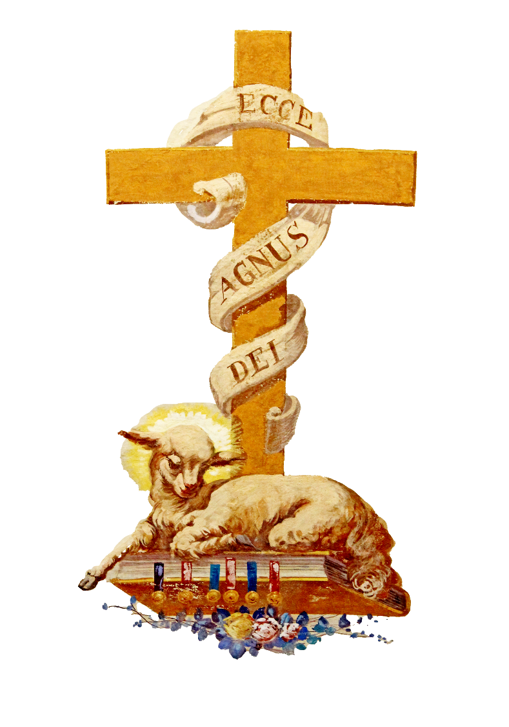
^{Opening Prayer}
Lord Jesus Christ,
We entrust our family to You and ask for Your blessing and protection.
We love You Lord Jesus with all our hearts, and we ask that You help our family to become more like the Holy Family.
Help us to be kind, loving, and patient with one another.
Give us all the grace we need to become saints and Your faithful disciples.
Amen.

Slide 3
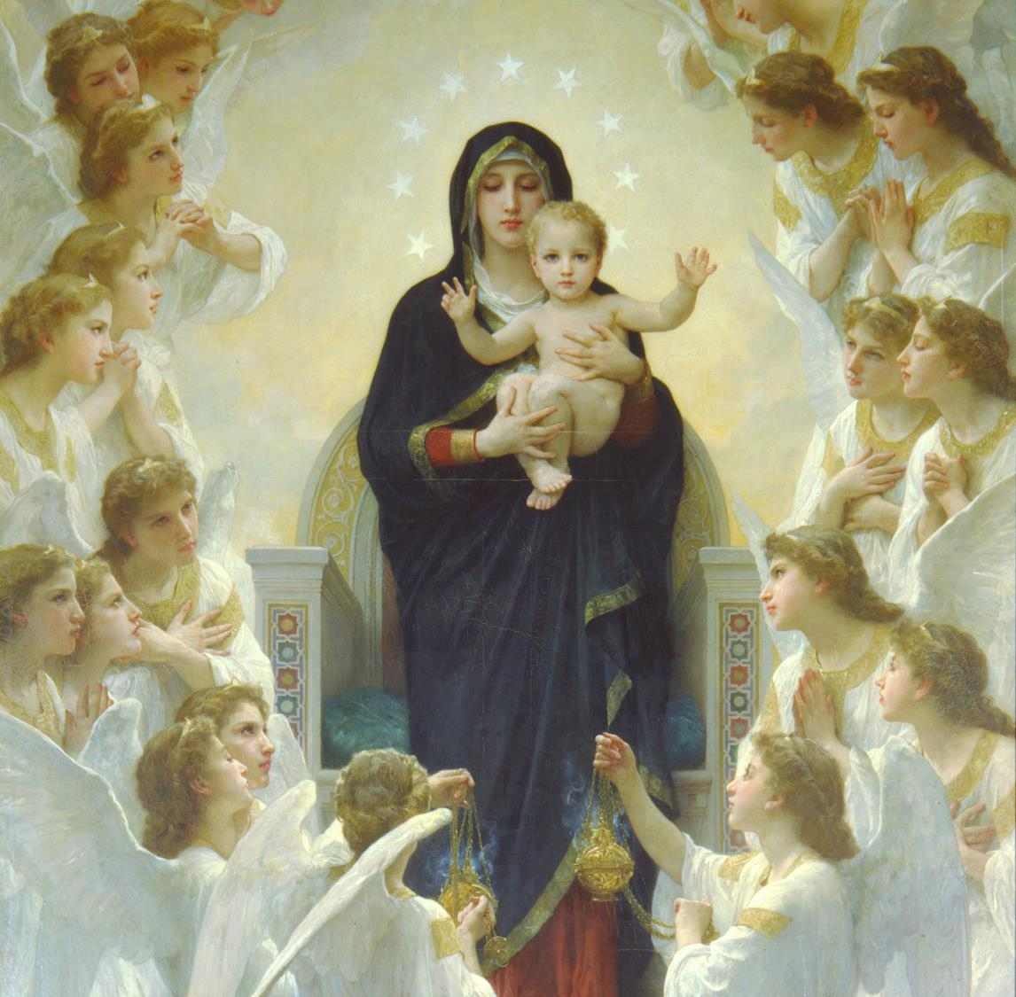
^{ICE BREAKER}
Honoring Mary
Share ideas from Week 2 and families discuss how they will honor Mary during the month of May.
Each family then shares with the large group the ways they will honor Mary.

Slide 4
WATCH
Model Disciple | Mary, Explained https://www.youtube.com/watch?v=IOo00lcDjHE
Mary - The Best Disciple and Our Model https://www.youtube.com/watch?v=nKyZ1H2ZD_E

Slide 5
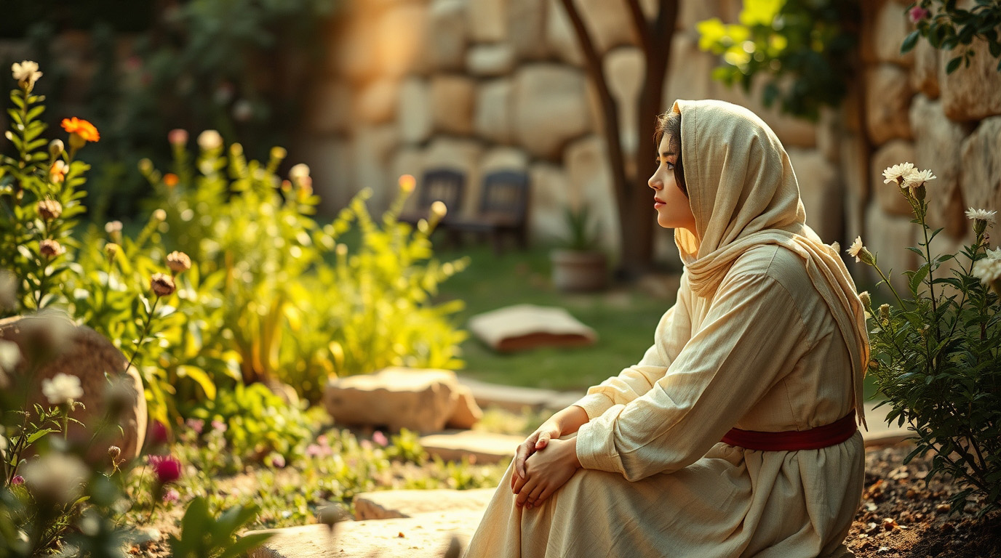
FINDING MARY IN THE BIBLE SCAVENGER HUNT
Mary is Jesus’ first disciple! She knew about His coming and began learning from Him right from the moment Mary conceived Jesus in her womb!
Reading about Mary’s life in Sacred Scripture shows us an example or model to follow, so that we too can be true disciples of Jesus.

Slide 6
FINDING MARY IN THE BIBLE SCAVENGER HUNT
Read each Bible verse and using the hint provided, find the hidden object that represents that moment in Mary’s life.
Luke 1:26-38
hint: Mary believed, even as a young teen, what the Archangel Gabriel said to her, that nothing is impossible for God! vs 37
Of what would paintings of Archangel Gabriel’s wings appear to be made?

Slide 7
FINDING MARY IN THE BIBLE SCAVENGER HUNT
Luke 2:1-20
hint: Giving birth to her baby in a stable full of animals could have been a humiliating experience for many mothers, but Mary was humble. She offered herself to God and was one in the peace of Christ Whom she was bringing into the world. She trusted in His love.
What do you think Mary would have used as a cushion in the manger to soften it for Jesus when He was a newborn baby?

Slide 8
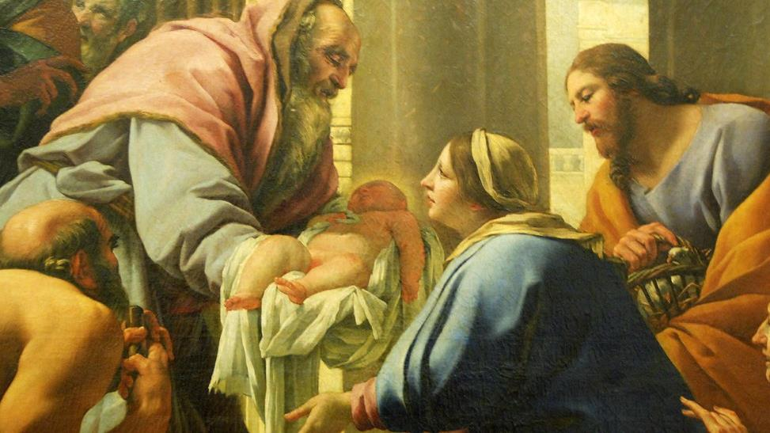
FINDING MARY IN THE BIBLE SCAVENGER HUNT
Luke 11:27-28
hint: Jesus explains that Mary is to be praised above everything for hearing the word of God and keeping it.
That is the essence of who she is! Those who do this are blessed. By her life, Mary shows us how to hear the word of God and live it!
What kind of paper was the word of God written on in ancient times?

Slide 9
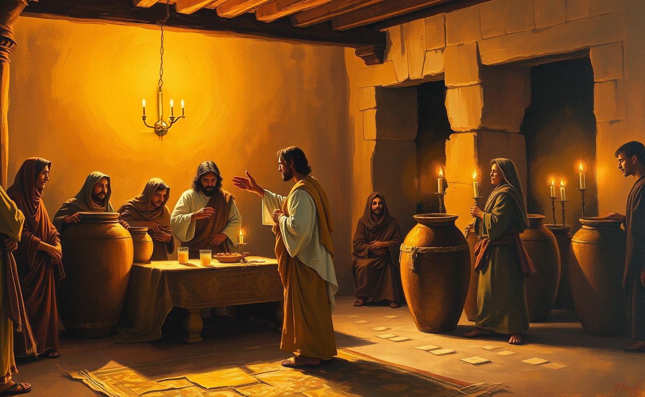
FINDING MARY IN THE BIBLE SCAVENGER HUNT
John 2:1-12
hint: “Do whatever He tells you”, are the words that Mary lived by and are the words she says to us today! Mary did whatever God our Father asked of her, even though it was often difficult; she trusted in God’s great love. When we are struggling with anything, Mary our mother will always pray for us. All we have to do is ask her, as the couple at the wedding of Cana did, and she will always go to Jesus to ask Him to help us.
Jesus changed the water into the good wine.
What is used to keep wine in a bottle?

Slide 10
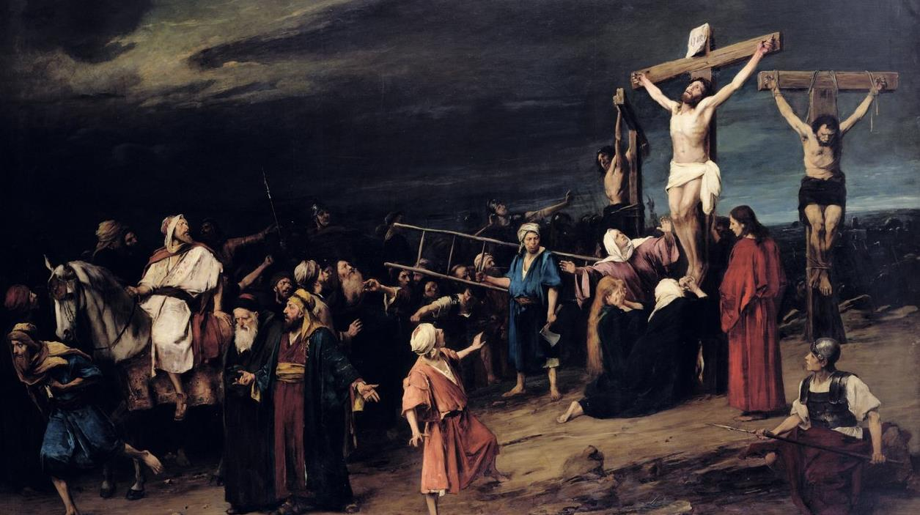
FINDING MARY IN THE BIBLE SCAVENGER HUNT
John 19:23-27
hint: The soldiers cast lots to see who would get to keep Jesus’ tunic for himself. “It was seamless, woven in one piece from the top down.” vs 23 Some ancient stories tell us it was Mary who had woven that tunic so beautifully and with such love. While the soldiers were doing this, Jesus, knowing He was about to die, made certain that Mary would be cared for and gave her to John, “Woman, behold your son…. Son, behold your mother.” With these words, Mary is now both Jesus’ mother and the mother of all God’s children. She is our Holy Mother too! After this, Jesus said, “’It is finished.’ And bowing his head, he handed over his spirit.” vs 30 And the sword of sorrow pierced Mary’s heart.
Look for two items!
#1 Jesus’ tunic was woven by Mary’s hands in one piece.
#2 This is when Simeon’s prophecy was fulfilled, a sword of great pain had pierced Mary’s heart, “so that the thoughts of many hearts may be revealed.” Lk 3:35

Slide 11
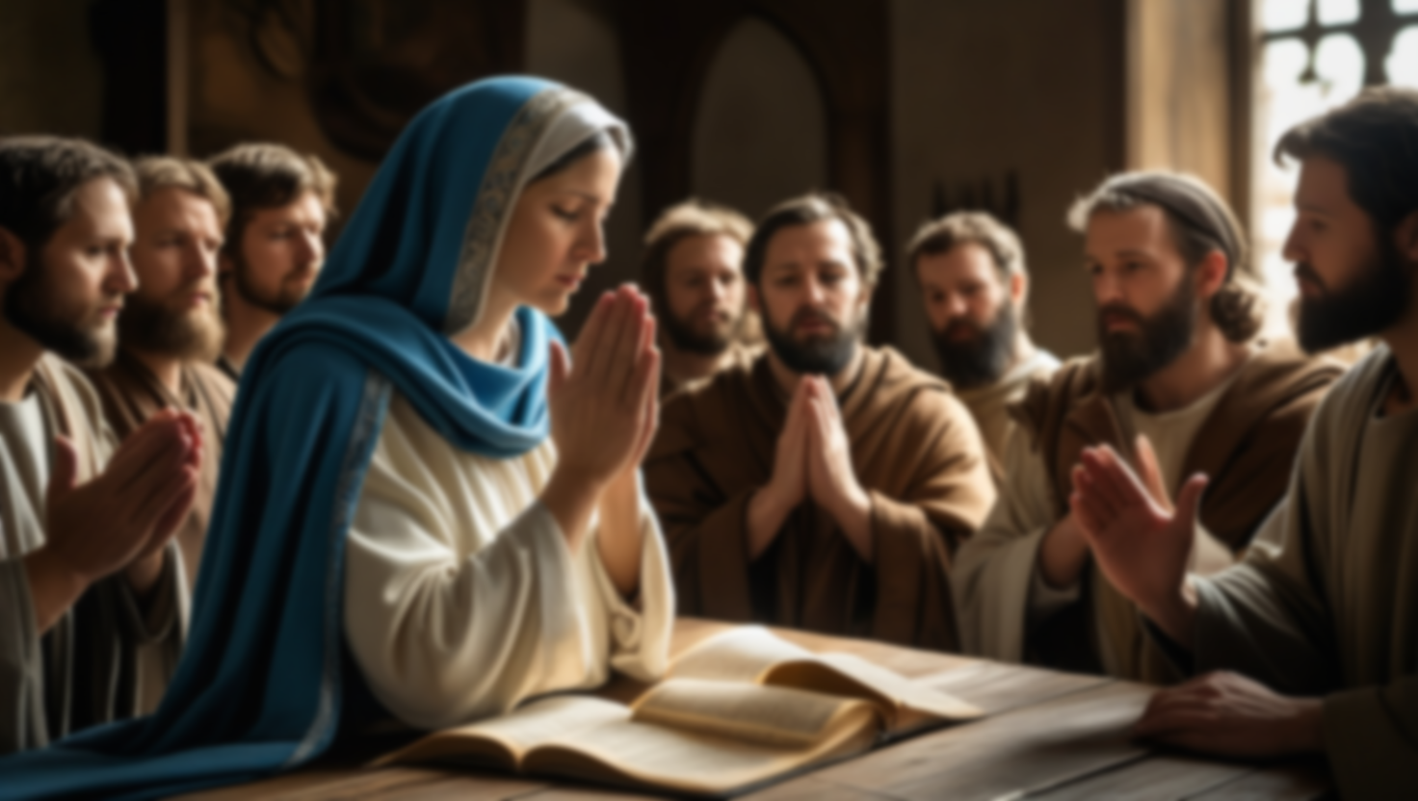
FINDING MARY IN THE BIBLE SCAVENGER HUNT
Acts 2:13-14
hint: After Jesus ascended to Heaven the Apostles listened to Jesus’ instructions and returned to Jerusalem where they prayed and fasted together with Mary and the other disciples for nine days. It must have been very comforting for the frightened Apostles to have Mary with them to listen, comfort and pray with them. She was now truly their mother too! Since she is also our mother, we should never hesitate to ask her to help us to follow Jesus. She gave her life to God, so that through her Son Jesus, our hearts would be healed and made one with His!
A prayer asking Mary to pray for us brings Jesus joy!

Slide 12
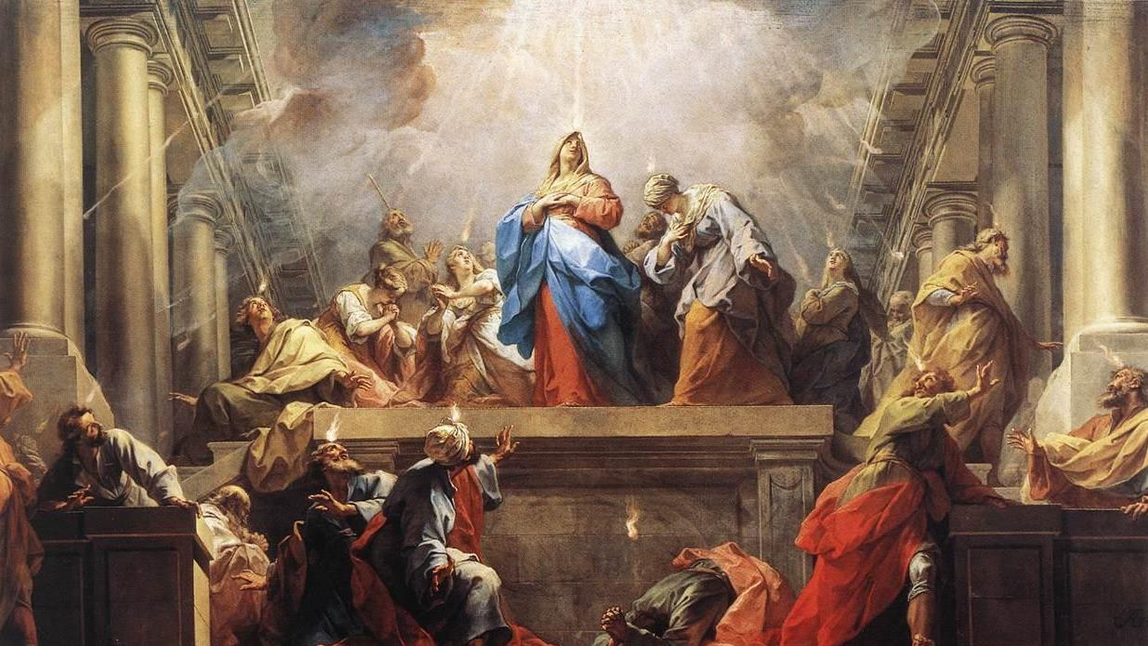
FINDING MARY IN THE BIBLE SCAVENGER HUNT
Acts 2:1-4
hint: Pentecost is often called the birthday of the Church! The Apostles, disciples and all those who would be baptized, made up this infant Church. To help her survive, the Church needed a wise, warm, loving, spiritual mother to guide her. Mary cared for this little Church just as Mary had cared for, nurtured and safeguarded her infant Son, Jesus.
Mary is Jesus’ mother and the mother of all God’s children, still caring for and interceding for us all with her Holy Mother’s Immaculate Heart. Our Holy and Blessed Mother was present at the birth of the Church and she has been nurturing it ever since!
In what form did the Holy Spirit appear at Pentecost, as He “parted and came to rest on each one of them”? Vs 3

Slide 13
OPEN MIC
Now that Families Forming Disciples is coming to a close this year, each family will have the opportunity to share their experience with everyone.
How did learning about your call to love, the adventure of life in Christ, this year impact your relationship with God, one another and your parish church community?

Slide 14
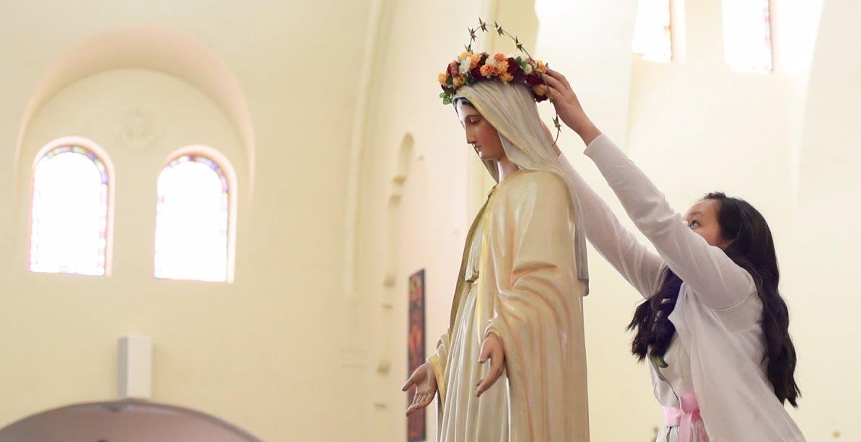
MAY CROWNING
As we end our Families Forming Disciples year, we thank God for bringing us together and we invite the Holy Spirit into our lives as Mary did.
Mary is the Spouse of the Holy Spirit, and during the month of May we honor Mary as Queen of Heaven and Earth. Her Son, Jesus, is our King, so therefore His Mother is our Queen!
A May crowning is a special way we honor Our Lady during the Month of May!

Slide 15
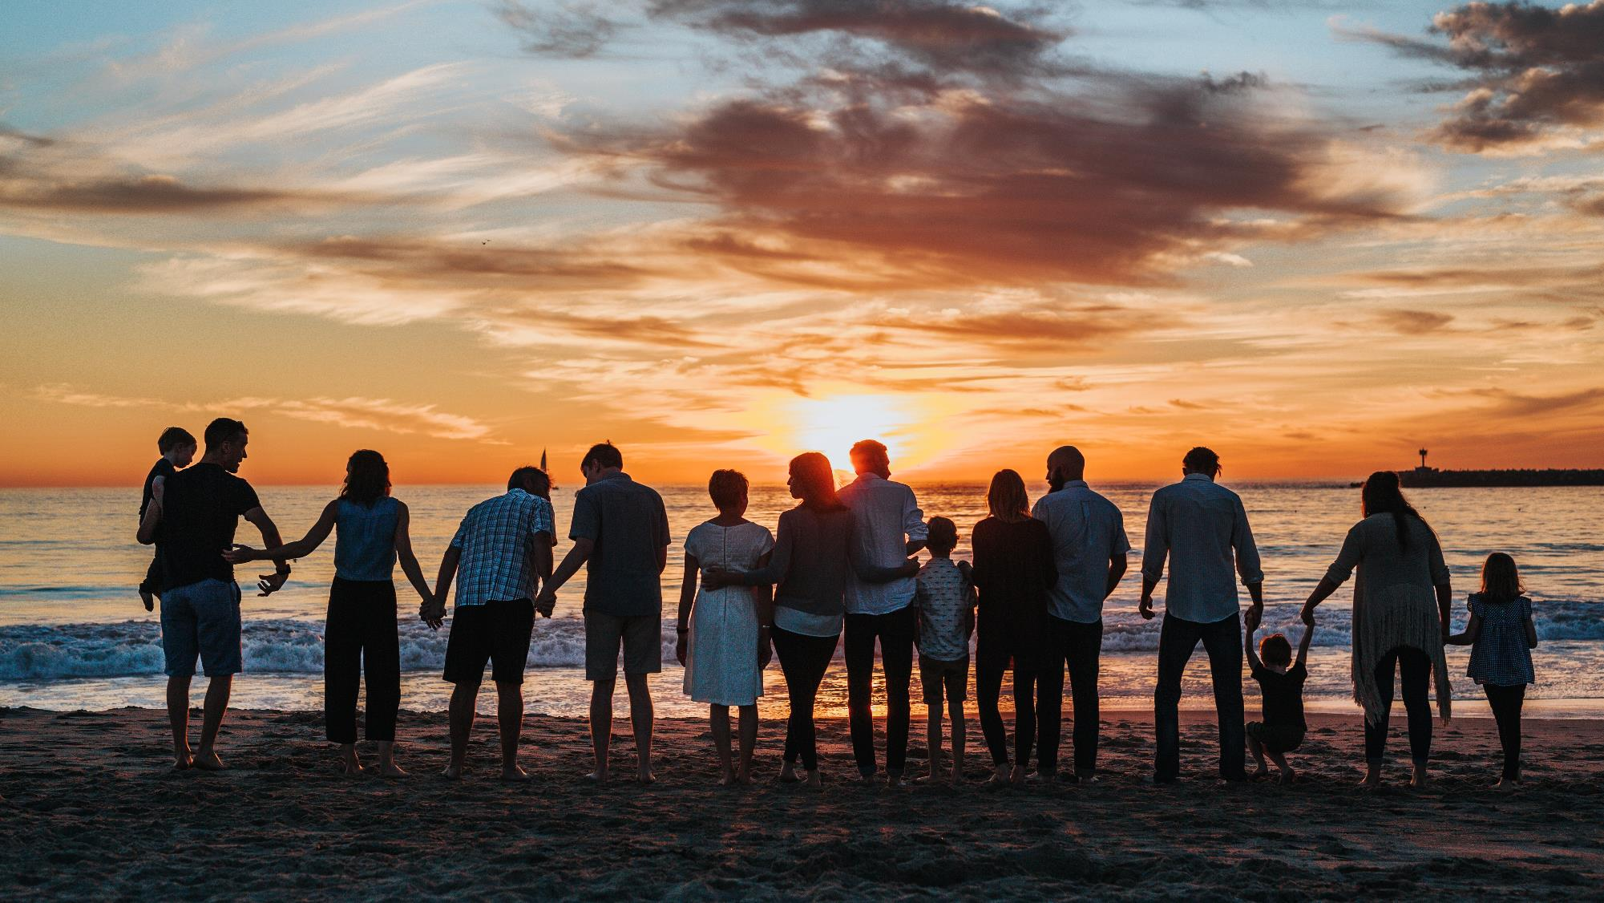
The call to share the Gospel of Jesus Christ and form disciples never ends!
Make a commitment to pray together regularly as a family, to have regular conversations about the faith, and to grow as disciples.
Thank you for your witness to Jesus!

