Slide 1
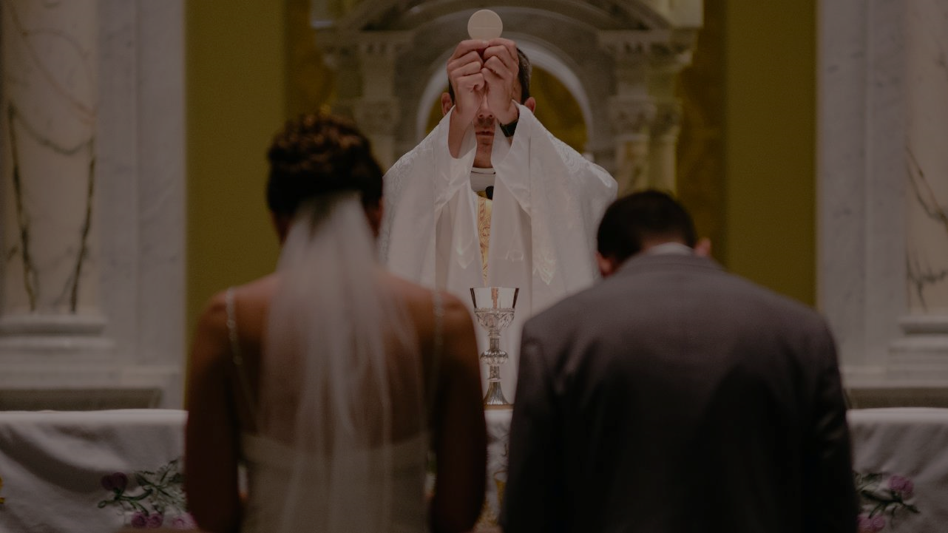
GOD’S SAVING LOVE FOR US:
LITURGY AND THE SEVEN SACRAMENTS
SACRAMENTS AT THE SERVICE OF COMMUNION & MISSION: HOLY MATRIMONY (MARRIAGE)

Slide 2
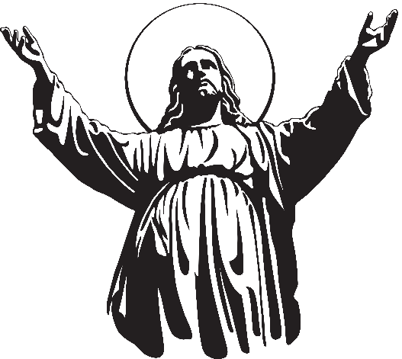
^{Opening Prayer}
Lord Jesus Christ, We entrust our family to You and ask for Your blessing and protection.
We love You Lord Jesus with all our hearts, and we ask that You help our family to become more like the Holy Family.
Help us to be kind, loving, and patient with
one another.
Give us all the grace we need to become saints and Your faithful disciples. Amen.
This Photo by Unknown Author is licensed under CC BY-NC

Slide 3
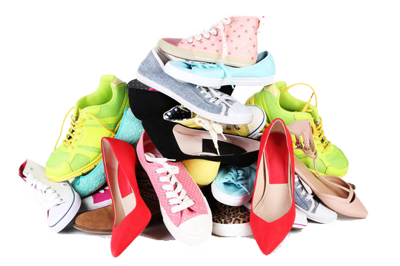
SHOE EXCHANGE
How to Play:
Everybody leaves one of his/her shoes by the door.
Everyone gathers, makes a circle and redistribute the shoes, so each person has one that doesn’t belong to him/her.
Set a 5-minute timer and everybody finds the shoe’s owner..
They then have a 2-minute discussion explaining who their favorite saint is and why.
Adapted from https://scienceofpeople.com

Slide 4
REVIEW
Last month we said there are two Sacraments at the Service of Communion and Mission. In the Scriptures, we learned that Jesus called the Twelve to be His Apostles. These men were set aside to carry on Jesus’ ministry with His authority to serve in a unique way.
Because Jesus wants to be closer to us, to heal us and to keep His promise to always be with us, God has continued to call some baptized men to the ministerial priesthood.
These men, through priestly ordination, receive what sacrament?

Slide 5
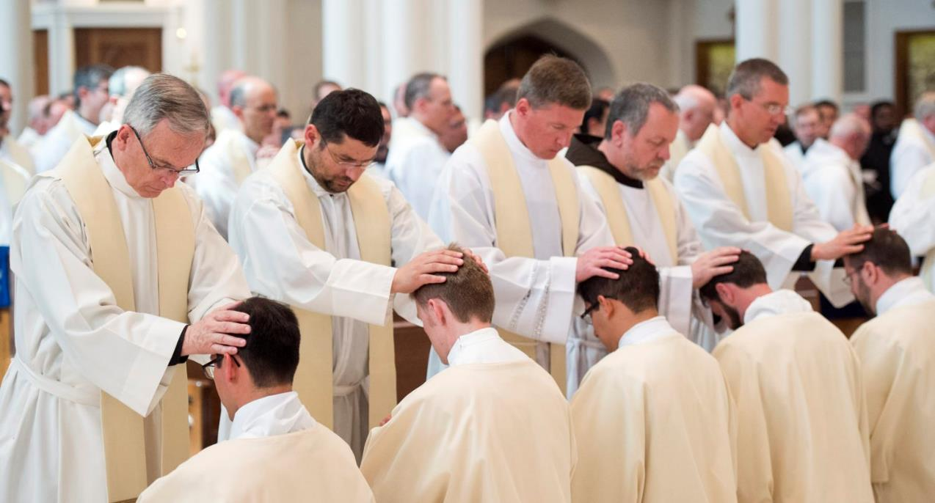
REVIEW
The Sacrament of
Holy Orders

Slide 6
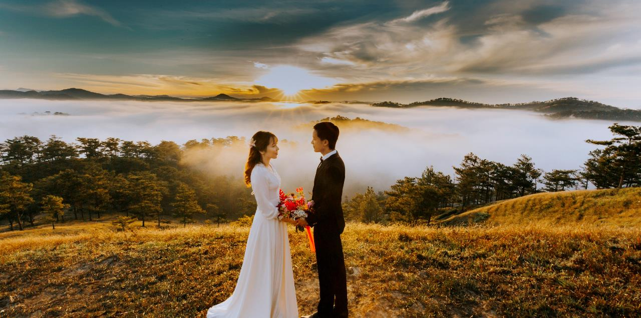
TOPIC
The Sacrament of Marriage is also a vocation, or a calling from God.

Slide 7
VIDEO
Catholic Kids Media - What is Marriage?
https://www.youtube.com/watch?v=1Ub9XfxgLQA

Slide 8
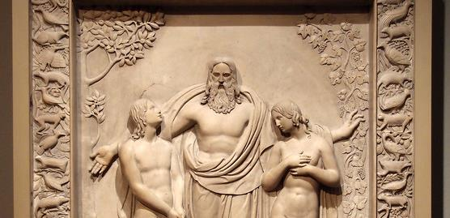
SACRAMENTS OF SERVICE AND COMMUNION

Slide 9
What makes Catholic Marriage a Sacrament?
https://www.youtube.com/watch?v=0czyU8vXmII

Slide 10
TOPIC
Does anyone remember what a covenant is?
A covenant is a special agreement or promise.
https://www.youtube.com/watch?v=03jNblopq4k

Slide 11
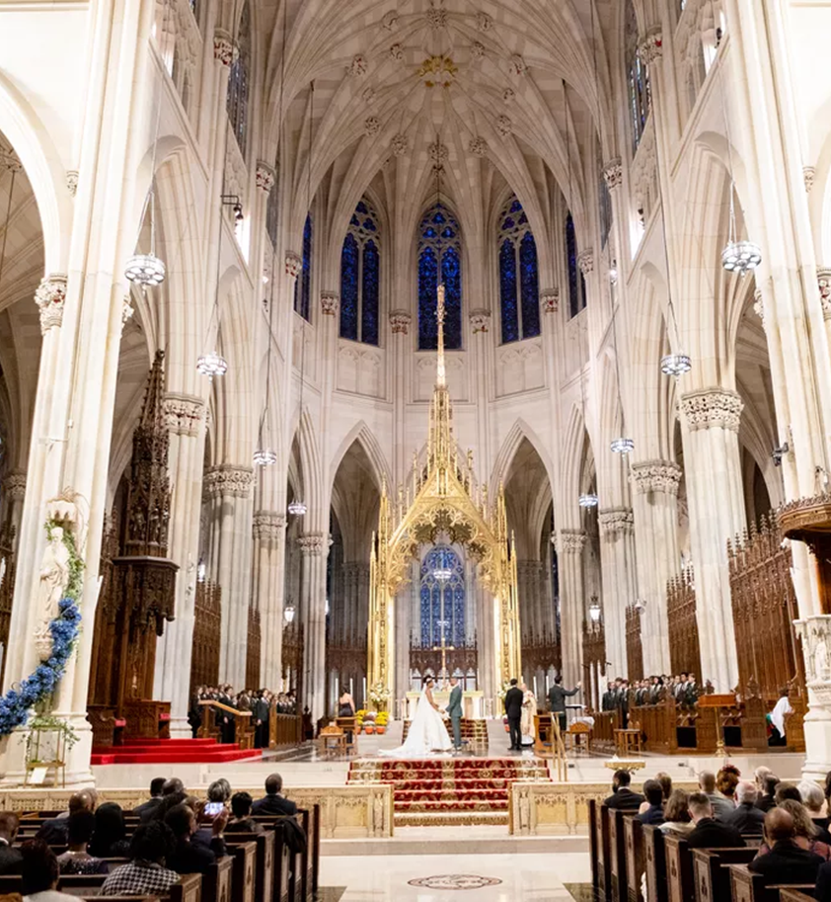

Slide 12
MARRIAGE
https://www.youtube.com/watch?v=4wEhi7cM8lM

Slide 13
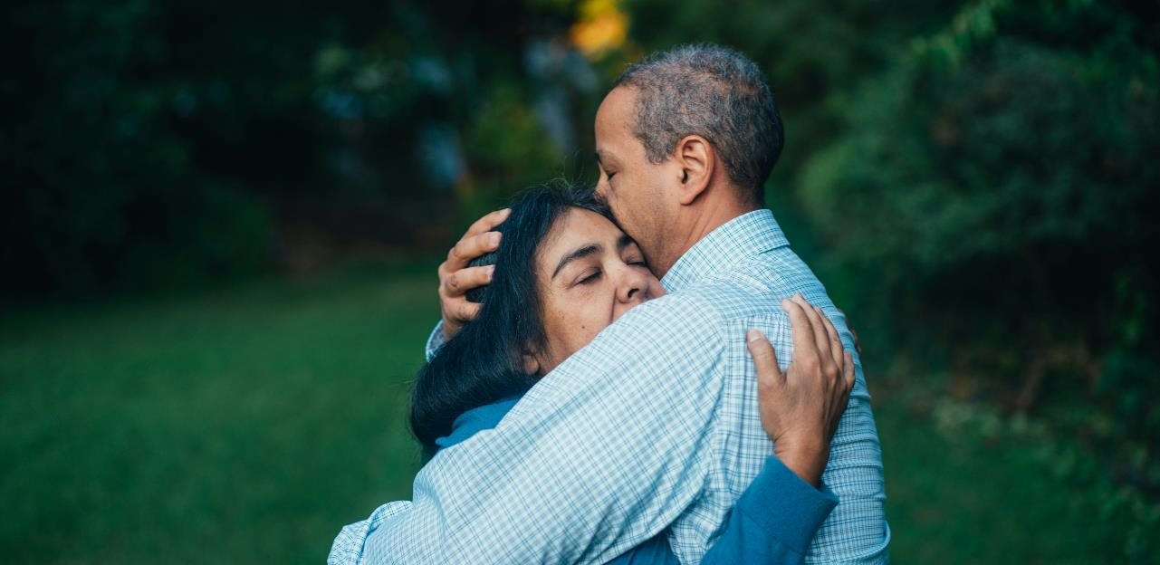
FAMILY CONVERSATION
Name a couple or couples you have known who are positive models of the Sacrament of Marriage
for you and for others.
List the important qualities that make them wonderful examples.

Slide 14
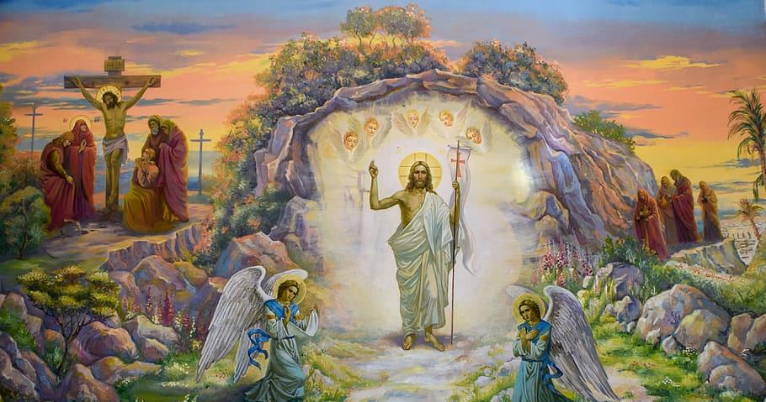
FAMILY AT-HOME MISSION
Watch the videos about the Sacrament of Marriage.
Find a sacramental, favorite keepsake or photo from your wedding or of a couple who are a witness to the holiness of marriage and bring them to the Week 3 gathering.
Review the resources on celebrating the Easter Season and watch the video on Easter together.
Make a plan for how your family will (continue to) celebrate the Easter Season.
Be prepared to share about your Celebrating the Easter Season Plan the next gathering.
Gather around your home altar and pray together a decade of the Rosary, meditating on the First Glorious Mystery, the Resurrection of Our Lord, or the Chaplet of Divine Mercy, praising God for the gift of His Son’s Resurrection!
Families complete the Families Forming Disciples Family Survey

Slide 15
STATIONS OF LIGHT
Light candle
Pray the Sign of the Cross
Watch: Stations of Light video
https://catholic-link.org/quotes/stations-of-the-resurrection-via-lucis/
4. Close with a Glory Be…

