Slide 1
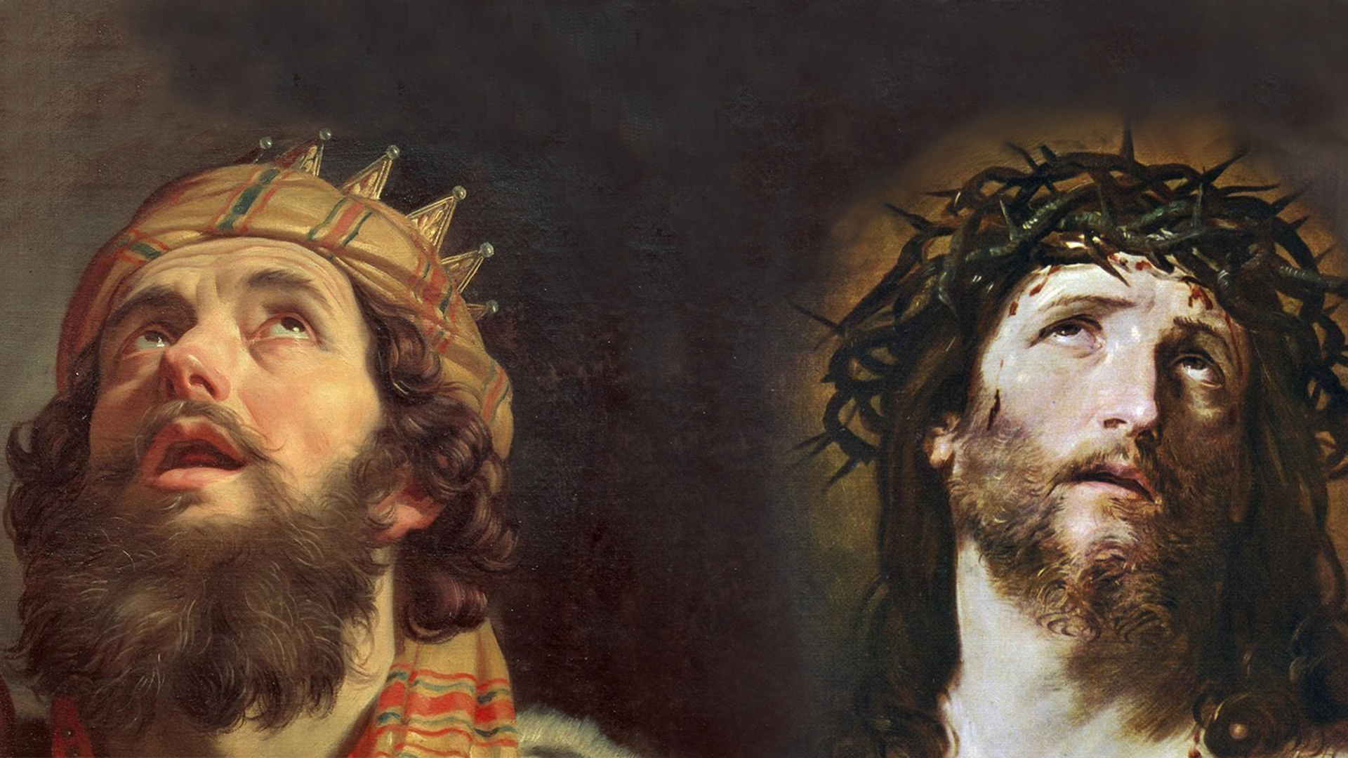
FAMILIES FORMING DISCIPLES
GOD’S COVENANT WITH DAVID (ROYAL COVENANT)
JESUS, THE DESCENDENT OF DAVID AND THE KING OF KINGS

Slide 2
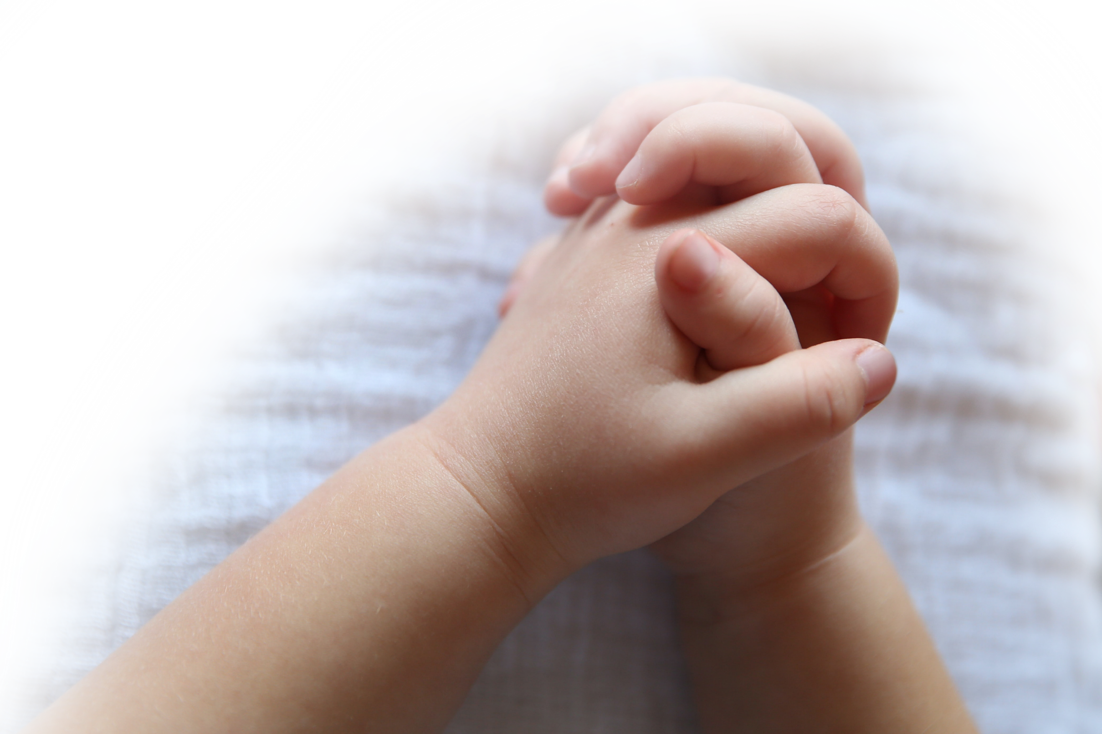
^{Opening Prayer}
Lord God, You loved this world so much that You gave Your one and only Son, that we might be called Your children too. Lord, help us to live in the gladness and grace of Easter Sunday, every day. Let us have hearts of thankfulness for Your sacrifice. Let us have eyes that look upon Your grace and rejoice in our salvation. Help us to walk in that mighty grace and tell Your Good News to the world. All for Your glory do we pray, Lord. Amen.
by Rachel Marie Stone

Slide 3
^{Ice Breaker}
JERUSALEMA DANCE
https://www.youtube.com/watch?v=Nt6MhPXXr4Y

Slide 4
^{Ice Breaker}
EASY JERUSALEMA DANCE FOR YOUNG AND OLD
https://www.youtube.com/watch?v=yalBVOeHqsE

Slide 5
FAMILY SHARING
Jerusalem, my home,
Save me! Join me,
Don’t leave me here!
My place is not here,
My kingdom is not here,
Save me, Come with me!
What is your favorite Psalm and why?

Slide 6
PSALMS | CATHOLIC CENTRAL
https://www.youtube.com/watch?v=UADk6L4RfZU

Slide 7
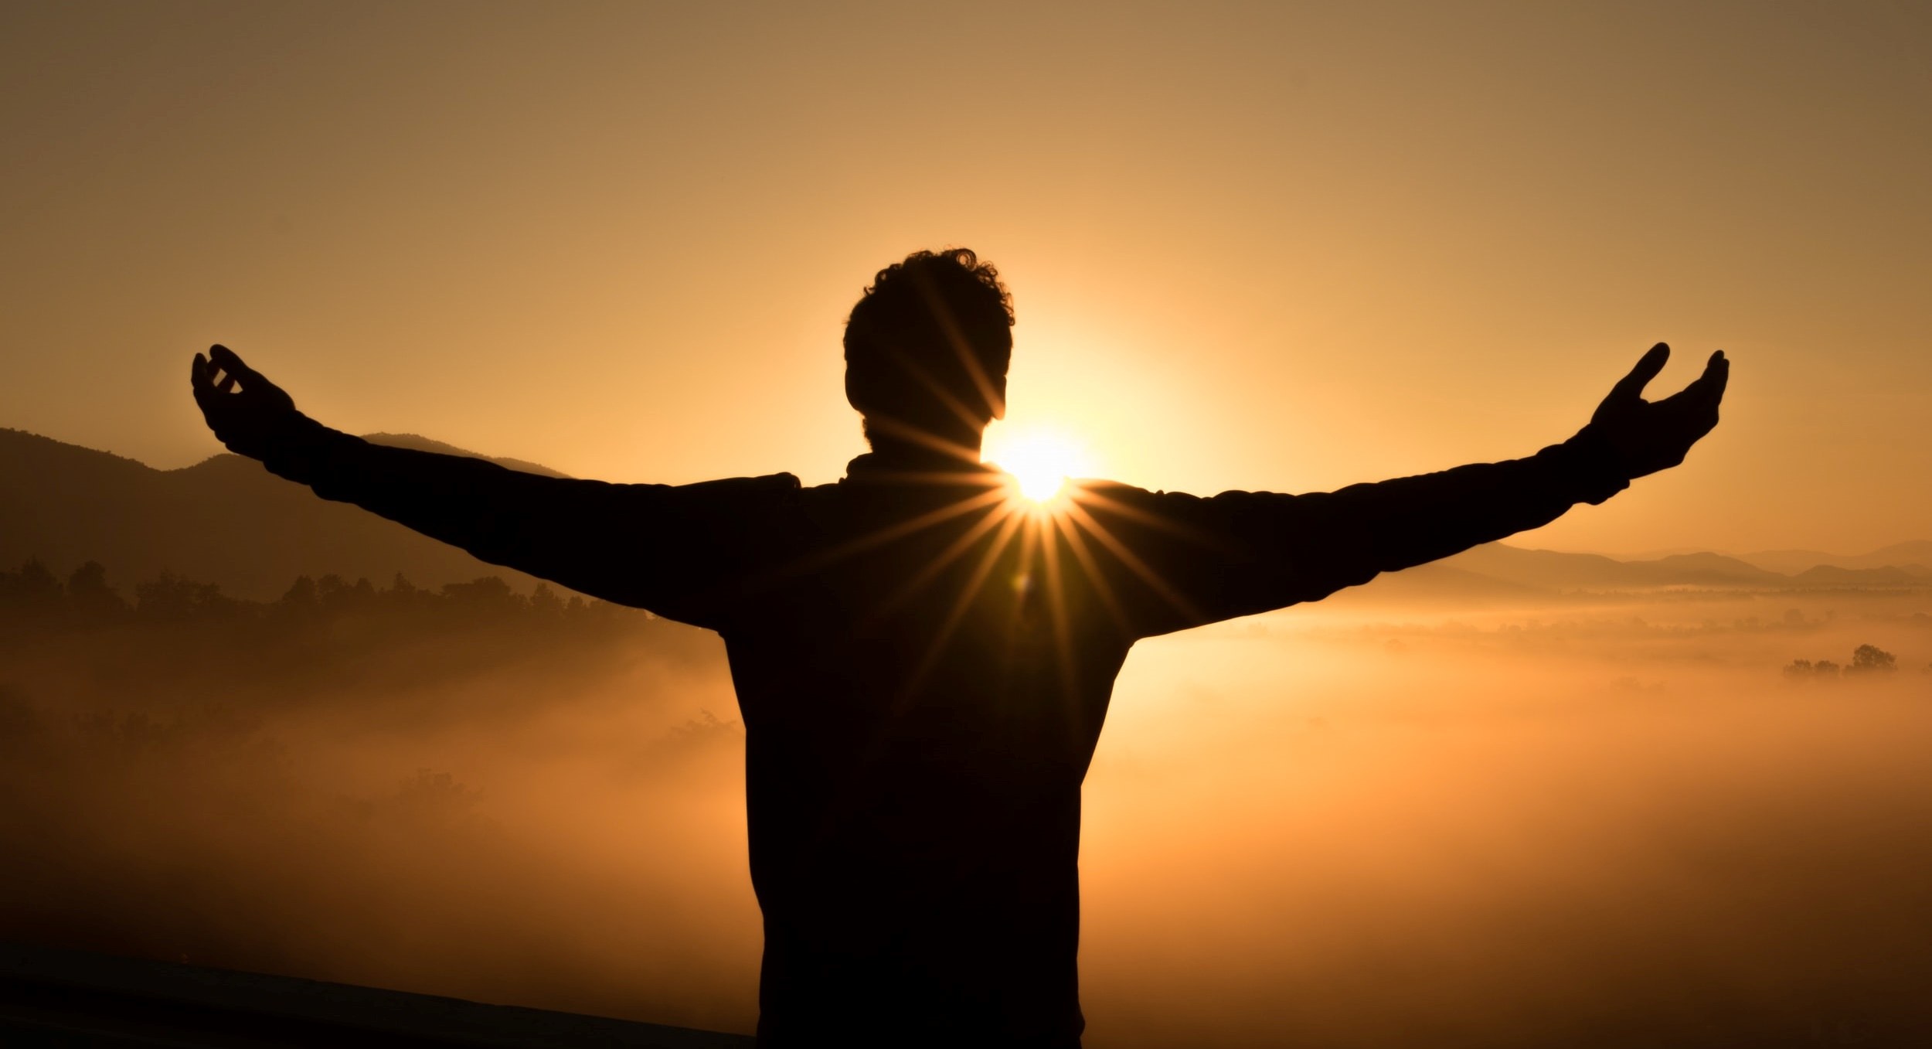
PSALMS of King David
A MAN AFTER GOD’S OWN HEART

Slide 8
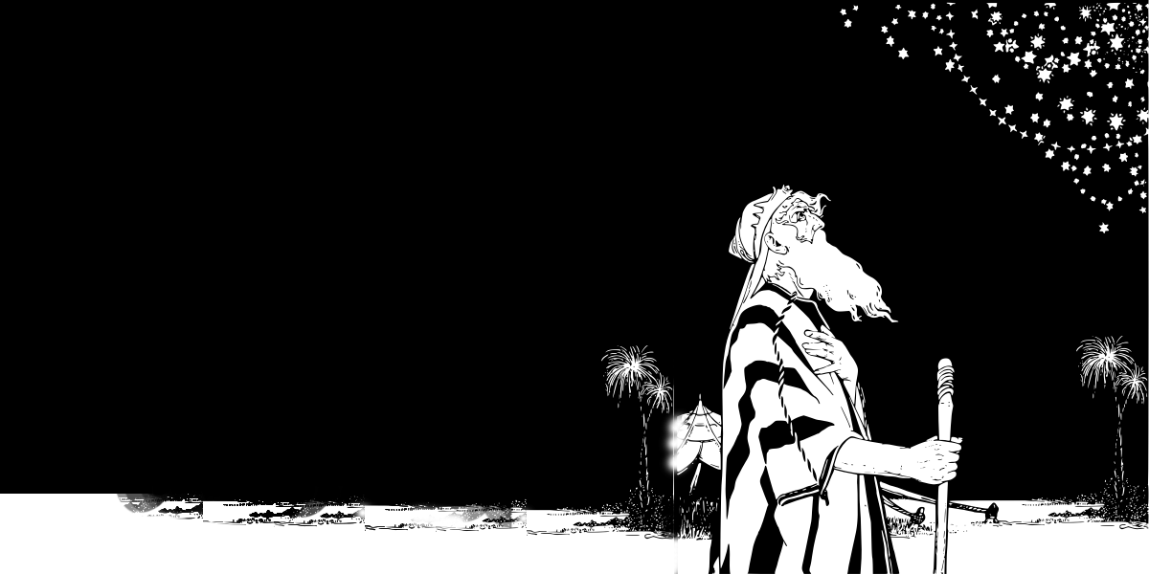
THE PROMISES
“I will make you a great nation.”
“Your descendants will inherit this land.”
“Your seed will bless the world.”

Slide 9
THE PROMISES
And to his Seed which is Jesus Christ
Galatians 3:16

Slide 10
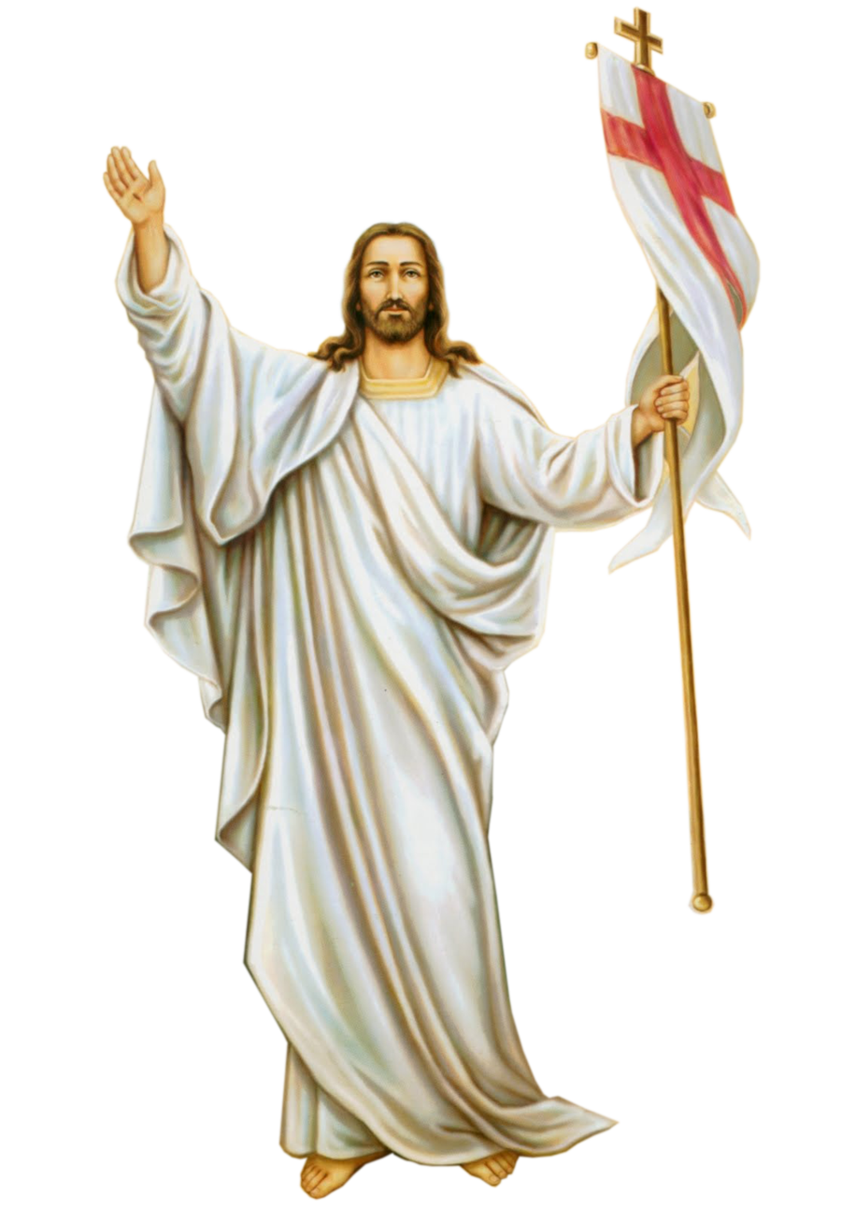
FAMILY CONVERSATION
What is your family’s plan for Living the 50 Days of the Easter Season fully?

Slide 11
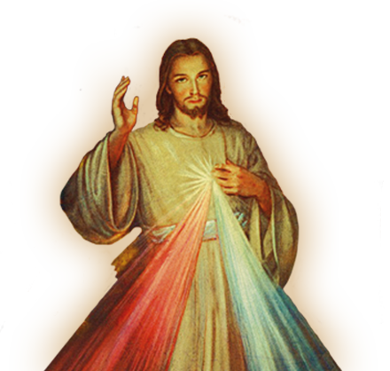
CLOSING PRAYER
Pray the Divine Mercy Chaplet

