Slide 1
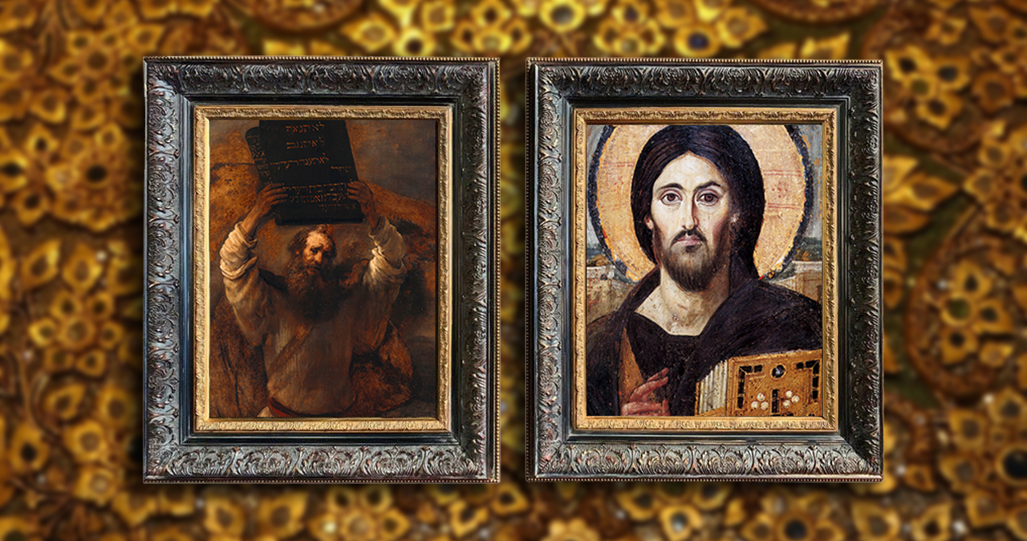
FAMILIES FORMING DISCIPLES
Jesus:
The New Moses,
The Rescuer

Slide 2
^{Opening Prayer}
Lord Jesus Christ,
We entrust our family to You and ask for Your blessing and protection. We love You Lord Jesus with all our hearts and we ask that You help our family become more like the Holy Family. Help us to be kind, loving, and patient with one another. Give us all the grace we need to become saints and Your faithful disciples.
Amen.

Slide 3
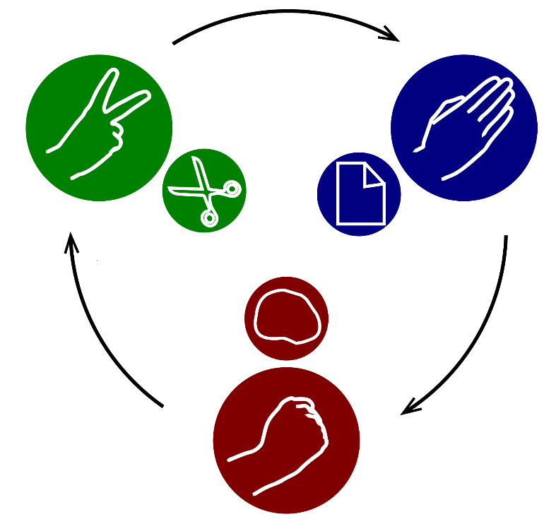
^{Ice Breaker}
Family
ROCK – PAPER – SCISSORS

Slide 4
FAMILY LENTEN PLANS?
How are your Family Lenten Plans going?
What traditional Lenten practices of prayer, fasting and almsgiving have you been practicing?
Have those practices and traditions brought you closer to God?

Slide 5
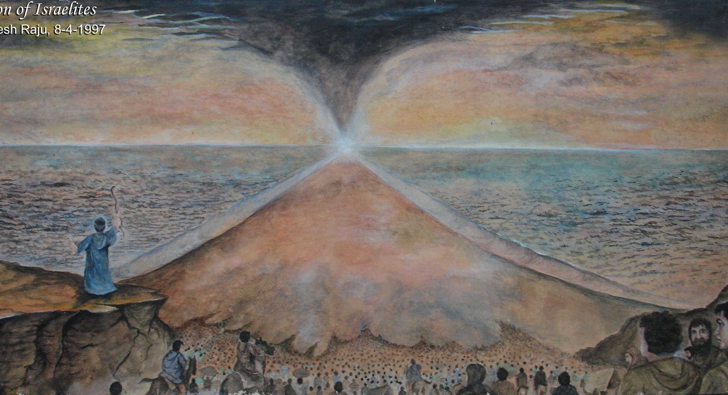
THE BEGINNING OF ISRAEL AS A GREAT NATION

Slide 6
PASSOVER & DEATH OF THE FIRSTBORN

Slide 7
Watch: The Prince of Egypt, Red Sea Crossing
&/or Read: Exodus 14:10-31

Slide 8
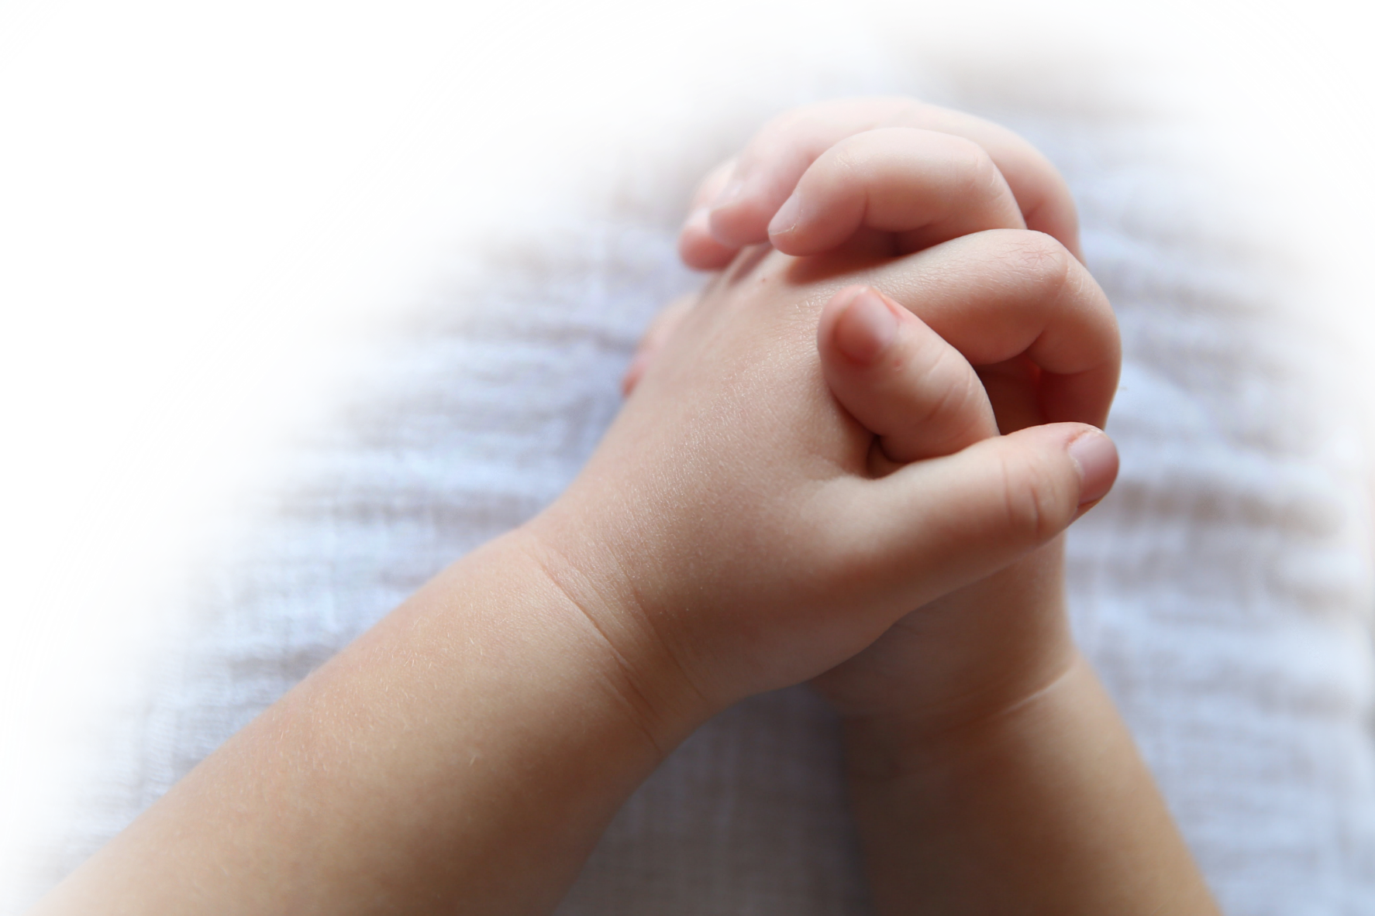
FAMILY CONVERSATION
Remember, you too are adopted sons and daughters of Abraham! Your family, and each one of you,
are also God’s special,
chosen people!
Share about a time when God
answered your prayers.
How did you feel?

Slide 9
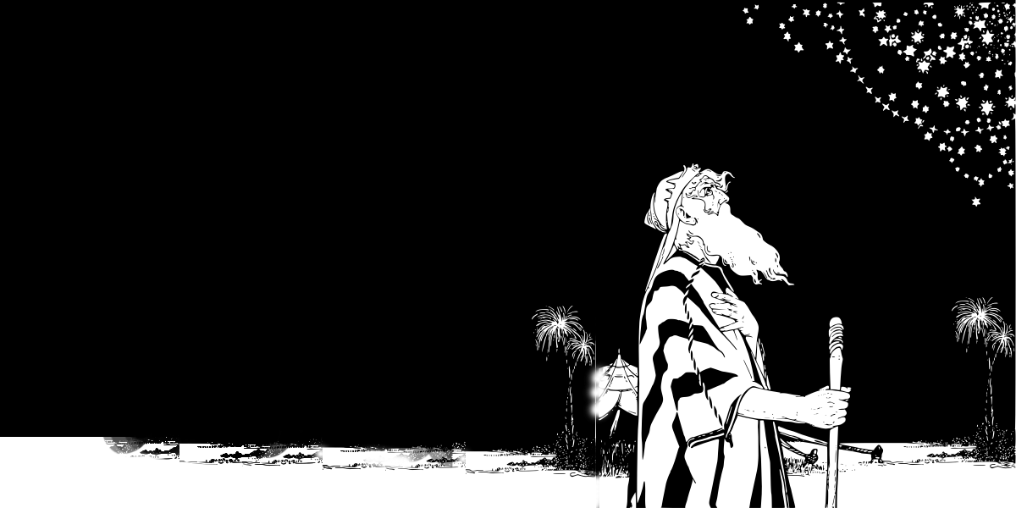
PROMISES FULLFILLED
Let’s read the Bible!
This would fulfill the promise God made to Abraham all those centuries ago,
“I will make of you a great nation and I will bless you” Gen. 12:2.

Slide 10
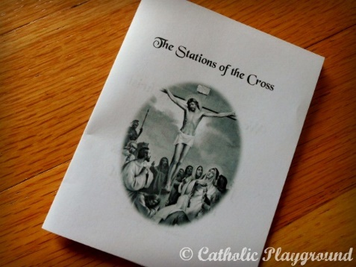
Family Mission Activity
1. Introduce Mission Activity
2. Explain Activity
i. Watch two or more of the videos on Lent and Joshua and the Israelites
ii. Review Holy Week At-Home ideas for the days of Holy Week
iii. Discuss how your Family Lenten Plan is going and review/renew your practice of the Lenten pillars of praying, fasting and almsgiving. Encourage each other and stay the course!
iv. Color Stations of the Cross Mini Coloring booklet.
v. Gather around your prayer altar as a family. Take a moment to be silent and bring yourselves into God’s presence. Pray and meditate on the Stations of the Cross using your booklet. Place your Stations of the Cross booklet on your home altar/prayer space.
vi. Remember to bring your Stations of the Cross booklet to Week 3’s

Slide 11
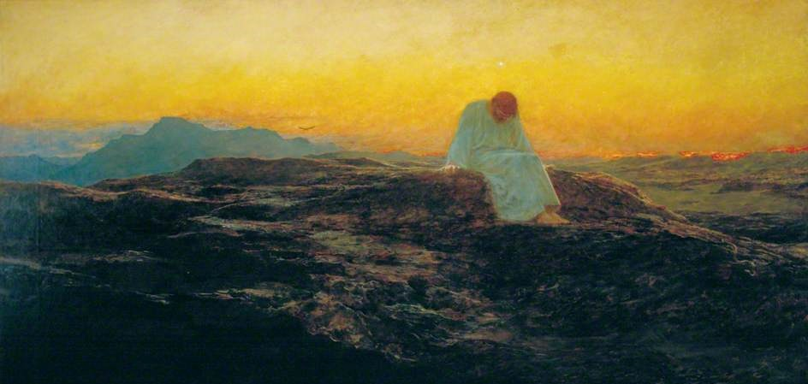
Closing Prayer
Dear Lord, we thank you for the gift of Your Son, Jesus, who calls us to imitate Him by:
Fasting from judging others; Feasting on Christ dwelling in them.
Fasting from fear of illness; Feasting on the healing power of God.
Fasting from words that pollute; Feasting on speech that purifies.
Fasting from discontent; Feasting on gratitude.
Fasting from anger; Feasting on patience.
Fasting from pessimism; Feasting on hope.
Fasting from negatives; Feasting on encouragement.
Fasting from bitterness; Feasting on forgiveness.
Fasting from self-concern; Feasting on compassion.
Fasting from suspicion; Feasting on truth.
Fasting from gossip; Feasting on purposeful silence.
Fasting from problems that overwhelm; Feasting on prayer that sustains.
Fasting from anxiety; Feasting on faith.
This Lent we ask that You pour out your holy grace upon our families, that we may fast and feast in love. Amen.
^{- Author Unknown}

