Slide 1
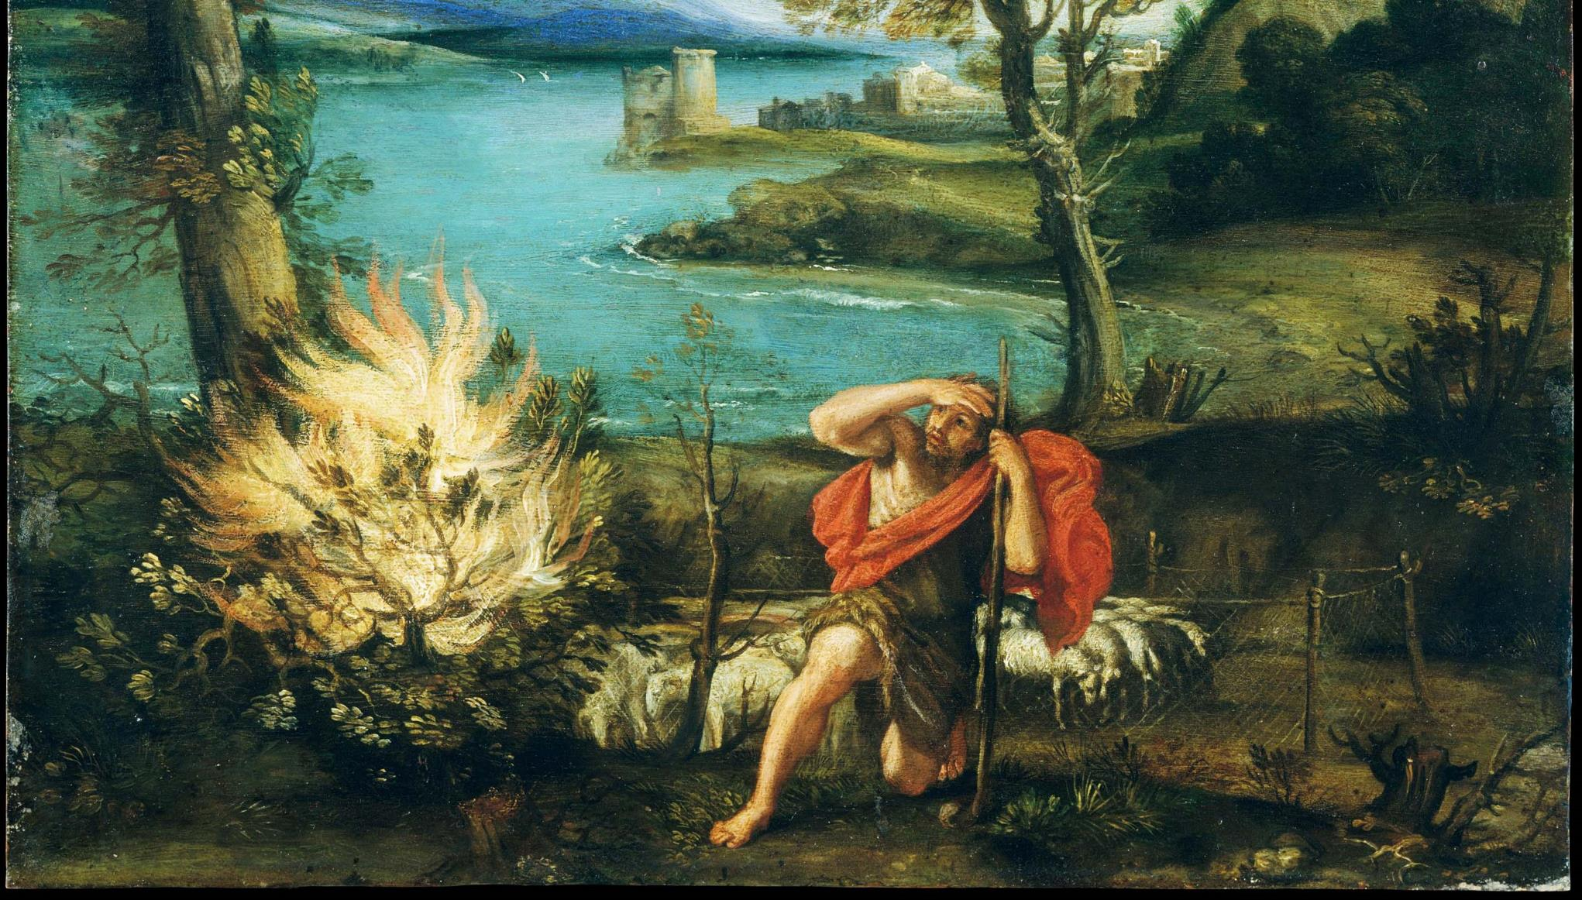
^{Families Forming Disciples}
GOD’S COVENANT WITH MOSES

Slide 2
^{Opening Prayer}
Lord Jesus Christ,
We entrust our family to You and ask for Your blessing and protection. We love You Lord Jesus with all our hearts and we ask that You help our family become more like the Holy Family. Help us to be kind, loving, and patient with one another. Give us all the grace we need to become saints and Your faithful disciples.
Amen.

Slide 3
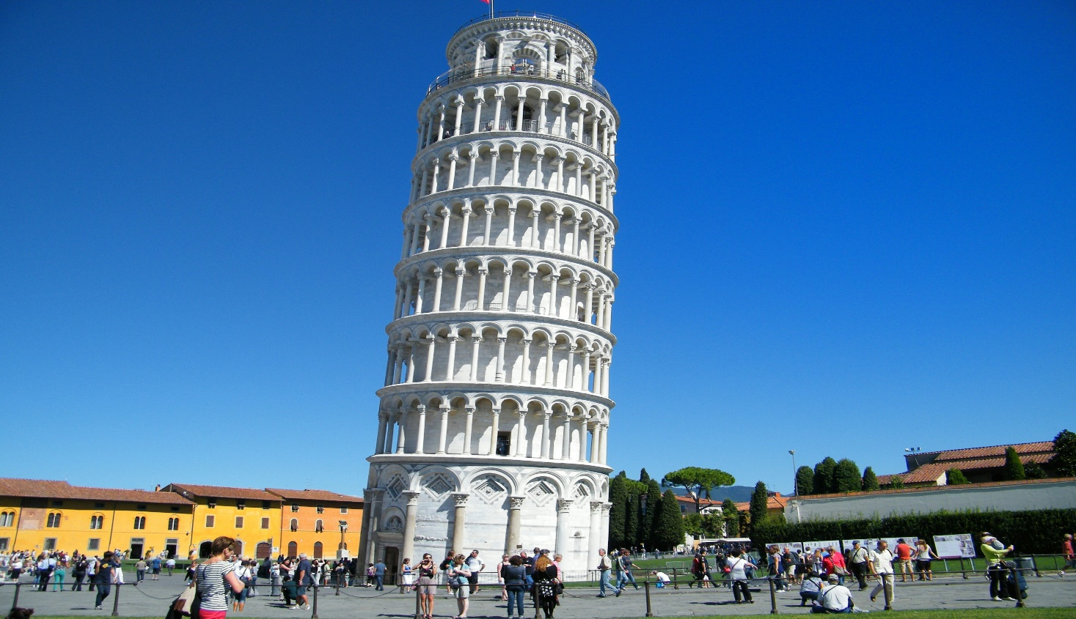
^{Ice Breaker}
Build a Leaning Tower

Slide 4
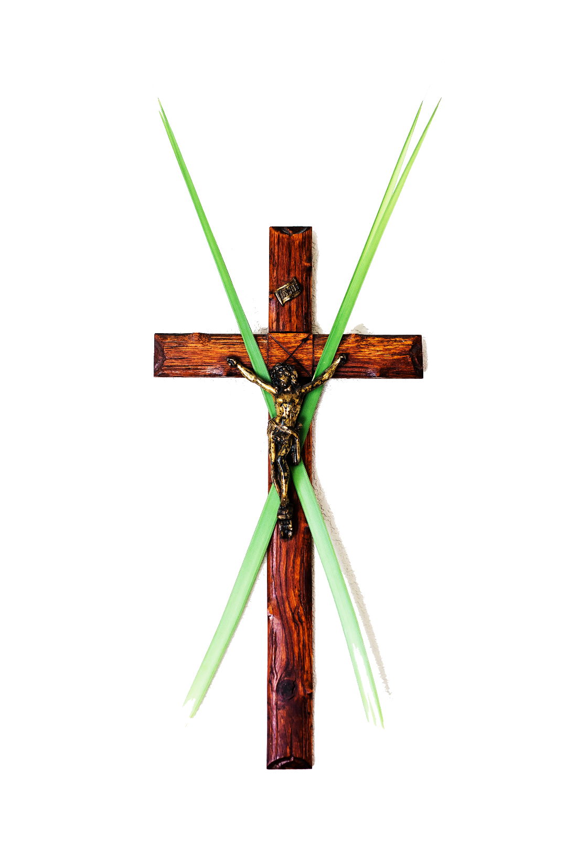
FAMILY SHARING
Each family shares about their Family Lenten Plan and how it relates to the three Lenten Pillars of Prayer, Fasting and Almsgiving.
Families that brought in a sacramental or a picture of their home altar, please share those items and talk about why they are important to your family.

Slide 5
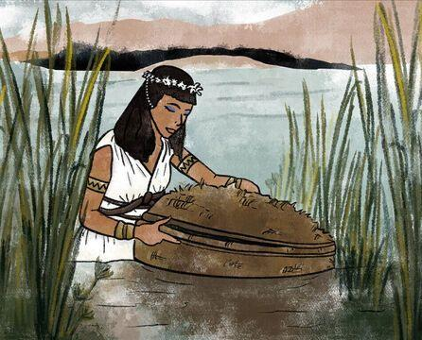
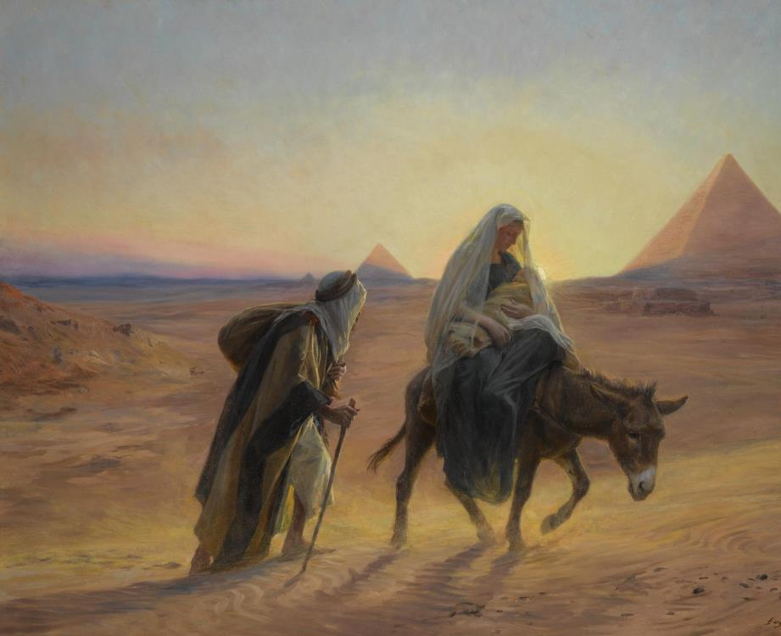
REVIEW MAIN CONCEPT
Baby Moses foreshadowed the Baby Jesus’ escape into Egypt.

Slide 6
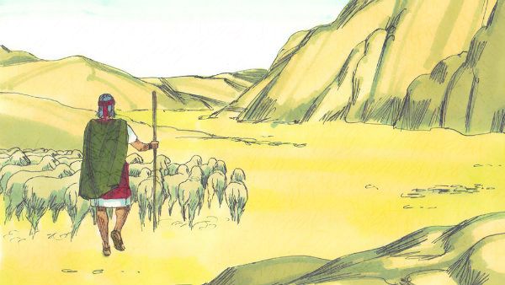
CONTENT
Exodus 2

Slide 7
FAMILY CONVERSATION
The Prince of Egypt (1998) Scene: "I am that I am"/Burning bush
https://www.youtube.com/watch?v=GqDMBlRaJJM

Slide 8
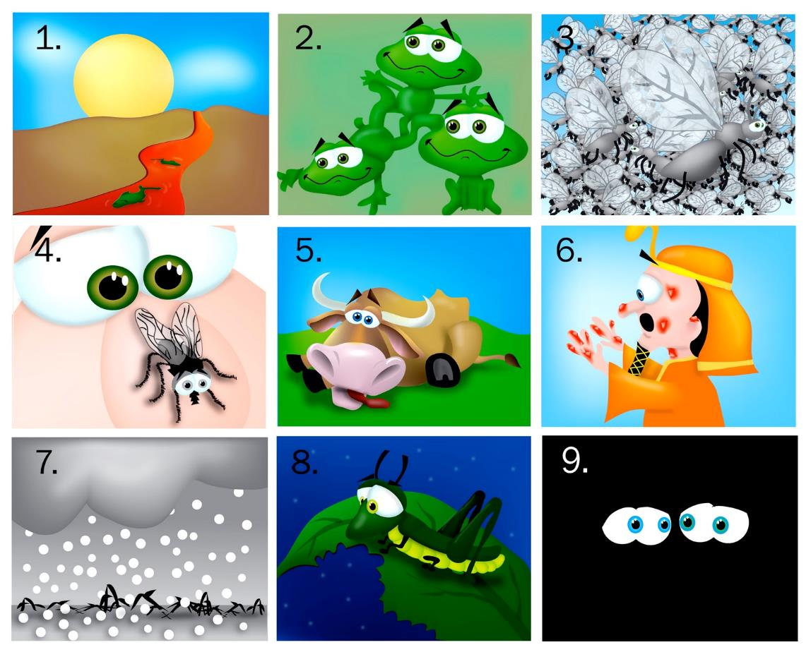
THE TEN PLAGUES
Let’s read the Bible!

Slide 9
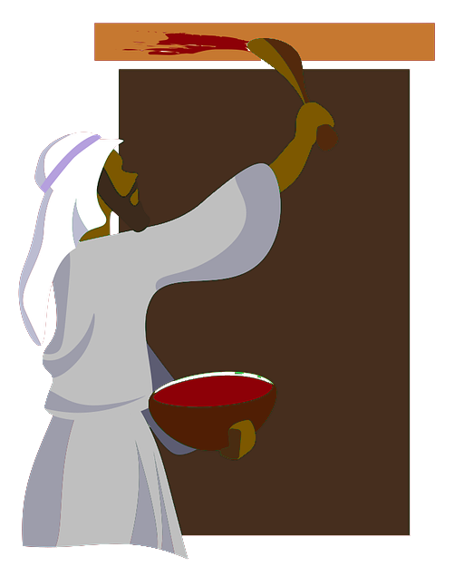
PASSOVER

Slide 10
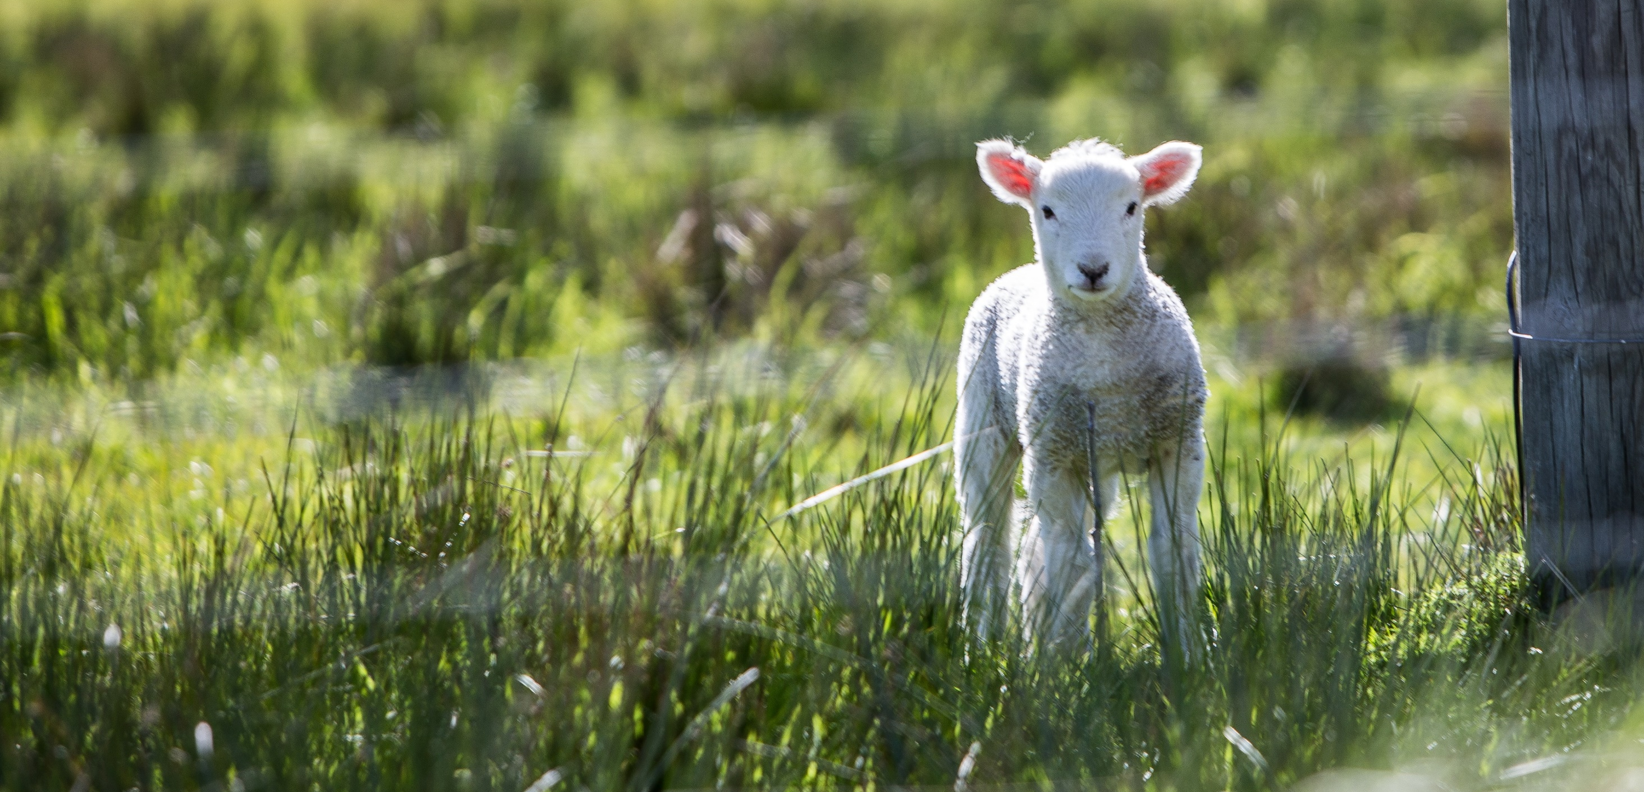
Family Conversation
Do you see any clues from this Passover story that point to Jesus? What are they? Are there any clues that remind you of the Eucharist or the Holy Sacrifice of the Mass?

Slide 11
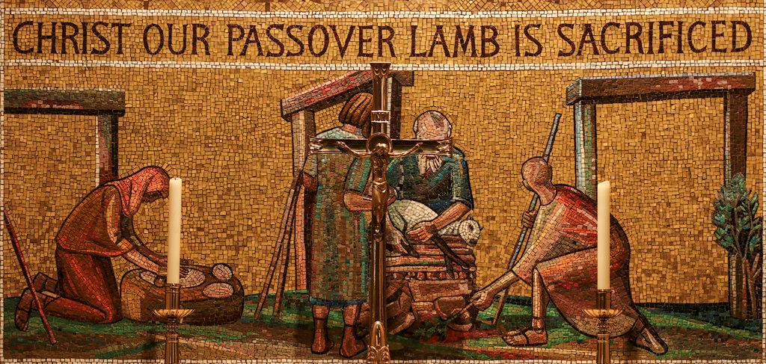
Read Possible Answers

Slide 12
Closing Prayer
Dear God, Holy One,
We ask You to help each member of our family here to be completely humble and gentle in all their interactions; and to be patient, bearing with one another's faults in love – even when we're tired, frustrated, angry, or hurt. Thank You for sending Your Son who gave His life to save us from our sins and for the gift of the Holy Eucharist. Give us Your grace and help us to make every effort to remain united in the Holy Spirit within our homes. Please bind us together in peace.
Amen.

