Slide 1
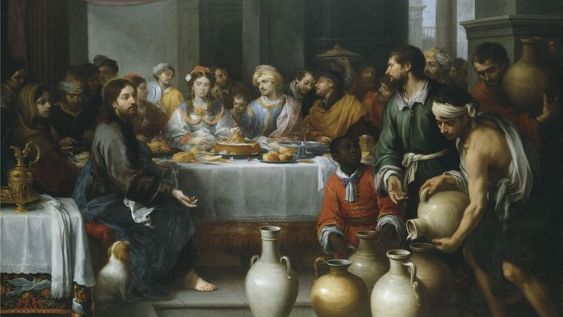
THE LIFE OF CHRIST: THE LUMINOUS MYSTERIES
THE WEDDING AT CANA

Slide 2
^{Opening Prayer}
Lord Jesus Christ, we entrust our family to You and ask for Your blessing and protection. We love You Lord Jesus with all our hearts and we ask that You help our family become more like the Holy Family. Help us to be kind, loving, and patient with one another. Give us all the grace we need to become saints and Your faithful disciples.
Amen.

Slide 3
^{Ice Breaker}
THANKFUL GAME
Gather everyone in your family around a table
Pass out one notecard to each person.
On separate notecards, write down each person’s name, shuffle, and place in a bowl. Then have each person draw a name. If anyone draws themselves they should redraw.
On the blank notecards, have everyone write three things he/she are grateful for about the person they drew.
One person reads their card out loud. Then have the rest of the family guess who the card is about.
Smile and remember to focus on love, not only during Thanksgiving and Christmas but each and every day.

Slide 4
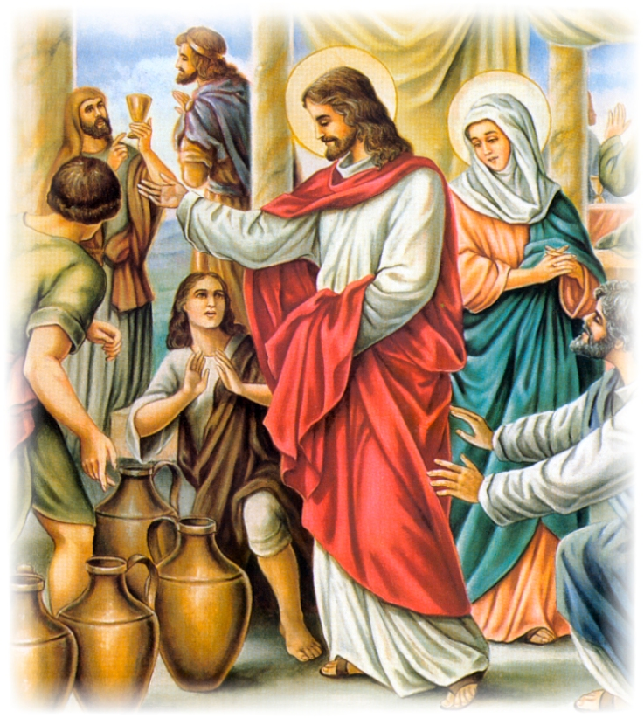
MAIN CONCEPT
Today,
we’re going to learn
about the
Wedding at Cana!

Slide 5
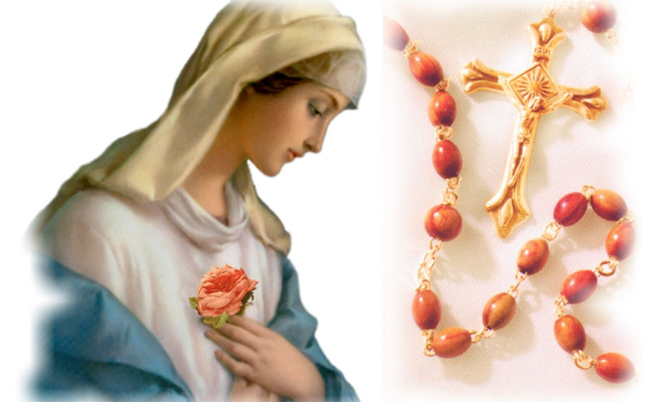
FAMILY SHARING (large group)
This month, during Week 2, you reached out to a grandparent(s) or senior adult(s) in your family/ community and shared about how the Joyful Mysteries of the Rosary are about Jesus’ birth and childhood.
To whom did you reach out?
Which Joyful Mystery is his/her favorite and why?
Did he/she ever pray the Rosary or read the Bible either as a child or as an adult?
What wisdom did your grandparent or senior share with you about living your faith?

Slide 6
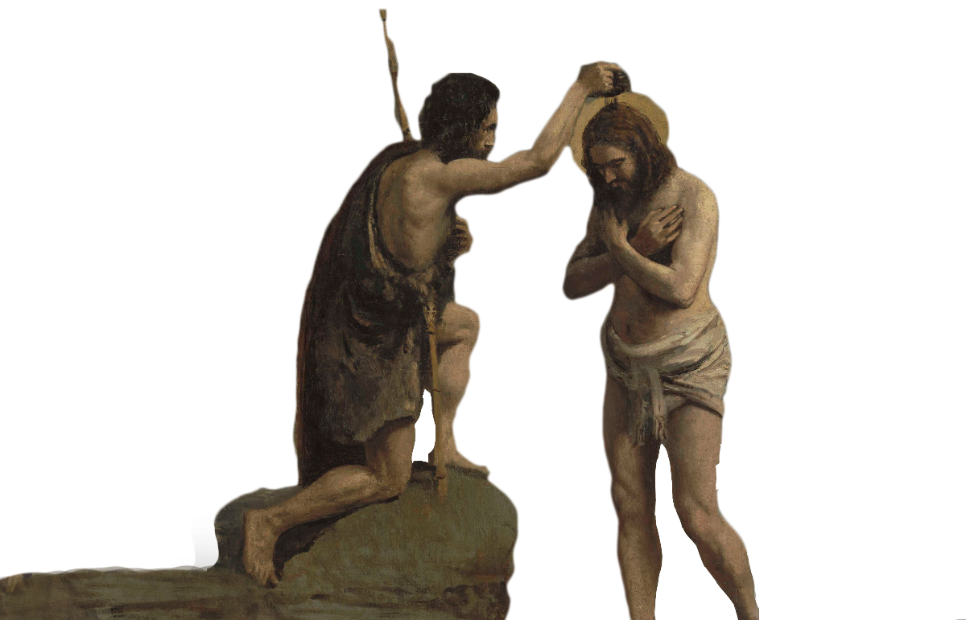
JESUS’ BAPTISM
Do you remember
what happened at
Jesus’ baptism?

Slide 7
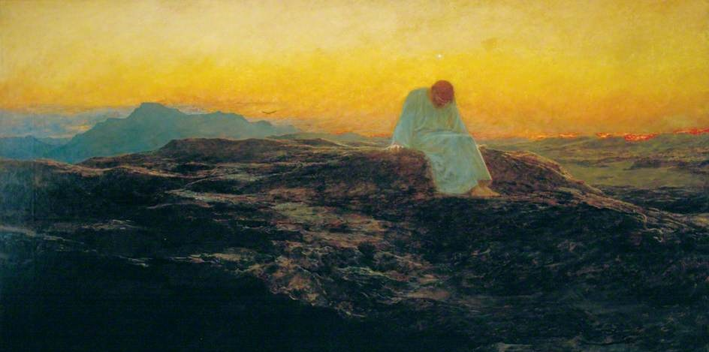
Led by the Spirit…
Does anyone know where the
Holy Spirit led Jesus right after
Jesus was baptized?

Slide 8
Wedding at Cana
https://youtu.be/nD88q3vGNR4

Slide 9
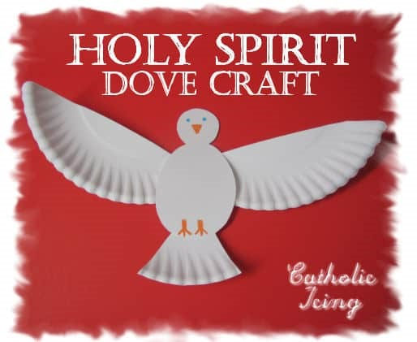
FAMILY ACTIVITY
The Holy Spirit is active in every moment of our lives,
just as He was in Jesus’ life.
The Holy Spirit was at Jesus’ baptism.
The Holy Spirit led Jesus into the desert, and
the Holy Spirit led Mary throughout her life.
Think about how the Holy Spirit is with you and
your family
as you create the Holy Spirit Dove Craft.
(by Catholic Icing:https://www.catholicicing.com/)

Slide 10
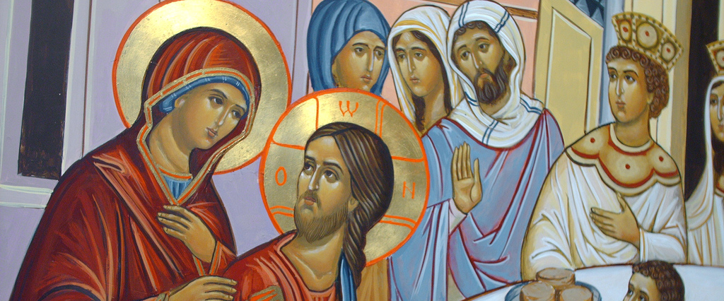
CLOSING PRAYER
When we say each prayer of the Rosary, we are also thinking about the life that Jesus and Mary lived together on earth.
Those moments are called mysteries, and in our hearts we put ourselves there with Jesus and Mary.
Today, we will think about the story of the Wedding at Cana, and unite ourselves there with them in that mysterious moment,
as we pray a decade of the
Rosary together.

