Slide 1
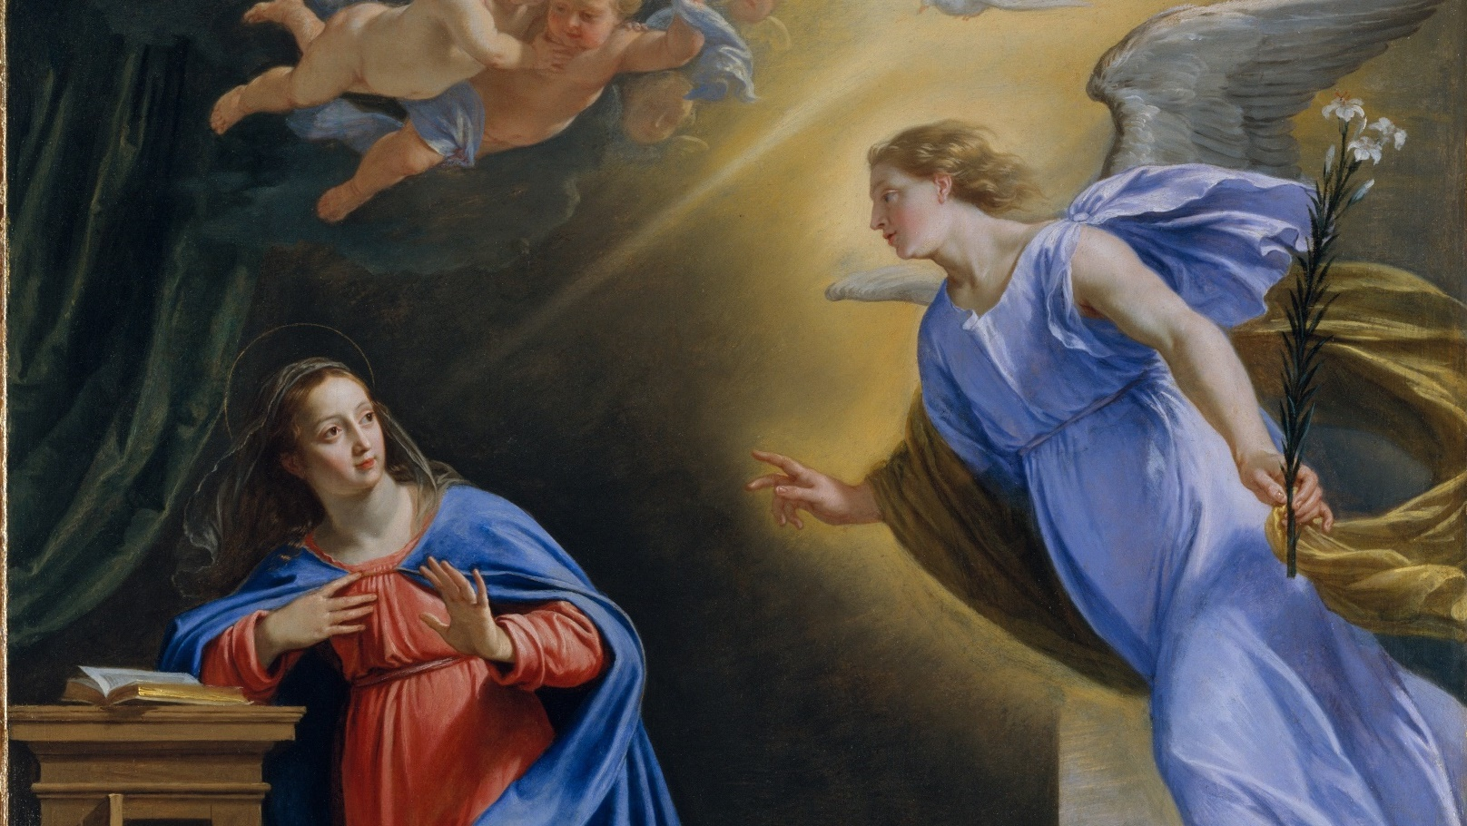
THE LIFE OF CHRIST: THE JOYFUL MYSTERIES

Slide 2
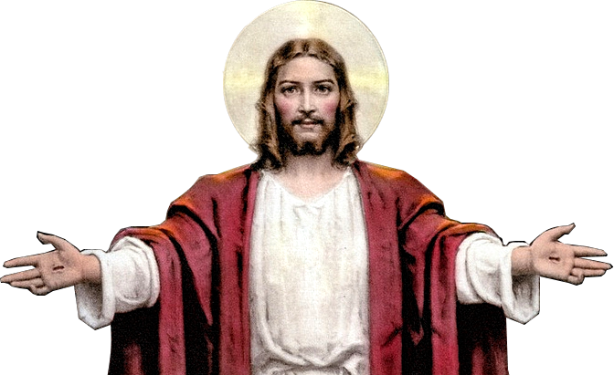
^{Opening Prayer}
Lord Jesus Christ, we entrust our family to You and ask for Your blessing and protection. We love You Lord Jesus with all our hearts and we ask that You help our family become more like the Holy Family. Help us to be kind, loving, and patient with one another. Give us all the grace we need to become saints and Your faithful disciples.
Amen.

Slide 3
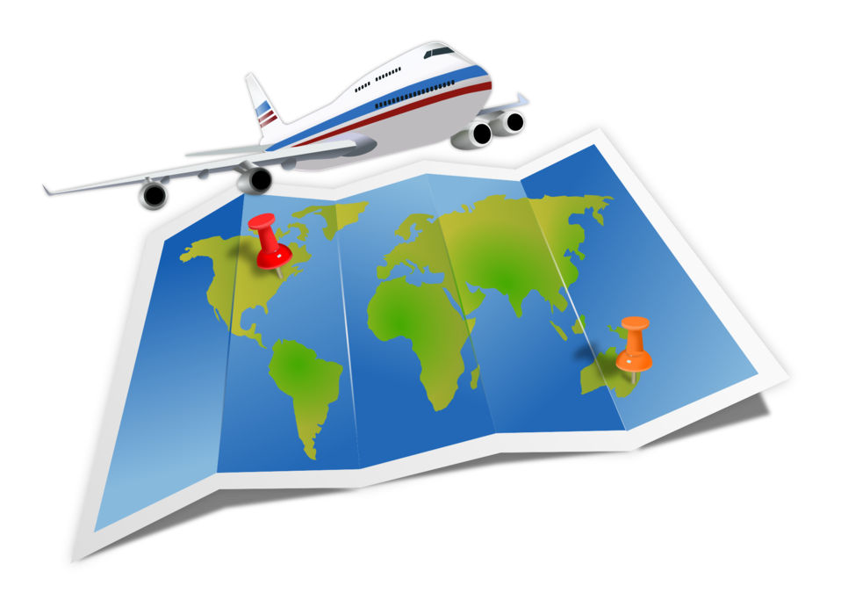
^{Ice Breaker}
FAMILY ADVENTURE
Each family member answers the question:
If you were to plan a journey or family adventure, where would your family go and why?

Slide 4
Question?
What is the first part of the Bible called?

Slide 6
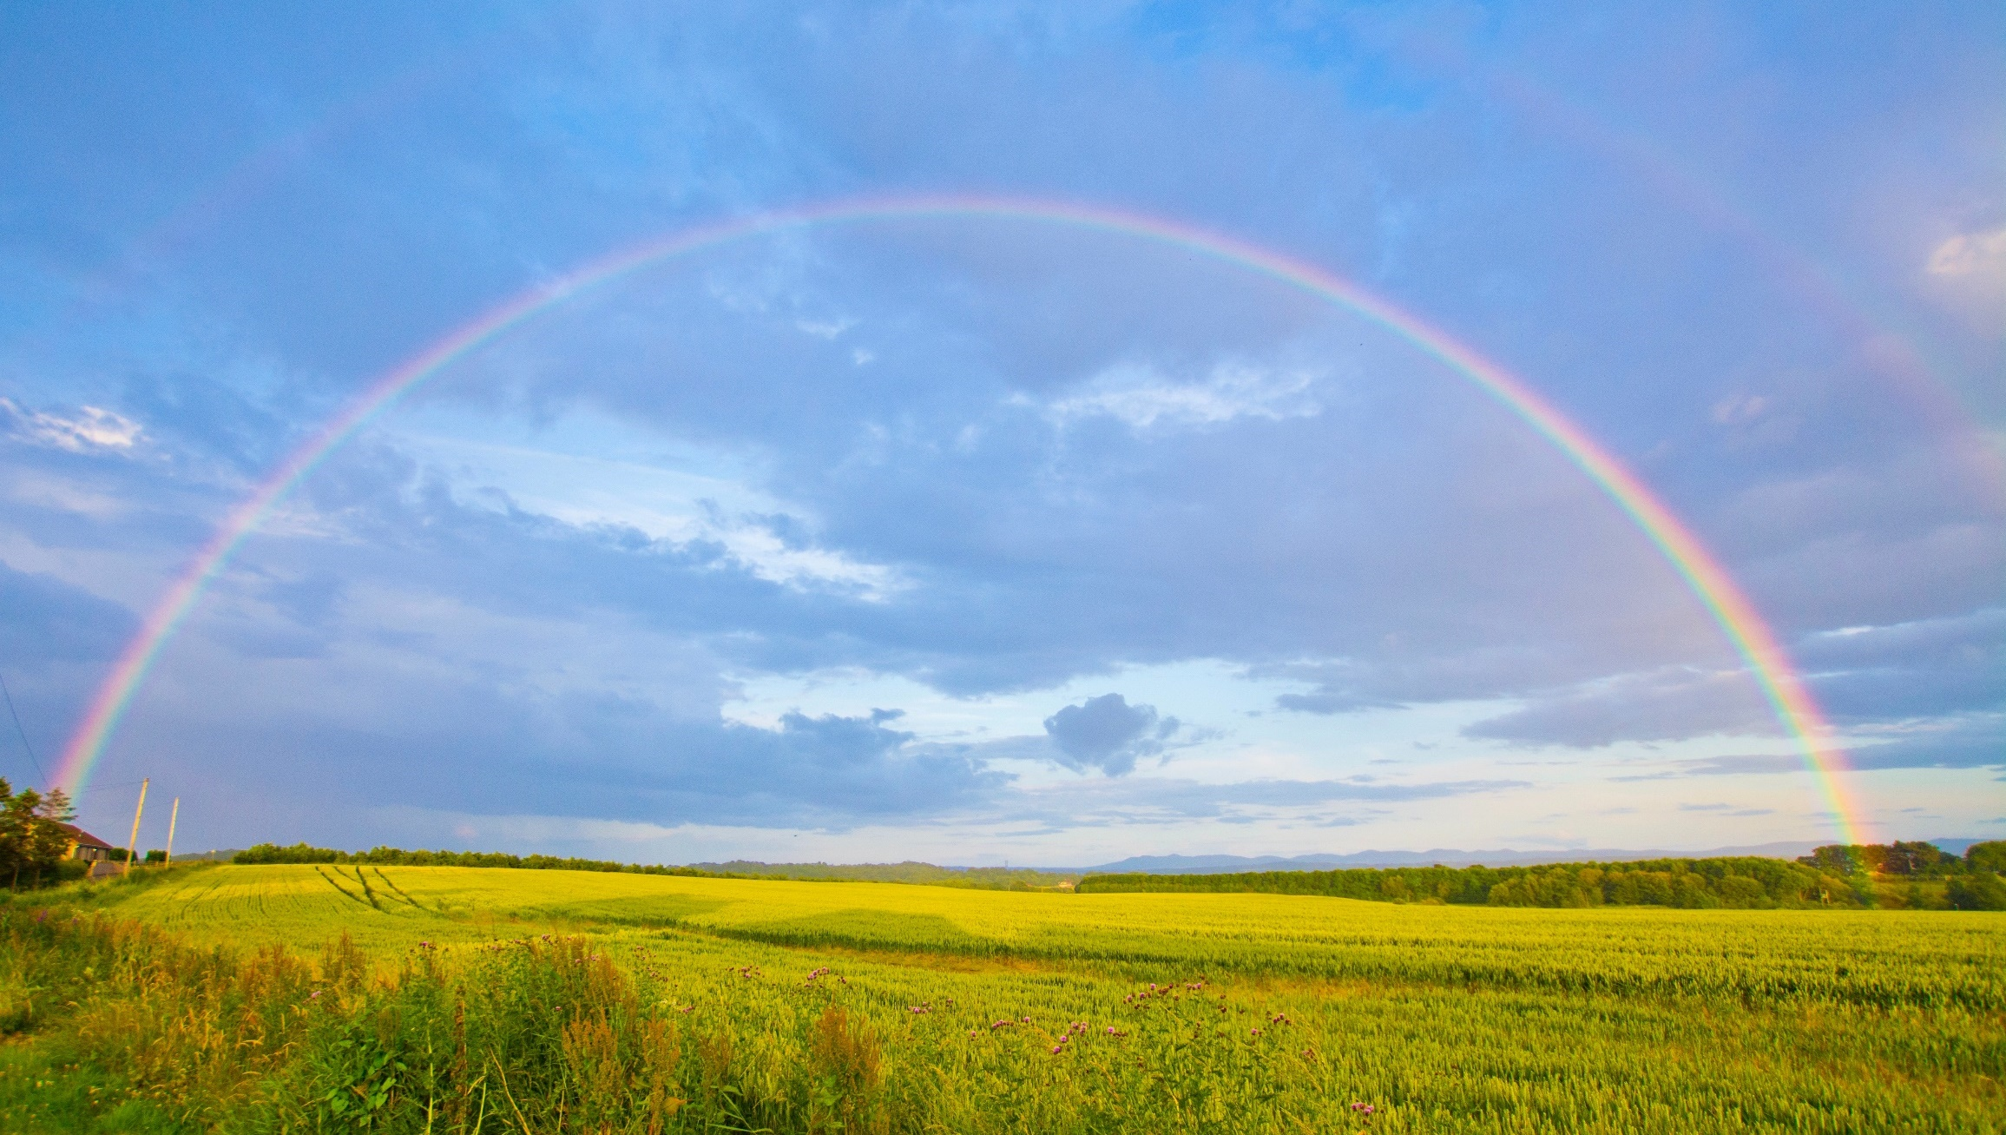
I set my bow in the clouds
to serve as a sign of the covenant between me and the earth.
GENESIS 9:13

Slide 7
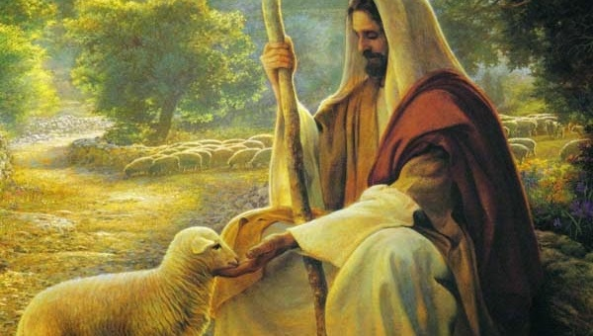

Slide 8
FAMILY CONVERSATION
The Catholic Church has Seven Sacraments:
Share about a time when you received one of the Sacraments and knew God’s covenantal love for you.

Slide 9
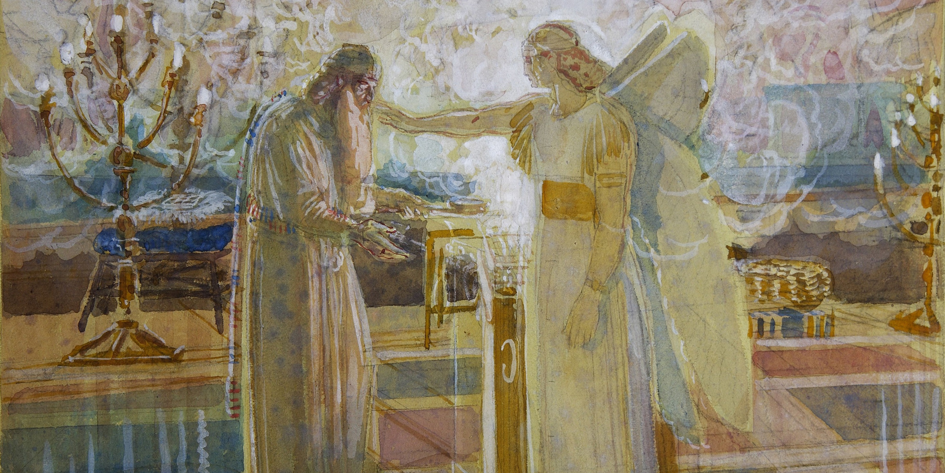
LUKE 1:5-25

Slide 10
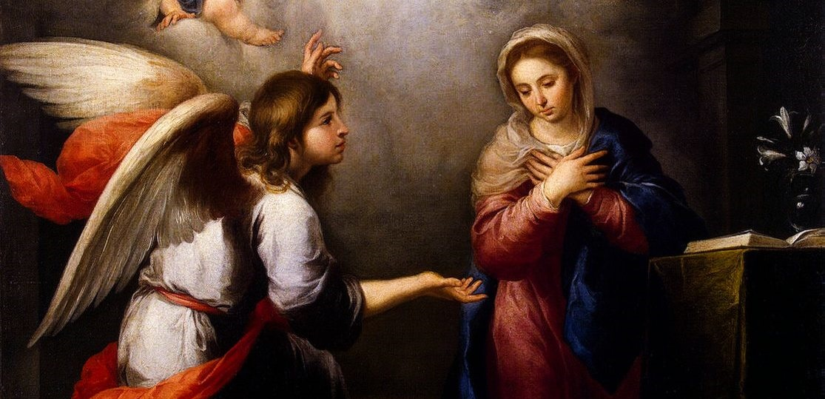
THE ANNUNCIATION

Slide 11
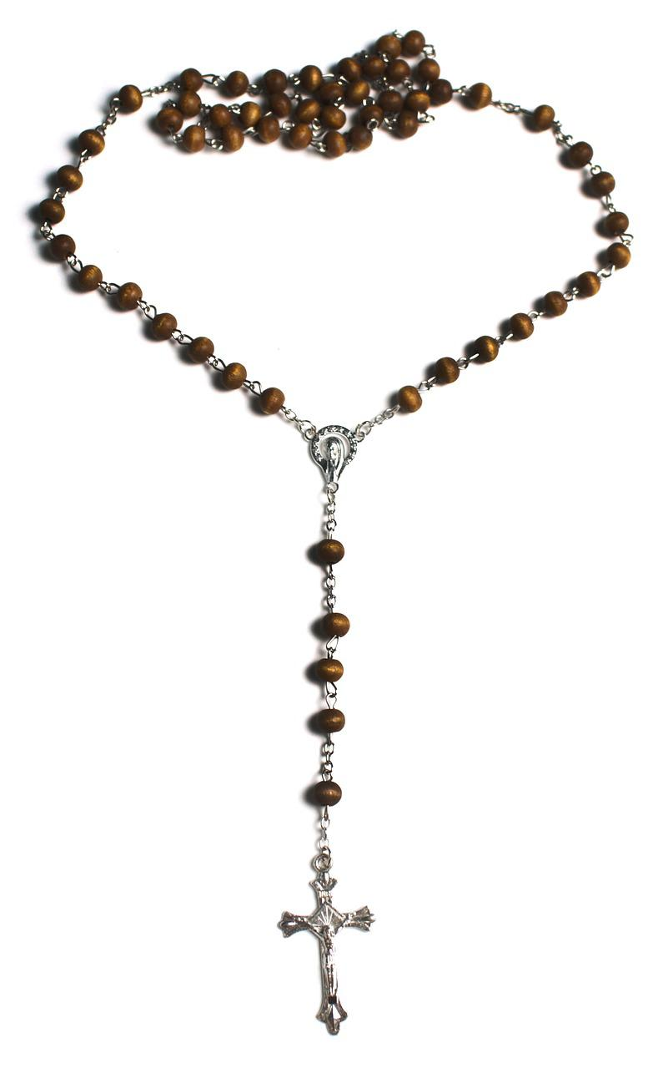
FAMILY MISSION
Your Family At-Home Mission is to:
Review the resources provided
Learn more about the Gospel
Enjoy making Full of Grace Ice Cream Floats
Pray a decade of the Rosary meditating on the Second Joyful Mystery (the Visitation) together around your home altar/ prayer space.
Be prepared to share about what the Gospel is and what you learned about the four Gospel writers at the Week 3 gathering.

Slide 12
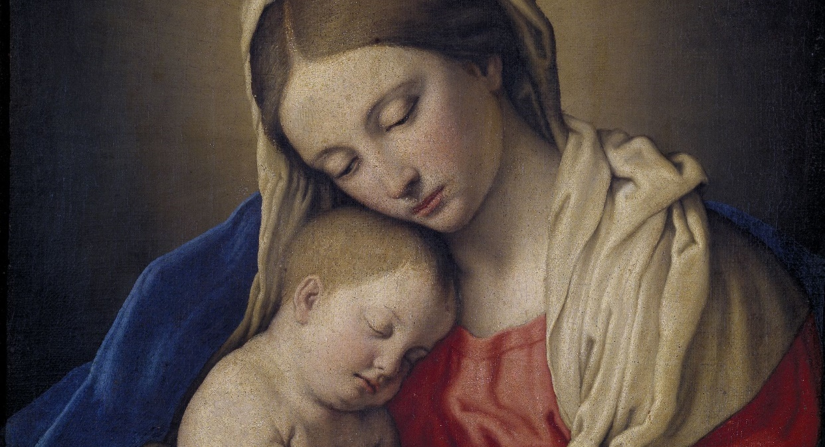
CLOSING PRAYER
Mother Mary, pray for us that our families may receive the grace to truly love your Son, our Lord Jesus Christ. Amen.

