Slide 1
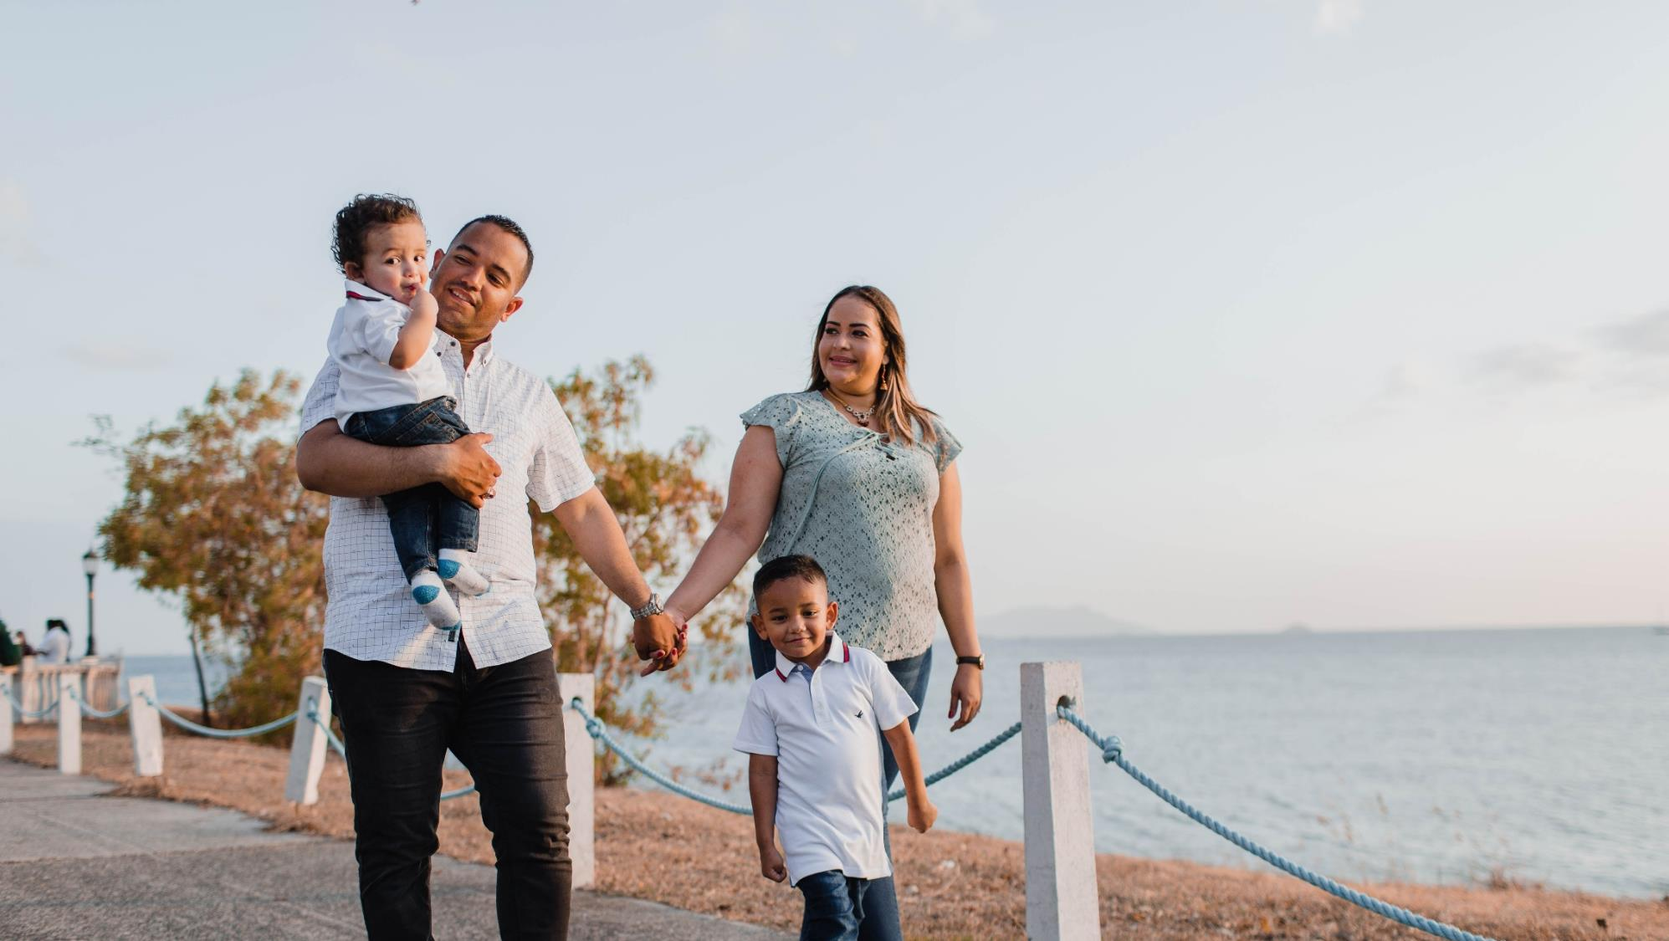
^{FAMILIES FORMING DISCIPLES}
^{LESSON 2 – WEEK 3}

Slide 2
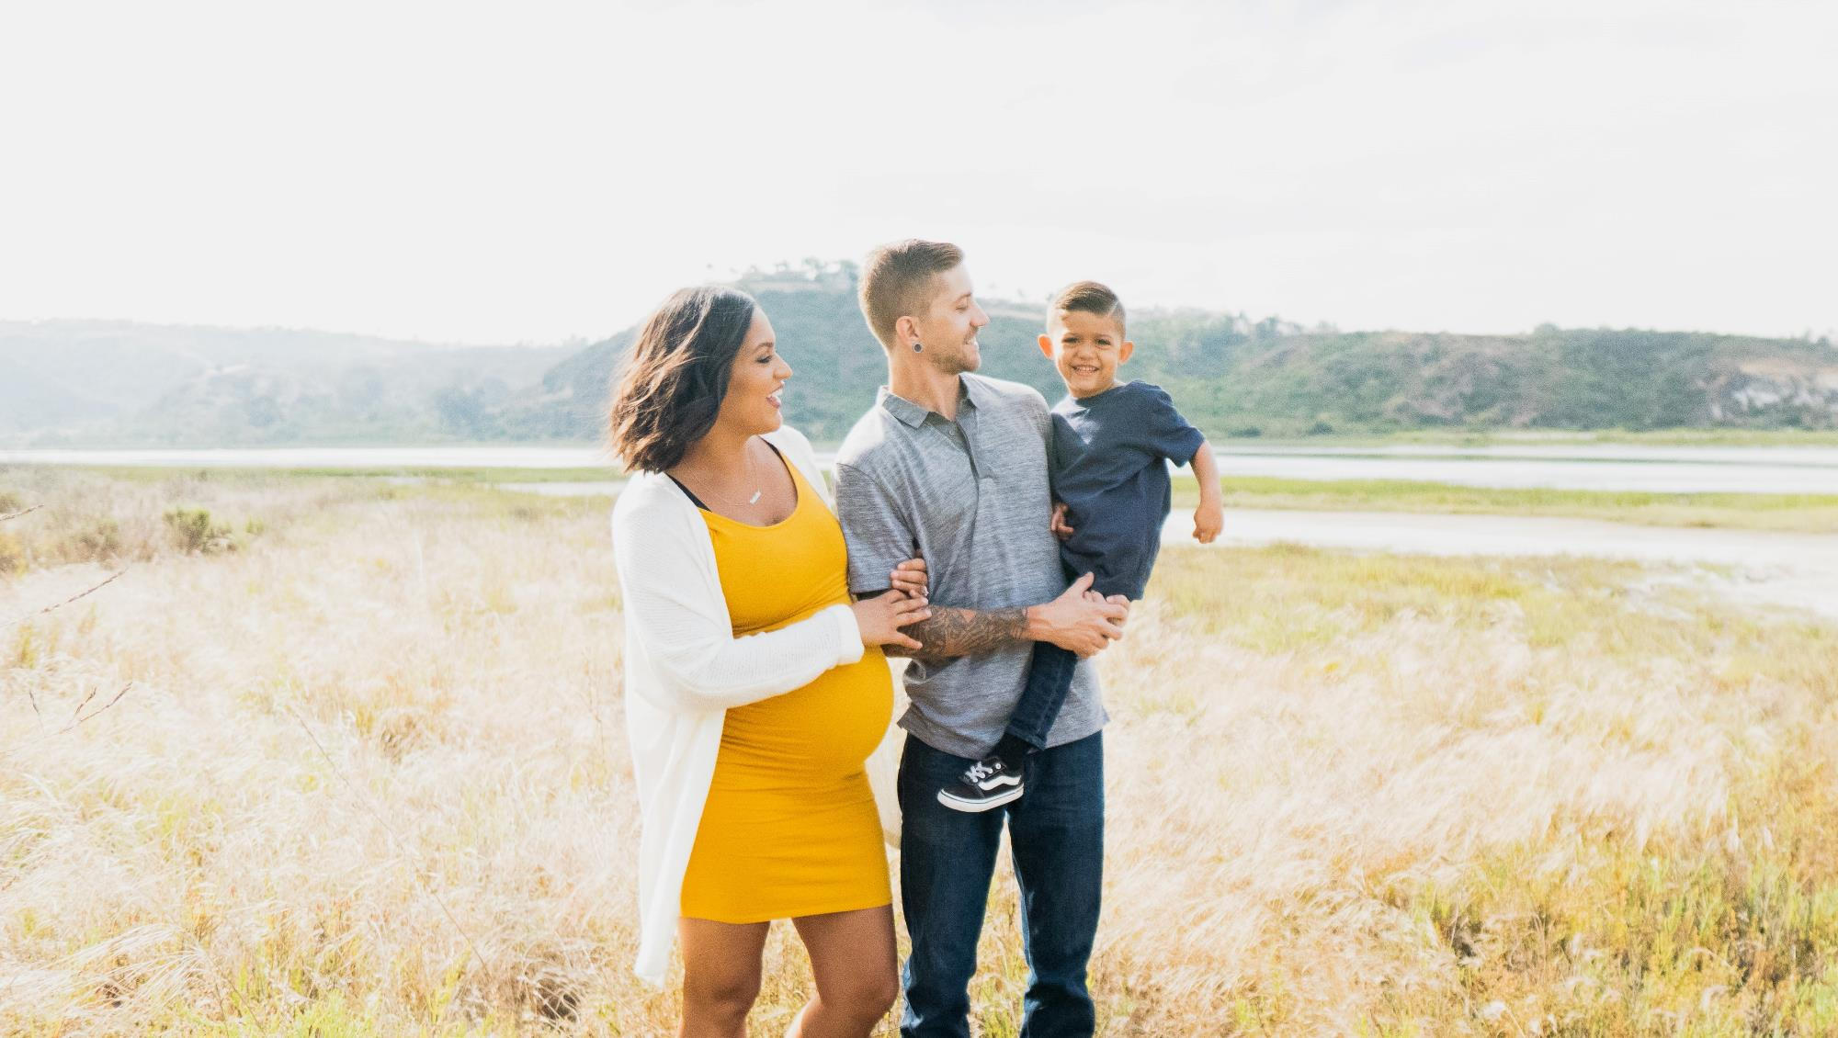
Introducing the Family Rosary as praying with Mary, looking to Jesus with her; Preparing for All Saints Day & All Souls Day
TOPIC

Slide 3
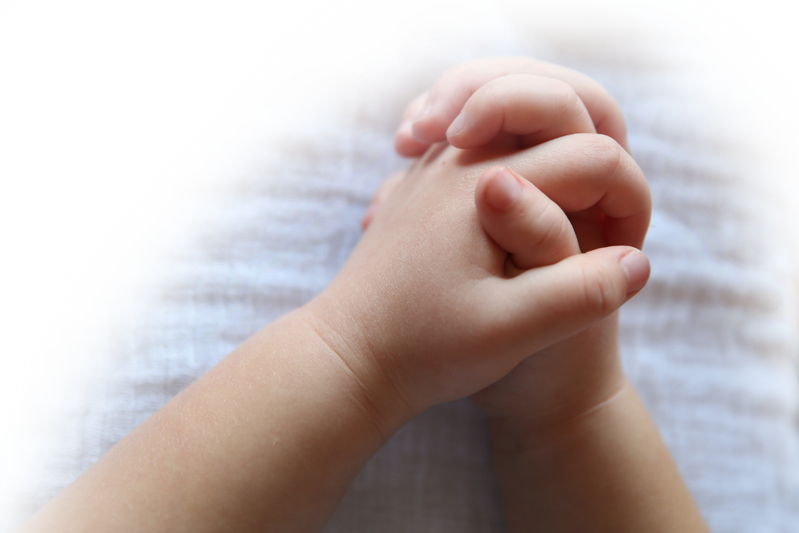
^{Opening Prayer}
Come, Holy Spirit, Lord of Life, bless us and grant us the grace of loving our families, as Jesus calls us to do. Help us to build peace in our hearts, in our homes, and in our world.
^{Our Father…}
(adapted from Catholics For Family Peace)

Slide 4
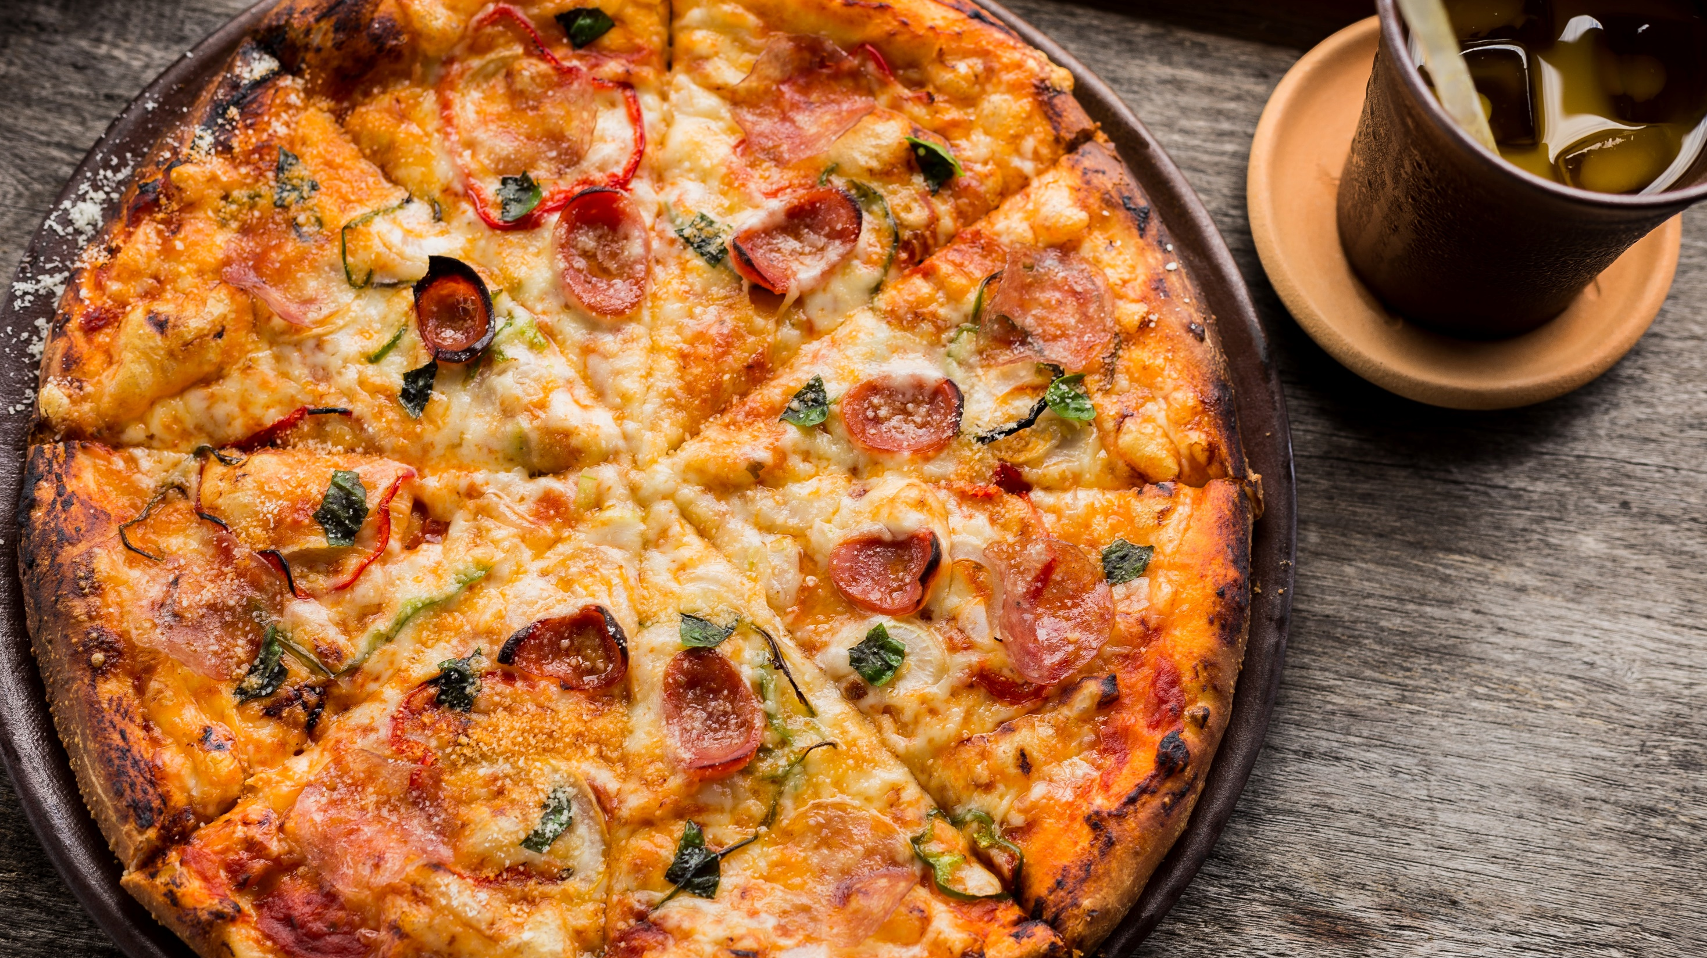
^{ICE BREAKER}
^{If you} could eat only one food for the rest of your life, what would it be?

Slide 5
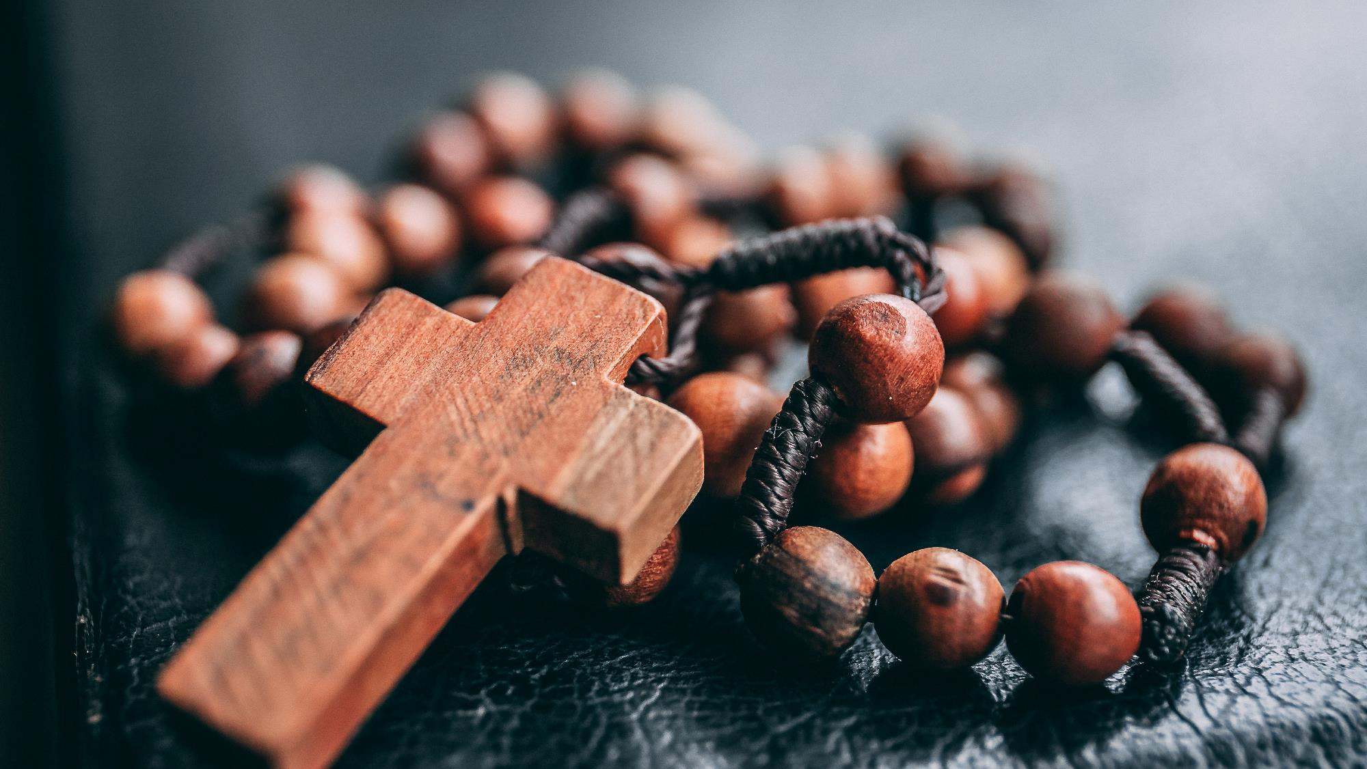
Review Main Concept
Rosary is praying with Mary, looking to Jesus with her, and preparing for All Saints Day & All Souls Day

Slide 6
Watch Praying the Rosary with Your Family

Slide 7
FAMILY SHARING
Please share one thing you learned from the at-home ^{video.}
Please show your home altars and tell us about the rosaries that you have placed there.

Slide 8
Content
October is the month of the Rosary. When we say one of the prayers on the rosary, we are giving Mary a spiritual rose and asking her to pray for whatever is on our heart. At the end of the Rosary, we have given her an entire bouquet.
When we say each prayer, we are also thinking about the life that Jesus and Mary lived together on earth. Those moments are called mysteries, and in our hearts we put ourselves there with Jesus and Mary in that mystery moment with them. We will talk more about this during this year.
On November 1st, All Saints Day, we celebrate and show God that we are grateful for the saints who are in Heaven and for all the help they give us.
On November 2nd, All Souls Day, we pray for our loved ones who have died as well as for all those who are in Purgatory waiting for us to pray for them, so they too can go to Heaven and finally be with God forever!

Slide 9
Watch Being Catholic: All Saints & All Souls Day

Slide 10
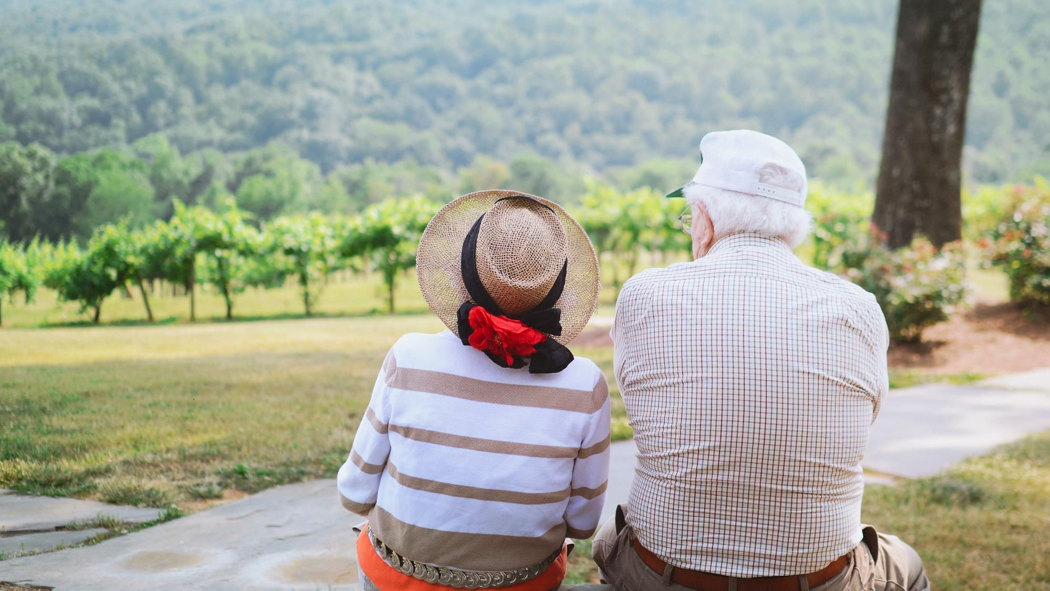
FAMILY SHARING
Please show the photo/picture and tell about the loved one that you will be praying for during All Souls Day which is celebrated on November 2nd.

Slide 11
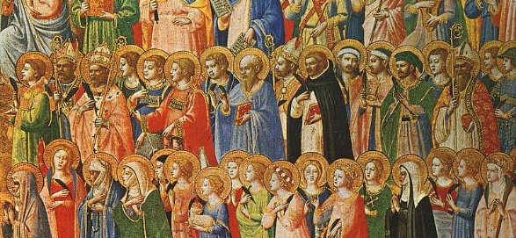
^{Content Continued}
Our loved ones who have died may already be in Heaven with God, but since we can’t know that for certain, we will pray for them just to be sure they have all the help and love we can give to them. If they are in Heaven, Mary will use the grace from our prayers to help a poor soul in Purgatory who has no one to pray for him/her, because God never wastes anything!

Slide 13
Using the Rosary for Children pamphlets/booklets we will pray one decade of the rosary together for our loved ones who have died and for one another.

Slide 14
^{REMINDER}
^{Next meeting date and time.}

