Slide 1
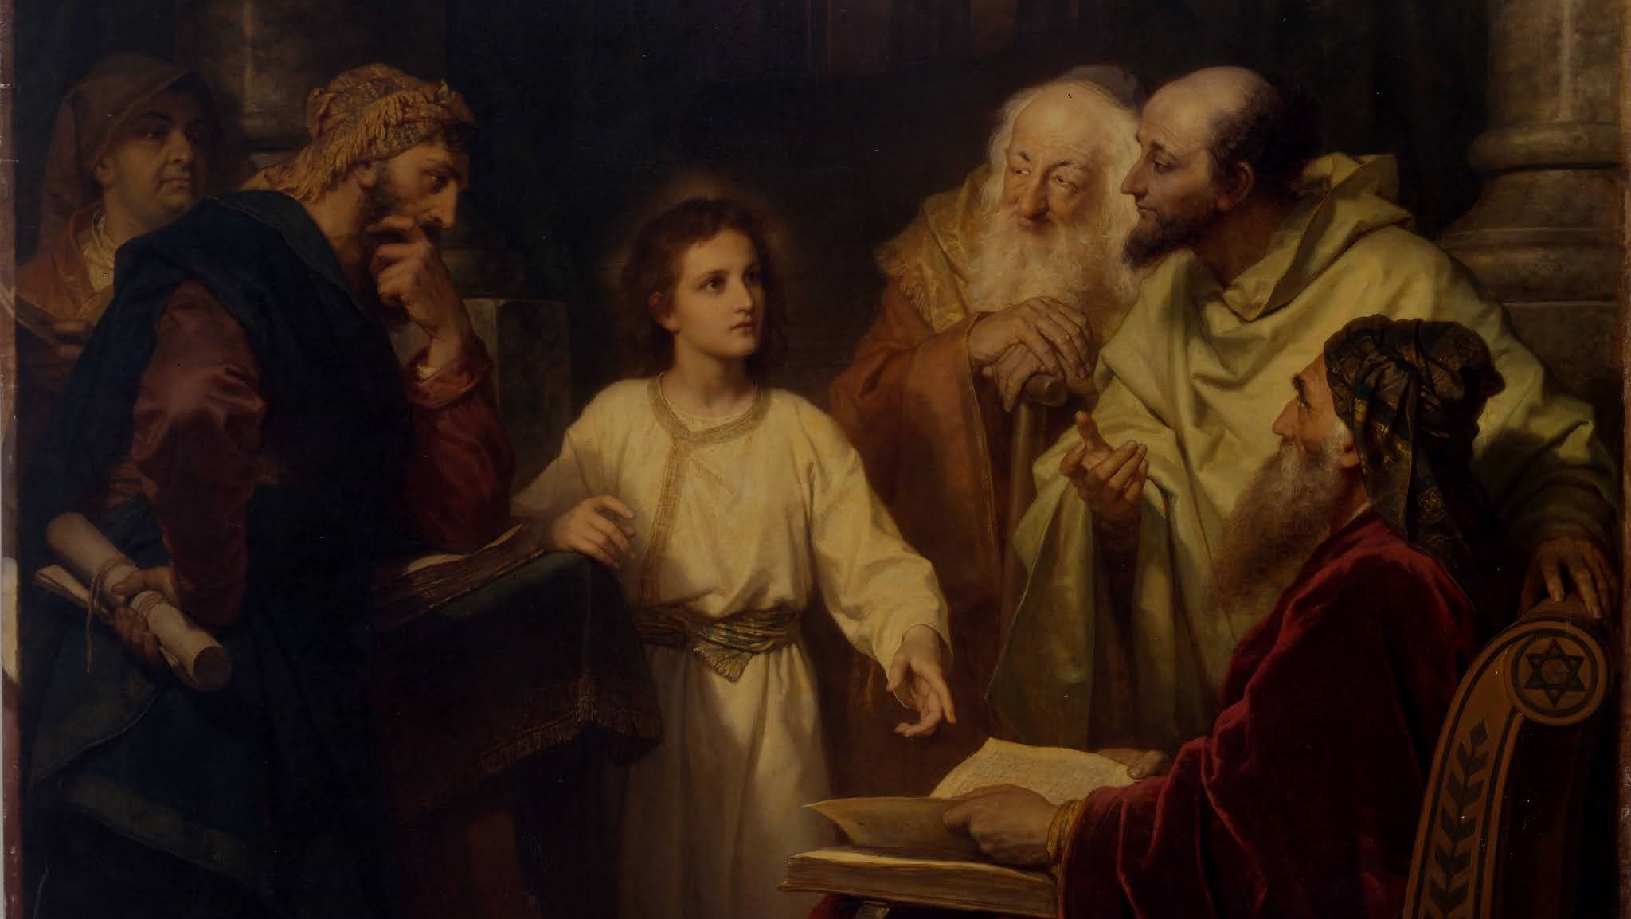
THE LIFE OF CHRIST: THE JOYFUL MYSTERIES
THE FINDING IN THE TEMPLE
PREPARING FOR ALL SAINTS’ & ALL SOULS’ DAY

Slide 2
^{Opening Prayer}
Lord Jesus Christ, we entrust our family to You and ask for Your blessing and protection.
We love You Lord Jesus with all our hearts and we ask that You help our family become more like the Holy Family.
Help us to be kind, loving, and patient with one another.
Give us all the grace we need to become saints and Your faithful disciples.
Amen.

Slide 3
^{Ice Breaker}
is a game where players draw an item or a phrase, and everybody else guesses. Each family is a team and the leader sets a timer. Family members take turns drawing and guessing, and the family with the most correct guesses after everyone has a turn wins.
BIBLE PICTIONARY
Here is a list of Bible Pictionary phrases for you to draw:
Simeon, Anna, Mary, Joseph, Baby Jesus, Presentation in the Temple, Archangel Gabriel, Elizabeth, Visitation of Mary to Elizabeth, Nativity of Jesus, The Annunciation
Sometimes the answer will be close enough, but not exactly what is written in the phrase. The drawer can use good sense to see if the guesser has the right idea!

Slide 4
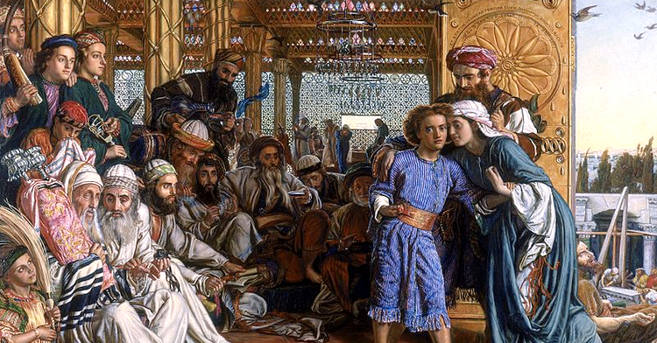
THE FINDING IN THE TEMPLE

Slide 5
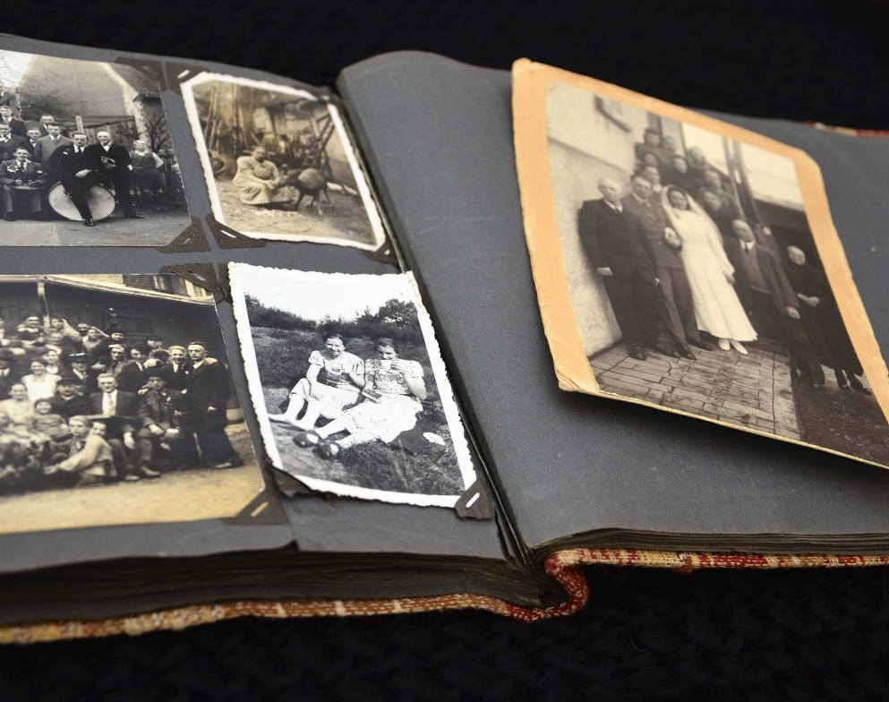
FAMILY SHARING (with larger group)
Show the photo/picture and tell about the loved one(s) that you will be praying for during All Souls Day which is celebrated on November 2nd.
Share about who the person is, and why he/she is important to your family.
Do you know if that special person had a favorite saint? If, so who is it?
Do you have a favorite saint? Why is the saint your favorite?

Slide 6
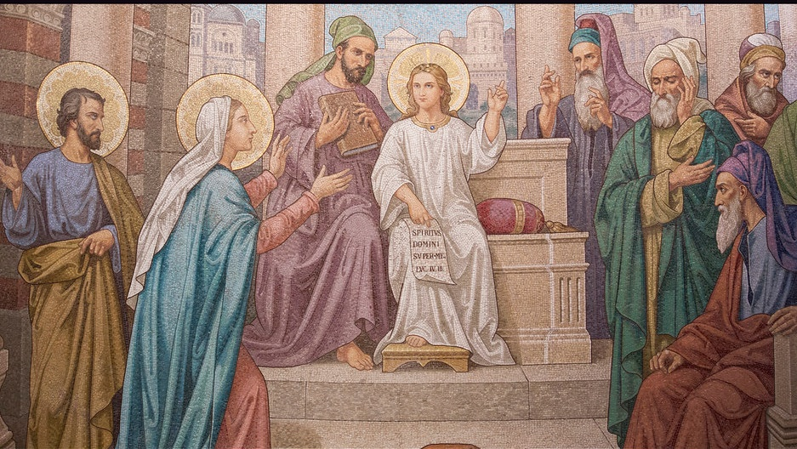
LUKE 2:41-52

Slide 7
VIDEO
Young Jesus at the Temple or Jesus at 12 (for younger children)

Slide 8
FAMILY CONVERSATION
How do you think Joseph and Mary felt during the three days when they were searching for Jesus?
Do you think Mary and Joseph fully understood what Jesus meant by leaving their family, spending three days talking to the teachers of the Temple, and then telling his parents that that was what he was supposed to be doing?
Joseph was a saint, Mary was a saint that was immaculate and had no stain of sin on her soul, and Jesus was and is God. If the Holy Family had moments when they did not fully understand one another, is it surprising that our families also have moments when we do not understand one another too? What can we do to follow their example of how to love one another even when we don’t understand?

Slide 9
FAMILY ACTIVITY
Play: Jesus as a Boy Hopscotch or Dice Game
(by Catholic Mom)
Take turns throwing a pebble on a hopscotch square. Hop to the number and answer the question, or each family member takes turns rolling a pair of dice and answers the question that correlates with the number they have rolled.
1. What town was Jesus born in?
2. Jesus was born in a house. True or false?
3. What town did Jesus grow up in?
4. How old was Jesus when Mary and Joseph took him to Jerusalem for the Feast of the Passover?
5. What is this Feast of the Passover?
6. When the festival was over, Mary and Joseph joined the other families going back to Nazareth. Where did they think Jesus was during this time?
7. When did Mary and Joseph realize that Jesus was missing?
8. Where did Mary and Joseph go when they couldn’t find Jesus?
9. How many days did Mary and Joseph search for Jesus in the city?
10. Where did they find Jesus?
11. What was Jesus doing?
12. What did Jesus say to his parents when they found him?

Slide 10
CLOSING PRAYER
Our loved ones who have died may be in Heaven with God, but since we can’t know that for certain, we will pray for them just to be sure they have all the help and love we can give to them. If they are in Heaven, Mary will use the grace from our prayers to help a poor soul in Purgatory who has no one to pray for him/her, because God never wastes anything!
Meditating on the Mystery of the Finding of Jesus in the Temple, let us pray a decade of the rosary for our loved ones.

