Slide 1
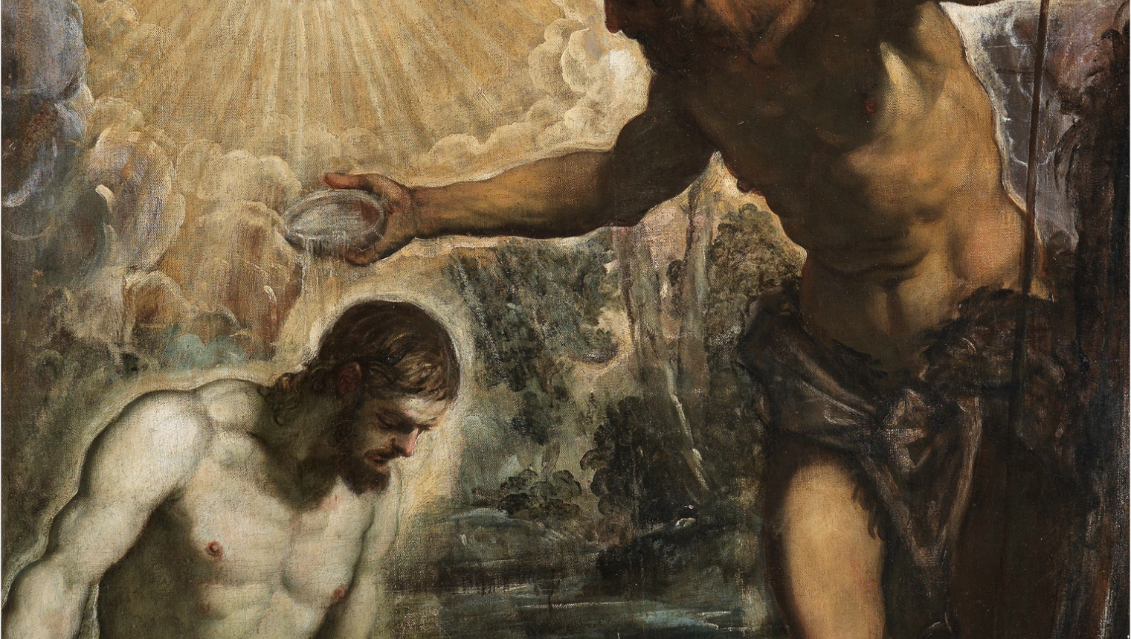
THE LIFE OF CHRIST: THE LUMINOUS MYSTERIES
THE BAPTISM OF JESUS IN THE JORDAN

Slide 2
^{Opening Prayer}
Lord Jesus Christ, we entrust our family to You and ask for Your blessing and protection. We love You Lord Jesus with all our hearts and we ask that You help our family become more like the Holy Family. Help us to be kind, loving, and patient with one another. Give us all the grace we need to become saints and Your faithful disciples.
Amen.

Slide 3
^{Ice Breaker}
CHORES A BORE?
What is your least favorite chore?
What is your favorite chore and why?

Slide 4
Question?
Does anyone remember the story of the very first Passover from the Book of Exodus in the Old Testament?
What was 10th and final plague that God sent?

Slide 5
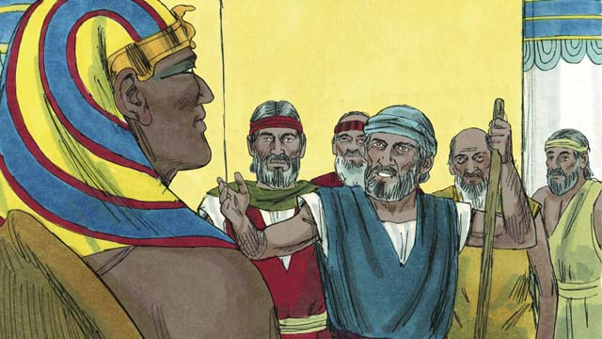
EXODUS 11:4-5
At midnight I will go forth through Egypt. Every first-born in this land shall die,
from the first-born of Pharaoh on the throne to the first-born of the slave-girl at the handmill, as well as all the first-born of the animals.
Exodus 11:4-5

Slide 6
The Prince of Egypt (1998)
https://youtu.be/HXmru6NrSAY

Slide 7
JOHN THE BAPTIST
https://youtu.be/tiEQh8Y67l4

Slide 8
BAPTISM OF JESUS
https://youtu.be/T2D1p6t8-Yo

Slide 9
FAMILY CONVERSATION
Today we talked about how people wanted to be baptized by John as a way to be closer to God.
Is there an area of your life that you would like to “leave behind in the waters”? Jesus is waiting for you to place this area in his hands.
You can share with your family, or reflect and keep it between yourself and Jesus.

Slide 10
FAMILY CONVERSATION (continued)
It is sometimes easier to think about our sins and shortcomings than our strengths or virtues, but God sees all of us!
Name a kindness that you did for someone else.

Slide 11
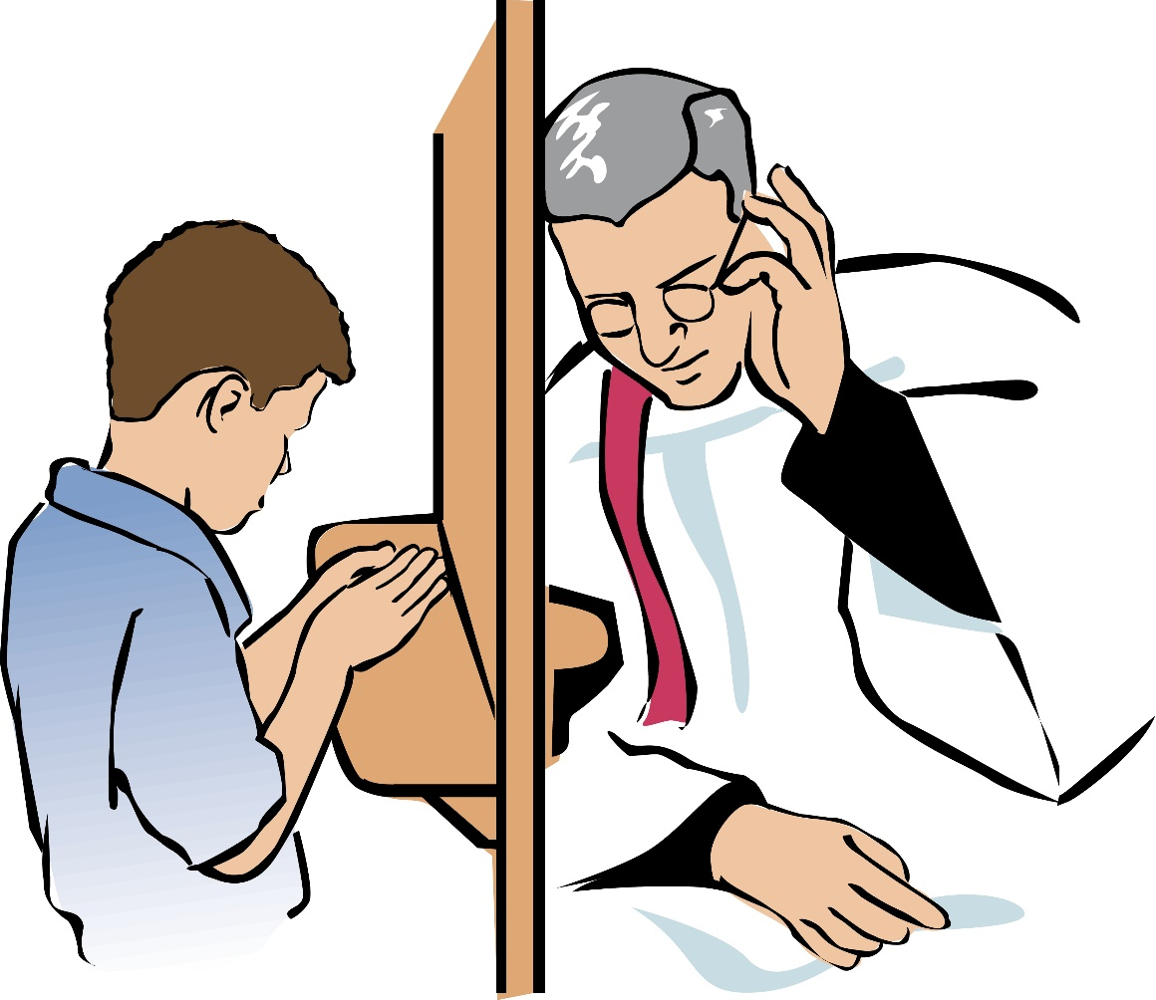
SACRAMENT OF RECONCILIATION
Consider going to the Sacrament of Reconciliation to let Jesus wash your soul clean with His grace and love.
This is a beautiful way to spiritually prepare ourselves during Advent for Jesus’ coming at Christmas.

Slide 12
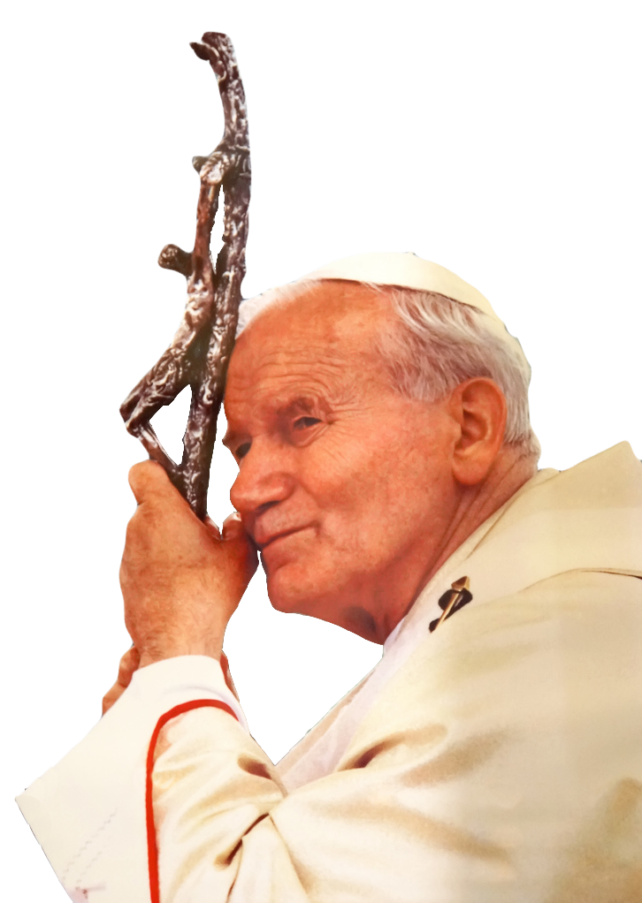
FAMILY MISSION
Reach out to a grandparent(s) or senior adult(s) in your family/ community. Share that the Joyful Mysteries. Which one is his/ her favorite and why? Ask if he/she ever prayed the Rosary or read the Bible either as a child or as an adult. Does your grandparent or senior have any wisdom to share with you about living your faith? *Take notes and be prepared to share about what your grandparent or senior adult shared.
Watch the videos on Week 2’s Family Guide.
Read the information about Saint John Paul II and the Luminous Mysteries.
Gather around your prayer altar as a family. Light your Jesus Is Our Light candle that you made last month. Take a moment to be silent with God together, and pray a decade of the Rosary together meditating on the Baptism of Jesus.

Slide 13
CLOSING PRAYER
Almighty ever-living God, who, when Christ had been baptized in the River Jordan and as the Holy Spirit descended upon Him, solemnly declared Him your beloved Son,
grant that Your children by adoption, reborn of water and the
Holy Spirit,
may always be well pleasing to You. Amen.

