Slide 1
^{Families Forming Disciples}
Lesson 3 – Week 1

Slide 2
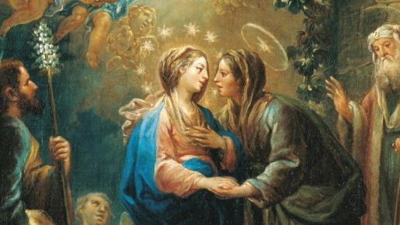
TOPIC: Preparing for Advent & The Spiritual ^{& Corporal Works of Mercy}
REFERENCES:
GOALS:
Make a plan for Advent by considering how Mary experienced the first Advent and how she prepared for the birth of Jesus.
Reflect on the Second Joyful Mystery of the Visitation of Mary to Elizabeth.
Make a plan to practice the Spiritual and Corporal Works of Mercy during Advent.
^{Is 7:14, 9:1-2}
^{Lk 1:26-56, 6:36}
^{Rev 22:17, 20}
^{CCC: nos. 524, 2447}

Slide 3
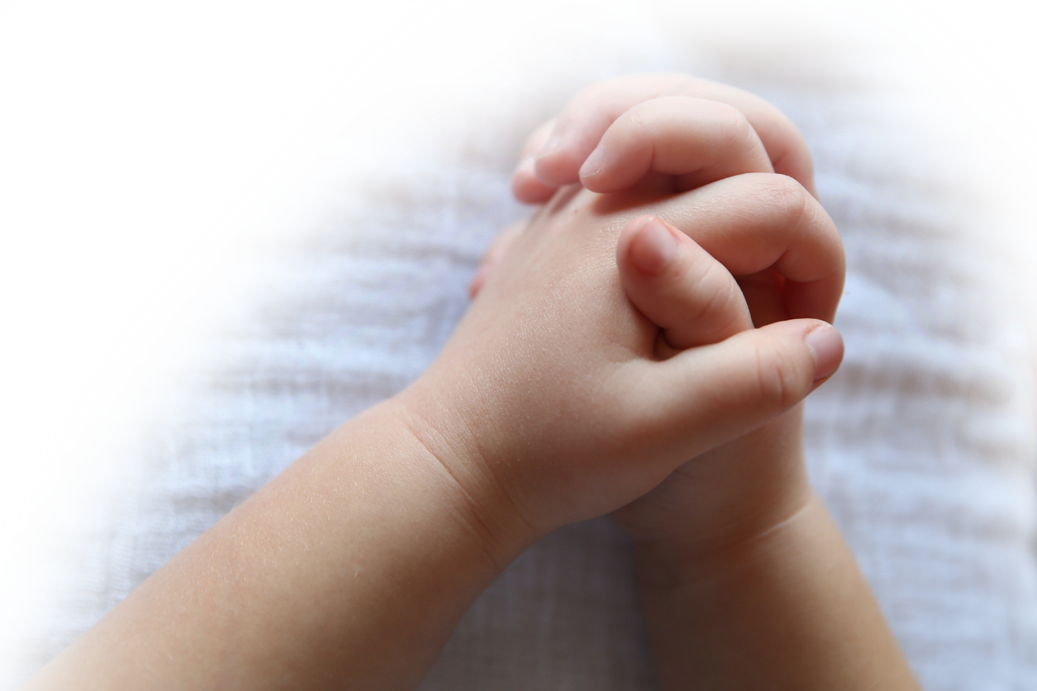
^{Opening Prayer}
Come, Spirit of Knowledge, bless us and grant us the grace of loving the Church and finding in her a sure guide for truth and service to God’s will, especially in our relationships at home and in our extended families.
^{Hail Mary…}
(adapted from Catholics For Family Peace)

Slide 4
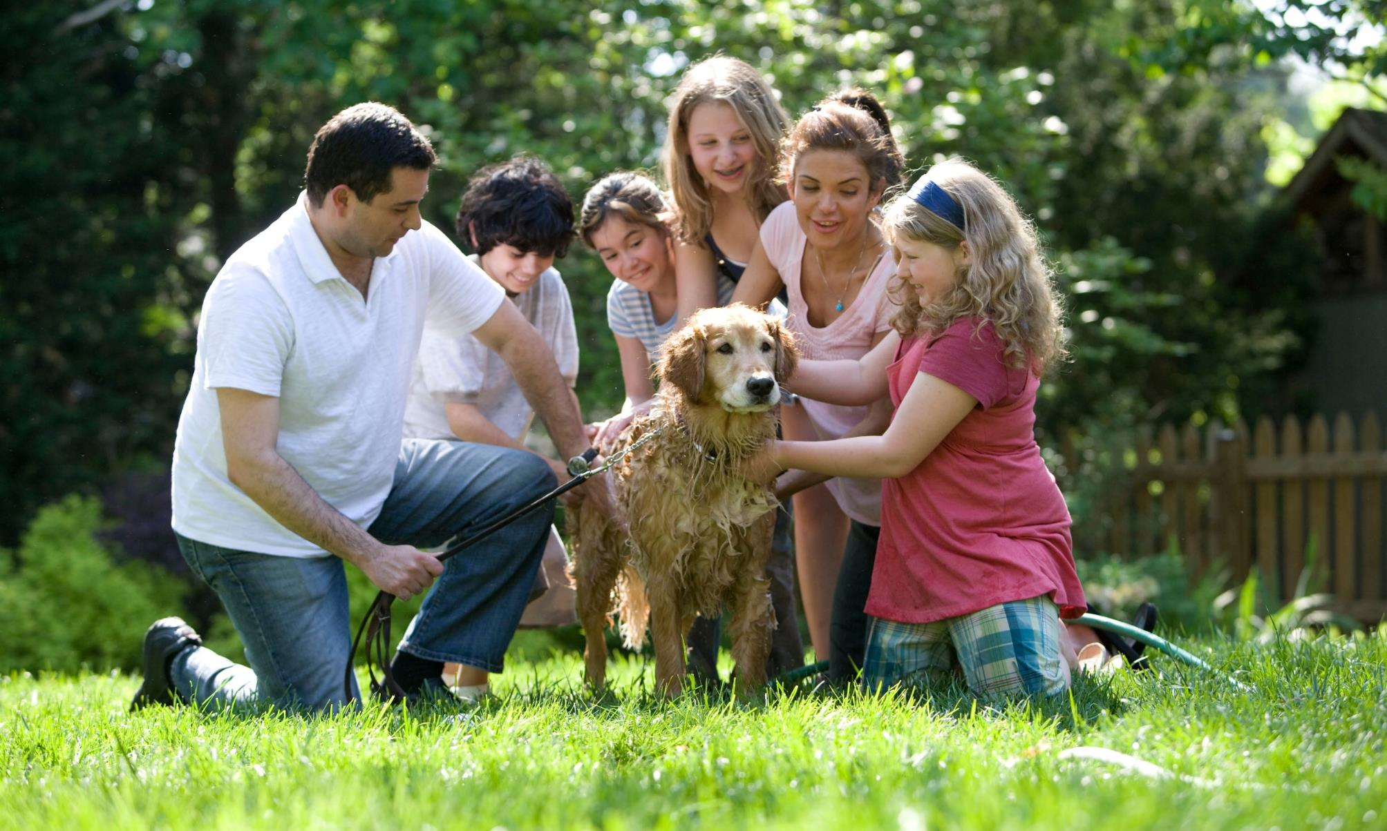
^{Ice Breaker}
Fact or Fiction?
Brainstorm three statements about yourselves. Two of these statements must be facts, or truths, and one must be something made up (fiction).(Mute everyone)
One by one, we will take turns saying our three statements, while the other families try to guess which statement is not true (fiction).

Slide 5
^{When you think of the term} “Advent”, what two words come to mind?

Slide 6
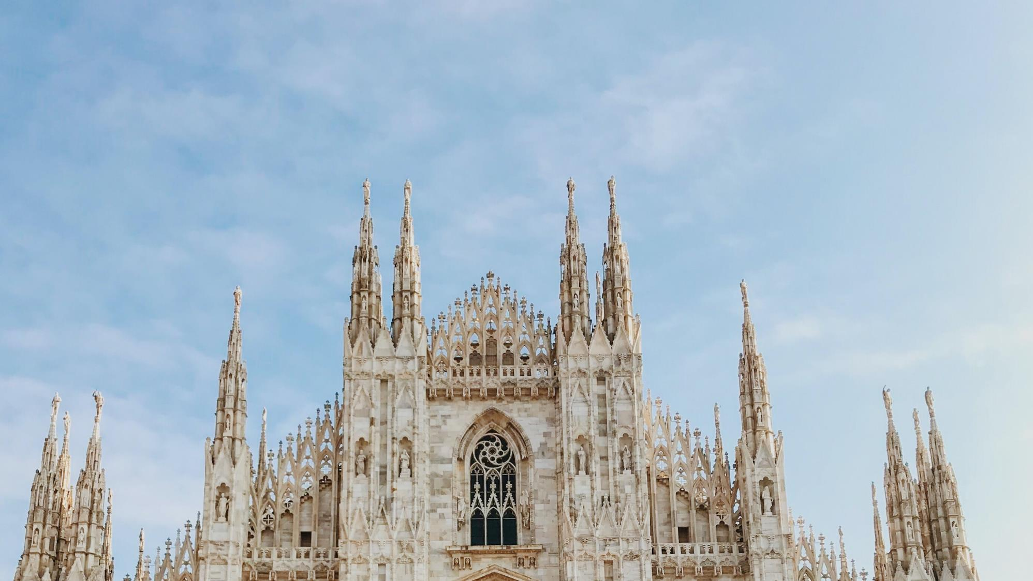
Our Topic for today
Advent is a time when we prepare our hearts to celebrate our Lord and Savior Jesus’ first coming in the mystery of His Incarnation and in His birth at Christmas and to renew our hope in Jesus’ second coming. We look to the first Advent to learn from Mary how to prepare ourselves by doing loving works of mercy for one another.

Slide 7
^{Family Conversation}
(For Parents) When you were growing up, how did your family prepare for Christmas during Advent?
(For whole family) What are your favorite things to do during Advent?

Slide 8
^{Content}
Open your Bibles and read Luke 1:26-56 aloud.
For Younger Children
For Teens & Tweens

Slide 9
Content
Who was the first person to know that God’s Son was coming to earth to save us and to prepare for His coming?
^{How did Mary prepare?}

Slide 10
Content
After Mary learned from the angel Gabriel that she and Elizabeth were both going to give birth, Mary traveled for several days (possibly a whole week) “in haste” to get to her cousin Elizabeth’s house. As Luke’s Gospel relates, there was great joy in the greeting of Mary and Elizabeth, and Mary’s haste in visiting her cousin was surely inspired by the good news shared by the angel Gabriel, who confirmed that “nothing will be impossible for God” (Lk 1:37). We also know that Elizabeth was already six months pregnant, and a lot older than Mary. Physically, her pregnancy would make it more difficult for Elizabeth to be able to take care of her husband Zechariah, herself and her home. So, Mary went to help care for her cousin Elizabeth and “remained with her about three months” before returning home (Lk 1:56). Together the two women rejoiced about how loving God is and meditated on the mysteries they were experiencing. Surely they prayed for their unborn babies, for themselves and for many others in need of prayer. We can imagine that Mary, in a spirit of great joy, did many works of mercy to prepare for the coming of the Savior during that first Advent, when they were waiting for Jesus’ birth. We can all learn from what she did and follow her example, because there is no other human being who knows more about how to create a place in one’s heart for Jesus than His Mother and our Mother, Mary. Let’s make a plan for preparing our own hearts for Jesus this Advent.

Slide 11
^{What is Advent?}

Slide 12
Mission
1
2
Introduce Mission Activities
Mission Activities are to be done at home during Week 2 and to be shared at the gathering of families on Week 3.
Explain
Activity
i. Watch the two videos and/or read the USCCB explanations about the Spiritual and Corporal Works of Mercy (links provided in week 2’s handout).
ii. Decide which Works of Mercy your family will do this Advent and make a Family Advent Plan.
iii. Reach out to a grandparent(s) or senior adult(s) in your family or community and ask them about their favorite memories of Advent when they were growing up. Consider sharing about the experience through social media.
iv. Be prepared to share about your Family Advent Plan and your Senior Sharing at the next gathering.

Slide 13
Mission
3
Spiritual & Corporal Works of Mercy
Works of Mercy first begin at home within our family. Works of Mercy give us opportunities to love one another with God’s love, and then to share that love by serving our neighbors.
Do not to feel as if they have to do all of the Works of Mercy, because that’s not practical. Some works you may already do, like praying for the living and the dead. That’s great! We encourage you to keep doing those works and please pick one or two more that will fit naturally into your family life to do for Advent.
My Senior Sharing experience- who was the senior adult that I interviewed, and what he/she shared about their favorite memories of Advent when they were growing up.

Slide 14
^{Review & Close in Prayer}
Review key point and close in prayer

