Slide 1
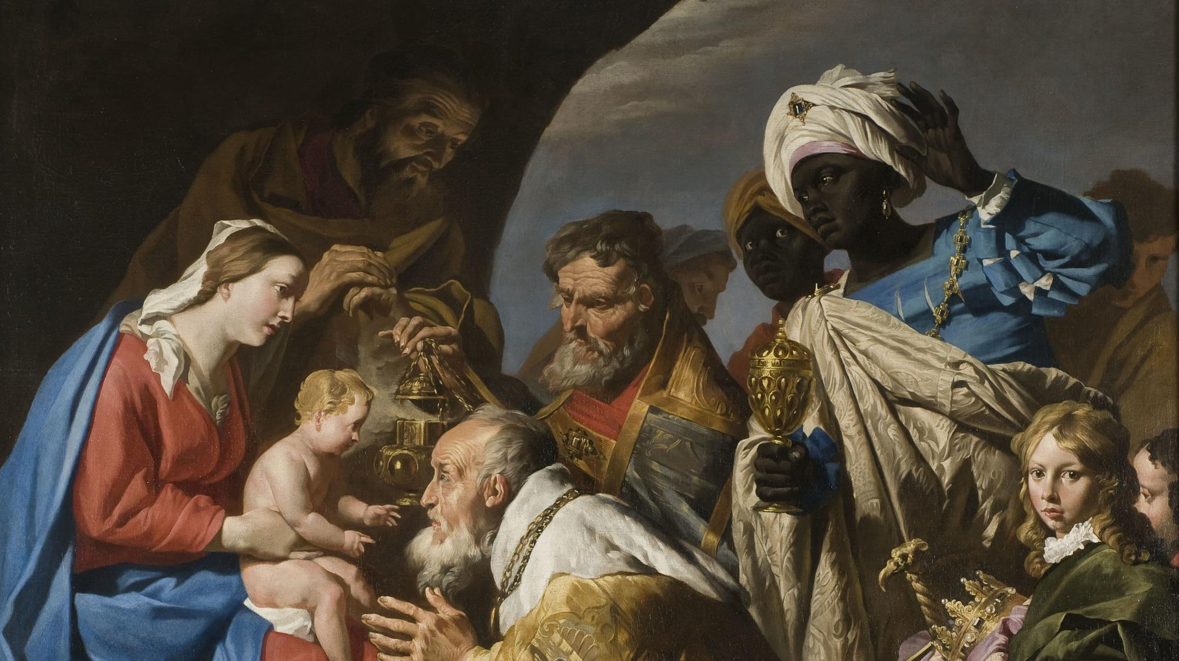
FAMILIES FORMING DISCIPLES
^{Lesson 5 – Week 1}

Slide 2
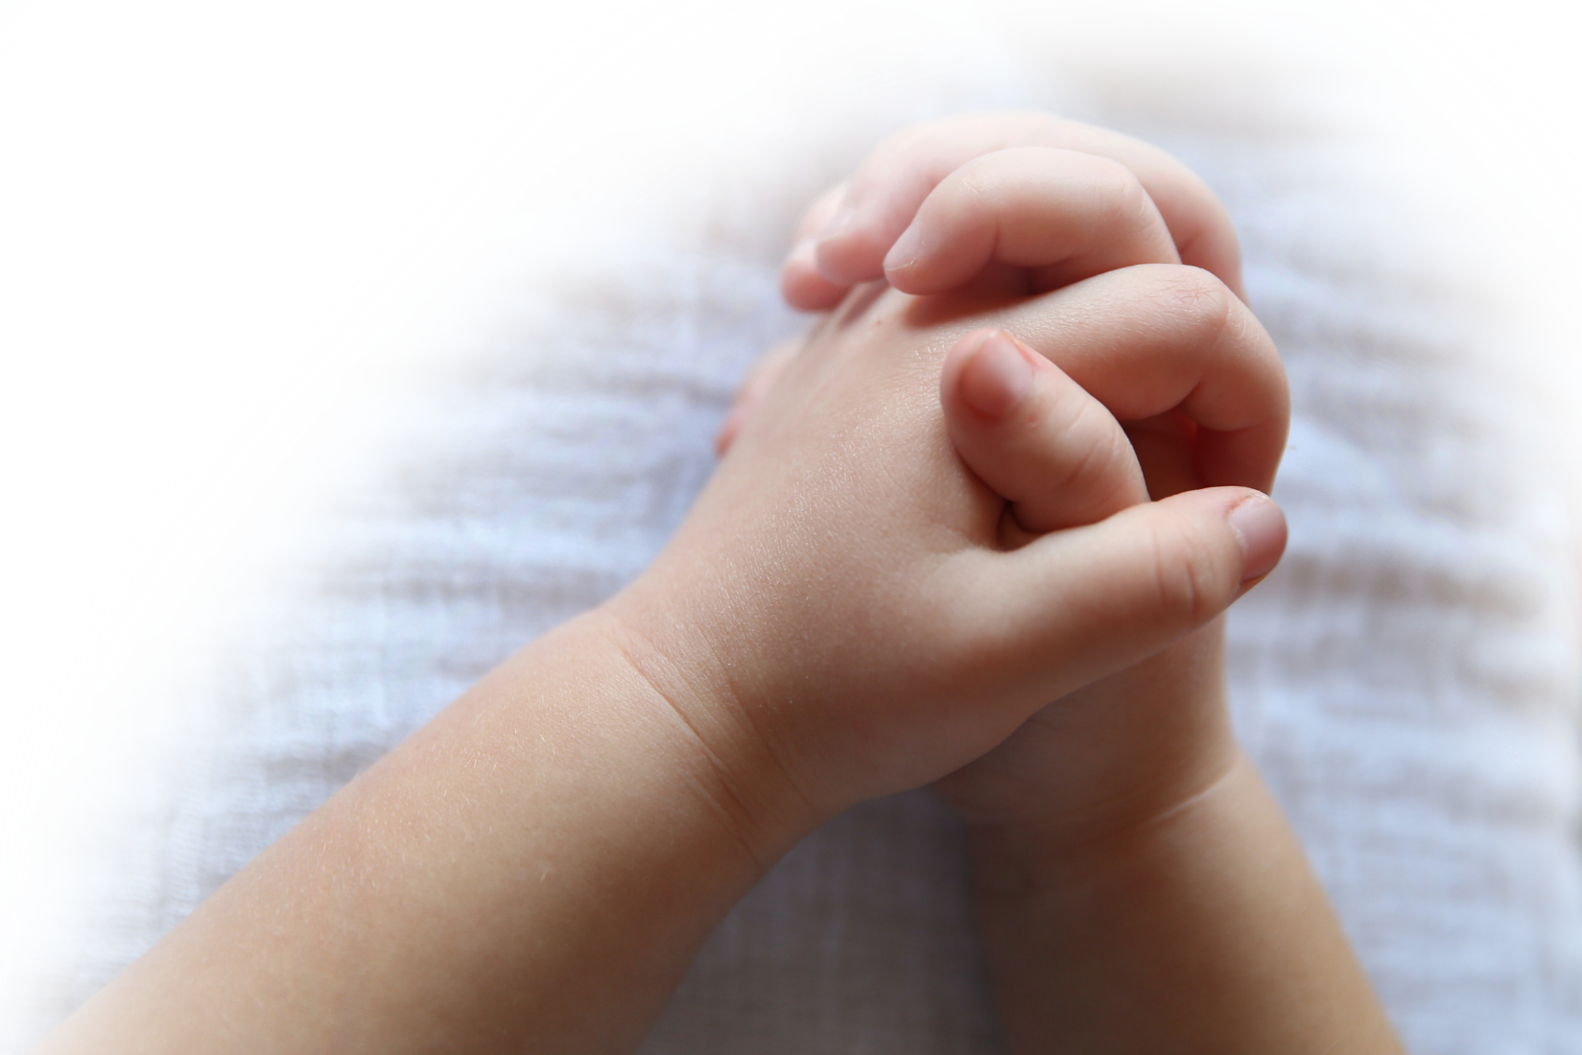
^{Opening Prayer}
Come, Spirit of Wisdom, bless us and grant us the grace of conforming our lives fully to God’s holy Word, so that we may have compassion for one another, especially those who are poor, lonely, or afraid. Our Father…
(adapted from Catholics For Family Peace)

Slide 3
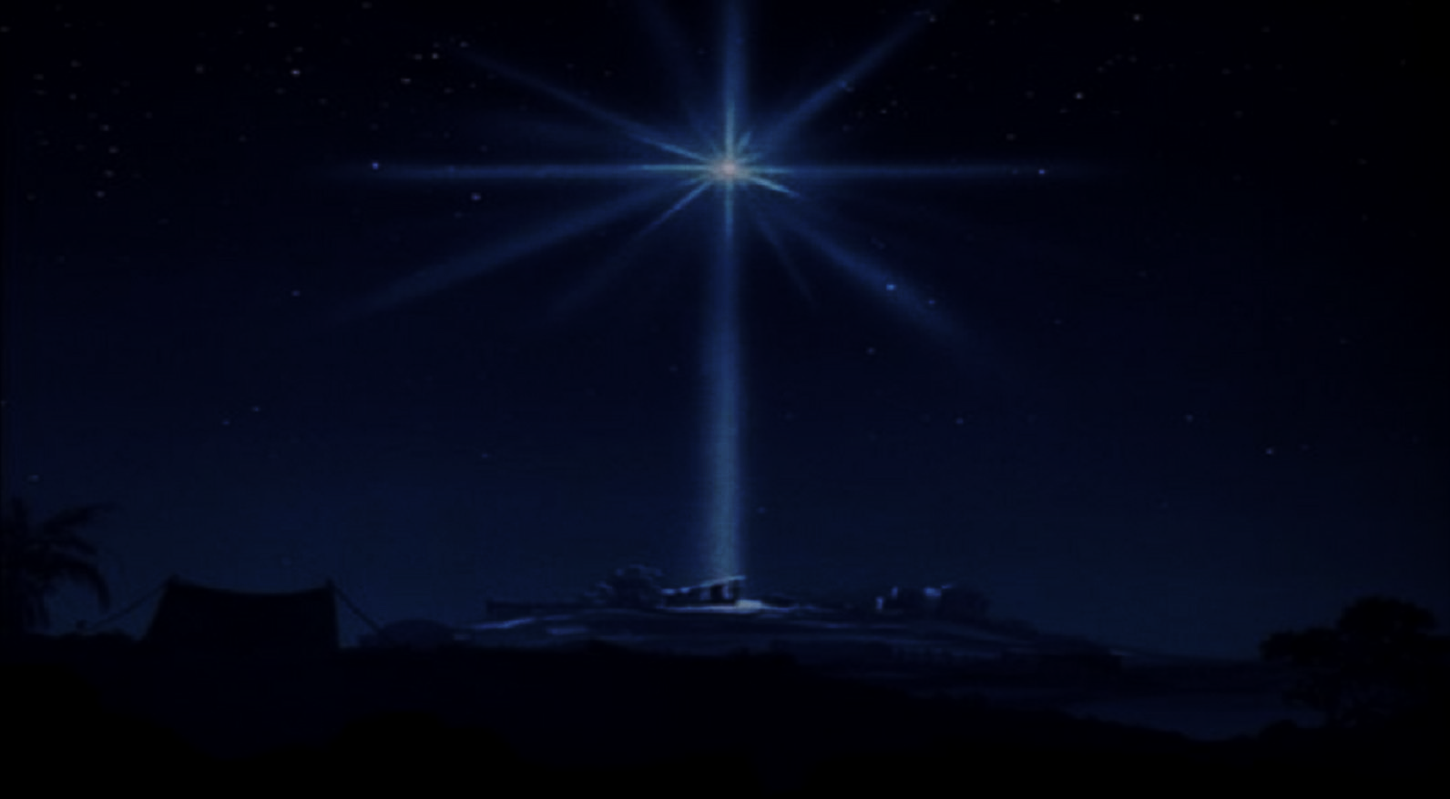
Goals
• To introduce families to the Solemnity of the Epiphany of the Lord and the tradition of the Epiphany blessing/chalking the door
• To reflect on the First Luminous Mystery, the Baptism of the Lord, and on Jesus’ mission
• To explore how we answer God’s call to live our Baptism

Slide 4
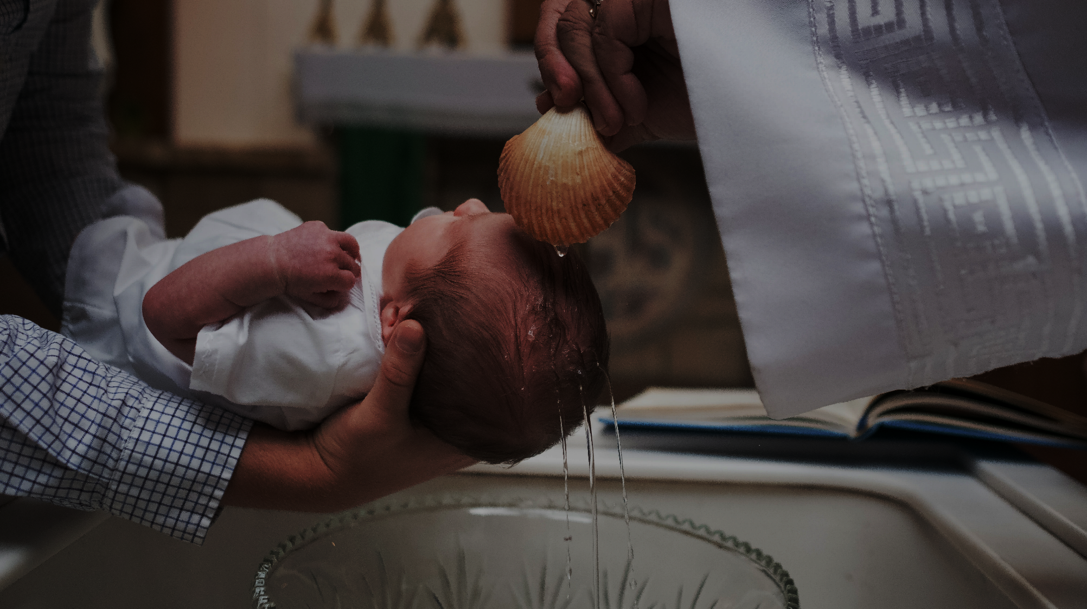
Materials
• Blessed chalk (Supplied by parish)
• Holy Water (Supplied by parish)
• Baptismal candles/sacramentals/clothing, photos (Family items gathered)

Slide 5
Ice Breaker
Would you rather…
Eat ice cream or cake?
Have the super strength of Samson or the wisdom of Solomon?
Watch basketball or football?
Watch Jesus heal a blind man or watch Jesus walking on water?
Play baseball or soccer?
Would you rather live at the beach or in the mountains?
Be a shepherd or a magi?
Would you rather be a bodybuilder or a professional golfer?
Name the animals or build the ark?
Go fishing with Peter or be baptized by John the Baptist?
If virtual, hold up 1 finger for the first choice, or 2 fingers for the second choice in response to the question

Slide 6
What does Epiphany mean?
Have you ever celebrated Epiphany Sunday, or
Have you ever heard of any special ways families celebrate the Solemnity of Epiphany?
If so, how?

Slide 7
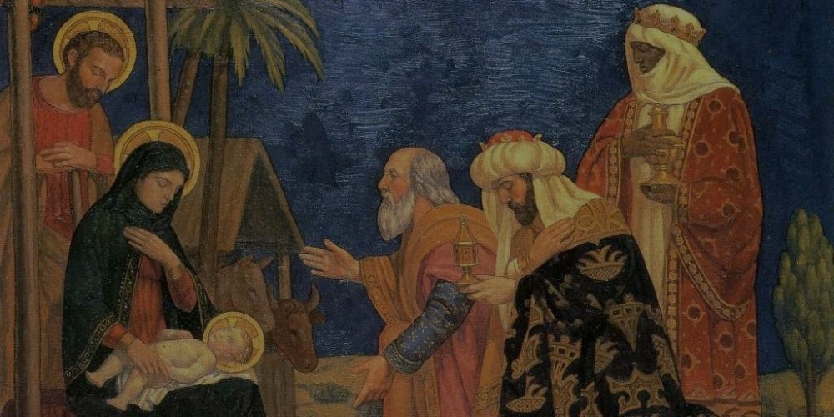
Topics
Epiphany is a solemnity (a great feast) in the season of Christmas when we celebrate the visit of the Wise Men or Magi to the Christ Child.
The visit of the Wise Men or Magi is a clear sign or manifestation that shows the world that the baby Jesus is the King of kings.

Slide 8
WHAT IS EPIPHANY?
https://youtu.be/sPAFQakL-JE

Slide 9
Scripture
Matthew 2:1-12
When Jesus was born in Bethlehem of Judea, in the days of King Herod, behold, magi from the east arrived in Jerusalem,
saying, “Where is the newborn king of the Jews? We saw his star at its rising and have come to do him homage.”
When King Herod heard this, he was greatly troubled, and all Jerusalem with him.
Assembling all the chief priests and the scribes of the people, he inquired of them where the Messiah was to be born.
They said to him, “In Bethlehem of Judea, for thus it has been written through the prophet:
‘And you, Bethlehem, land of Judah,
are by no means least among the rulers of Judah;
since from you shall come a ruler,
who is to shepherd my people Israel.’”
Then Herod called the magi secretly and ascertained from them the time of the star’s appearance.
He sent them to Bethlehem and said, “Go and search diligently for the child. When you have found him, bring me word, that I too may go and do him homage.”
After their audience with the king they set out. And behold, the star that they had seen at its rising preceded them, until it came and stopped over the place where the child was.
They were overjoyed at seeing the star,
and on entering the house they saw the child with Mary his mother. They prostrated themselves and did him homage. Then they opened their treasures and offered him gifts of gold, frankincense, and myrrh.
And having been warned in a dream not to return to Herod, they departed for their country by another way.

Slide 10
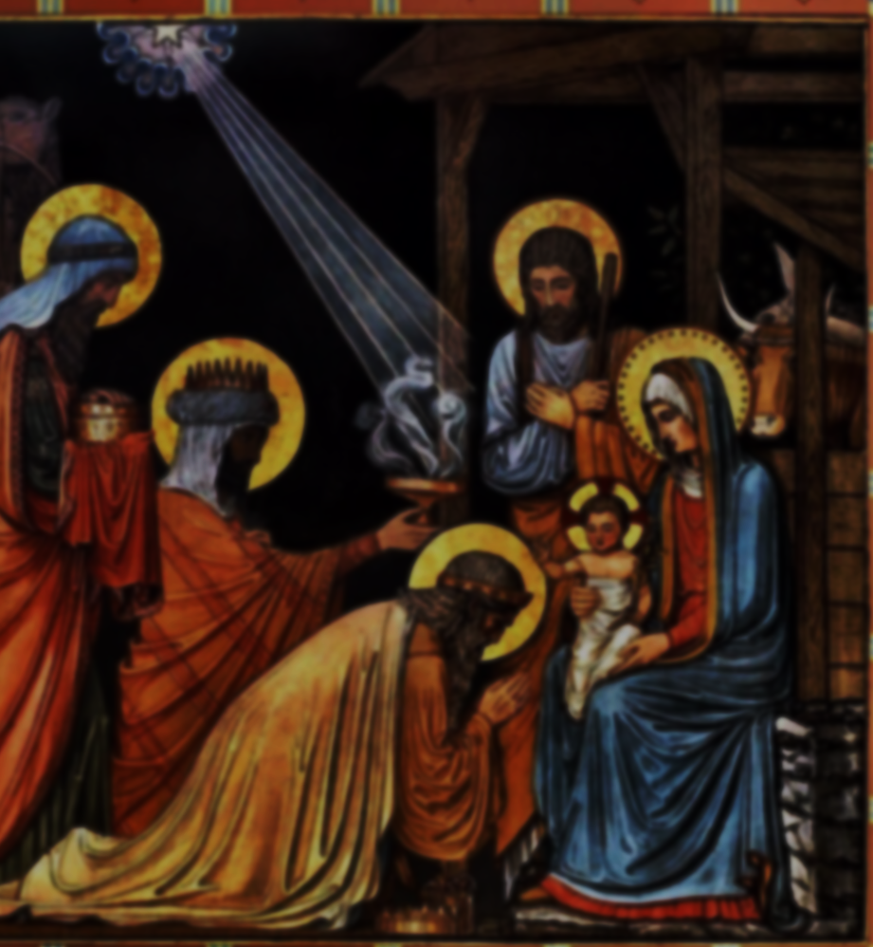
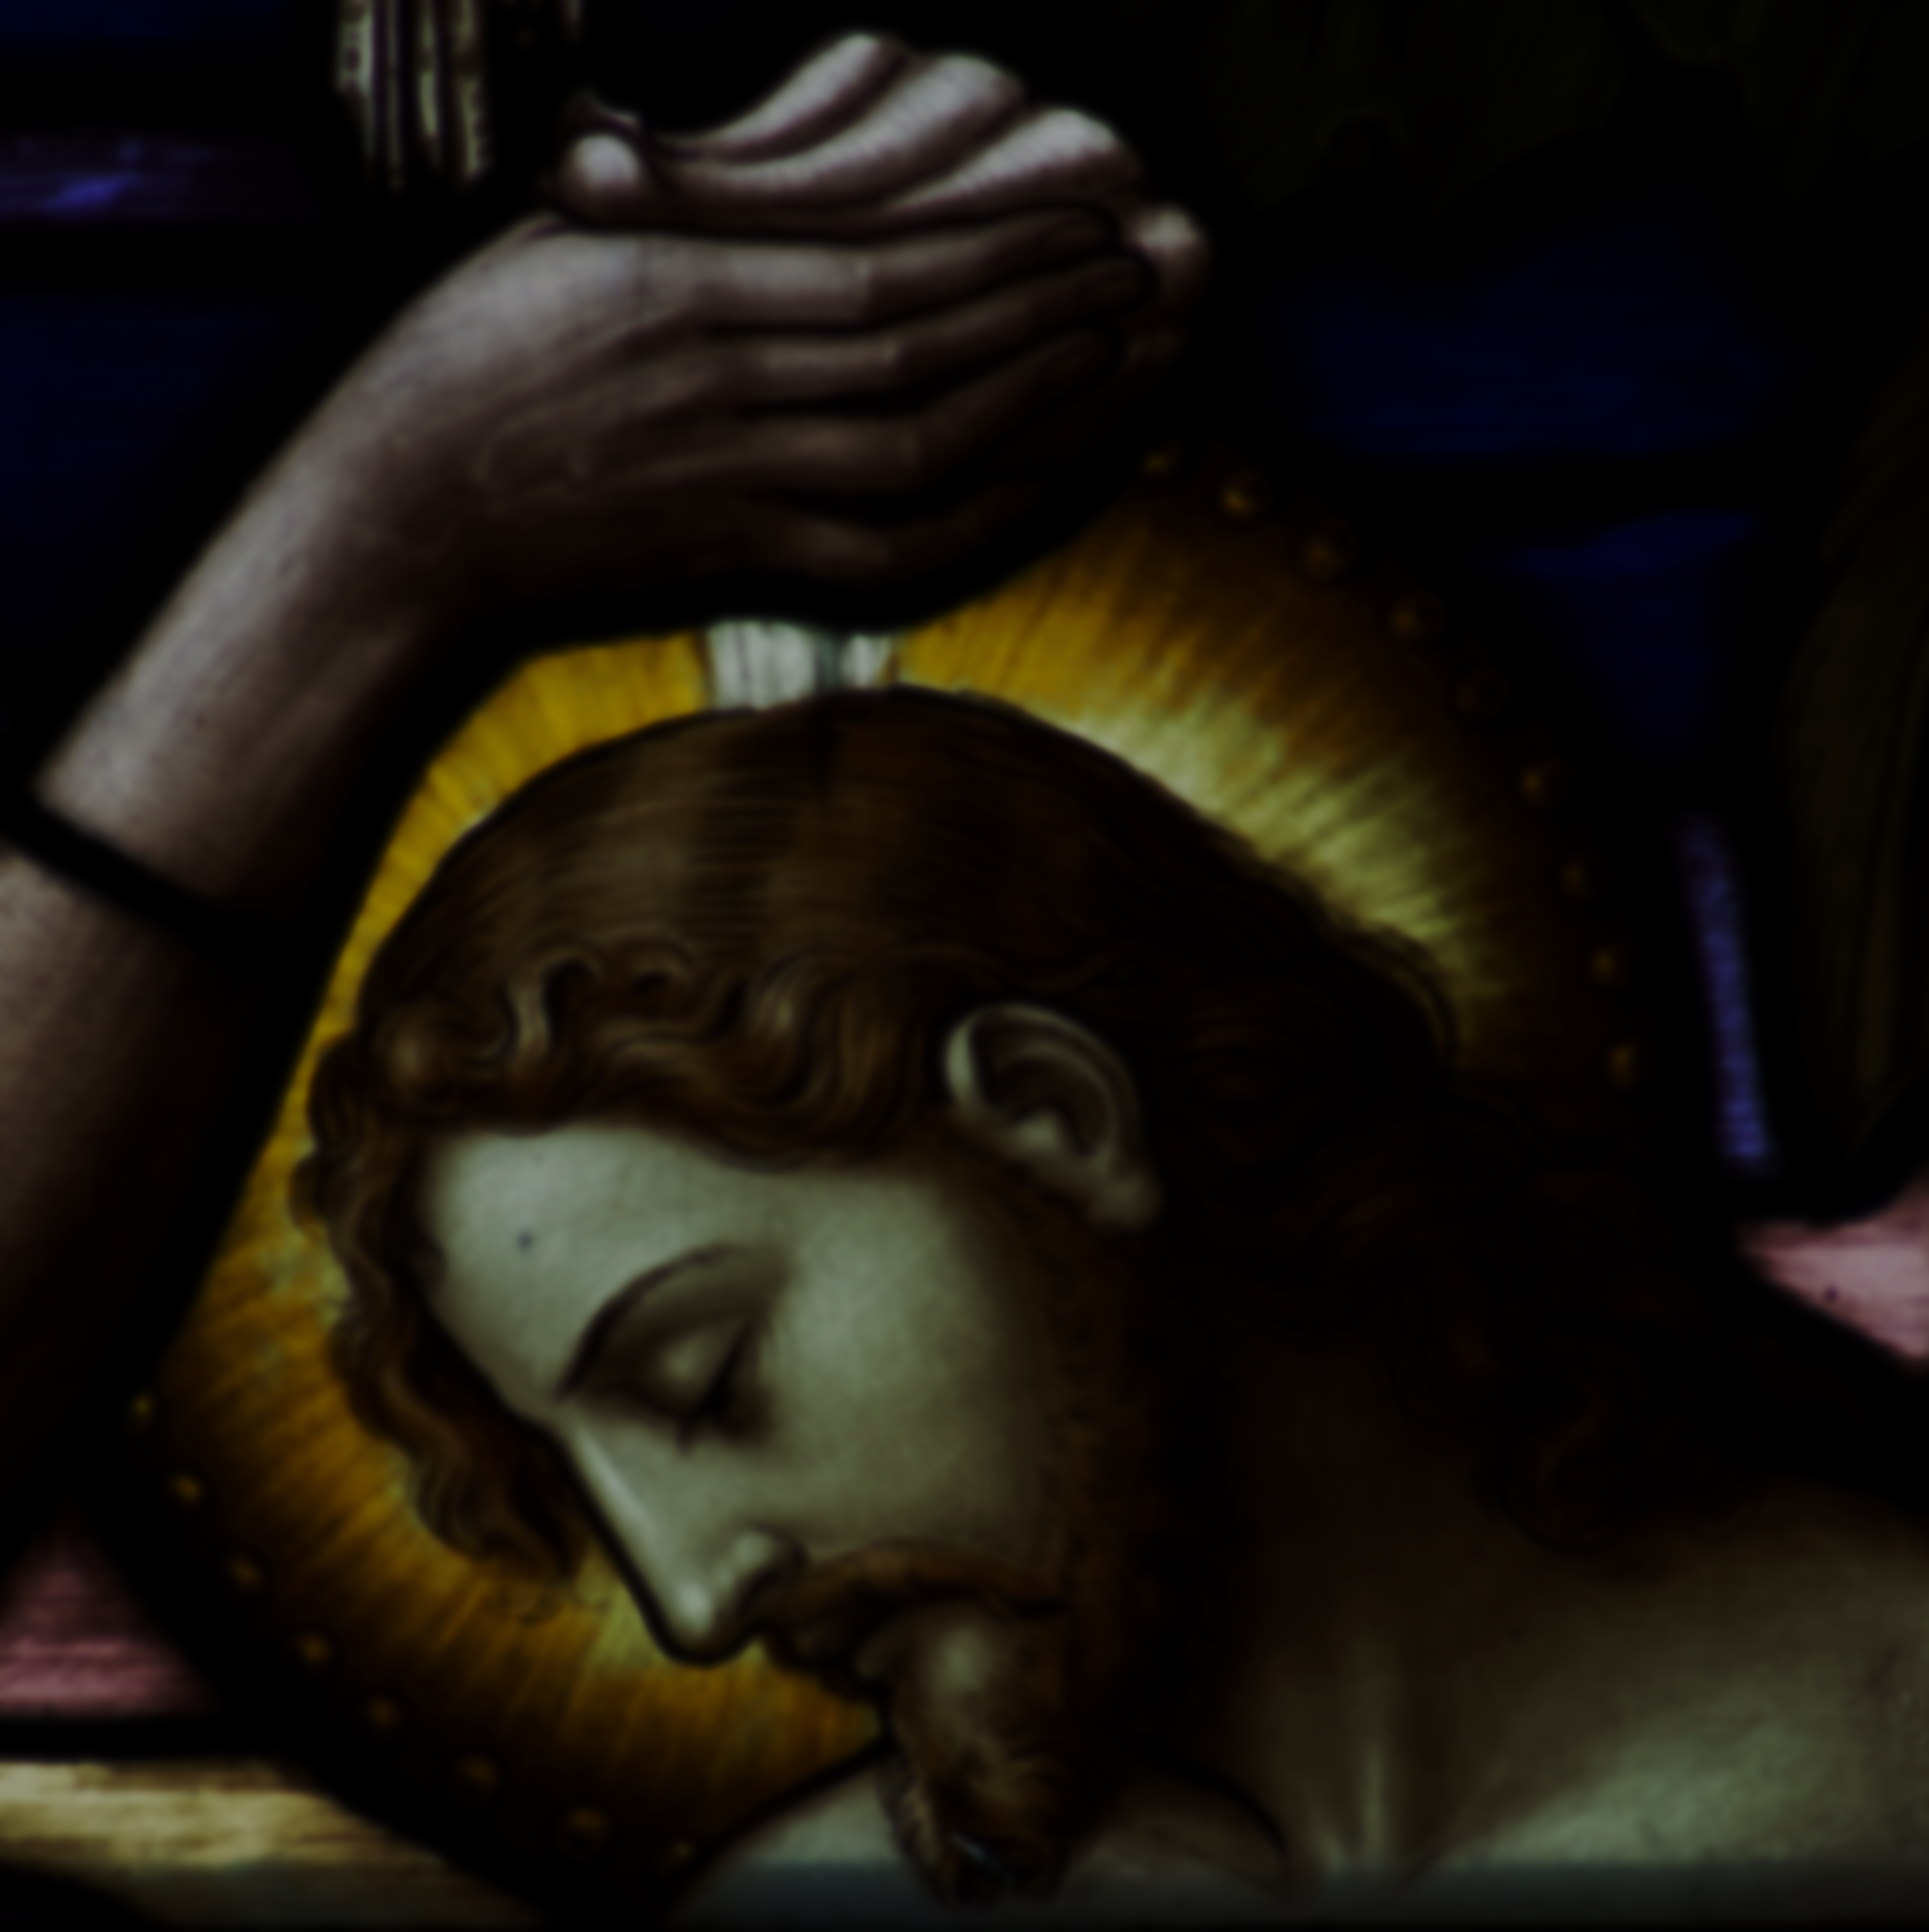
Mission
Epiphany
Watch videos about the Visit of
the Magi to the Christ Child
Family Epiphany Blessing &
mark the mantle of your front door
with blessed chalk
Baptism of the Lord
Baptism items or sacramentals
Watch the Baptism videos

Slide 11
Prayer
Option 1: Pray together the Hail Mary
Option 2: Lord Jesus, may you bless each of the families that have gathered together today. Help us to grow continually closer to you. This we pray in Your Holy Name. Amen.

