Slide 1
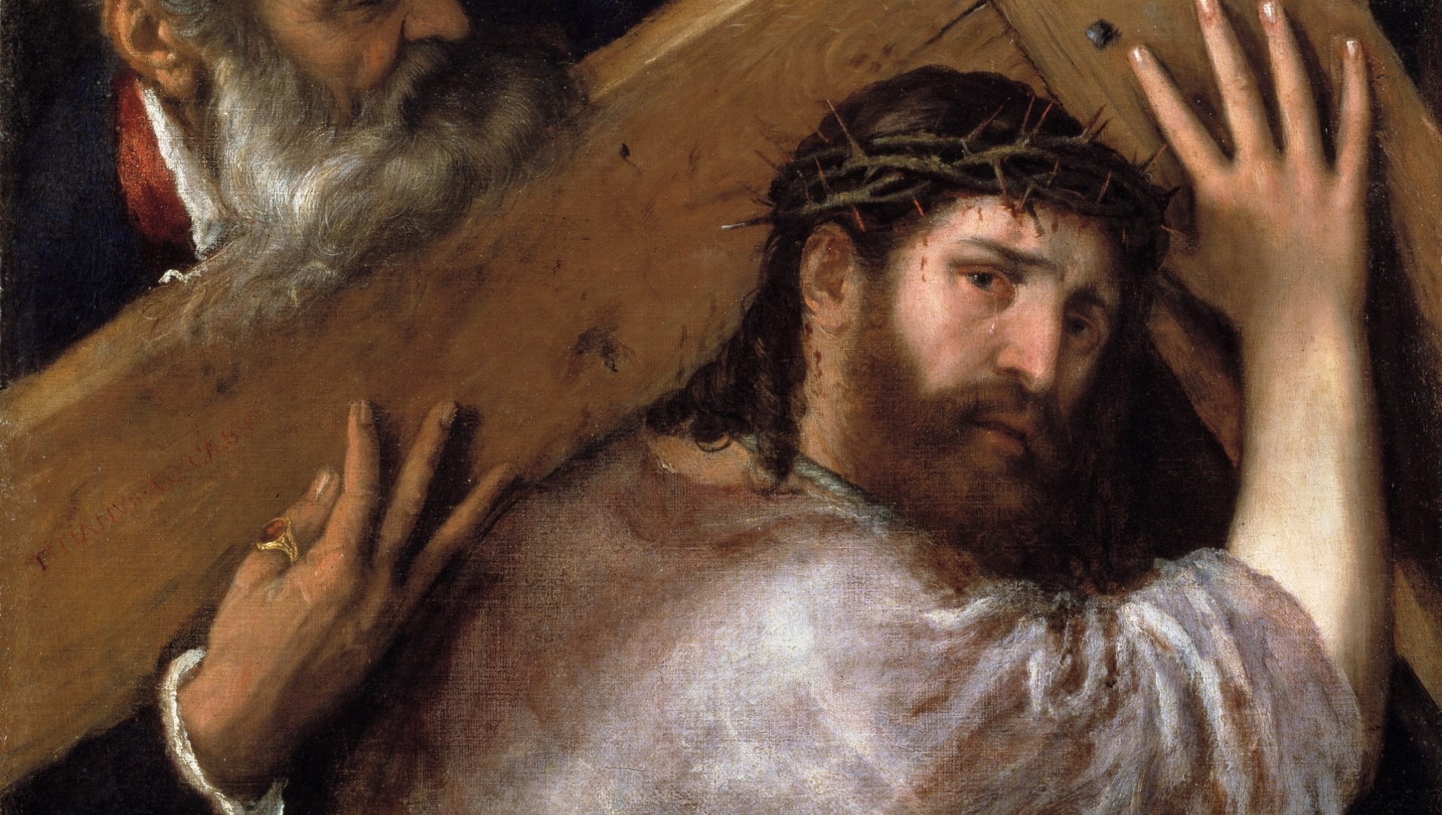
THE LIFE OF CHRIST: THE SORROWFUL MYSTERIES

Slide 2
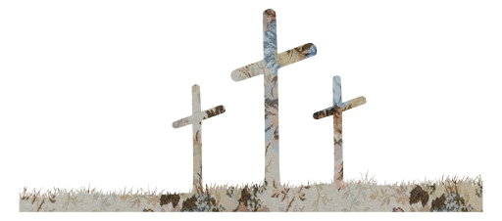
^{Opening Prayer}
Lord Jesus Christ, we entrust our family to You and ask for Your blessing and protection. We love You Lord Jesus with all our hearts and we ask that You help our family become more like the Holy Family. Help us to be kind, loving, and patient with one another. Give us all the grace we need to become saints and Your faithful disciples.
Amen.

Slide 3
^{Ice Breaker}
Movie Star

Slide 4
FAMILY SHARING
Share about your Family Lenten Plan, and
how it relates to the three Lenten Pillars of Prayer, Fasting and Almsgiving.
Families who brought in a sacramental or a picture of your home altar,
share about those items and talk about why they are important to your family.

Slide 5
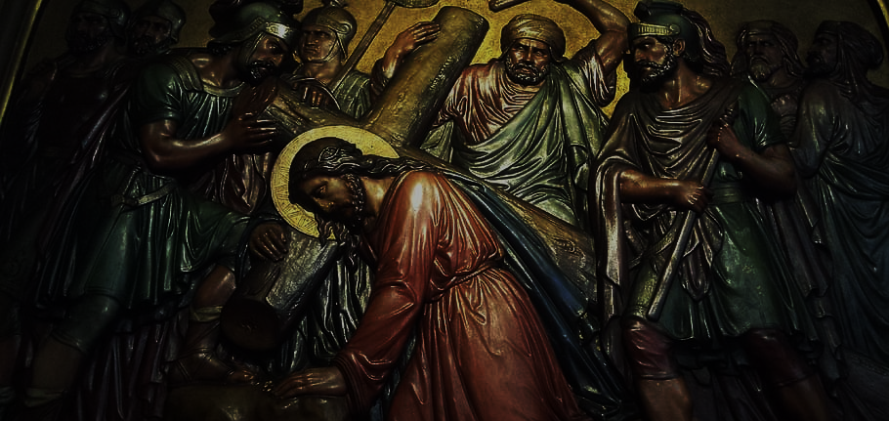
REVIEW MAIN CONCEPT
Today we will prepare for Lent by learning, reflecting on,
and praying the Stations of the Cross.

Slide 6
FAMILY ACTIVITY
(catholicicing.com)

Slide 7
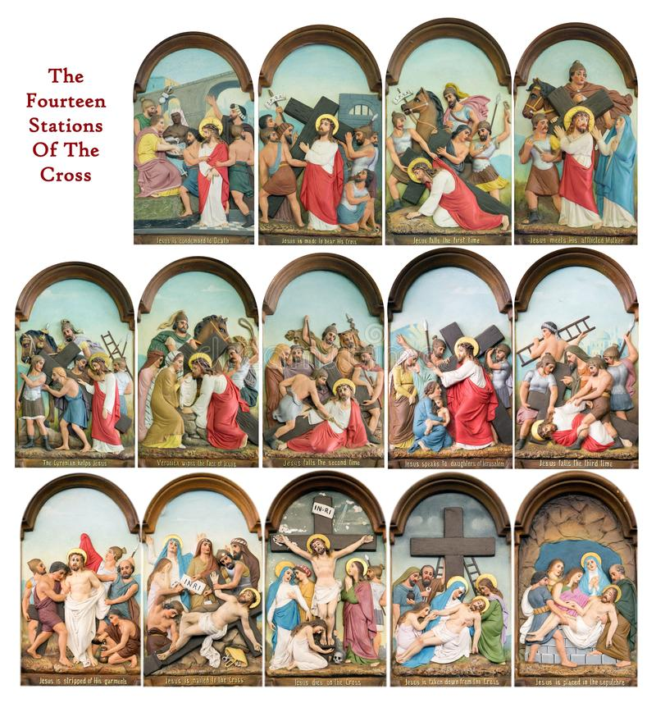
CLOSING PRAYER
Pray the Stations of the Cross

