Slide 1
FAMILIES FORMING DISCIPLES
^{Lesson 4 – Week 1}

Slide 2
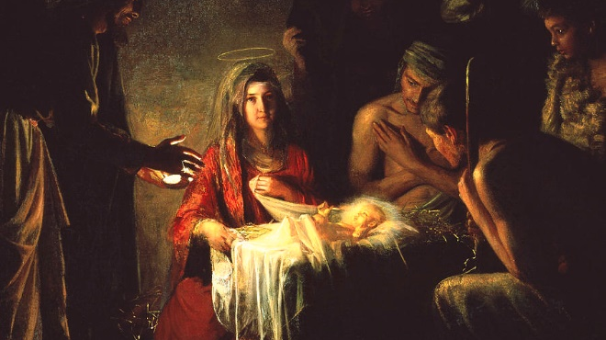
Topic: Prayerfully Preparing for Christmas & Grace and Holiness in Family Life
REFERENCES:
Goals:
Lectio Divina and Family Rosary: Families will be introduced to and guided in an Ignatian meditation on the Third Joyful Mystery of the Birth of Our Lord
Families will learn about and celebrate the Solemnity of the Immaculate Conception and the Feast of Our Lady of Guadalupe, reflecting on the presence of grace and the call to holiness in family life
Families will learn about and prepare Advent/Christmas symbols in their homes
^{Sacred Scripture}
^{Is 9:5-6}
^{Mt 1:18-25}
^{Lk 1:28; 2:1-21}

Slide 3
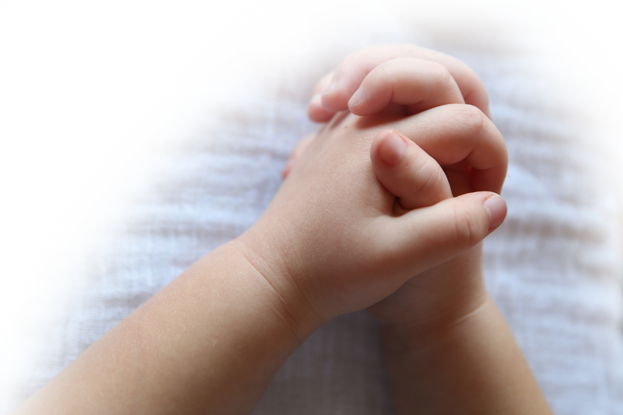
^{Opening Prayer}
^{Advent Prayer for Families}
Heavenly Father, your Son, Jesus, is your greatest gift to us, a great sign of your love. Guide us as we strive to walk in that love together as a family this Advent. Help us to do our Family Advent Plans. As we prepare our hearts for Christmas, bring us closer to each other and to your Son. Give us the grace and strength we need every day. Help us to always trust in you. Come, Lord Jesus, lead all people closer to you. Come and dispel the darkness of our world with the light of your love. Amen.
Adapted from Dynamic Catholic

Slide 4
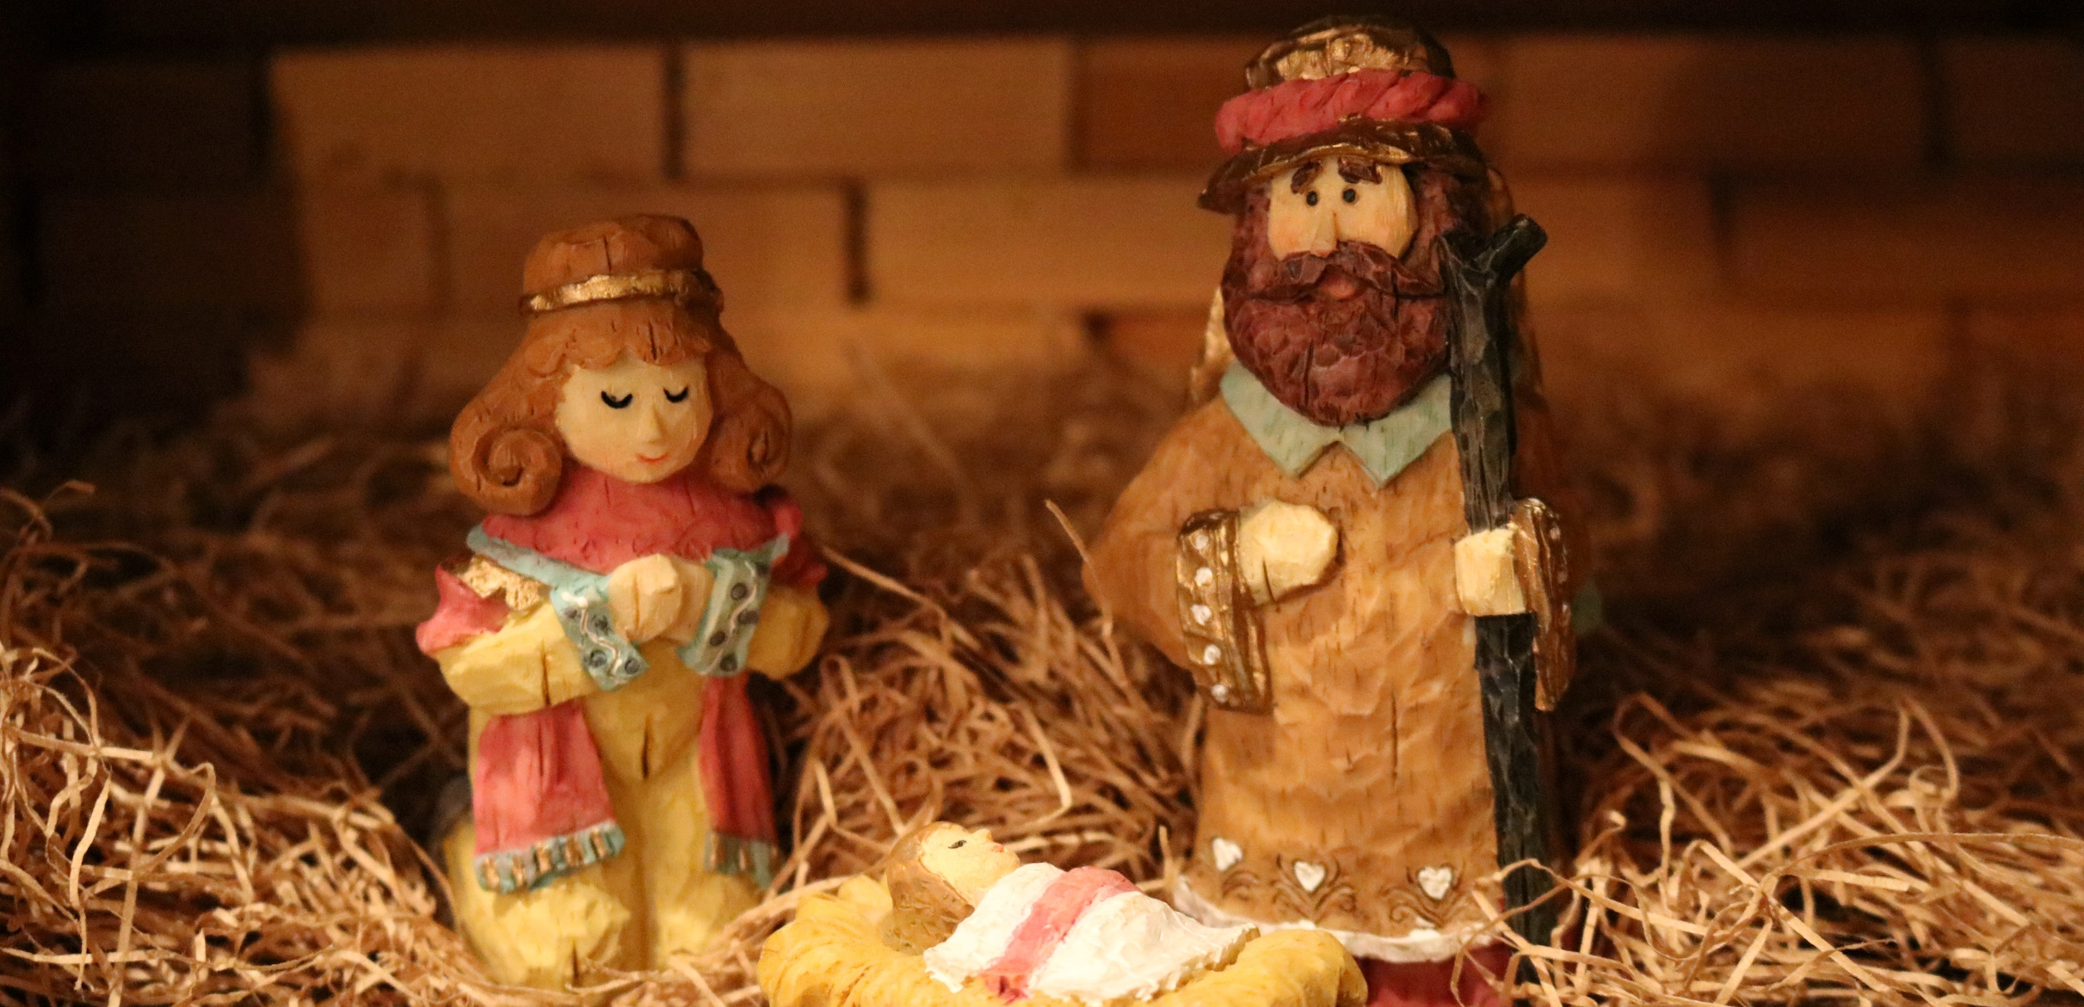
^{Ice Breaker}
Write down as many Advent and Christmas traditions as you can within 1 minute.

Slide 5
Name one or two of your family’s favorite Christmas traditions.

Slide 6
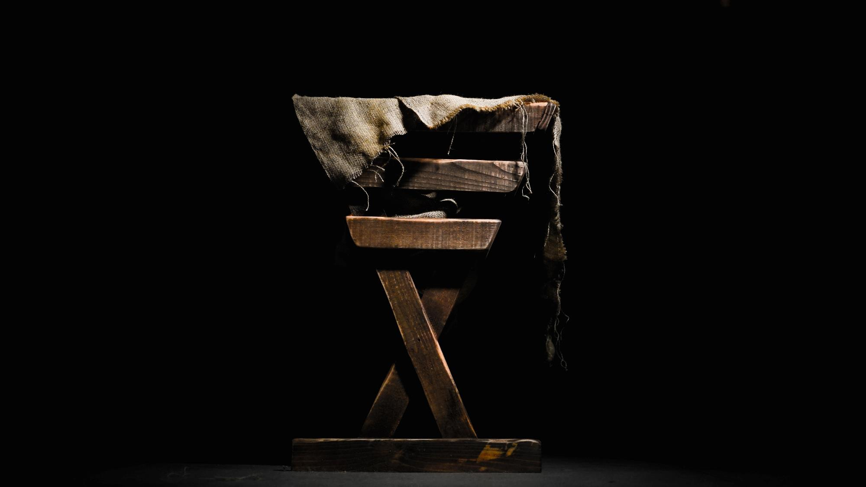
Today’s Topic
The Birth of Jesus
Luke 2: 1-20

Slide 7
^{Content}
Going to the Holy Land with Jesus
Please find a comfortable place to sit (or lie on your beach towels), close your eyes and relax as if you were resting somewhere peaceful.
Breathe slowly in and out, while picturing Jesus sitting in your midst.

Slide 8
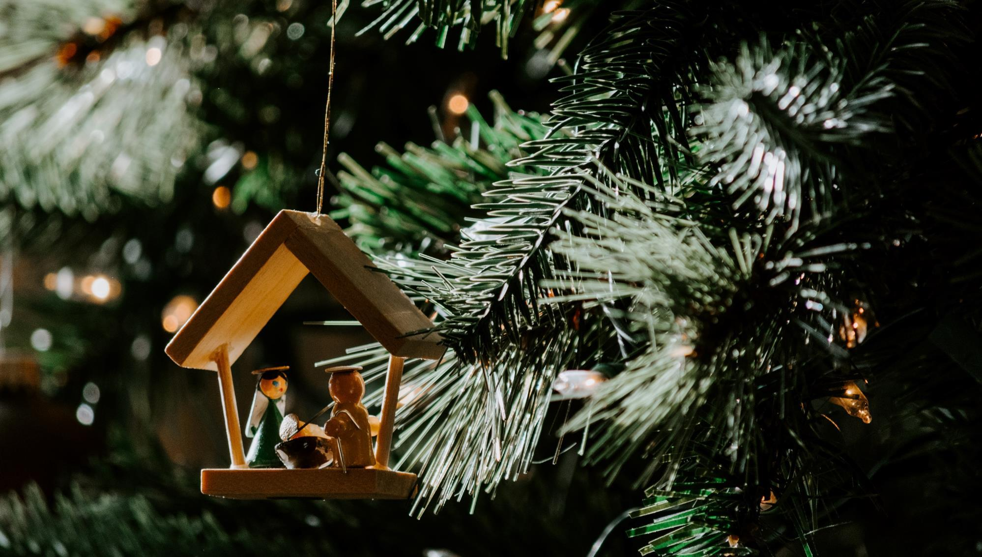
Content
What did Jesus show you?
What was it like to be there with the Holy Family, Mary, Joseph and the Child Jesus?
Private family conversation

Slide 9
Guidelines for Sharing:
Listen with respect
Avoid interrupting or correcting
Signal when your family is done
We will wait in silence for the other families to finish

Slide 10
Mission
1
2
Step 1: Introduce Mission Activity
Mission Activities are to be done at home during Week 2 and to be shared at the gathering of families on Week 3
Explain the Activity
Show a sample of your Advent Wreath, candle or Manger
Share why you chose it
& watch
Complementary Videos

Slide 11
Mission
3
Video about the Immaculate Conception
What is the Immaculate Conception?
What does the Immaculate Conception mean?

Slide 12
Review and Prayer
Dear Jesus, You entered our world on Christmas as the Prince of Peace. This Advent, as we strive to live out our baptismal call to holiness and follow You more faithfully, fill us with a deep and abiding peace. Help us share that peace with everyone we encounter, especially those who need it most. Amen.
Our Lady of Guadalupe, patroness of the Americas, and Immaculate Heart of Mary, patroness of the Archdiocese of Atlanta, pray for us!
Adaptad from Dynamic Catholic

