Slide 1
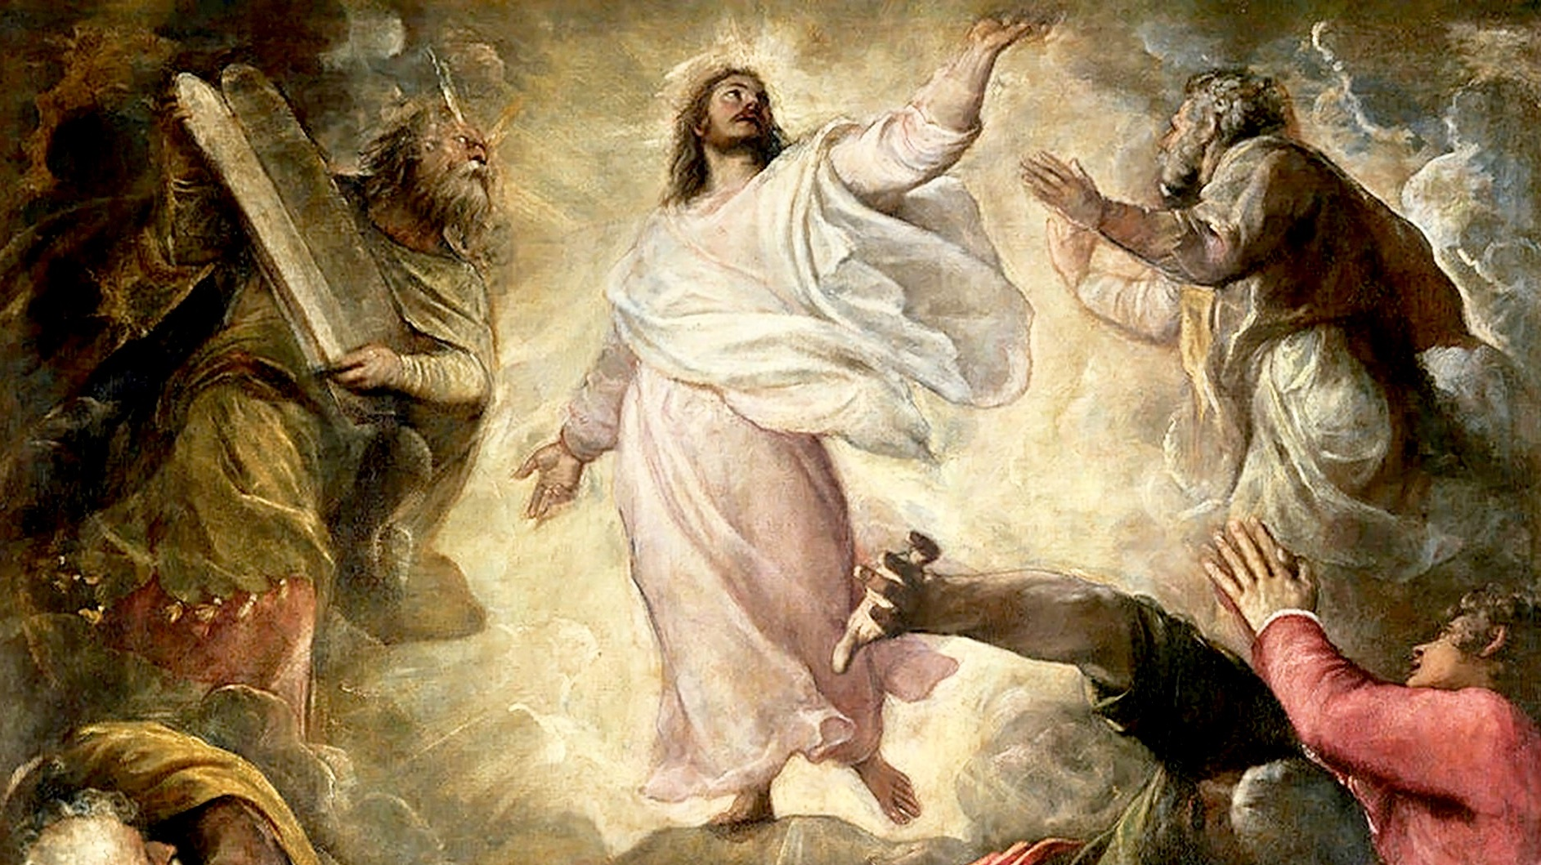

THE LIFE OF CHRIST: THE LUMINOUS MYSTERIES
THE TRANSFIGURATION

Slide 2

^{Opening Prayer}
Lord Jesus Christ, we entrust our family to You and ask for Your blessing and protection. We love You Lord Jesus with all our hearts and we ask that You help our family become more like the Holy Family. Help us to be kind, loving, and patient with one another. Give us all the grace we need to become saints and Your faithful disciples.
Amen.

Slide 3

^{Ice Breaker}
THE GIFT OF GIVING
What gifts did you give to your family and or friends?
Did you or are you planning to make a special donation to a person or organization?
How do you feel when you give to others?

Slide 4
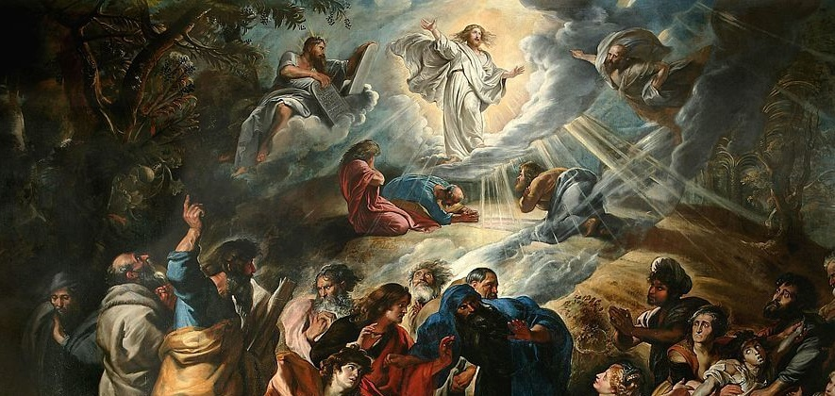
TRANSFIGURE?

Slide 5
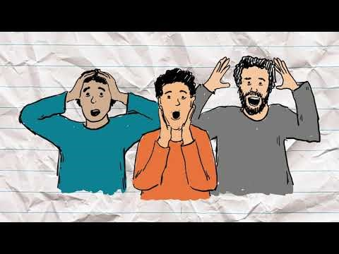
TRANSFIGURE?
While we watch this short video, consider these questions:
In the story, whose appearance changed and was made glorious or beautiful?
Why was that person transfigured?
What do you think it meant?
https://youtu.be/dC081rBhFsE

Slide 6
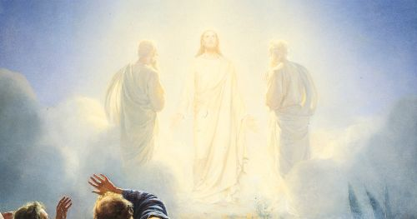
MATTHEW 17

Slide 7

FAMILY CONVERSATION
Families sit in a circle.
Each person identifies one or two qualities (or gifts) about the person on his/her right-hand side that help show he/she is a beloved son or daughter of God.

Slide 8

FAMILY ACTIVITY
Transfiguration of Jesus Sun Catcher Craft
by Catholic Design
This “sun-catcher” is meant to resemble the gleaming white light that Jesus had shown on the mountain during His transfiguration.
“..his face shone like the sun and his clothes became white as light.”
Mt 17:2

Slide 9
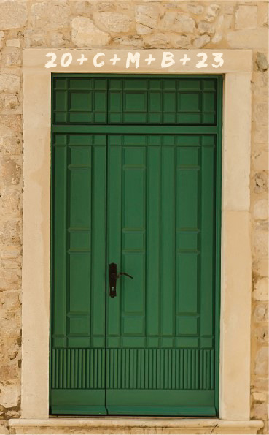
FAMILY MISSION
Your Family At-Home Mission is to watch the videos about the Transfiguration of Jesus, and read the article on the Epiphany. Then, together as a family, mark the mantle of your front door with chalk (blessed, if possible) and pray the Family Epiphany Blessing.
Be ready to share your Family Epiphany Blessing experience, as well as your front door mantle (take a picture) at Week 3’s gathering of families.
(Family Mission Activities adapted from Catholic Digest)

Slide 10
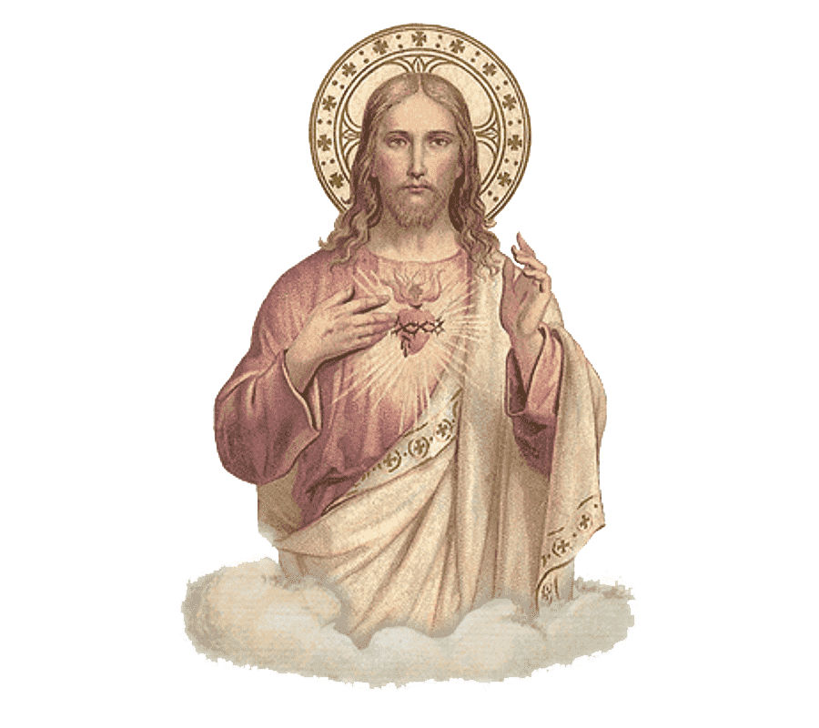
CLOSING PRAYER
Jesus, how good it is to be here with You. Let us never lose sight of Your glory. Let us live in Your presence forever.
We ask all this in the name of the Father, and of the Son, and of the Holy Spirit. Amen.
(The Word Among Us)

