Slide 1
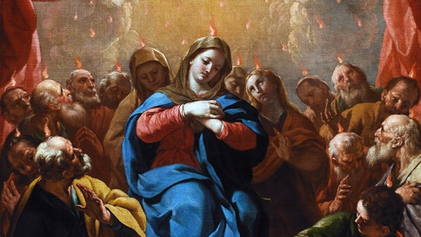
THE LIFE OF CHRIST: THE GLORIOUS MYSTERIES
THE DESCENT OF THE HOLY SPIRIT AT PENTECOST

Slide 2
^{Ice Breaker}
In the Bible we read that Jesus breathed on his followers to give them the Holy Spirit.
We also read that the Holy Spirit came to the disciples in the upper room on the day of Pentecost like a strong driving wind.
For this game, we are going to use our breath to create wind to move the balloons across the finish line. No one can use any part of their body to move the balloon; they can only use their breath.

Slide 3
^{Opening Prayer}
Lord God, fill us with your Holy Spirit that we may go out and share Jesus’ love and light with others like the disciples did. In the name of the Father,…
(Family Faith Formation, Archdiocese of Adelaide)

Slide 4
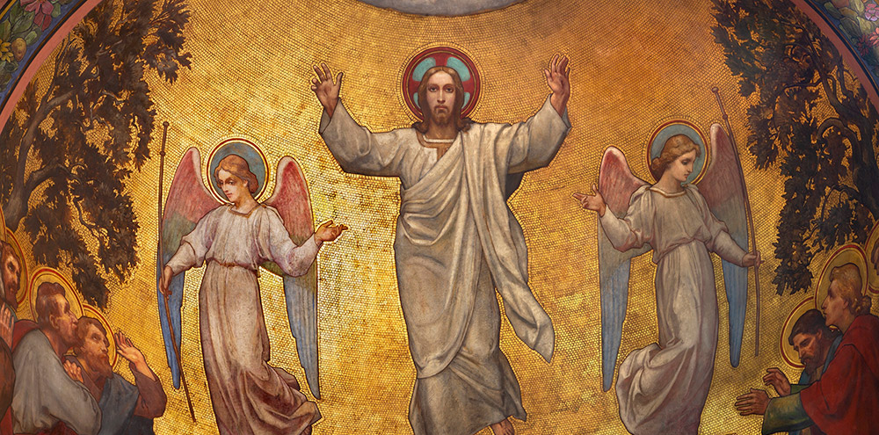
Go, and make disciples
“All power in heaven and on earth has been given to me.
Go, therefore, and make disciples of all nations, baptizing them in the name of the Father, and of the Son, and of the holy Spirit, teaching them to observe all that I have commanded you. And behold, I am with you always, until the end of the age.” Matthew 28:18-20

Slide 5
KID BIBLE STORY: PENTECOST
https://www.youtube.com/watch?v=vuUK6REOWuE

Slide 6
ACTS 2:1-11
Pentecost Sunday – What is Pentecost? (Catholic Kids Media)
https://www.youtube.com/watch?v=YO6Xm9-FC0Q

Slide 7
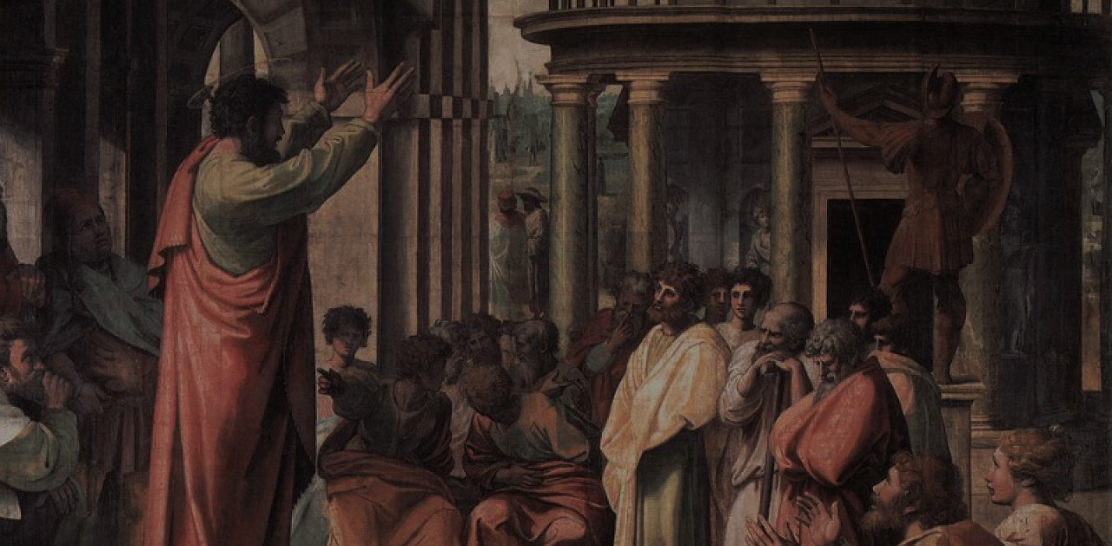
ACTS: 2:38-41
“Peter said to them, ‘Repent and be baptized, every one of you in the name of Jesus Christ for the forgiveness of your sins; and you will receive the gift of the holy Spirit.
For the promise is made to you and to your children and to those far off, whomever the Lord our God will call.’
He testified with many other arguments, and was exhorting them, ‘Save yourselves from this corrupt generation.’
Those who accepted his message were baptized, and about three thousand persons were added that day.”

Slide 8
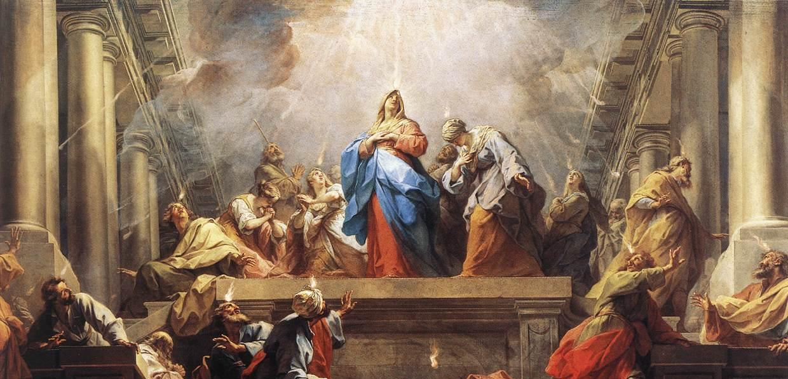
FAMILY CONVERSATION
If you had been there at the first Pentecost, do you think you would have believed Peter and the disciples?
What do you believe is the difference between an admirer of Jesus and a disciple of Jesus?
How does being a person who has been baptized in the name of the Father, and of the Son, and of the Holy Spirit affect your life, how you see God, and yourself?

Slide 9
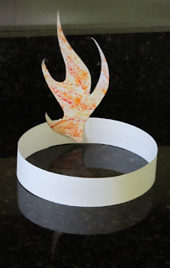
FAMILY ACTIVITY
Tongues of Fire Wearable Headband Craft
Use card stock paper or cardboard to cut out flame shapes
Have the children paint them with water colors, or glue red and orange pieces of tissue paper on it to make it look like flames.
Use a strip of paper for the headband, fitting it to each child’s head and using a stapler to secure the headband.
Attach the flames to the headband using the stapler as well.

Slide 10
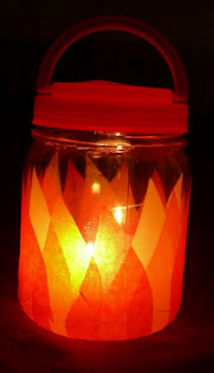
FAMILY ACTIVITY
Holy Spirit Fire Lantern Craft
Cut pieces of colored tissue paper in the shape of flames.
Paint the outside of the entire jar with Modge Podge.
Layer paper flames on the outside of the jar.
Cover the outside of the jar with a thin layer of Modge Podge.
Allow jar to dry completely.
Turn on the votive light and place inside the lantern and put the lid on the jar.
When you want to turn off the light, just open the jar and take the votive out to switch it off.
Families place their Holy Spirit Fire Lanterns on their home altars to light during Family Prayer Time.

Slide 11
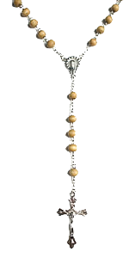
Your Family At-Home Mission
Your Family At-Home Mission is to watch together as a family, the videos that are appropriate for your children’s age level.
Then, place your Holy Spirit Fire Headband or Lantern on your family’s home altar, and pray together a decade of the Rosary meditating on the Third Glorious Mystery,
The Descent of the Holy Spirit at Pentecost.
Lastly, please complete the Families Forming Disciples Family Survey.

Slide 12
CLOSING PRAYER
Lord Jesus Christ,
We entrust our family to You and ask for Your blessing and protection.
We love You Lord Jesus with all our hearts and we ask that You help our family to become more like the Holy Family.
Help us to be kind, loving, and patient with one another.
Give us all the grace we need to become saints and Your faithful disciples.
Amen.

