Slide 1
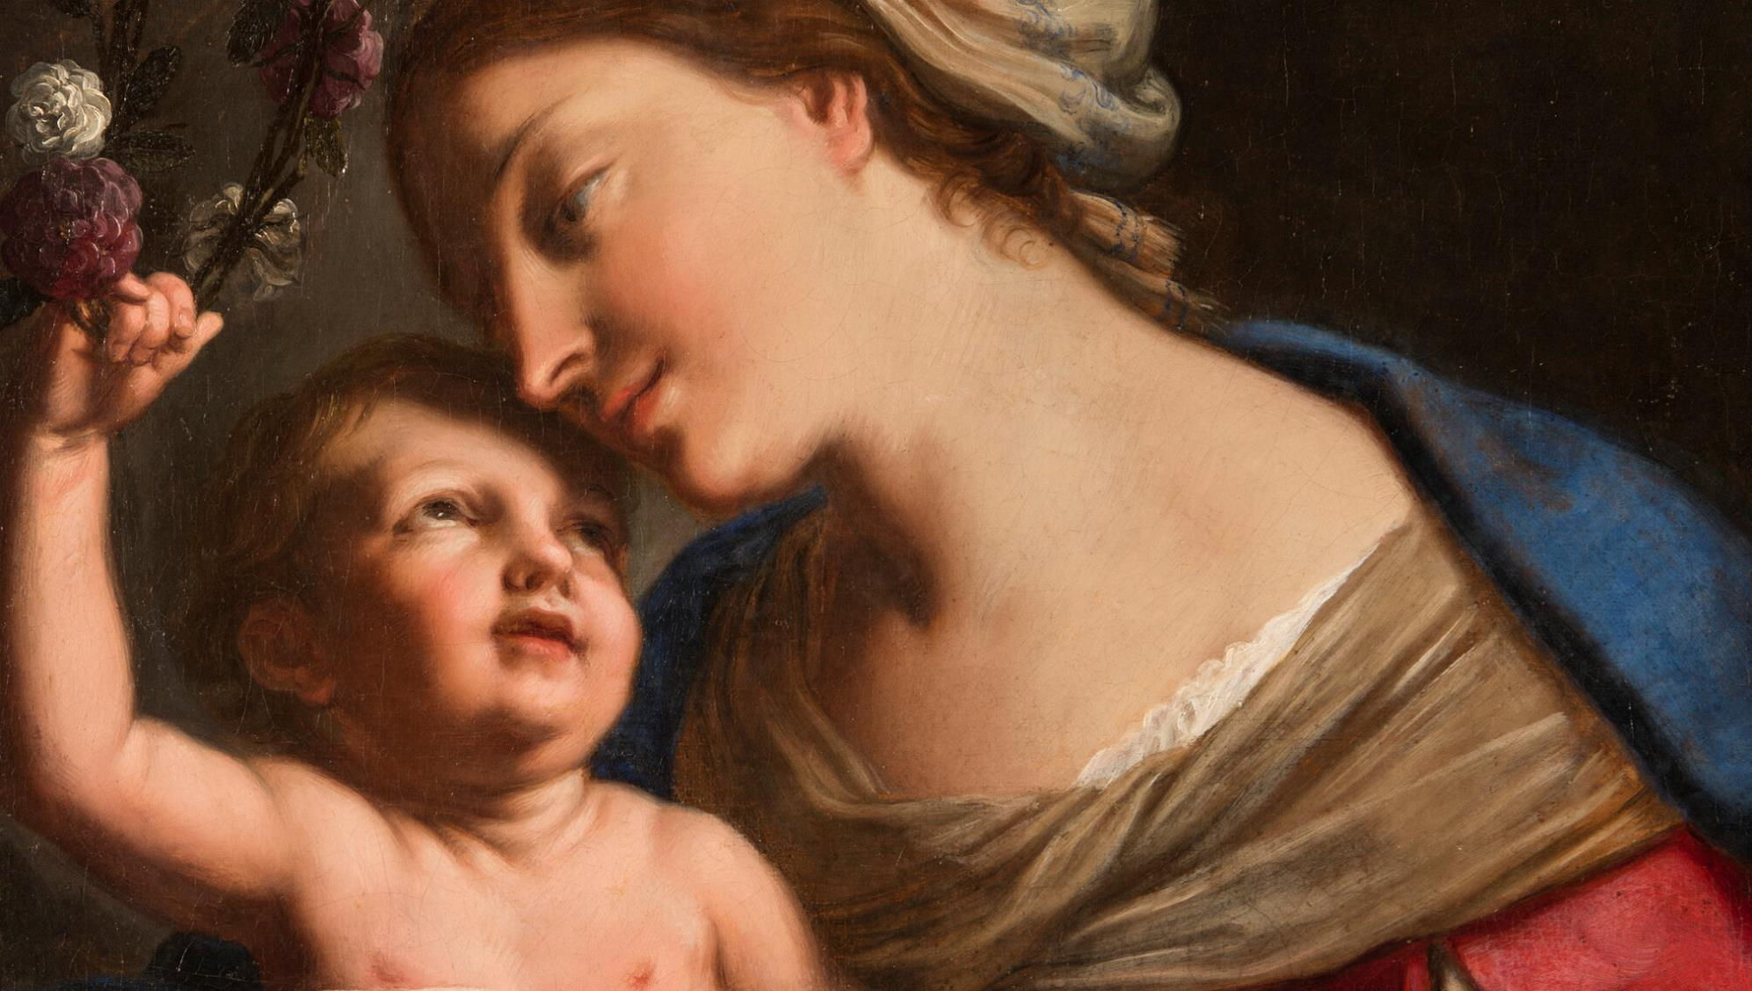
GOD’S SAVING LOVE FOR US: LITURGY AND THE SEVEN SACRAMENTS
TOPIC: MARY, OUR MOTHER AND OUR QUEEN!

Slide 2
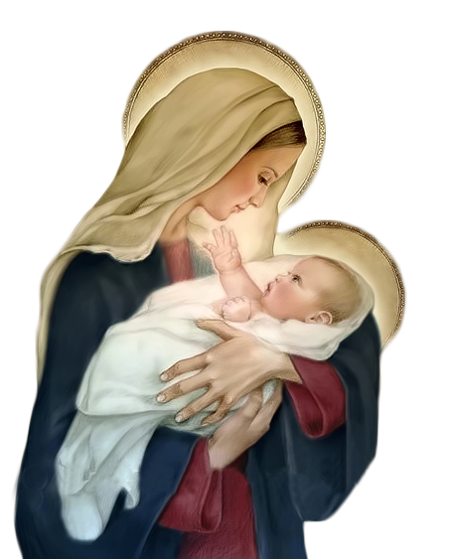
^{Opening Prayer}
Lord Jesus Christ, We entrust our family to You and ask for Your blessing and protection.
We love You Lord Jesus with all our hearts, and we ask that You help our family to become more like the Holy Family.
Help us to be kind, loving, and patient with
one another.
Give us all the grace we need to become saints and Your faithful disciples. Amen.
This Photo by Unknown Author is licensed under CC BY-NC

Slide 3
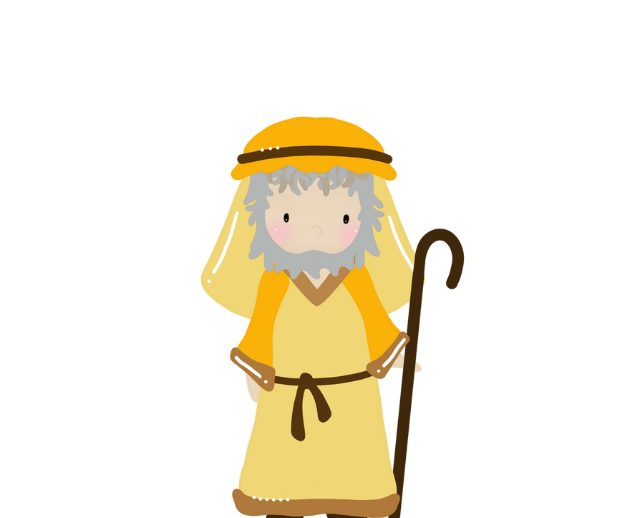
WHO AM I?
How to Play:
Each family member chooses a favorite bible character or saint, but does not reveal who it is.
The other family members ask 5 questions, and then based on the information, guess who the favorite person is.
Lastly, the person explains why the bible character or saint is his/her favorite.
(Adapted from youthgroupgames.com)

Slide 4
MAIN CONCEPT: MARY IS OUR MOTHER AND OUR QUEEN
Watch: Struggling to View Mary as Your Mother?
https://youtu.be/vQn3v8ywNGI?si=wGT8cxxydizbmsWh

Slide 5
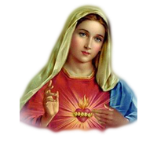
FAMILY CONVERSATION
Have you ever asked Mary
to pray for you?
Was there ever a time in your life when you knew Mary had helped you?
Do you think of Mary as a mother who cares for you?

Slide 6
OPEN MIC
Now that Families Forming Disciples is coming to a close this year, we invite you all to please share your experiences:
How did learning about the Seven Sacraments of the Catholic Church impact your relationship with God, one another and your church community?

Slide 7
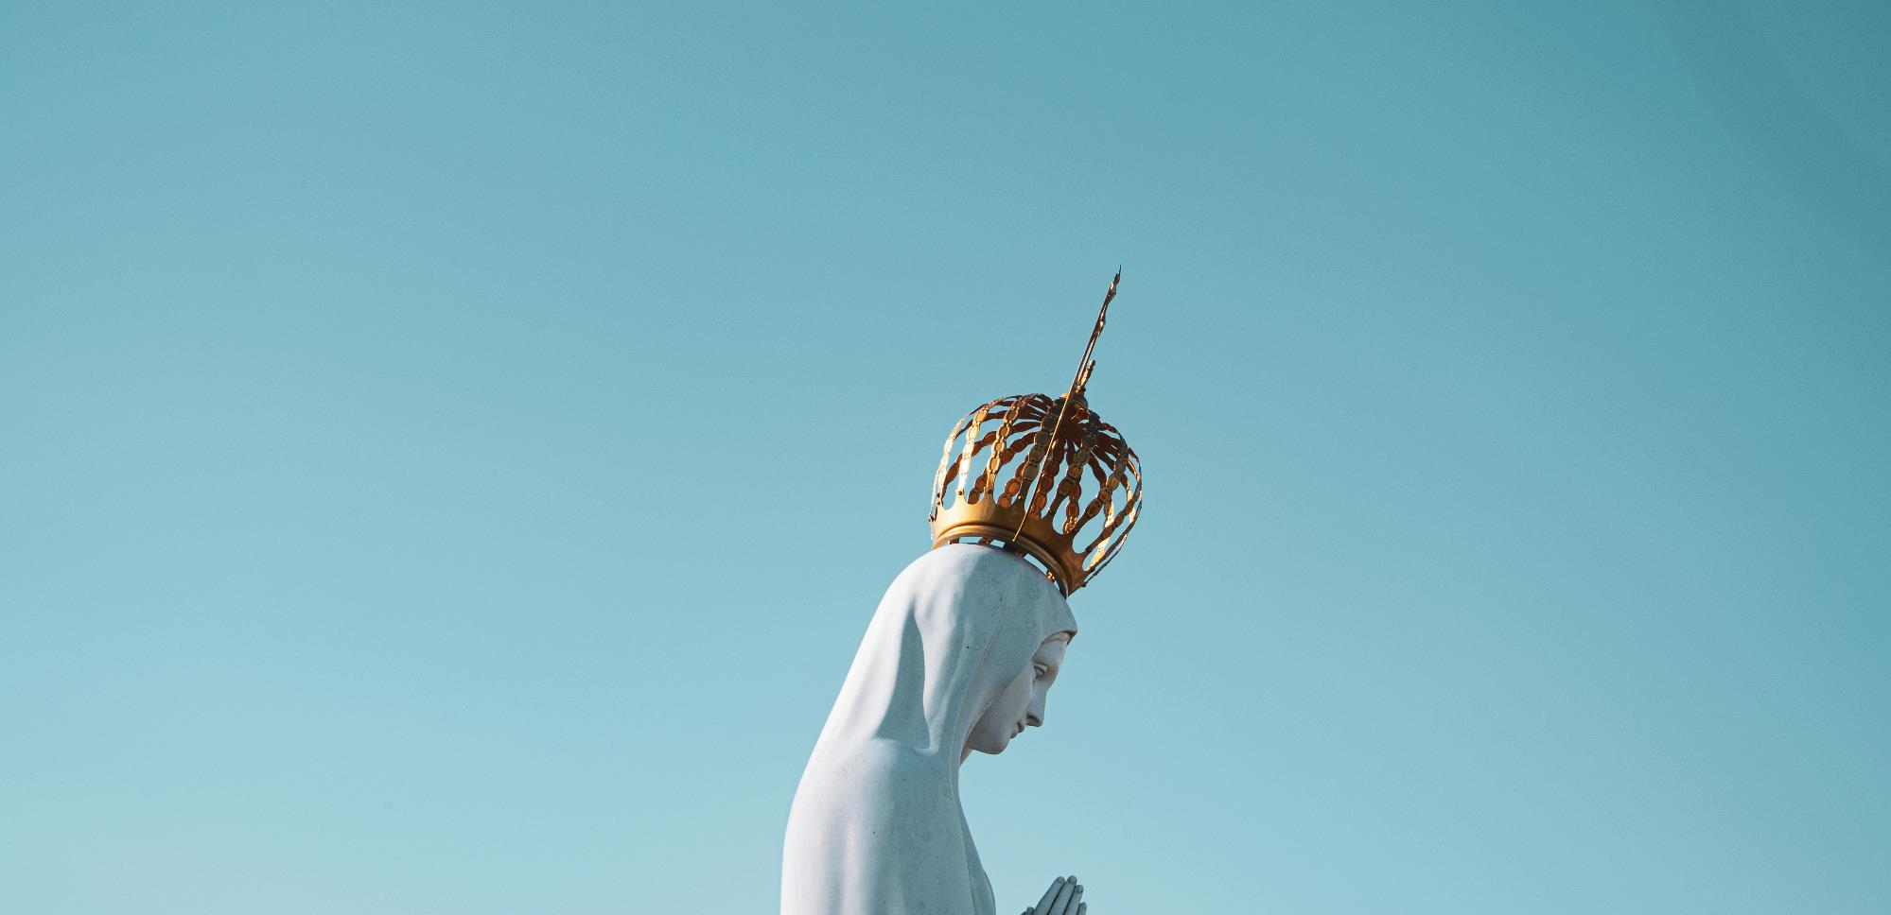
MAY CROWNING
We thank God for bringing us together and we invite the Holy Spirit into our lives as Mary did.
Mary is the Spouse of the Holy Spirit, and during the month of May we honor Mary as Queen of Heaven and Earth.
Her Son, Jesus, is our King, so therefore His Mother is our Queen!
A May Crowning is a special way we honor Our Lady during the Month of May.

Slide 8
Celebrate to conclude the Families Forming Disciples Year!
This Photo by Unknown Author is licensed under CC BY-NC

