Slide 1
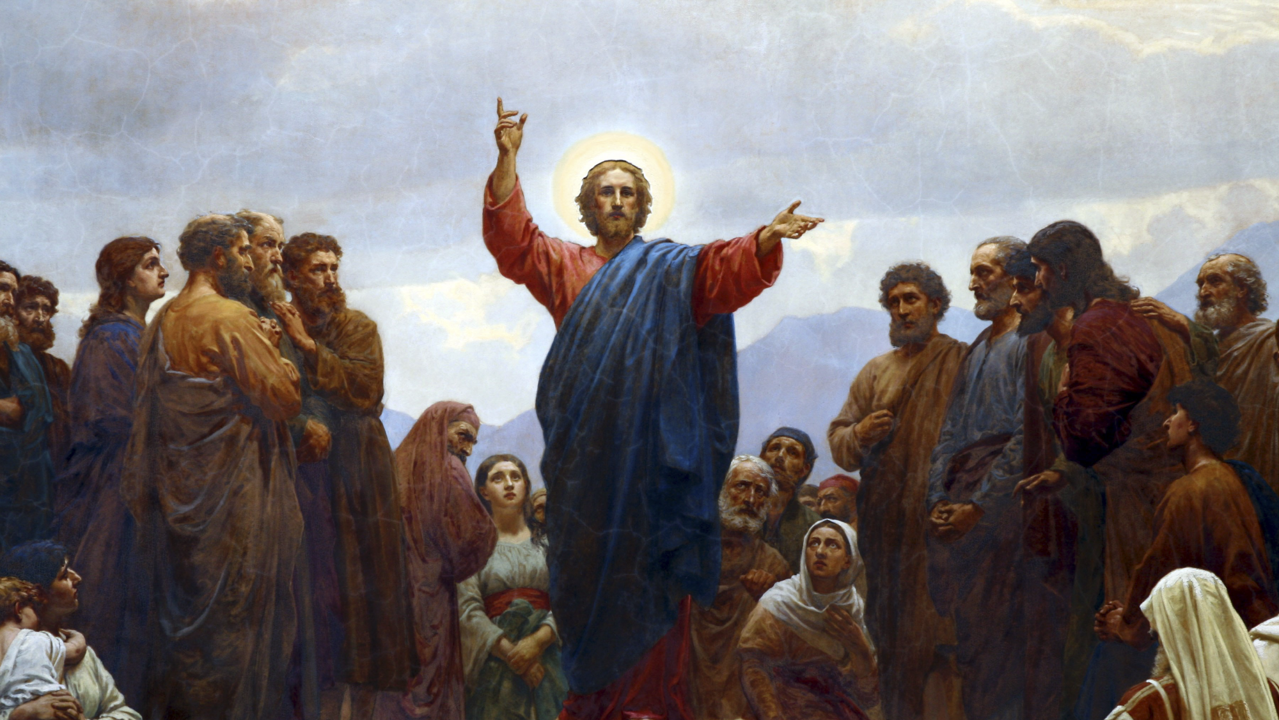
THE LIFE OF CHRIST: THE LUMINOUS MYSTERIES
PROCLAIMING THE KINGDOM OF GOD AND CELEBRATING THE BIRTH OF CHRIST
DURING ADVENT, ON CHRISTMAS DAY,
AND THROUGHOUT THE WHOLE CHRISTMAS SEASON!

Slide 2
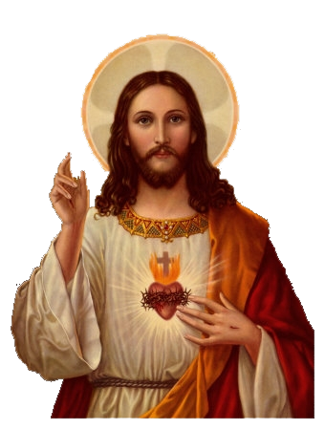
^{Opening Prayer}
Lord Jesus Christ, we entrust our family to You and ask for Your blessing and protection.
We love You Lord Jesus with all our hearts and we ask that You help our family become more like the Holy Family.
Help us to be kind, loving, and patient with one another.
Give us all the grace we need to become saints and Your faithful disciples.
Amen.

Slide 3
^{Ice Breaker}
CAROLING!
Take turns, as each person sings or hums his/ her favorite Christmas Carol. Then, the other family members guess the song title!

Slide 4
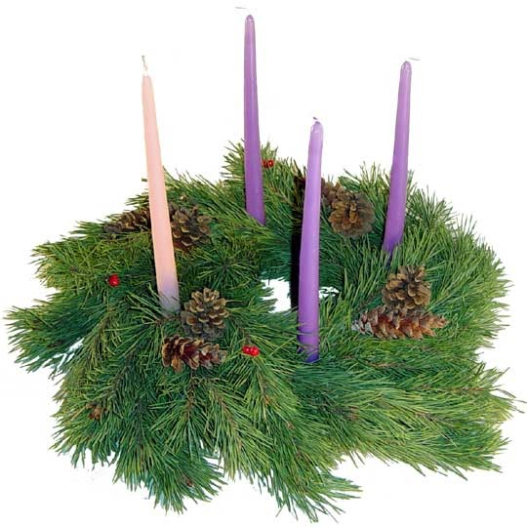
FAMILY SHARING
Share about your family’s plan to proclaim the Kingdom of God during Advent,
&
celebrate the Birth of Christ
on Christmas Day,
and throughout the whole Christmas Season!

Slide 5
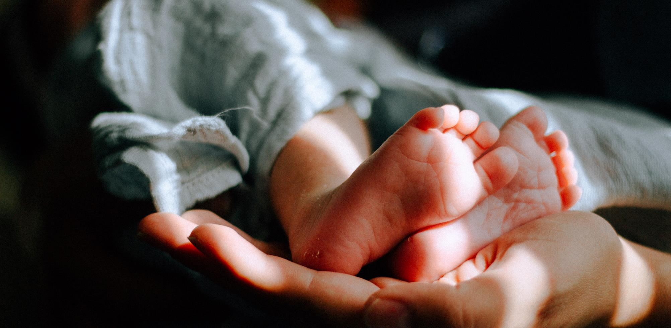
LECTIO DIVINA
Dear Jesus,
as we read and think about the story of Your life, we ask the Holy Spirit to come and speak to the hearts of all here, from the oldest to the youngest.
Read Luke 2:1-20.

Slide 6
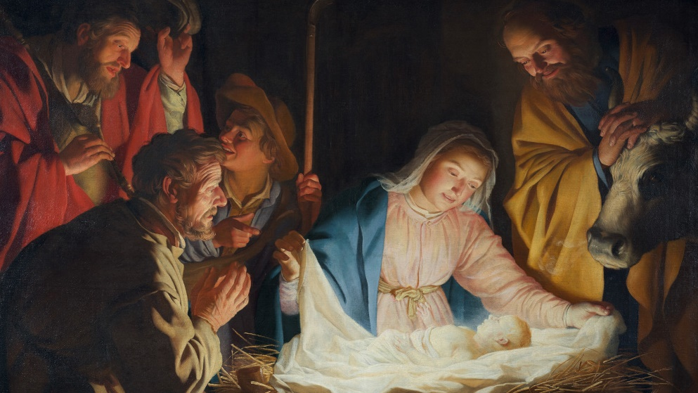
After reflecting quietly,
privately share with your family members about what stood out to you
in the Mystery of the Nativity of Our Lord,
and who in the story proclaimed the Kingdom of God.

Slide 7
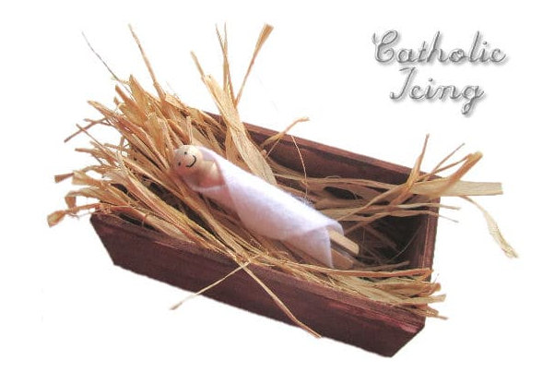
FAMILY ACTIVITY
Good Deeds and Sacrifices for Baby Jesus!
^{Making an Empty Manger}
When we are poor in spirit, when we mourn, are meek,
hunger and thirst for righteousness, are merciful, are clean
of heart, are peacemakers, are persecuted for the sake of
righteousness, or suffer for believing in Jesus, ours is the
^{Kingdom of Heaven!}
Keep your manger on your home altar.
Each time you love and sacrifice for others out of your love for God, place a straw in Baby Jesus’ manger to show you are preparing your heart, your family, your home and your community for the Kingdom of God.
On Christmas, place Baby Jesus in the warm manger made from your family’s love and sacrifices!
This is how the Kingdom of God is alive within us and how we share it with others!

Slide 8
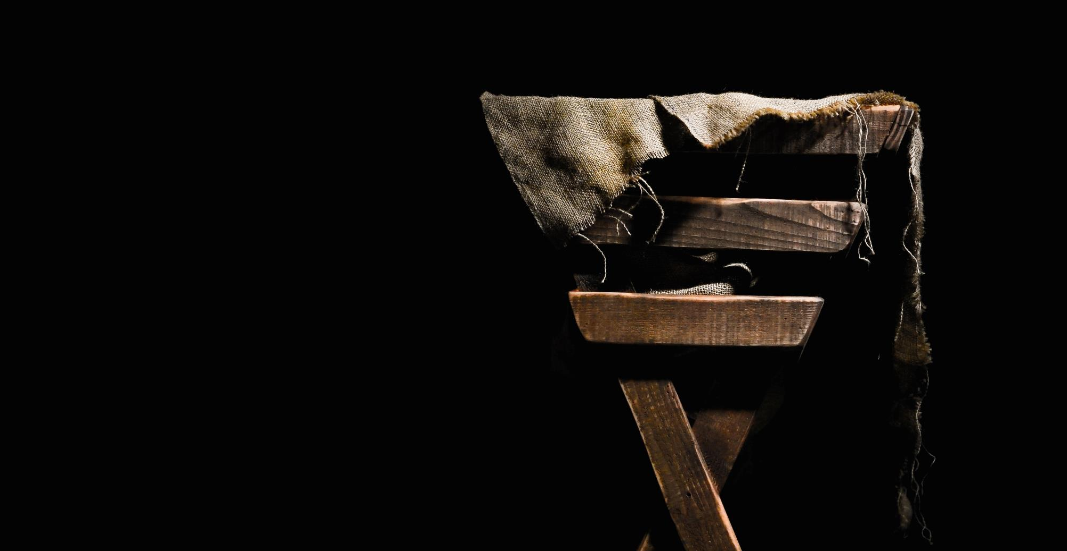
CLOSING PRAYER
God of Love, Heavenly Father, Your Son, Jesus, is Your greatest gift to us.
He is a sign and the very face of Your love.
Help us to walk in that love during the weeks of Advent, as we wait and prepare for His coming.
We pray this in the name of Jesus, our Savior.
Amen.

