Slide 1
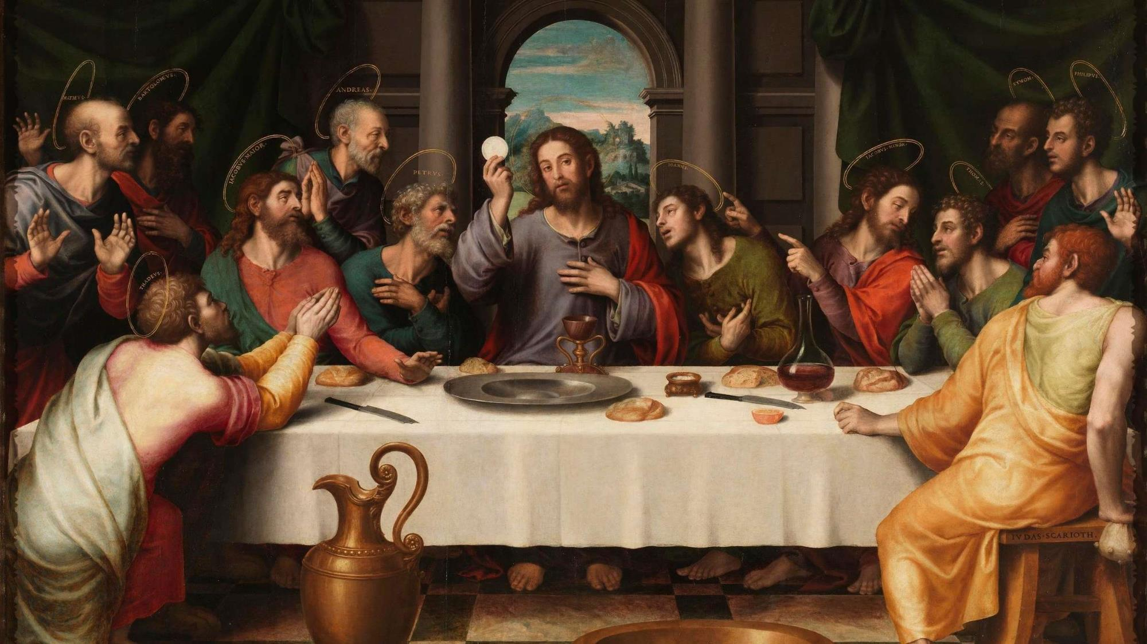
FAMILIES FORMING DISCIPLES
^{Lesson 7 – Week 1}

Slide 2
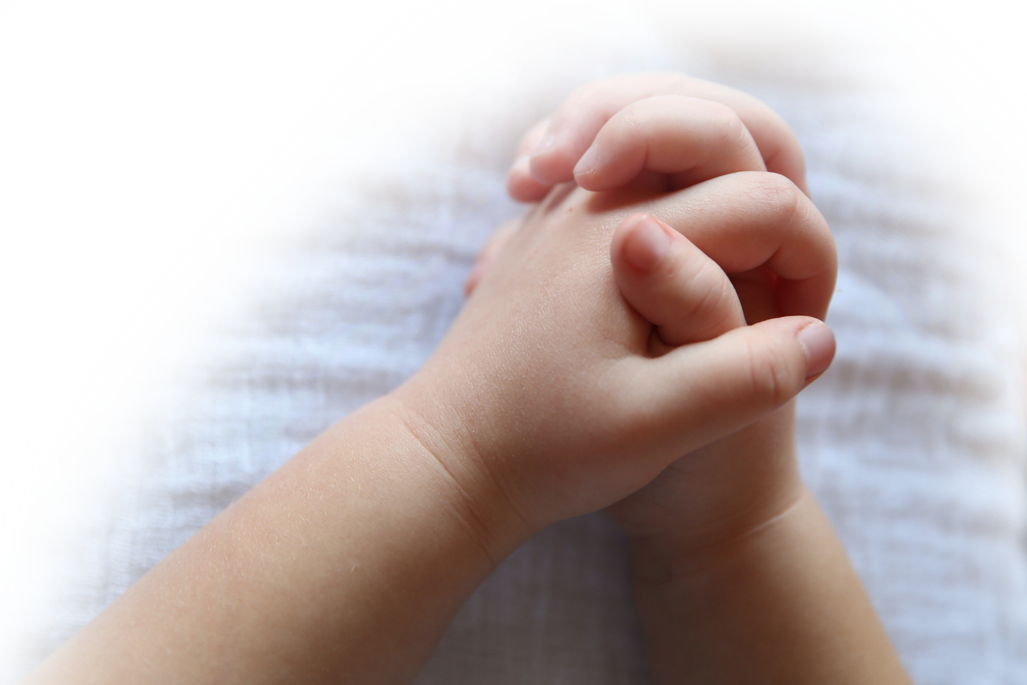
^{Opening Prayer}
Almighty and Everlasting God, You have given our families and the whole human race Your Son, Jesus Christ our Savior, as a model of humility. He fulfilled your will by becoming man and giving His life on the Cross. Help us to bear witness to You by following His example of suffering and make us worthy to share in His Resurrection. We ask this through our Lord Jesus Christ, Your Son. Our Father…
Adapted from: https://www.lords-prayer-words.com/times/meaning_of_lent_prayers.html

Slide 3
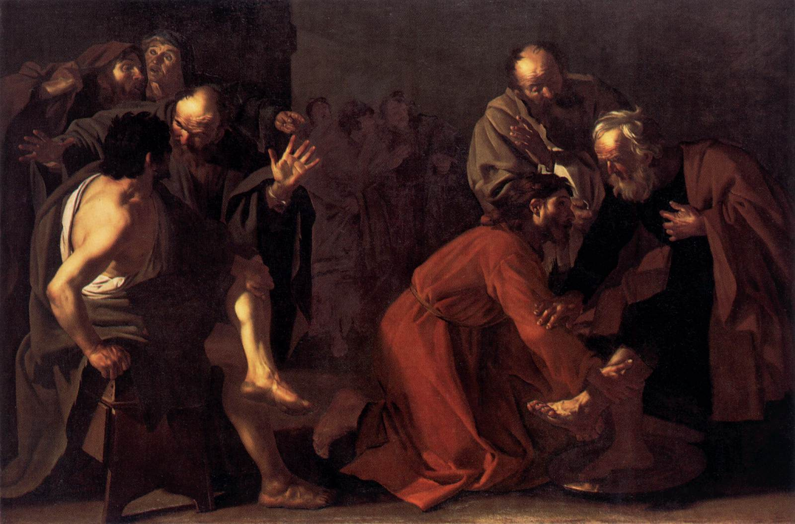
Goals
Families will reflect on Holy Week, Palm Sunday and Holy Thursday. Families will reflect on how Jesus chose to lay down his life because He loves them completely.
Families will make their Family Holy Week Plans

Slide 4
Materials
Bible
Anima Christi prayer cards (optional)

Slide 5
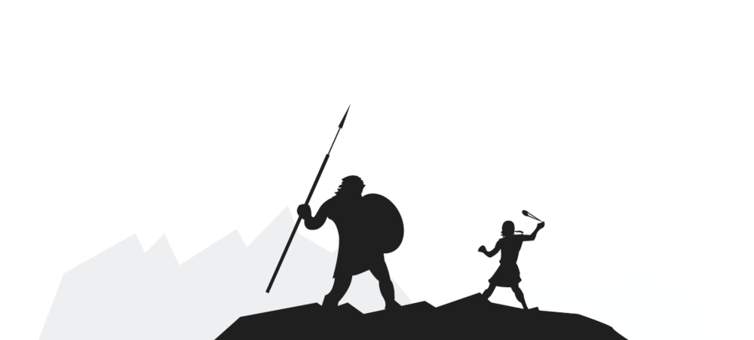
Ice Breaker
What is your favorite Bible story and why?

Slide 6
When you think of “Holy Week,” what two words come to mind?

Slide 7
Topics
Holy Week is a time when we prepare our hearts to remember the redemptive suffering and death of our Lord, Jesus Christ, and we prepare to celebrate His Resurrection. It begins with Palm Sunday of the Passion of the Lord and continues through the Sacred Triduum. Today we will begin to reflect on Holy Week and decide what our Family Holy Week Plans will be.

Slide 8
Family Sharing
(For parents) When you were growing up, what special traditions or religious practices did your family do during Holy Week?
(For the whole family) Which of the practices or traditions that you have experienced have brought you closer to God?

Slide 9
Content
So, what exactly is Holy Week?
Show video : Holy Week in Two Minutes by Busted Halo
(parents need to read text aloud)
https://www.youtube.com/watch?v=HugMM_3FfnI

Slide 10
Content
Holy Week is the holiest time of the year! It is when we remember the last week of Jesus’ earthly life and His saving work for us.
What is the special day that begins Holy Week?
Why is the day called Palm Sunday? What happened at the first Palm Sunday?
Why were the people excited about Jesus and praising Him as He entered Jerusalem?

Slide 11
Video
Show Video: Triumphal Entry and Results | The Life of Jesus by Jesus.net (watch up to minute 1:35)
https://www.youtube.com/watch?v=bXy8JJClj-Y

Slide 12
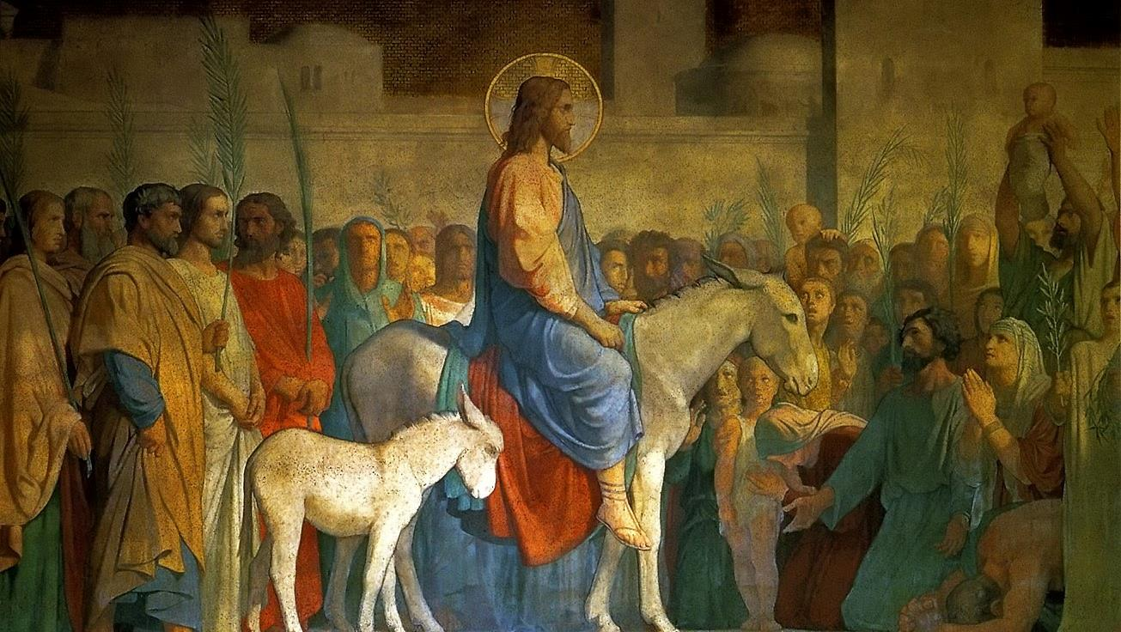
John 12:12-19
“Hosanna!
Blessed is he who comes in the name of the Lord,
[even] the king of Israel.”

Slide 13
Content
Does anyone know what the words Sacred Triduum mean?

Slide 14
Watch: From Fame to Death by Tweeting with God (2min)
https://youtu.be/-KPfk1fiUDs

Slide 15
Family Sharing
Is there anything holding you back from following Jesus with all your heart?
Is there anything more important to you than Heaven with your family?

Slide 16
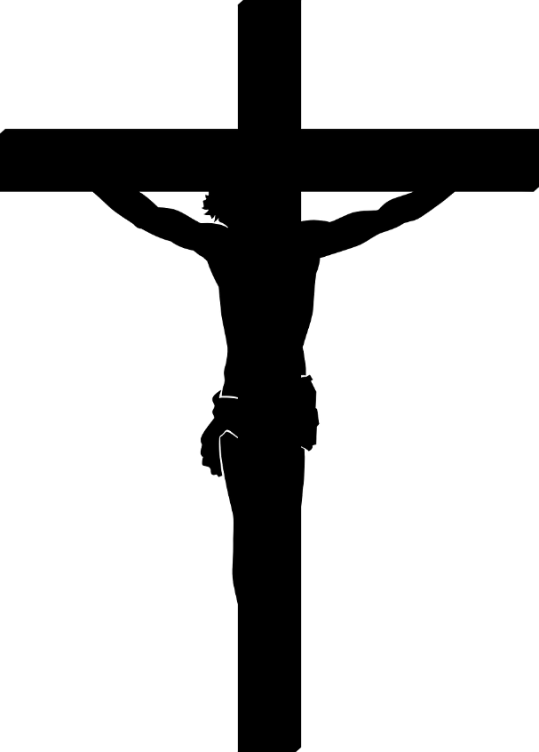
Mission & Close in Prayer
Anima Christi
Soul of Christ, sanctify me; Body of Christ, save me; Blood of Christ, inebriate me; Water from the side of Christ, wash me; Passion of Christ, strengthen me; O good Jesus, hear me; Within your wounds hide me; separated from you, let me never be; From the evil one protect me; At the hour of my death, call me; And close to you bid me;
That with your saints, I may be praising you forever and ever.
https://www.catholic.org/prayers/prayer.php?p=1140

