Slide 1
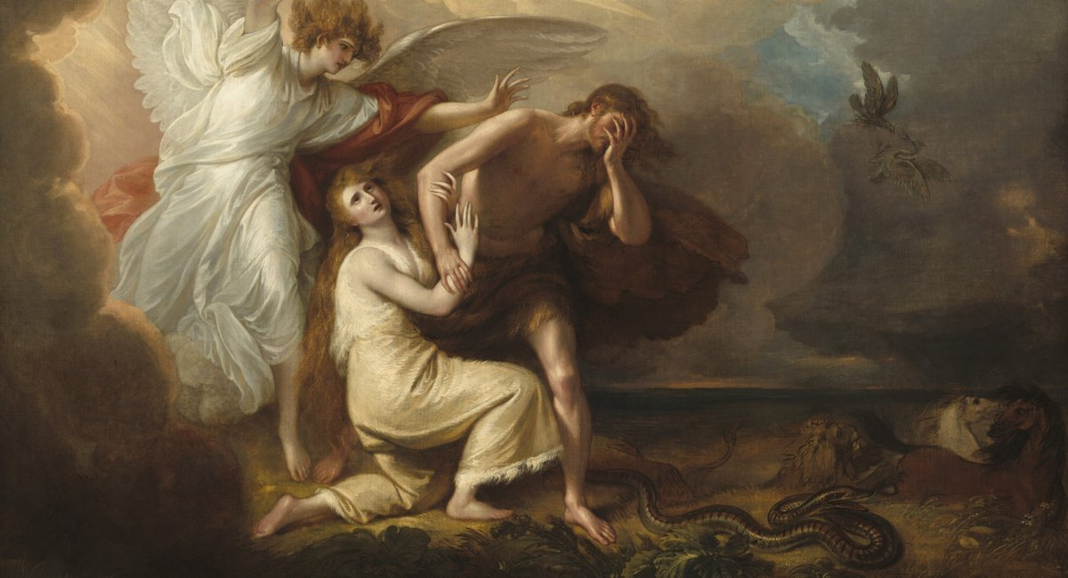
^{Families Forming Disciples}
The Fall and the Promise

Slide 2
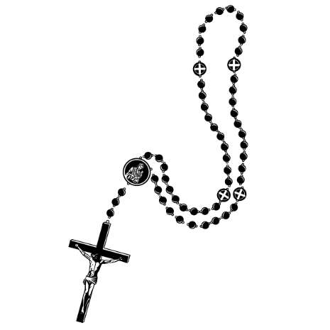
^{Opening Prayer}
Lord Jesus Christ,
We entrust our family to you and ask for your blessing
and protection. We love you Lord Jesus with all our
hearts and we ask that you help our family become
more like the Holy Family. Help us to be kind, loving,
and patient with one another. Give us all the grace
we need to become saints and your faithful disciples.
Amen.

Slide 3
^{Ice Breaker}
Who is it?

Slide 4
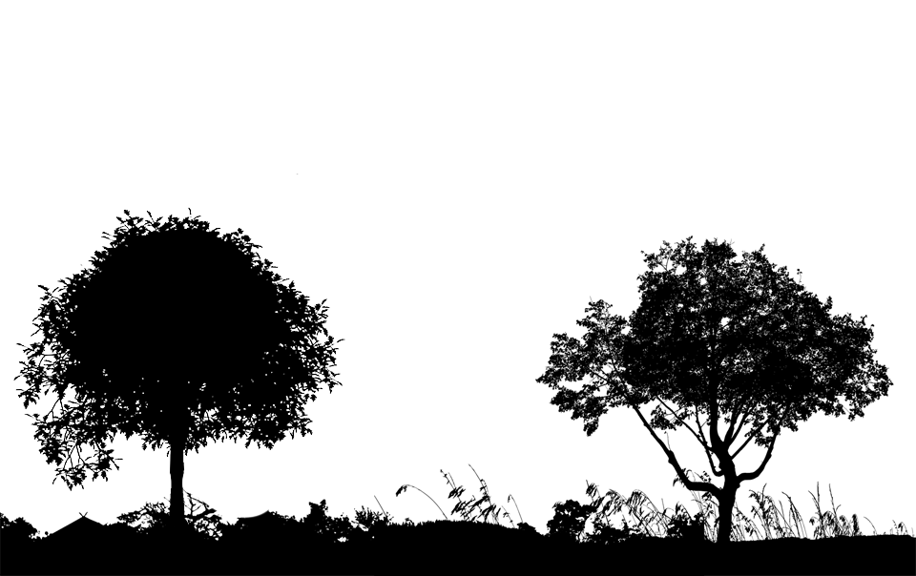
What were the names of the two trees that were ^{in the center of the garden?}

Slide 5
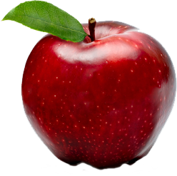
Our Topic for this month
Temptation and the Fall

Slide 6
^{Content}
^{https://youtu.be/D7LZnMHYrmY}

Slide 7
Family Conversation
What sacrifices does your family make for one another out of love?
Do mom and dad work outside and inside the home?
What acts of kindness or sacrifices do your family members do for one another?
How do you show one another love?

Slide 8
Mission
1. Introduce Mission Activities
Mission Activities are to be done at home during Week 2 and to be shared at the gathering of families on Week 3.
^{2. Explain Activity}
i. Read the USCCB explanations about the Spiritual and Corporal Works of Mercy (links provided in week 2’s handout).
ii. Decide which Works of Mercy your family will do this
Advent and make a Family Advent Plan.
iii. Etc.
^{3. Family Sharing}
Be prepared to share with other families your answers to the questions.

Slide 9
^{Review & Close in Prayer}
God our Father, loving and merciful, bring together and keep all of our families in the perfect unity of love and mutual support. Instill in each of us the spirit of understanding and affection for each other. Keep quarrels and bitterness far from us, and for our occasional failures please grant us your forgiveness and peace.
Strengthen the mutual love and affection of parents so that they may set a good example. Instill in our children self-respect and an awareness of Your love that they may respect and love others and grow in mature independence.
May the mutual affection and respect of our families be a sign of Christian life, through Jesus Christ, our Lord and Savior. Amen.

