Slide 1
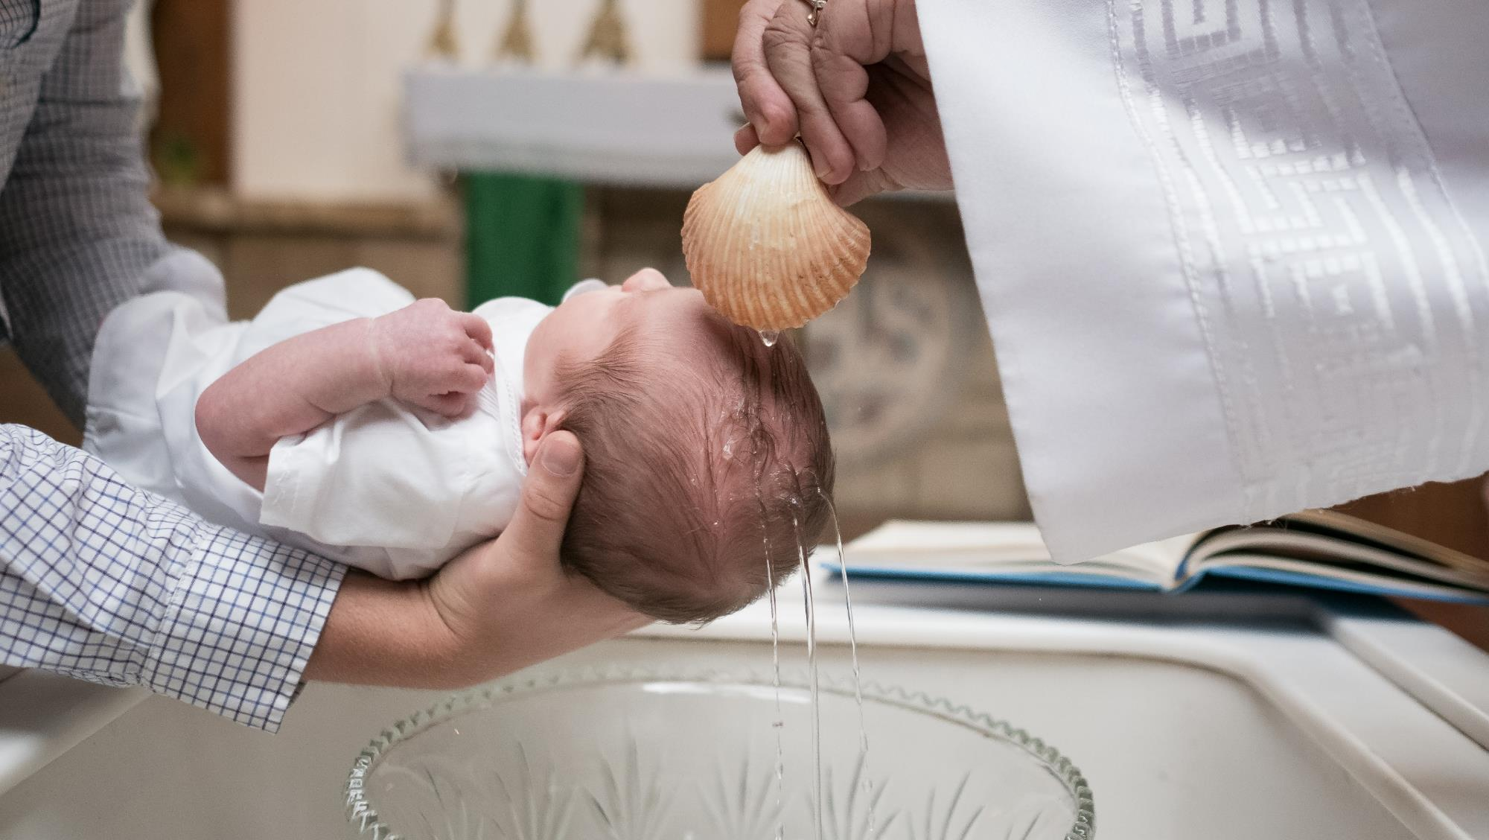
GOD’S SAVING LOVE FOR US:
LITURGY AND THE SEVEN SACRAMENTS
SACRAMENTS OF CHRISTIAN INITIATION: BAPTISM

Slide 2
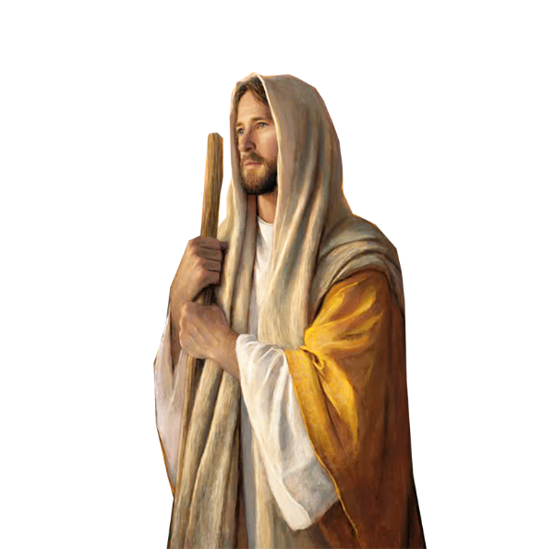
^{Opening Prayer}
Lord Jesus Christ,
We entrust our family to You and ask for Your blessing and protection.
We love You Lord Jesus with all our hearts, and we ask that You help our family become more like the
Holy Family.
Help us to be kind, loving, and patient with one another.
Give us all the grace we need to become saints and Your faithful disciples.
Amen.

Slide 3
^{Ice Breaker}
Water Drop Race
Tear off a sheet of wax paper for each player. Use the scissors to cut them into the same size.
Place a large drop of water on each sheet of wax paper.
Have the players blow on the drops to move them along the wax paper. They can either blow directly on the drop or use a straw.
First player to get their drop of water (or most of it) to the opposite side wins!
Adapted from https://www.signupgenius.com/

Slide 4
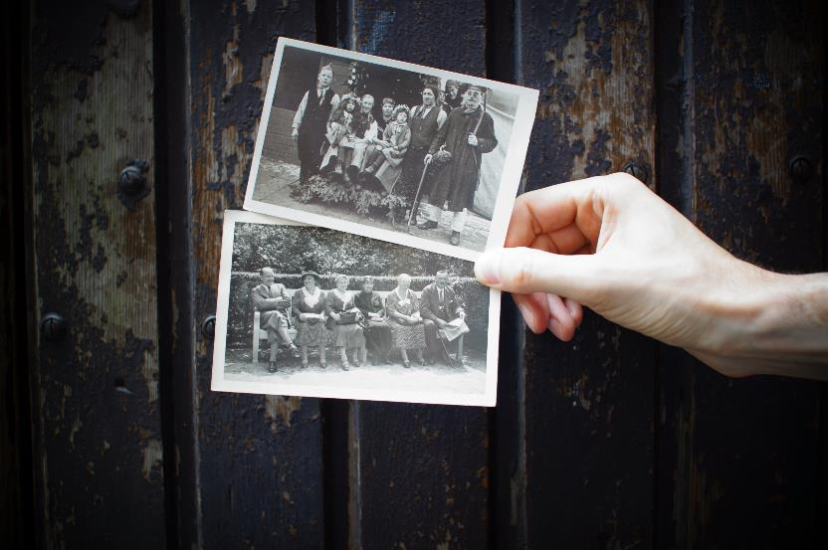
FAMILY SHARING
Each family shows the photo/picture of the loved one(s) for whom they will be praying for during All Souls Day, which is celebrated on November 2nd.
Share about who the person is, and why he/she is important to your family.
Was that special person named after a saint? Who is that saint?
Do you have a favorite saint? Why is that saint your favorite?
Are you named after a saint? Who is that saint?

Slide 5
REVIEW MAIN CONCEPT
A sacrament is an outward sign instituted by Christ to give grace, to help us grow in holiness. Sacraments are mysteries of the New Covenant established by Jesus; they are signs of the sacred action and presence of God in our midst today.
They are more than mere signs, however, for through the sacraments the
Lord gives His grace—His divine life—to us!

Slide 6
BAPTISM
Today, we are going to:
Learn more about the Sacrament of Baptism
Share about our own Baptisms
Renew our baptismal vows

Slide 7
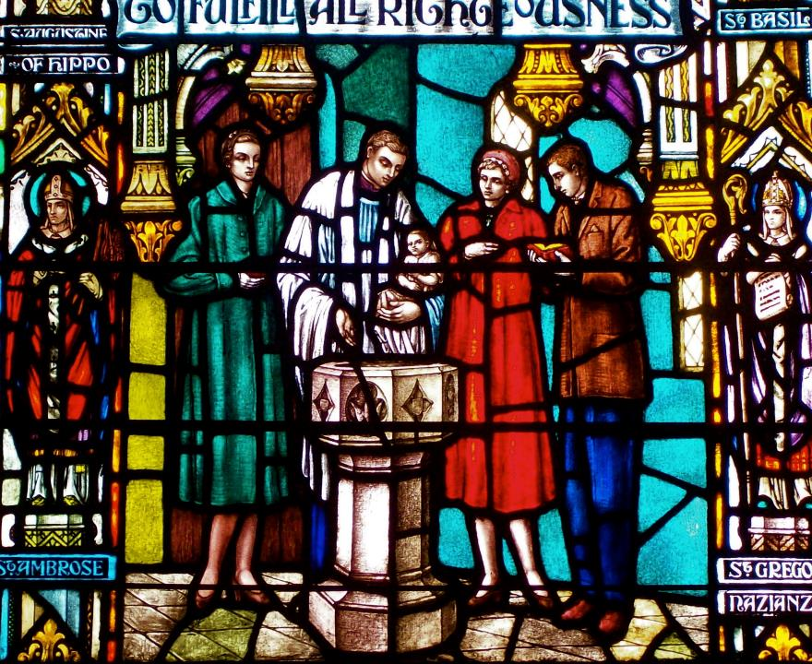
BAPTISM FACTS GAME
Each family thinks of, and writes down,
as many facts as they know about the
Sacrament of Baptism in two minutes.
The facts can include:
What is Baptism?
What does Baptism do for us?
How is someone baptized?
How many times can a person be baptized?
Who in the New Testament baptized Jesus?
Why do Catholics baptize infants?
Families share their lists at the end.
The family with the most Baptism Facts wins!

Slide 8
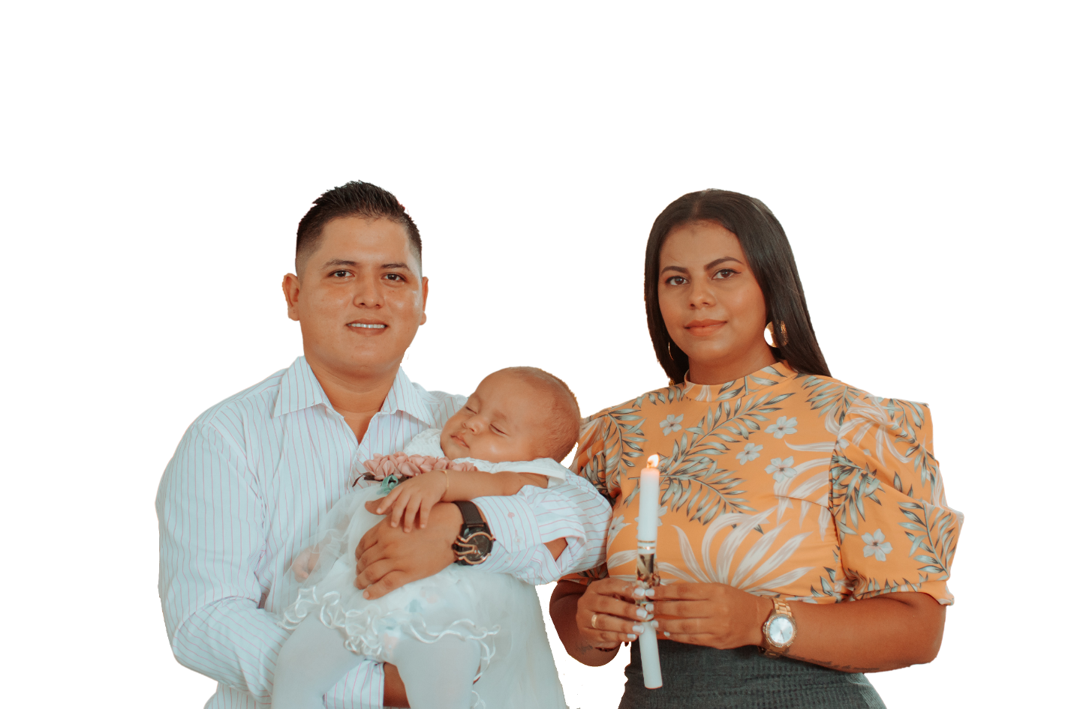
FAMILY CONVERSATION
Family members to show the sacramental(s) and photos from their own Baptisms that mark the beginning of their mission as children of God.
Families answer (some or all of) the following questions either
with their children or in a large group:
How old were you when you were baptized?
What do you know about your own Baptism?
If you were baptized as an adult, why did you want to be baptized?
How do you think you are answering God’s call to live out your Baptism?
Has Jesus helped you to live out your Baptism and if so, when or how?
What do you remember about each of your children’s Baptisms?
Why was it important to you that your children be baptized?
Parents, what do you hope for your children as they answer God’s call to live out their Baptism and share in Jesus’ mission in the world?
Children, what do you hope for your parents as they answer God’s call to live out their Baptism and share in Jesus’ mission?

Slide 9
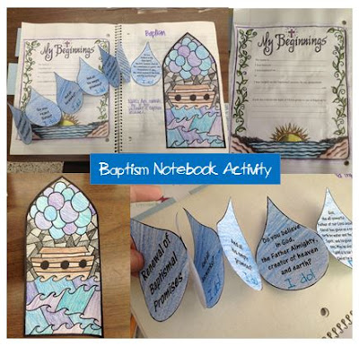
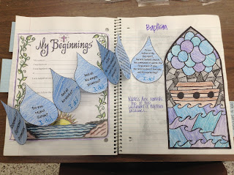
FAMILY ACTIVITY
Baptismal Promises Drops of Water Activity

Slide 10
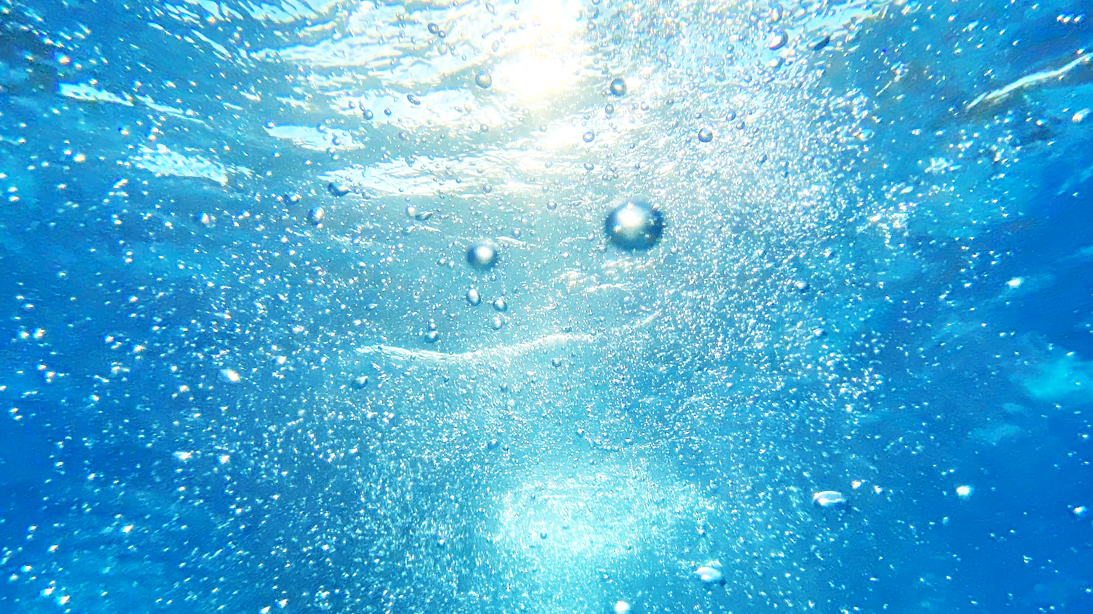
CLOSING PRAYER: RENEWAL OF BAPTISMAL PROMISES
Dear Heavenly Father, we thank You for loving us and for sending Your beloved Son, Jesus, to save us from our sins.
Now that we have reflected on our own Baptisms, we ask Jesus with the Holy Spirit to be in our midst.
As families, we come before You as we bless one another with holy water in the name of the Father, and of the Son, and of the Holy Spirit.
Parents use the holy water to bless each of their children and one another,
by making the sign of the cross on their foreheads (with your thumbs)
and saying:
”I bless you in the name of the Father, and of the Son, and of the Holy Spirit. Amen.”
Parents light the baptismal candles.
Families renew their Baptismal Promises. (next slide)

Slide 11
CLOSING PRAYER / RENEWAL OF BAPTISMAL PROMISES continued…
Leader: Today, your families will renew your baptismal promises to be the light of God in the world. After each promise please respond: I do.
Leader: Do you reject Satan? R. I do.
Leader: And all his works? R. I do.
Leader: And all his empty promises? R. I do.
Leader: Do you believe in God, the Father Almighty, creator of heaven and earth? R. I do.
Leader: Do you believe in Jesus Christ, his only Son, our Lord, who was born of the Virgin Mary was crucified, died, and was buried, rose from the dead, and is now seated at the right hand of the Father? R. I do.
Leader: Do you believe in the Holy Spirit, the holy Catholic Church, the communion of saints, the forgiveness of sins, the resurrection of the body, and life everlasting? R. I do.
All: God, the all-powerful Father of our Lord Jesus Christ, has given us a new birth by water and the Holy Spirit, and has forgiven our sins. May we always remember who we truly are, God’s beloved sons and daughters in whom He is well pleased. May we live with the Trinity as children of the family of God for ever and ever. Amen.

