Slide 1
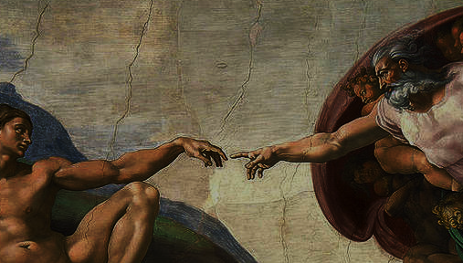
^{Families Forming Disciples}
Creation

Slide 2
^{Opening Prayer}
Lord Jesus Christ,
We entrust our family to you and ask for your blessing
and protection. We love you Lord Jesus with all our
hearts and we ask that you help our family become
more like the Holy Family. Help us to be kind, loving,
and patient with one another. Give us all the grace
we need to become saints and your faithful disciples.
Amen.

Slide 3
^{Ice Breaker}
Try not to laugh challenge
Families sit in a circle and the catechist chooses one person in each family to start the game.
That person smiles their widest, biggest, cheesiest smile at everyone else in the circle, trying to make them laugh. However, they must be silent, and cannot make faces or be silly, all they can do is smile.
For every person in the group who laughs at their smile, they receive one point.
After they have smiled at everyone in the group, they “wipe” the smile off their face with their hand and “pass” the smile to the next person in the circle.

Slide 4
^{Who wrote the Bible?}
https://www.youtube.com/watch?v=MDBMeDOI_Gg

Slide 5
Our Topic for this month
The Bible is the inspired word of God.

Slide 6
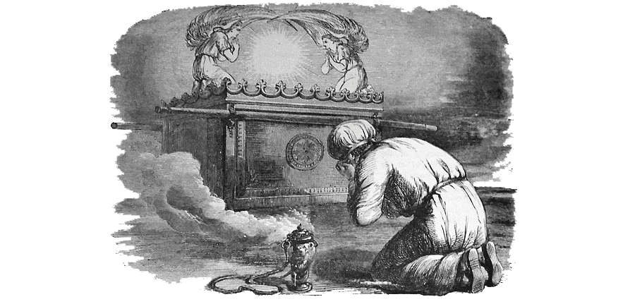
^{Content}
This year we are going to learn about the very important covenants God made with His people in the Bible and how God makes covenants/promises with you and me today when we receive the sacraments.
Testament = Covenant = Promise
Old Testament = Old Covenant = Old Promise
New Testament = New Covenant = New Promise

Slide 7
God put clues or signs in the Old Testament
These clues give us hints about what will happen in the New Testament when Jesus comes to save us, forming the New Covenant.
We will have to put on our bible detective hats and keep our eyes open for these signs.

Slide 8
Read the story of creation Genesis 1
Clue: Listen and look at what happens every time the Bible says, “God said”.
What did God create on the first day?

Slide 9
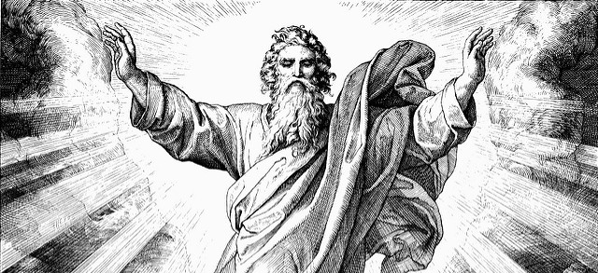
The First Day LIGHT; then, Day and Night &/or TIME

Slide 10
The Second Day Sky &/or SPACE

Slide 11
The Third Day God created a HOME for MAN

Slide 12
The Forth Day The sun to govern the day and the moon to govern the night

Slide 13
The Fifth Day God filled the sky and water with all kinds of living creatures.

Slide 14
The Sixth Day Wild animals, creeping things, and human beings

Slide 15
What happened every time we read the words, “God said” in the First Story of Creation?
These clues give us hints about what will happen in the New Testament when Jesus comes to save us, forming the New Covenant.
We will have to put on our bible detective hats and keep our eyes open for these signs.

Slide 16
Family Conversation
Is there a place that you have been to that reminds you of God’s presence?
God gave human beings dominion over the earth. How does your family enjoy what God has created? How does your family care for his creation?

Slide 17
Mission
1. Introduce Mission Activities
Mission Activities are to be done at home during Week 2 and to be shared at the gathering of families on Week 3.
2. Explain Activity
Watch one or both of the videos about the bible.
Find a picture of a family member or friend of the family who has died that you would like us all to pray for during Week 3 and on All Soul’s Day, or draw a picture of that person if you don’t have a photo.
Etc.
^{3. Family Sharing}
Be prepared to share with other families your answers to the questions.

Slide 18
^{Review & Close in Prayer}
Review briefly the goals of the lesson and remind everyone of the expectations for week 2 and 3.
Option 1: Pray together the Our Father
Option 2: Lord God, we thank You for the gift of Your inspired Word in Sacred Scripture. We thank you for the gift and goodness of creation. Help us live according to Your word.
^{In Jesus’ Name, we pray. Amen.}

