Slide 1
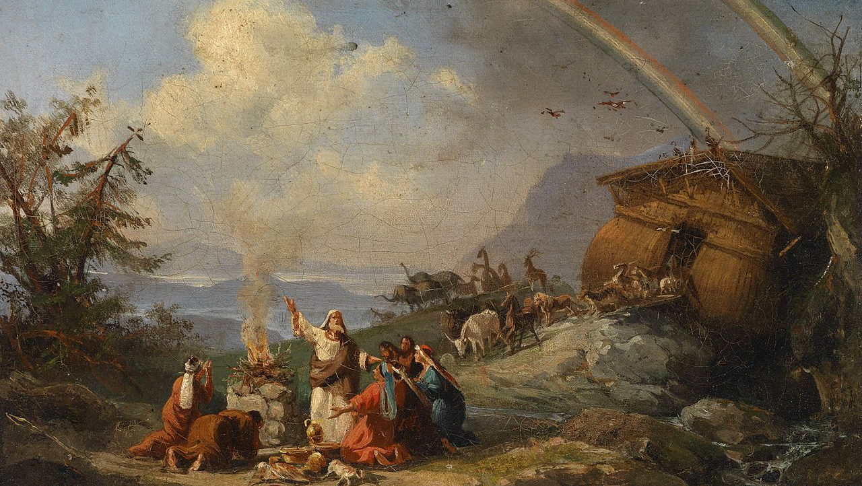
^{Families Forming Disciples}
Covenants and Sacraments

Slide 2
^{Opening Prayer}
Lord Jesus Christ,
We entrust our family to you and ask for your blessing
and protection. We love you Lord Jesus with all our
hearts and we ask that you help our family become
more like the Holy Family. Help us to be kind, loving,
and patient with one another. Give us all the grace
we need to become saints and your faithful disciples.
Amen.

Slide 3
^{Ice Breaker}
Noah’s Ark Charades
Each family member thinks of one animal or insect that they would like to have been saved from the flood on Noah’s Ark, but does not share it with anyone.
Then taking turns, each person acts out how their chosen animal or insect would act and sound, while the other members of the family guess which animal or insect it is.

Slide 4
What is your favorite story so far from the ornaments your family has created?

Slide 5
Our Topic for this month
Covenants and Sacraments

Slide 6
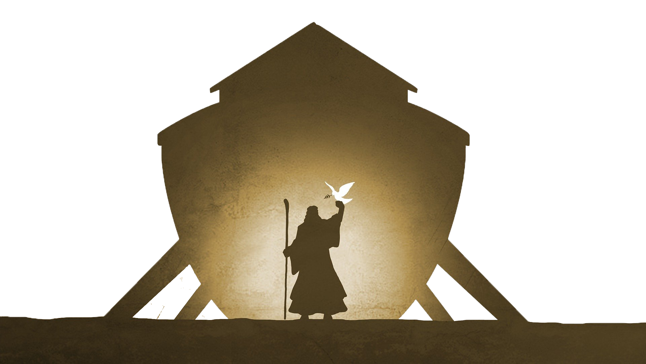
^{Content}
God’s Promise & Sign
(Gen 6:5 – 9:17)

Slide 7
Family Conversation
What do you know about your own baptism?
What do parents remember about their children’s baptisms?
When you baptized your children what did you want for them?
If you were baptized when you were older, why did you want to be baptized?
What role has God called you to thus far in your life?
How does knowing that Jesus sacrificed His life so that you could become a part of God’s family make you feel about your role in the world?

Slide 8
Mission
1. Introduce Mission Activities
Mission Activities are to be done at home during Week 2 and to be shared at the gathering of families on Week 3.
^{2. Explain Activity}
^{i.} Continue making your Jesse Tree and praying the scripture passage for each day together as a family.
^{ii.} Watch the videos listed and make a plan for keeping Jesus at the center of your family’s Christmas Day and Christmas Season!
^{iii.} Take a picture of your family practicing your favorite Advent or Christmas tradition together around your home altar!
^{iv.} Get ready to share about your family’s plan to celebrate the Birth of Christ on Christmas Day and during the whole Christmas Season at Week 3’s gathering of families.
^{3. Family Sharing}
Be prepared to share with other families your answers to the questions.

Slide 9
^{Review & Close in Prayer}
^{Heavenly Father,}
Your Son, Jesus, is Your greatest gift to us, a great sign of Your love. Guide us as we strive to walk in that love together as a family this Advent. Help us to do our Family Advent Plans. As we prepare our hearts for Christmas, bring us closer to each other and to Your Son. Give us the grace and strength we need every day. Help us to always trust in You. Come, Lord Jesus, lead all people closer to You. Come and dispel the darkness of our world with the light of Your love. Amen.
(Adapted from https://dynamiccatholic.com)

