Slide 1
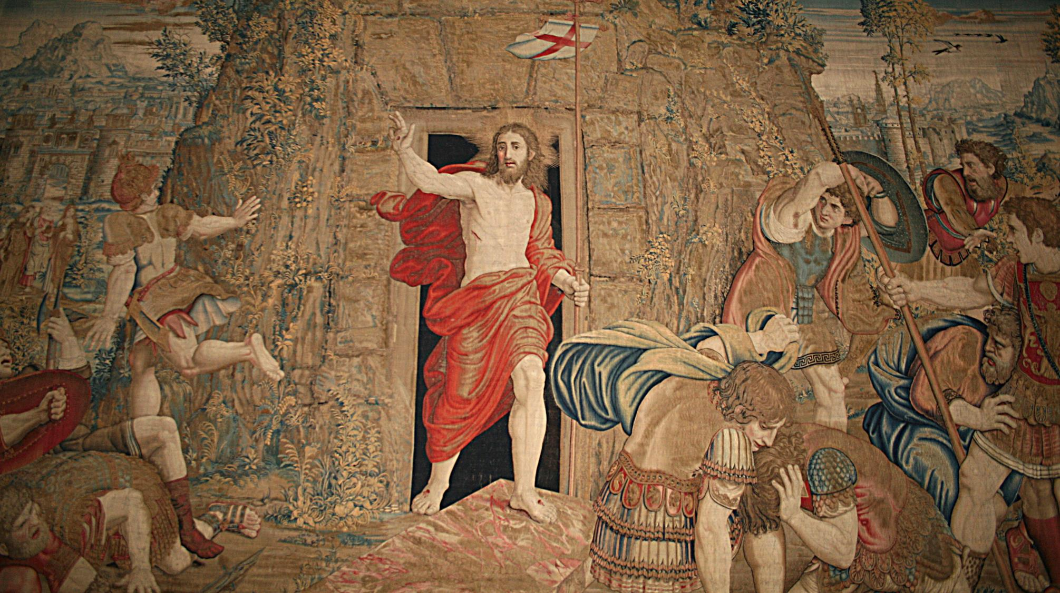
FAMILIES FORMING DISCIPLES
^{Lesson 8 – Week 1}

Slide 2
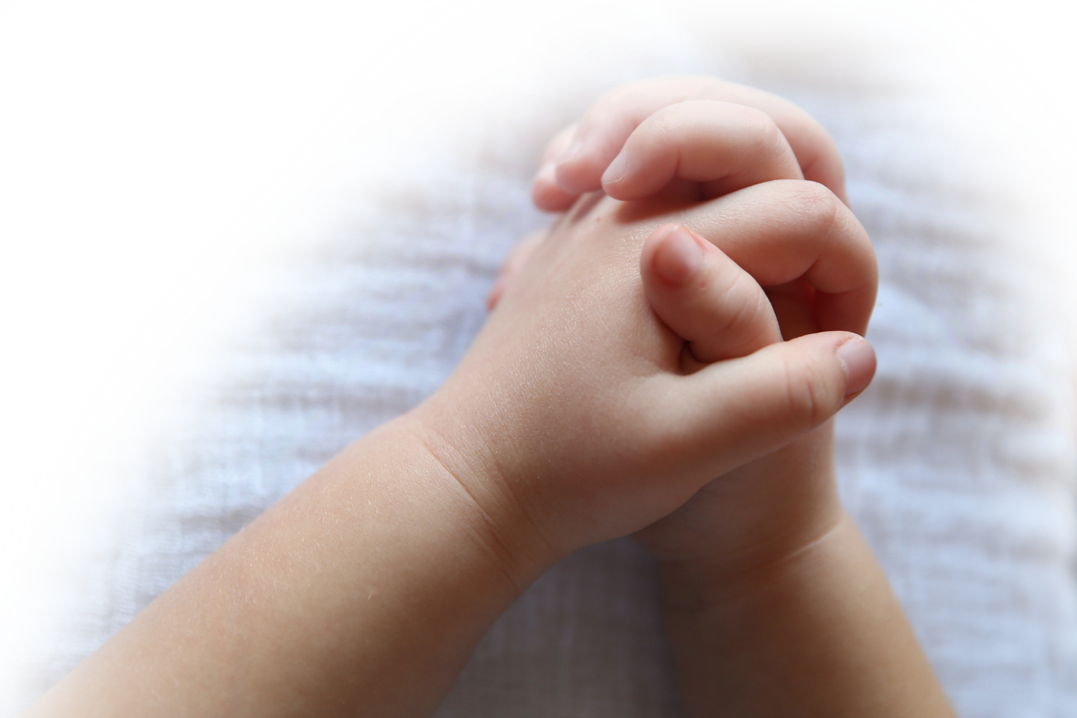
^{Opening Prayer}
Dear Lord Jesus Christ, by Your radiant and magnificent Resurrection, You broke the bonds of death and rose from the grave as a conqueror. You reconciled Heaven and earth. Our life had no hope of eternal happiness before You redeemed us. Your Resurrection has washed away our sins, restored our innocence, and brought us joy. How inestimable is the tenderness of Your love!
^{(Pope Saint Gregory the Great)}
^{Christ is risen! Alleluia!}
^{Glory Be…}

Slide 3
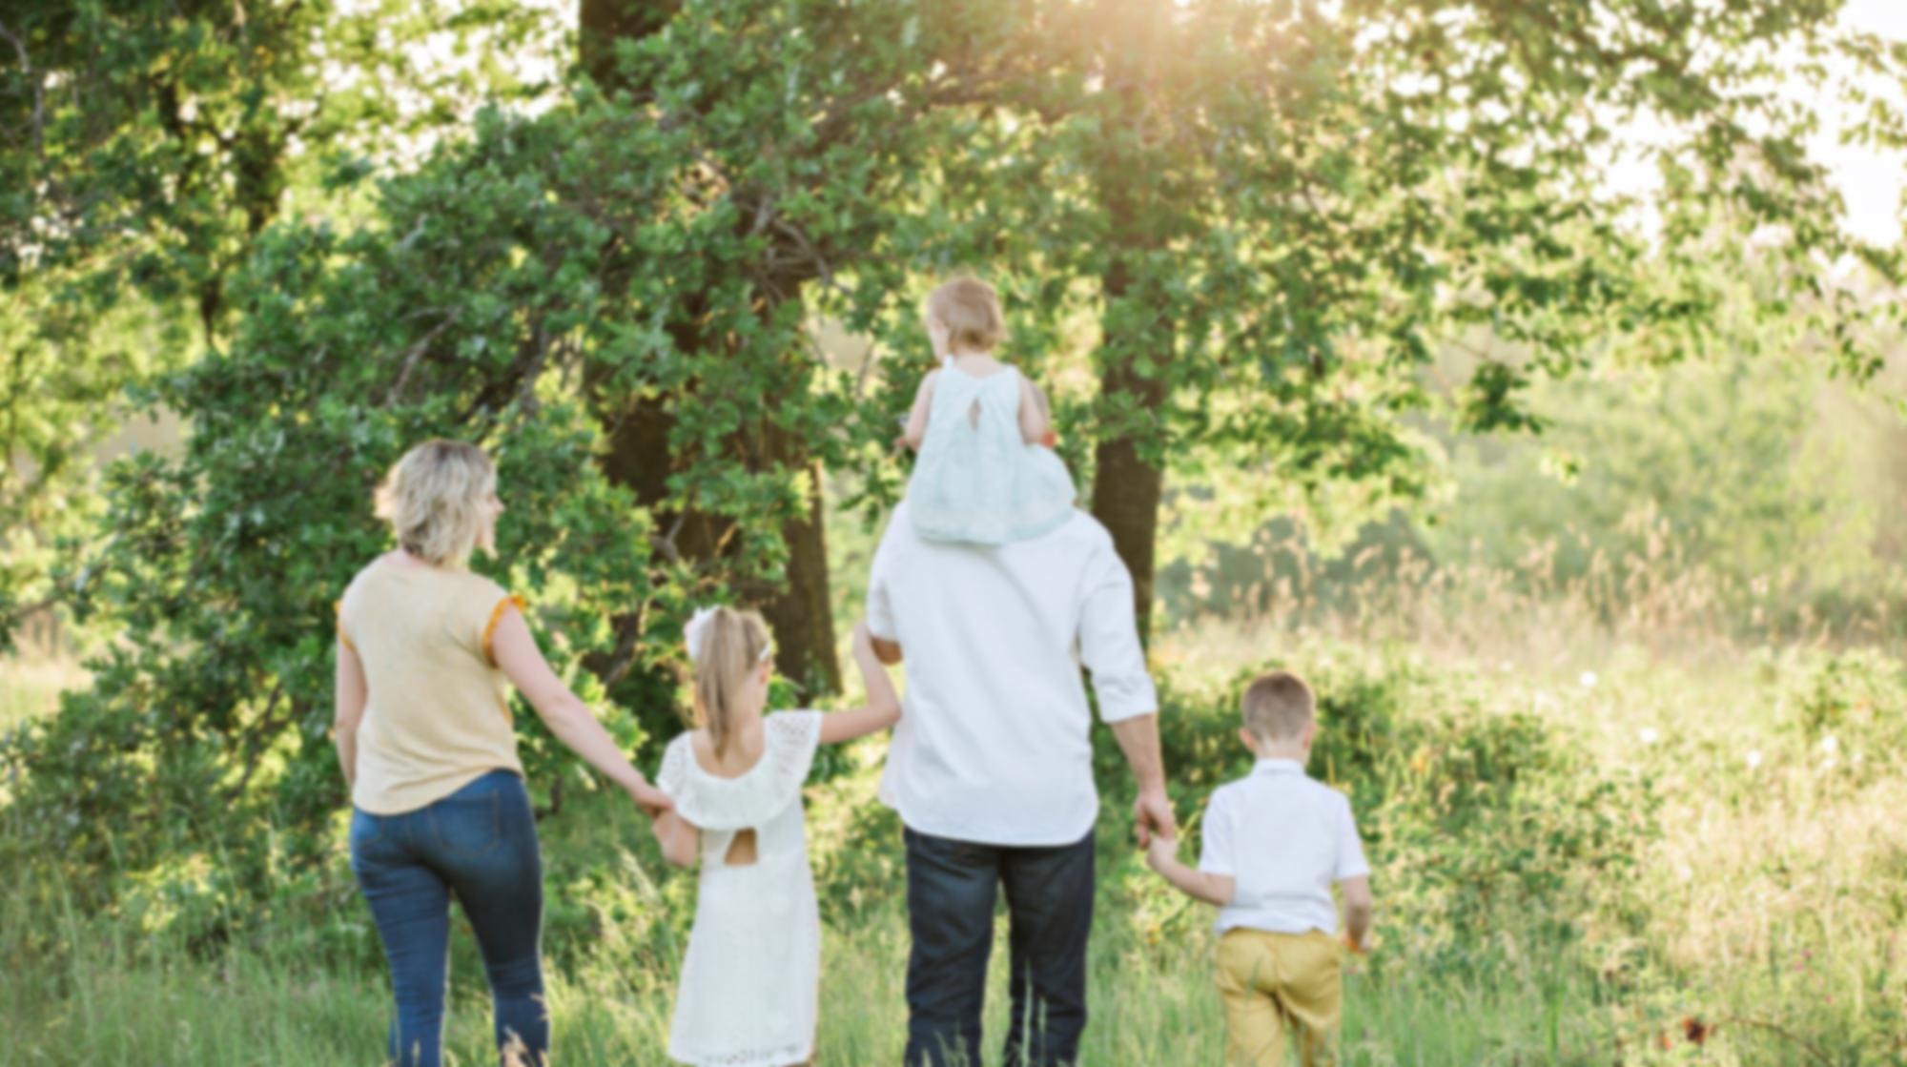
Goals
Families will reflect on the Good News (Gospel) of Jesus’ Paschal Mystery
Families will make their Living-the-Easter-Season Family Plan

Slide 4
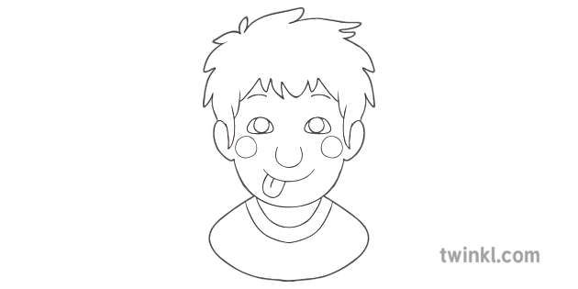
Ice Breaker
Sketch a family member!
Try to guess who it is!

Slide 5
What Family Holy Week activities did you do during Holy Week and Easter Sunday? Describe how these experiences impacted your family.
Did you grow closer to God or to one another?
Would you make these activities a family tradition for Holy Week and Easter Sunday?

Slide 6
Topics
Today we are going to explore what Easter really means and how we can live the joy of the Easter season in our families.

Slide 7
Content
Easter Sunday by Catholic Kids Media
^{(for younger children) 2 min}
https://youtu.be/Siv3MQcHrq8

Slide 8
Content
Saint John Paul II said that “We are an Easter people and Alleluia is our song!” At Easter we celebrate the joy of Jesus’ Resurrection and of God’s invitation to live with Him in Heaven forever!
But Easter is more than just one day! It is actually the longest liturgical season we have in the Church. The Easter season is fifty days long and officially begins at the Easter Vigil (the night before Easter Sunday).

Slide 9
Content
Why is Easter the longest liturgical season?
What does the word “Gospel” mean?
What do you think the Good News is? (hint: It is written in our Creed)

Slide 10
Video
Show Video: Mark Hart on Jesus Christ’s
Resurrection by Life Teen (for tweens & teens) 6 min
https://youtu.be/AtfEa4_QQLc

Slide 11
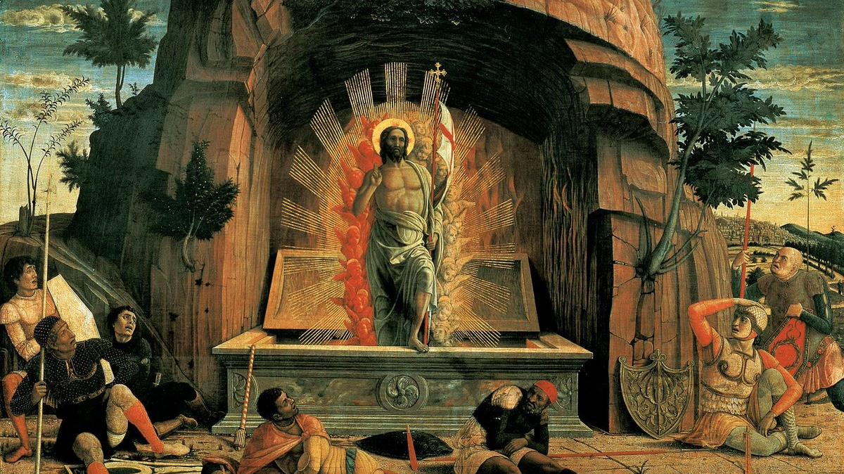
Family Sharing
Consider how you celebrated the Easter Octave and how you will celebrate all fifty days of the Easter Season. What can we do to keep the Risen Jesus at the center of our homes during this time? How can we celebrate for fifty days? What will our Living-the-Easter-Season Family Plan be?

Slide 12
Mission
Make a Resurrection Set for your home altar/prayer space.
Make your Living-the-Easter-Season Family Plan.
Complete the Families Forming Disciples Survey.

Slide 13
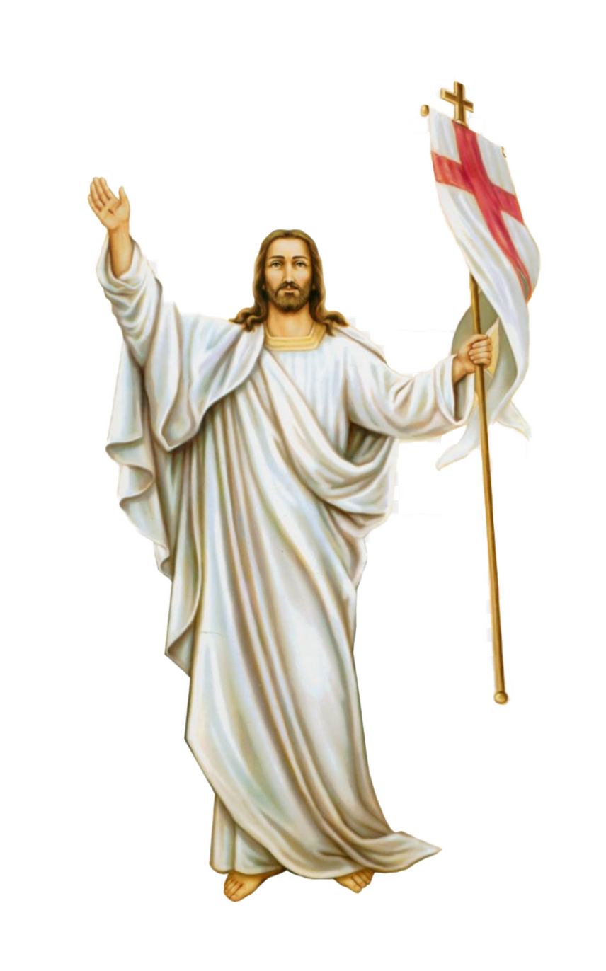
Close in Prayer
Use the Rosary for Children pamphlets/booklets to lead families in one decade of the Rosary together in which they meditate on the First Glorious Mystery of the Resurrection.

