Slide 1
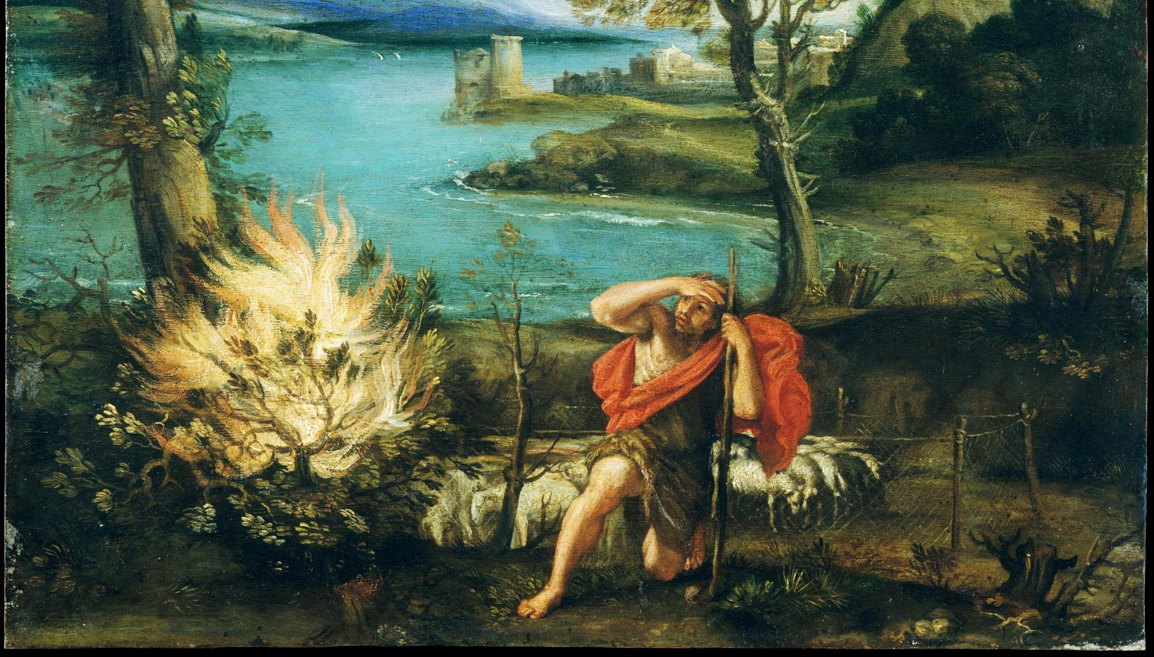
^{Families Forming Disciples}
GOD’S COVENANT WITH MOSES

Slide 2
^{Opening Prayer}
Lord Jesus Christ,
We entrust our family to You and ask for Your blessing and protection. We love You Lord Jesus with all our hearts and we ask that You help our family become more like the Holy Family. Help us to be kind, loving, and patient with one another. Give us all the grace we need to become saints and Your faithful disciples.
Amen.

Slide 3
^{Ice Breaker}
Truth
or
CHALLENGE

Slide 4
Question?
Why was the library so tall?

Slide 5
Why is the Bible a library?

Slide 6
Exodus 2:1-10 – The Prince of Egypt

Slide 7
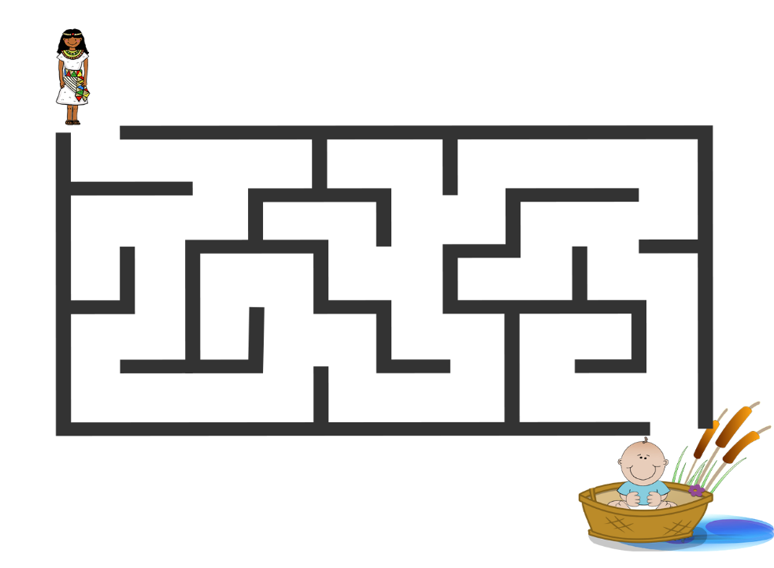
Family Activity: Baby Moses Maze
Let’s read the Bible!

Slide 8
Old Testament foreshadows New Testament

Slide 9
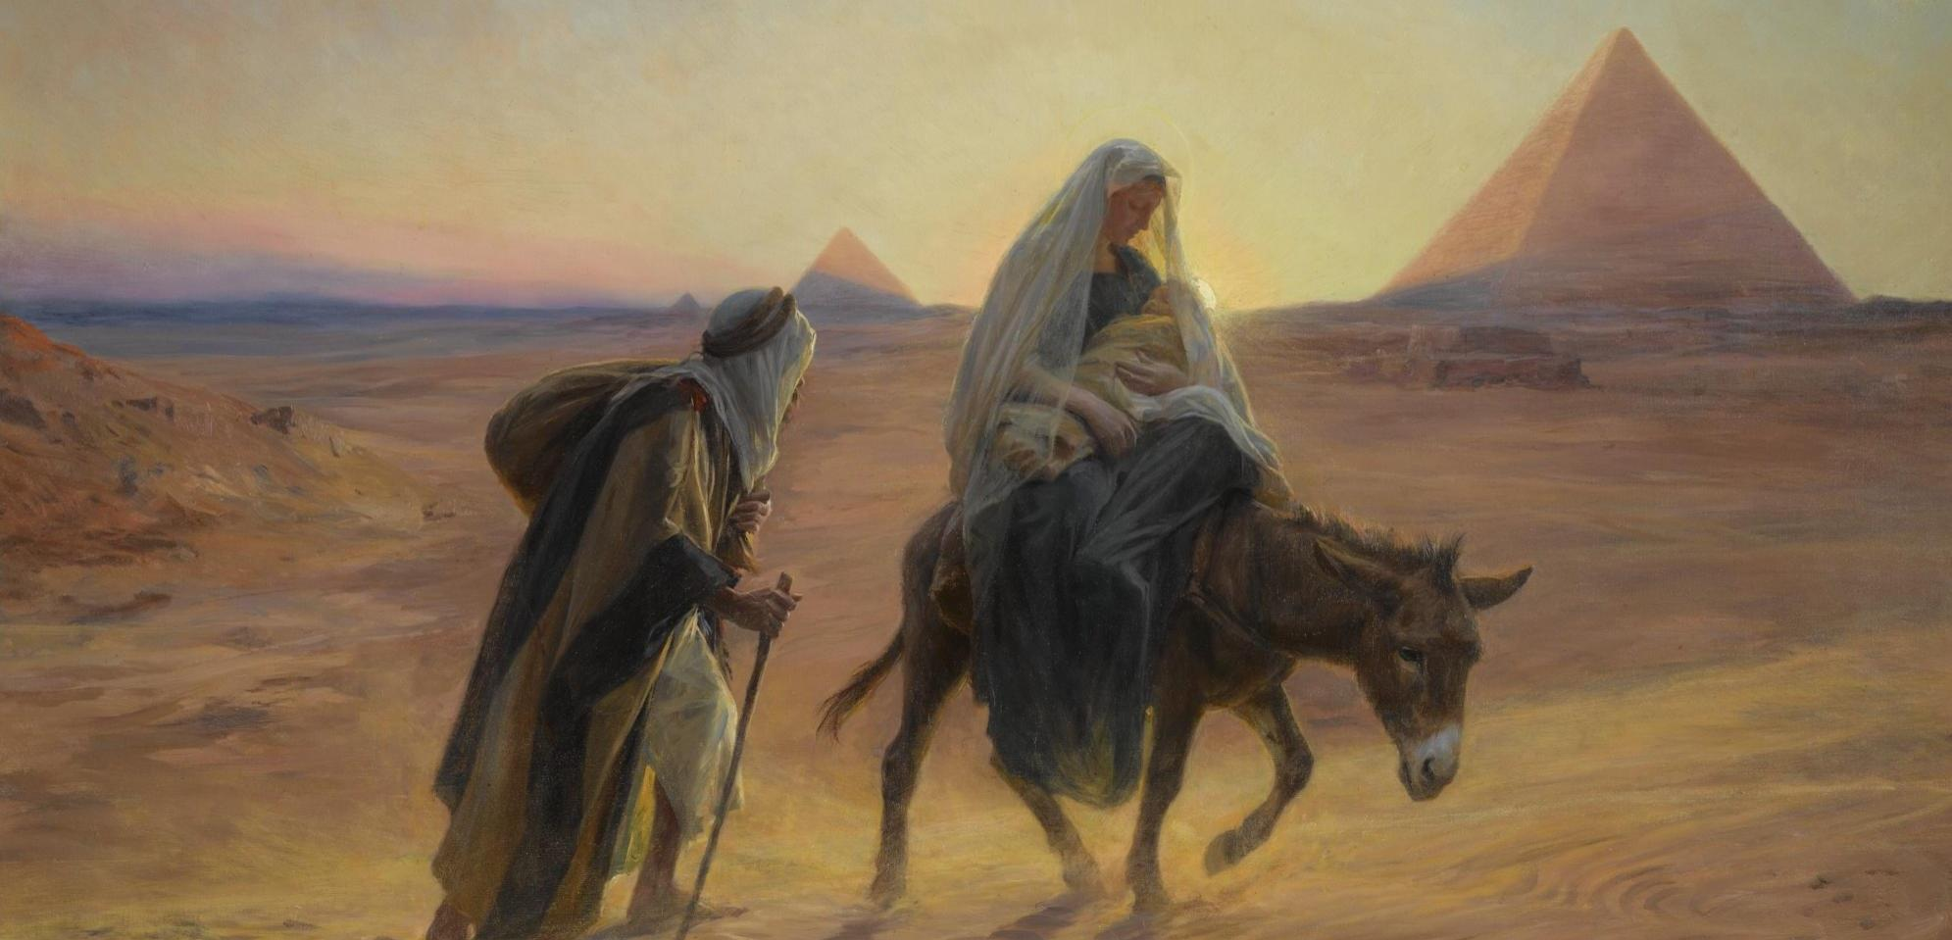
Baby Jesus Escapes

Slide 10
Family Conversation
When we read the Bible we have to put on our detective hats and look for the clues God has left there. What are some of the many ways that these stories of Moses and Jesus are similar?

Slide 11
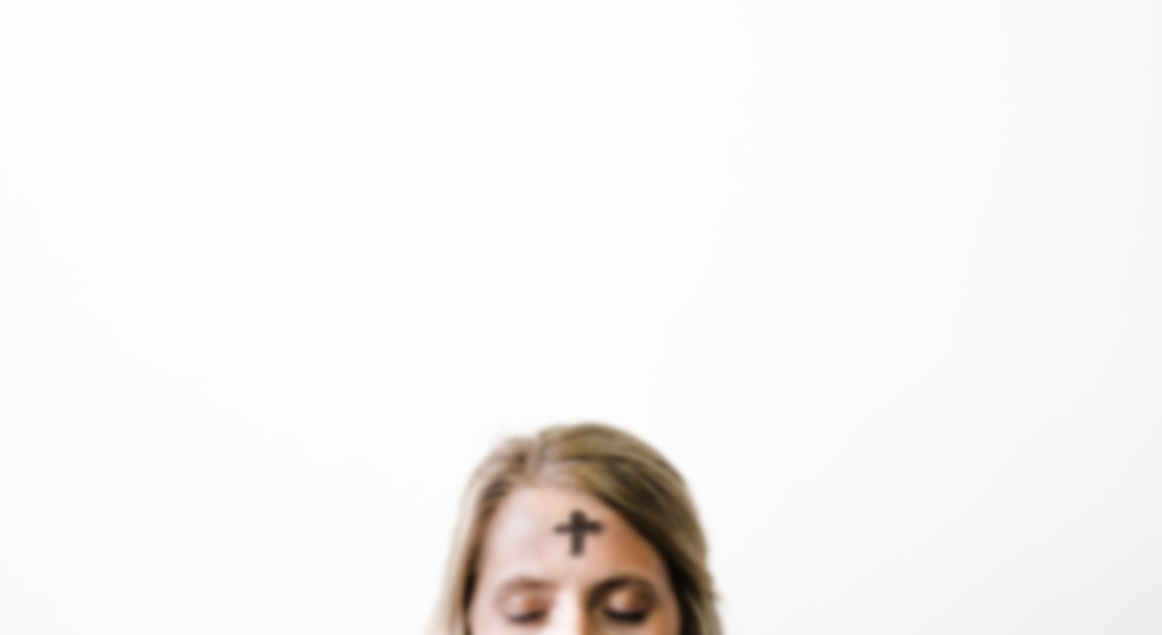
Family Mission Activity
1. Introduce Mission Activity
2. Explain Activity
Watch one or both of the videos on Ash Wednesday and Lent together
Read the USCCB explanations about the Spiritual and Corporal Works of Mercy, as well as the Lenten Family Plan
Pray and plan. First read Exodus 3:1-10 together as a family. Entrust your preparations for Lent to the Lord, praying that you may be faithful to what the Lord asks, like Moses. Then, decide together which works your family will do to practice the Lenten pillars of praying, fasting, and almsgiving and make a Family Lenten Plan.
As part of your Family Lenten Plan, schedule a time to go to confession together. The Sacrament of Penance and Reconciliation is a great opportunity to rely on the Lord’s mercy and grace and be renewed by the Lord’s forgiveness
Place a cross, crucifix or another sacramental on your family’s home altar to remind you of the upcoming Lenten Season.
3. Be prepared to share about your Family Lenten Plan and sacramental, at the next gathering.

Slide 12
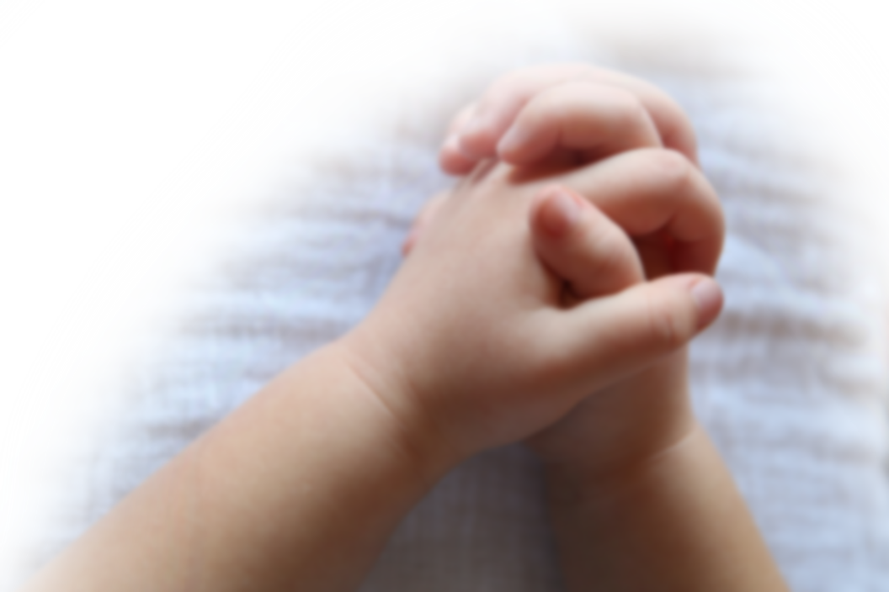
Closing Prayer
Dear God, Thank You for gathering us together today! Bless us and give us the wisdom to make the best choices for our family. Give us grace to trust in You even when we don't see immediate answers. Give us hope to carry on in spite of the circumstances around us. We thank You for hearing and answering our prayer.
Glory be to the Father, …

