Slide 1
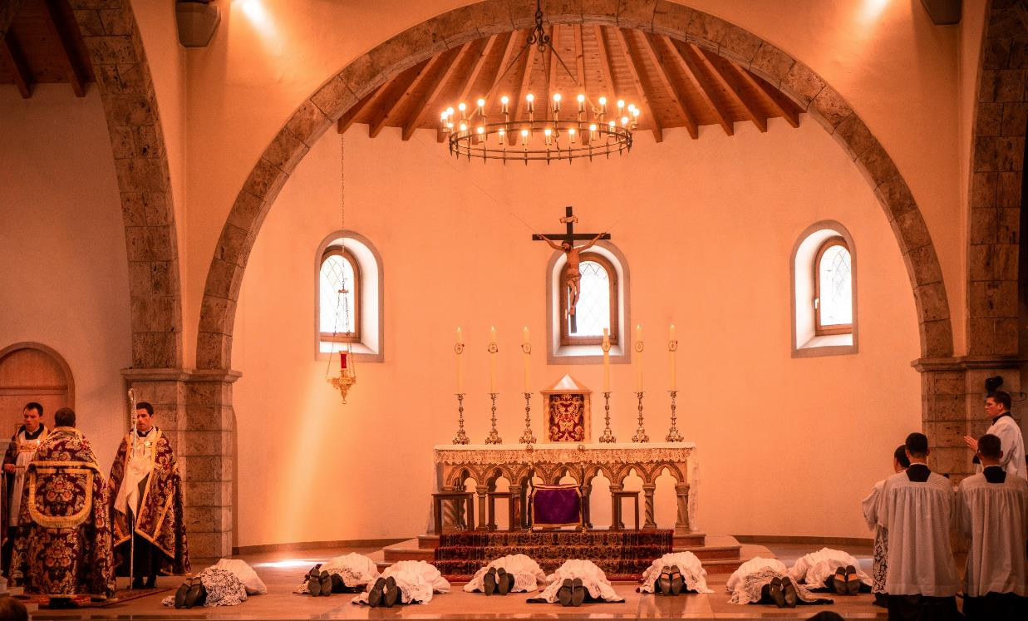
GOD’S SAVING LOVE FOR US:
LITURGY AND THE SEVEN SACRAMENTS
SACRAMENTS AT THE SERVICE OF COMMUNION AND MISSION: HOLY ORDERS

Slide 2
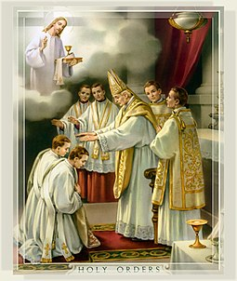
^{Opening Prayer}
Lord Jesus Christ, We entrust our family to You and ask for Your blessing and protection.
We love You Lord Jesus with all our hearts, and we ask that You help our family to become more like the Holy Family.
Help us to be kind, loving, and patient with
one another.
Give us all the grace we need to become saints and Your faithful disciples. Amen.
Ths Photo by Unknown Author is licensed under CC BY-SA

Slide 3
DRAW IT OUT!
What You Will Need: Plain paper for each person, a timer, pens or colored pencils
How to Play:
Break into groups of families or of at least four people.
Give each person a piece of paper and some colored pencils or a pen.
Set a time limit and have everyone draw as many items on their paper as they can about their life without writing their name.
Once the time is up, have everyone fold their paper in half and give it to the leader.
The leader mixes up the papers. Then, one at a time, they are opened for everyone to read and try to guess who the artist is.
Adapted from https://connectusfund.org/icebreaker-games-for-youth-groups

Slide 4
REVIEW
What are the Three
Sacraments of Christian Initiation?

Slide 5
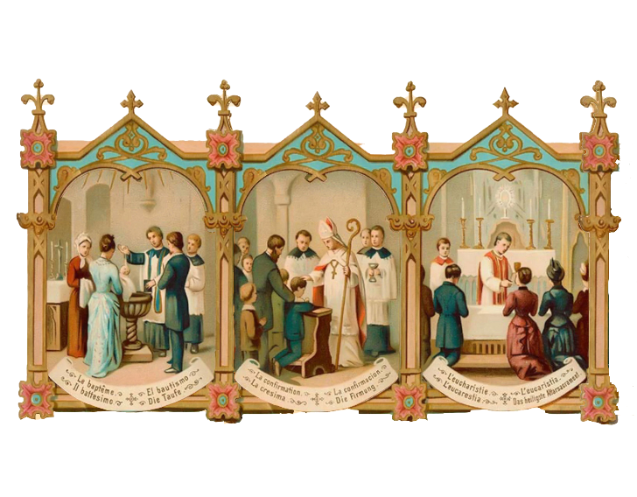
REVIEW
Baptism, Confirmation, and the Eucharist

Slide 6
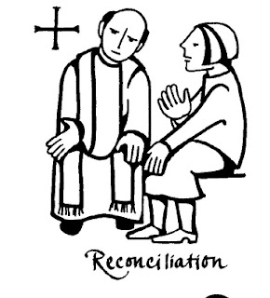
TOPIC
What sacrament did Jesus give to us to heal us of our sins and bring us closer to Him again?
Reconciliation
(or Penance, Confession)
This Photo by Unknown Author is licensed under CC BY-NC-ND

Slide 7
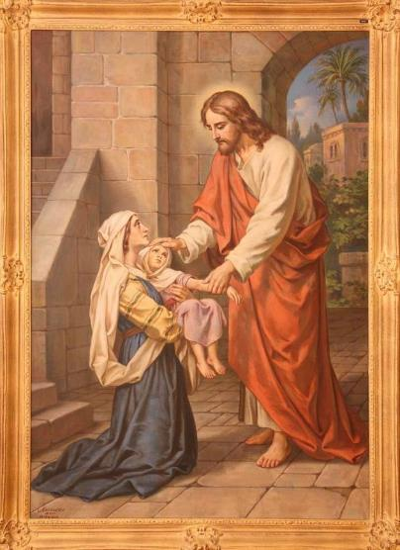
TOPIC
What is the second Sacrament of Healing that brings the
healing touch of Jesus into our lives?
Sacrament of the Anointing of the Sick

Slide 8
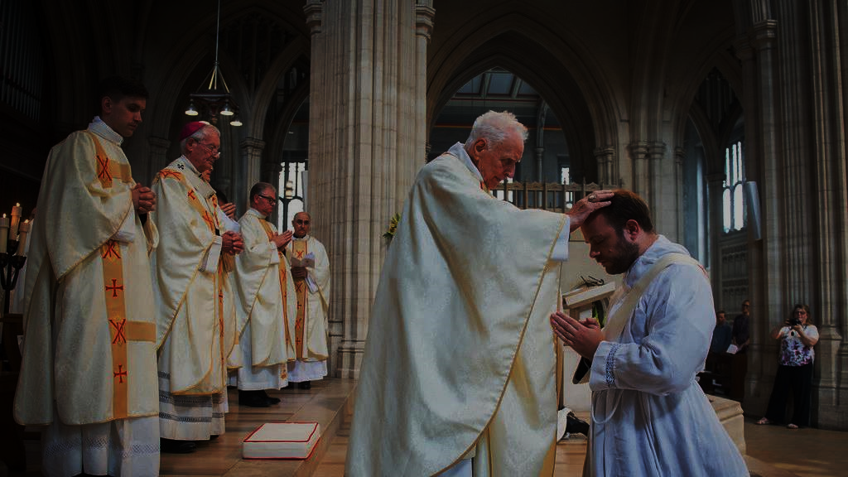
SACRAMENTS OF SERVICE AND COMMUNION
Sacraments
of Holy Orders
and
Matrimony (marriage)
This Photo by Unknown Author is licensed under CC BY-NC-ND

Slide 9
HOLY ORDERS
In Holy Orders,
some men of the Church
are set apart
and consecrated
through ordination
to serve
the whole Church
as priests.
https://www.youtube.com/watch?v=03jNblopq4k

Slide 10
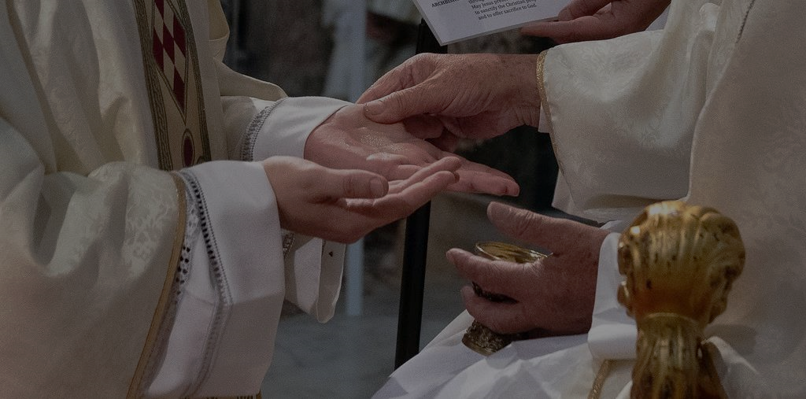
TOPIC
Today, we are going to learn about
Holy Orders
and
where the idea of the priesthood
was first introduced.
https://www.youtube.com/watch?v=03jNblopq4k
This Photo by Unknown Author is licensed under CC BY-NC-ND

Slide 11
JESUS: THE ROYAL PRIEST
https://www.youtube.com/watch?v=LBr-blQxIm4

Slide 12
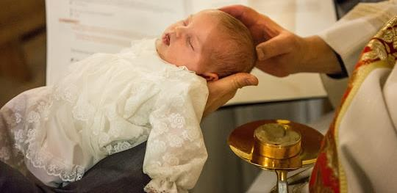
PRIEST, PROPHET, AND KING
When we were baptized, each of us was marked as priest, prophet and king.
We were made sharers in Christ’s own office as Priest, Prophet, and King!
Our participation in Christ’s priestly office is called the common priesthood of all believers.
That means that whenever we pray, care for someone, or listen to God,
we are living out this common priesthood of the faithful.
This Photo by Unknown Author is licensed under CC BY-SA-NC

Slide 13
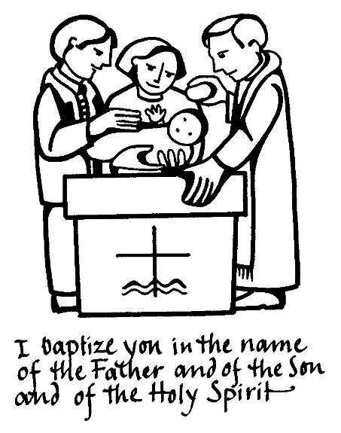
PRIEST, PROPHET, AND KING
When you were baptized
what color garment did you wear?
WHITE
This Photo by Unknown Author is licensed under CC BY-SA-NC

Slide 14
FAMILY ACTIVITY
The new white garment is a sign that you have been clothed in Christ!
Since you are a new person in Christ, who participates in the priesthood of all believers,
you are called to be Christ in the world.
Families brainstorm the many different ways you can continue the work of Christ in the world through your baptismal calling.
Write them on your poster board.
Share your ideas with everyone!
This Photo by Unknown Author is licensed under CC BY-SA-NC

Slide 15
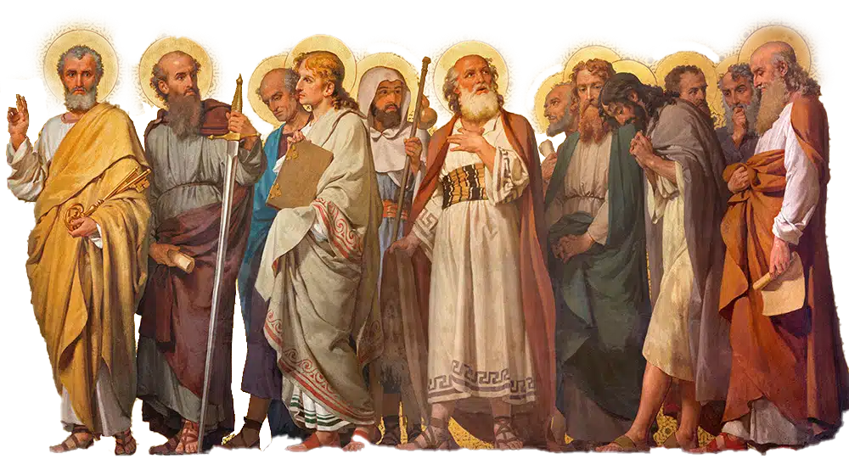
TWELVE (12)
Jesus preached, fed, converted and healed thousands of people when He walked the earth. He had many disciples, but how many did He call to be his Apostles?

Slide 16
HOLY ORDERS
https://www.youtube.com/watch?v=9TZy0C0VHjE

Slide 17
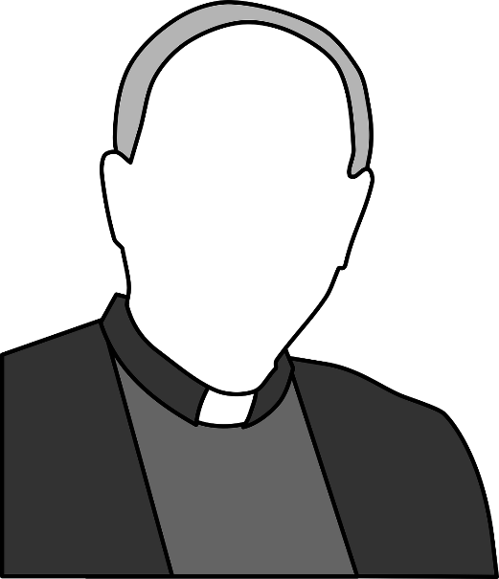
ASK A PRIEST! ACTIVITY
Families write questions they may have for the priest or deacon about
Holy Orders and
their vocation.

Slide 18
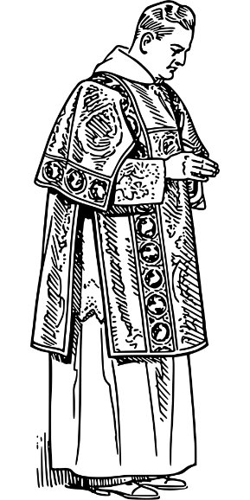
FAMILY AT-HOME MISSION
Watch the videos about the Sacrament of Holy Orders.
Watch one or more of the videos on Holy Week together.
Discuss how your family’s practice of the Lenten pillars of praying, fasting and almsgiving are going as we get closer to Easter and make your Family Holy Week Plan.
Be prepared to share about your Family Holy Week Plan at the next gathering.
Go to Sacrament of Reconciliation or make intentional plans to go to the Sacrament of Reconciliation as a family.

Slide 19
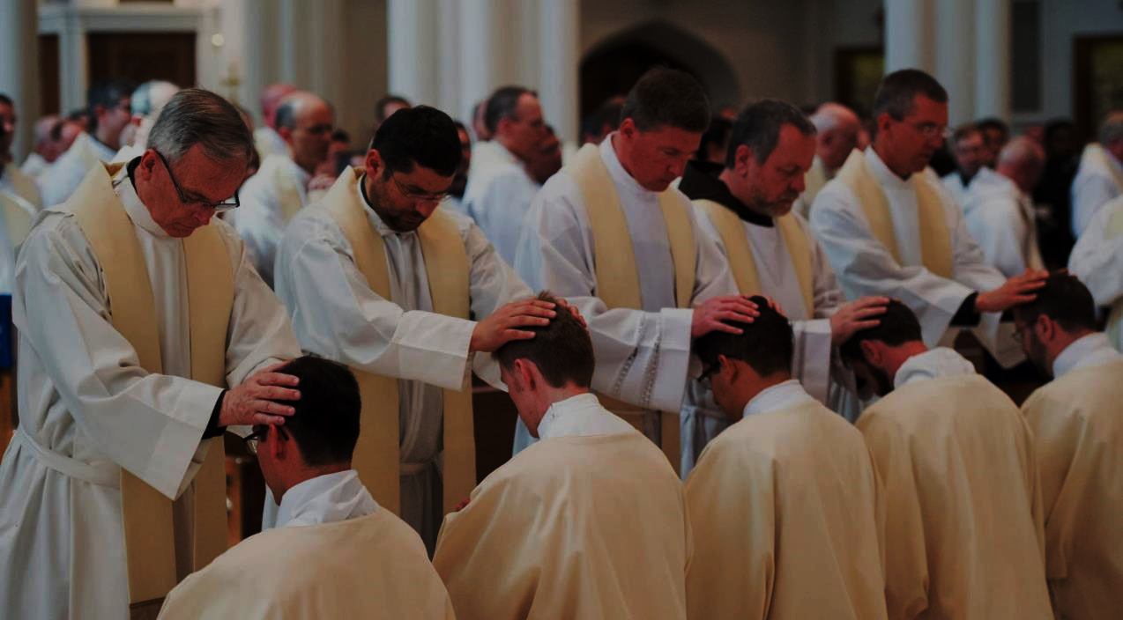
PRAYER FOR PRIESTS
O Jesus, our great High Priest,
Hear our humble prayers on behalf of your priests.
Give them a deep faith, a bright and firm hope and a burning love which will ever increase in the course of their priestly life.
In their loneliness, comfort them.
In their sorrows, strengthen them.
In their frustrations, point out to them that it is through suffering that the soul is purified, and show them that they are needed by the Church; they are needed by souls; they are needed for the work of redemption. Amen.
Adapted from https://www.catholicnewsagency.com
This Photo by Unknown Author is licensed under CC BY-SA

