Slide 1
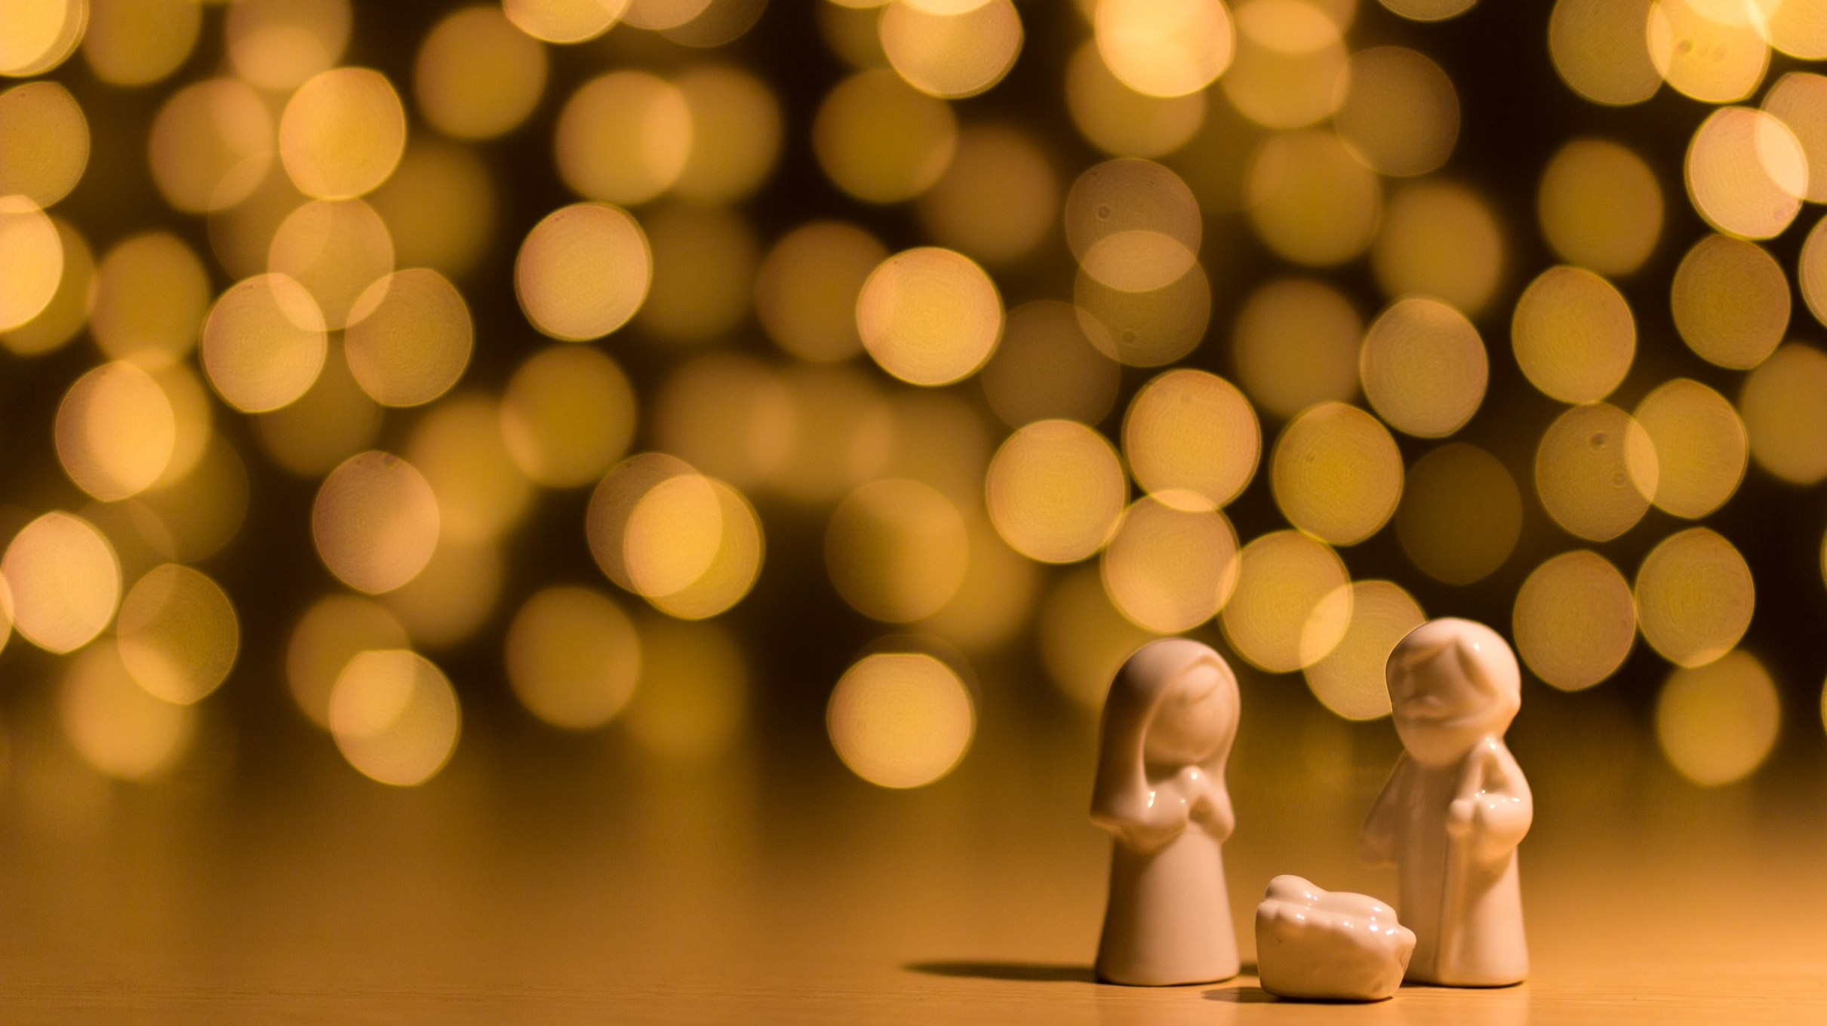
^{FAMILIES FORMING DISCIPLES}
^{Lesson 4 – Week} ³

Slide 2
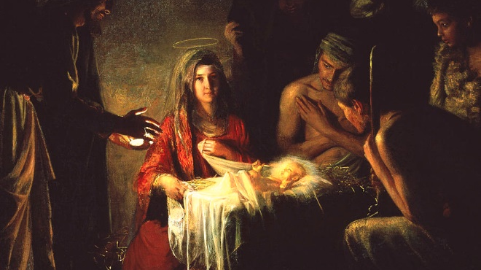
Topic:
Prayerfully Preparing for Christmas & Grace and Holiness in Family Life

Slide 3
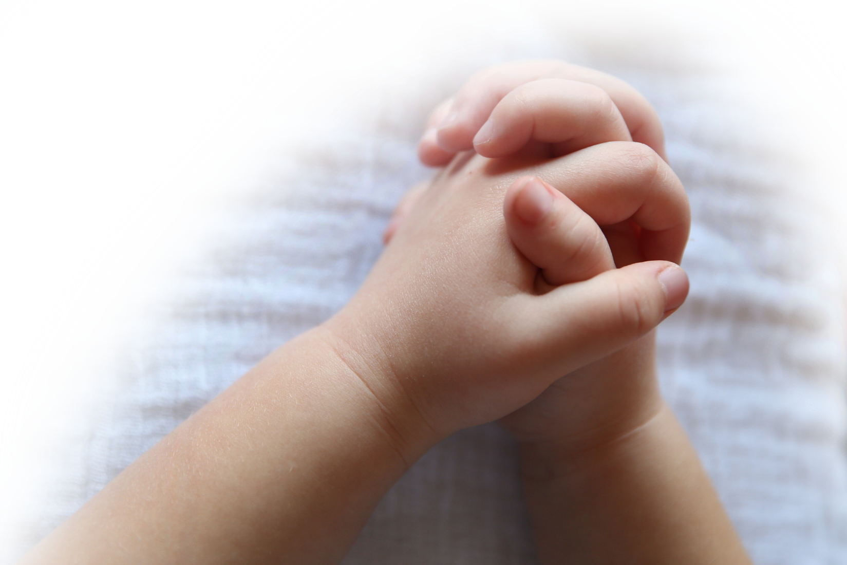
^{Prayer}
Dear Jesus, you are the hope in our messy world. This Advent, help us slow down, listen to your voice, and focus on what’s really important. We place our hope in you as we prepare our hearts to celebrate your birth on Christmas. Amen.
Adapted from Dynamic Catholic

Slide 4
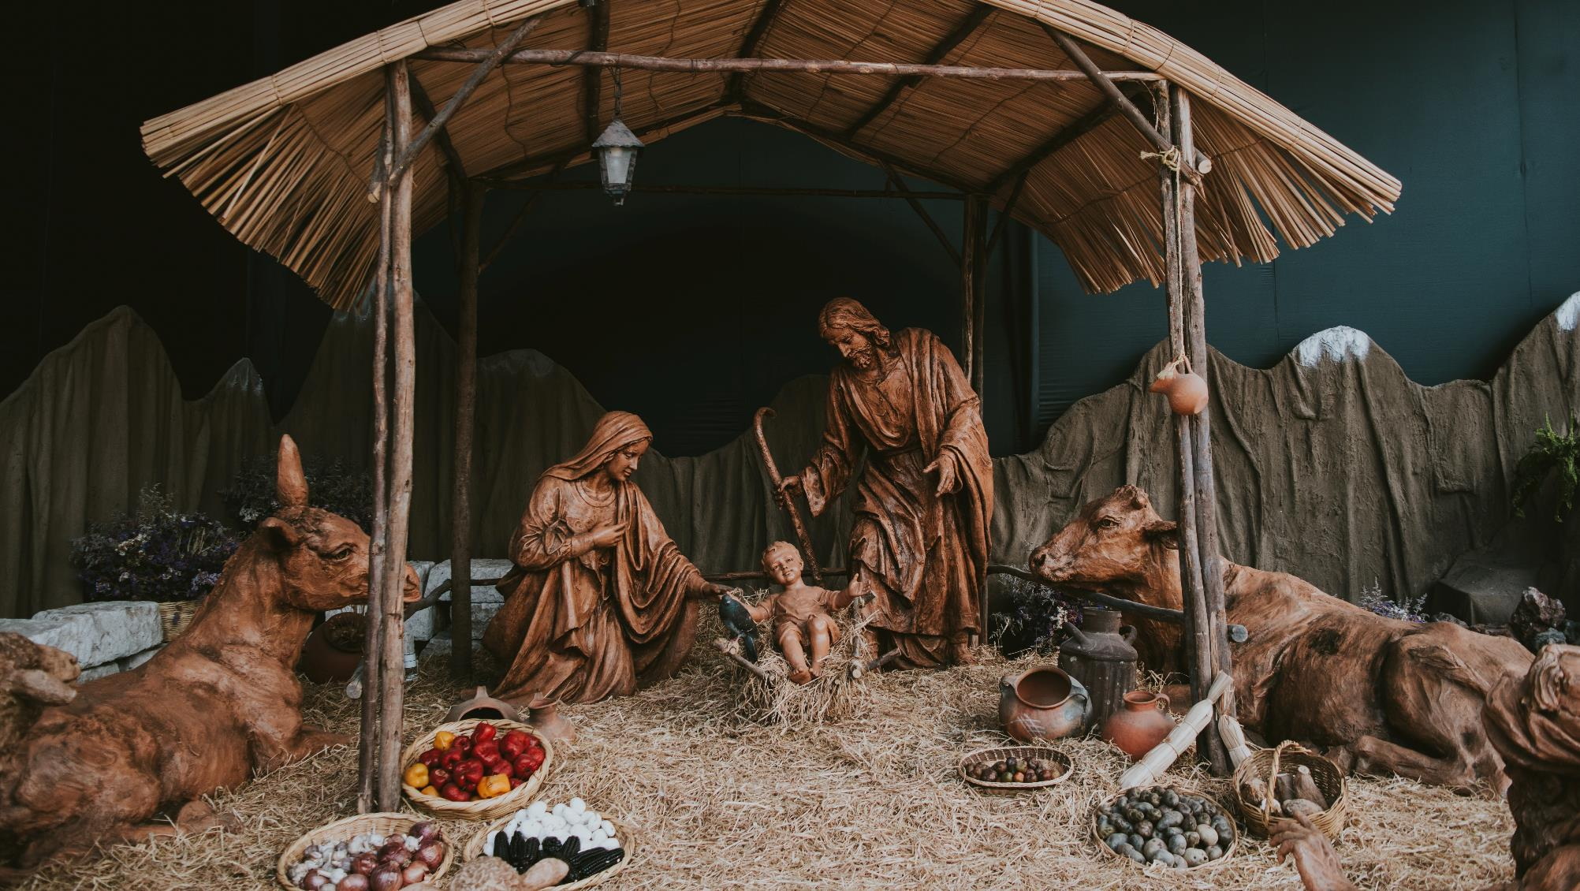
Materials
3 pieces of paper and a marker per family
Advent Wreaths or candle(s) and Nativity Sets they have placed on their home altars
Lighter to light candles for closing prayer

Slide 5
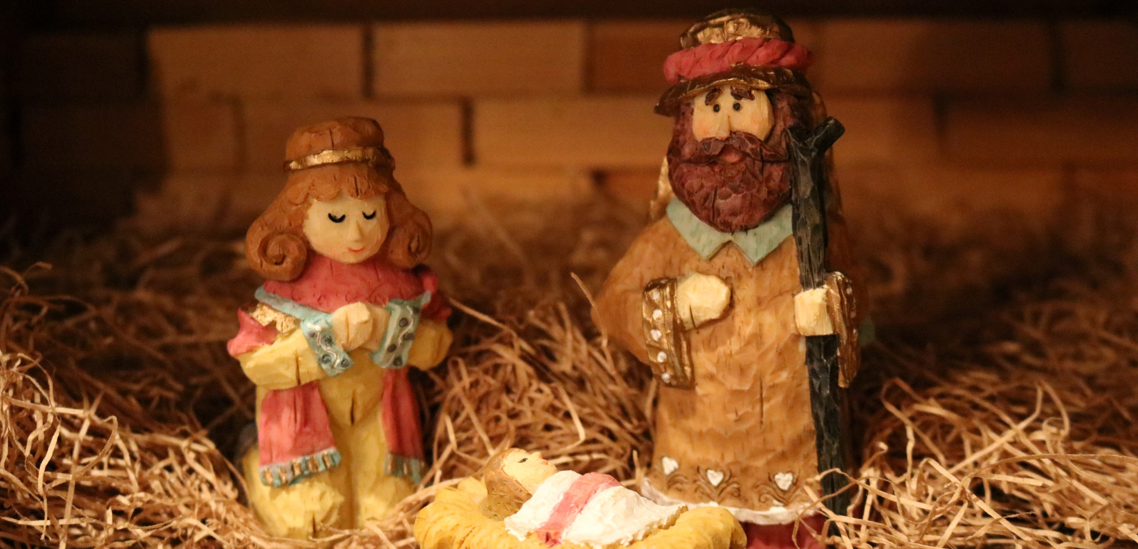
^{Ice Breaker}
^{What is the best gift God has}
^{ever given to you?}

Slide 6

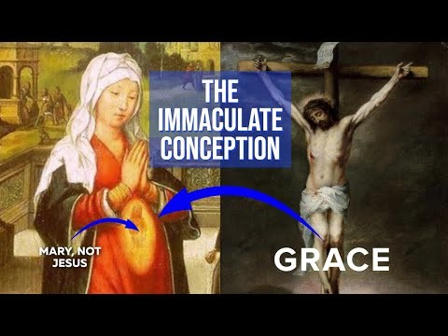

Write your family's responses on three separate sheets of paper.
Who is the Immaculate Conception?
What does the Immaculate Conception mean?
When do we celebrate the Solemnity of the Immaculate Conception?
Show your family's response sheet to the camera.
Play Immaculate Conception | Catholic Central [2:34 min]

Slide 7
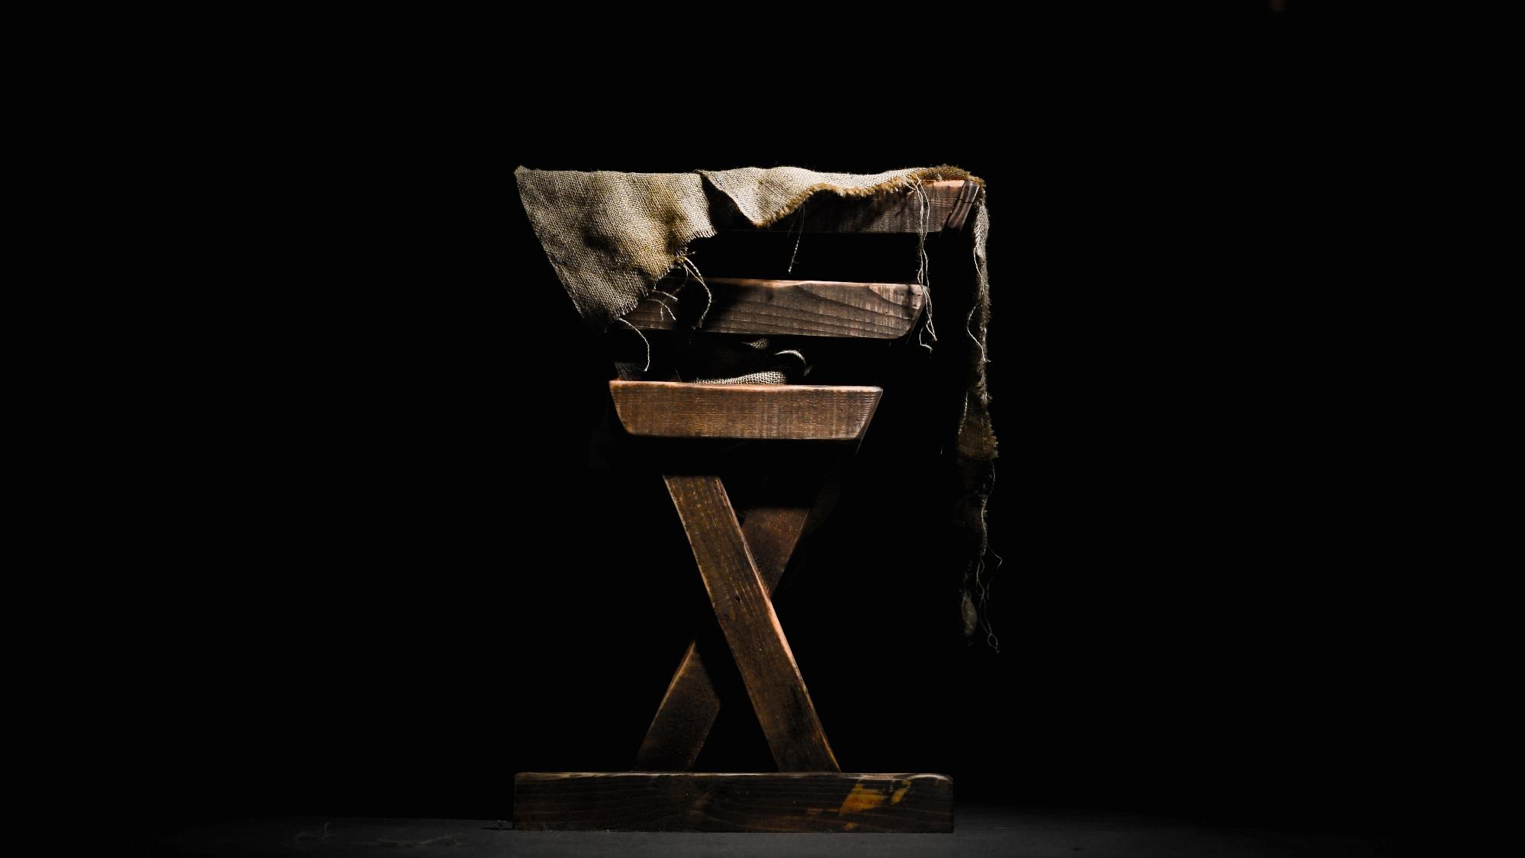
Content
Mary, from the moment she was conceived in St. Anne’s womb, received exceptional grace. In and through that grace, she continued to say yes to the Lord throughout her entire life, and this included growing up and living the call to holiness with her own family and extended family. At our own baptisms, we receive the beautiful gift of God’s grace as well. In and through that grace, we are able to say yes to the Lord and grow in holiness—grow as disciples of Jesus. The first and primary place where we rely on God’s grace and live the call to holiness is in our family life. Mary shows us this truth in her own life, and Jesus Himself confirms it in His years living in the Holy Family.

Slide 8
Family Sharing
Each family shows and shares about
your Advent wreaths, or candles and Nativity scenes

Slide 9
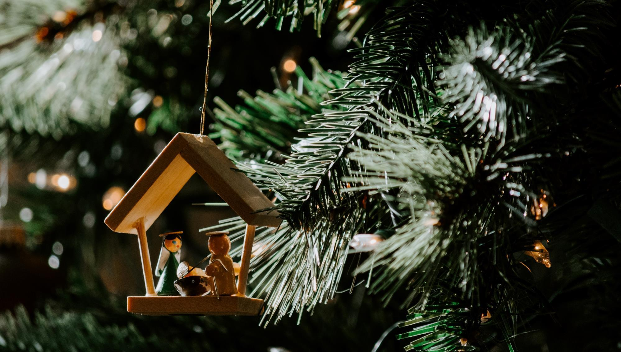
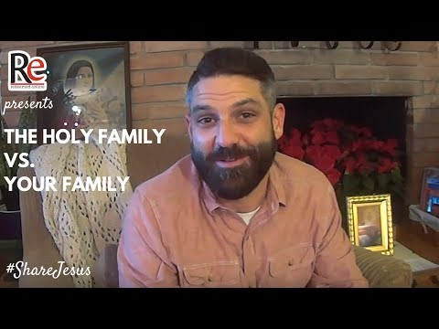
Content
Watch the video
THE HOLY FAMILY VS YOUR FAMILY
(5 min)

Slide 10
Affirmation Activity
Make a circle around or near your home altar.
How does Jesus live within each member of your family?
What are 3 things you like about the person on your right?
God loves you and He is pleased and proud of you all because you are trying to love one another as He loves you.
These efforts to love one another with, in and for God is what
makes your family holy!

Slide 11

Closing Prayer
Dear Jesus, as we light the candle(s) on our Advent wreath or on our home altar, may the light of your presence bring joy to our hearts. Bless our family and our friends, and be with all those who are in need this holiday season. Help us focus on you during this busy time. May we stay aware of the joy you bring into our lives. We want to find you in the everyday moments and come with hearts of gratitude to your manger on Christmas. Amen.
Adapted from Dynamic Catholic

