Slide 1
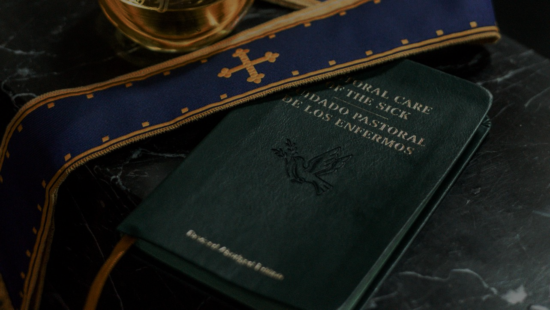
GOD’S SAVING LOVE FOR US:
LITURGY AND THE SEVEN SACRAMENTS
SACRAMENTS OF HEALING: THE ANOINTING OF THE SICK

Slide 2
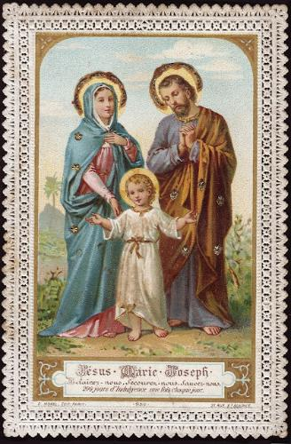
^{Opening Prayer}
Lord Jesus Christ, we entrust our family to You and ask for Your blessing and protection.
We love You Lord Jesus with all our hearts, and we ask that You help our family to become more like the Holy Family.
Help us to be kind, loving, and patient with one another.
Give us all the grace we need to become saints and Your faithful disciples. Amen.

Slide 3
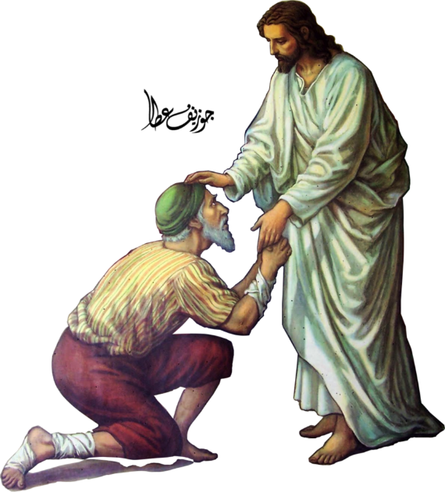
ICE BREAKER: Jesus, The Great Physician
Each family has a bible, piece of paper and pencil.
Using their bibles, families find and list as many people as they can who were healed by Jesus in the Gospels in 3 minutes, including the chapter and verse.
At the end of 3 minutes, the family with the most healings of Jesus listed wins!
The winning family reads their list aloud.
Adapted from www.signupgenius.com.

Slide 4
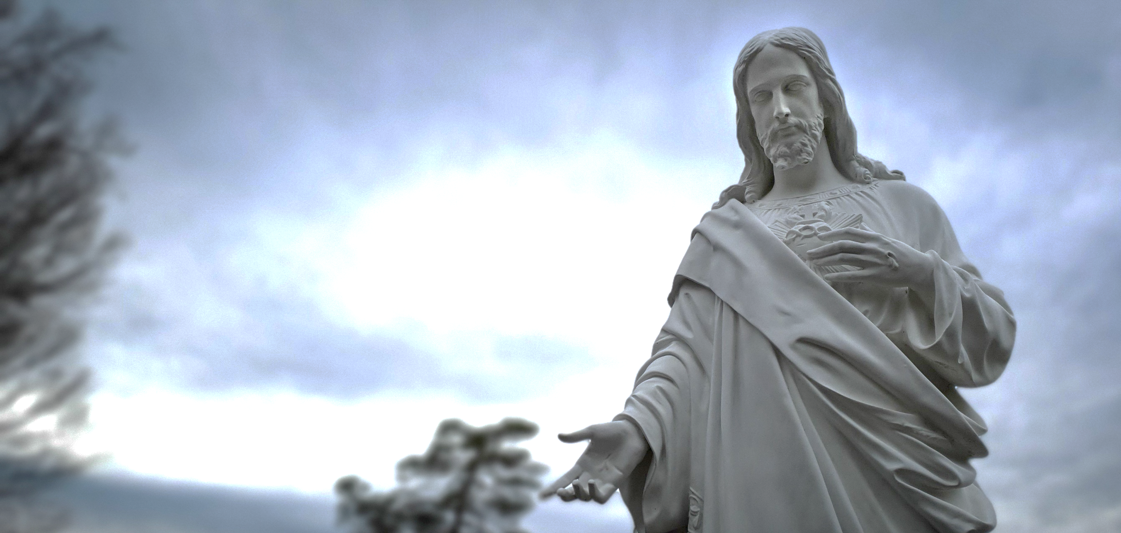
CONTENT
As we can see from the Scriptures, during his public life Jesus healed many people and cast out many demons. He gave His Apostles the power to cast out unclean spirits and to heal all kinds of sicknesses.
In fact, after Jesus rose from the dead, ascended into Heaven and took his place on His heavenly throne, St. James, one of the first Apostles, wrote about the early Church practicing the earliest form of the Sacrament of the Anointing of the Sick.
Please open your bibles to James 5:14-15.

Slide 5
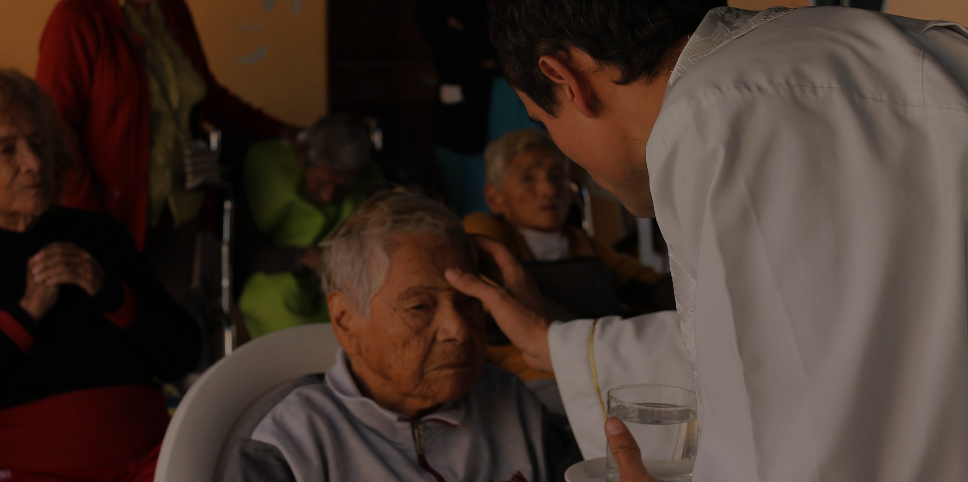
MAIN CONCEPT
The Sacrament of the Anointing of the Sick brings the healing touch of Jesus into our lives too. In this sacrament, we pray that the sick person be healed in body and soul. Sometimes a physical healing does take place, if it is God’s will, but not always. However, the Lord, through the power of the Holy Spirit, always offers spiritual healing and forgiveness, with or without the physical healing, in the Anointing of the Sick.

Slide 6
WATCH
Anointing of the Sick video | Catholic Central
Who can receive this sacrament?
Who administers this sacrament?
What does the priest use in this sacrament?
Is this a Sacrament of Initiation, Healing or Service?
Do we need it to get into Heaven?
Why are the gestures and/or signs of the Anointing of the Sick so powerful?
https://www.youtube.com/watch?v=n9Ujmdo8Aio

Slide 7
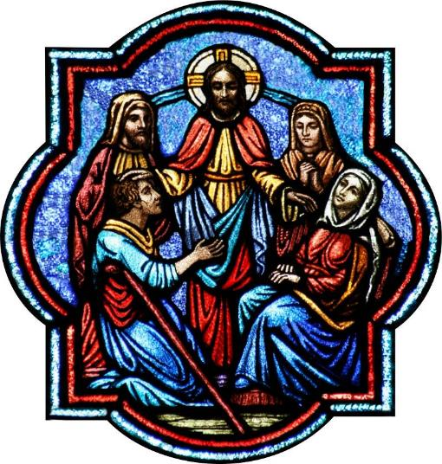
MAIN CONCEPT
Who can receive this sacrament?
Someone in danger of dying from sickness or old age, including, for example, anyone with a chronic sickness or a serious upcoming surgery
Who administers this sacrament?
Priest
What does the priest use in this sacrament?
Wears a Stoll & anoints with oils
Is this a Sacrament of Initiation, Healing or Service?
Healing
Do we need it to get into Heaven?
No (but it does help, especially if someone needs forgiveness of sins that is not able to be obtained through the Sacrament of Confession)
Why are the gestures and/or signs of the Anointing of the Sick so powerful?
Because they show us God is with us during our sickness

Slide 8
WATCH
JESUS HEALS THE LEPER
https://www.youtube.com/watch?v=VL8DThllZAY

Slide 9
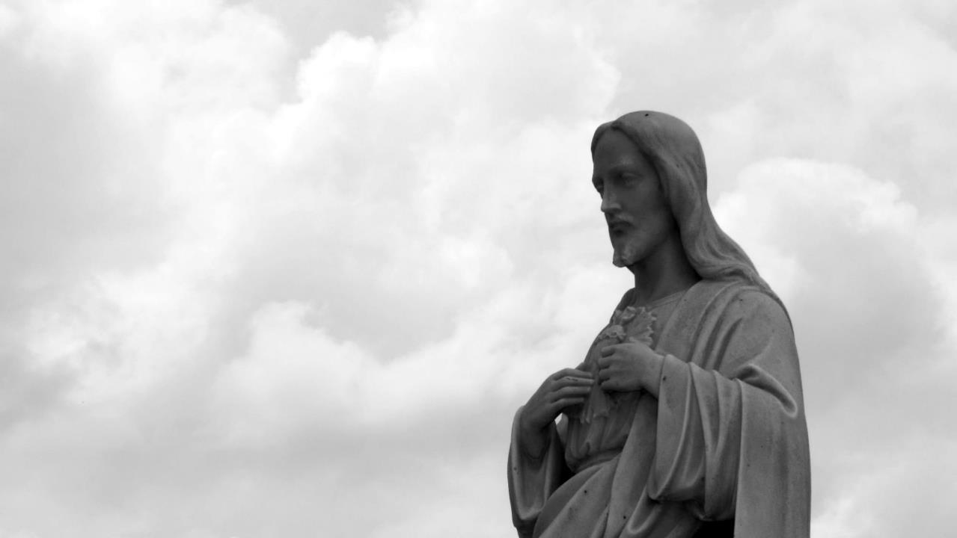
CORPORAL WORKS OF MERCY
Feed the hungry
Give drink to the thirsty
Shelter the homeless
Visit the sick
Visit the prisoners
Bury the dead
Give alms to the poor

Slide 10
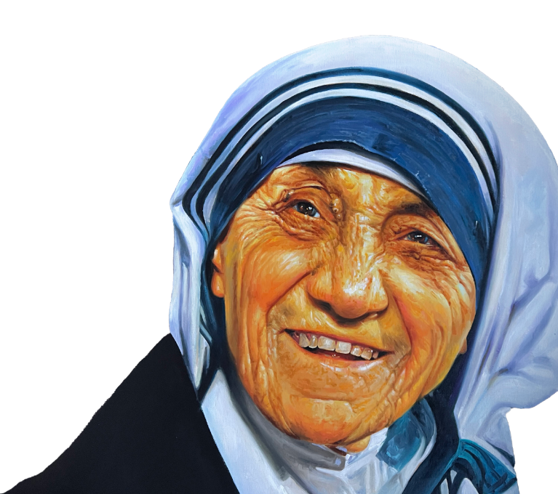
FAMILY ACTIVITY
“Hungry not only for bread - but hungry for love. Naked not only for clothing - but naked of human dignity and respect. Homeless not only for want of a home of bricks - but homeless because of rejection.” -St. Teresa of Kolkata
Reflecting on the words of Mother Teresa, each family creates a list of people who are sick and makes cards for them.
This is a Corporal Work of Mercy as Jesus calls us to comfort them!

Slide 11
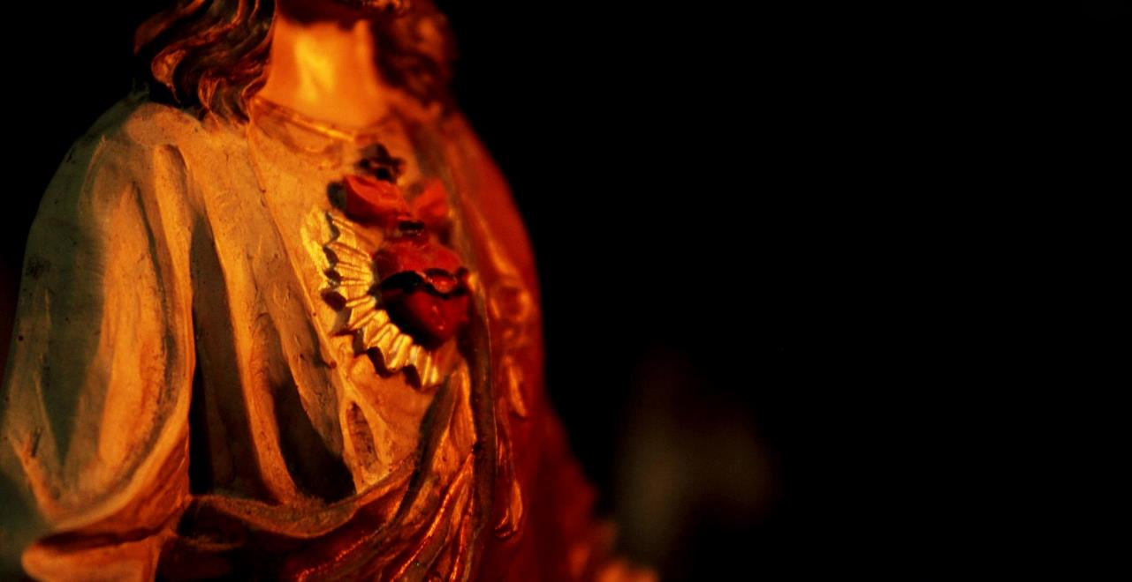
SPIRITUAL WORKS OF MERCY
Admonish the sinner. (Give correction to those who need it.)
Instruct the ignorant. (Share our knowledge with others.)
Counsel the doubtful. (Give advice to those who need it.)
Comfort the sorrowful.
Bear wrongs patiently.
Forgive all injuries.
Pray for the living and the dead.

Slide 12
CLOSING PRAYER
Today, we are going to close our time together by praying for those people for whom we have just made cards, which is a Spiritual Work of Mercy.
https://www.youtube.com/shorts/l-q6ROzfVjI

Slide 13
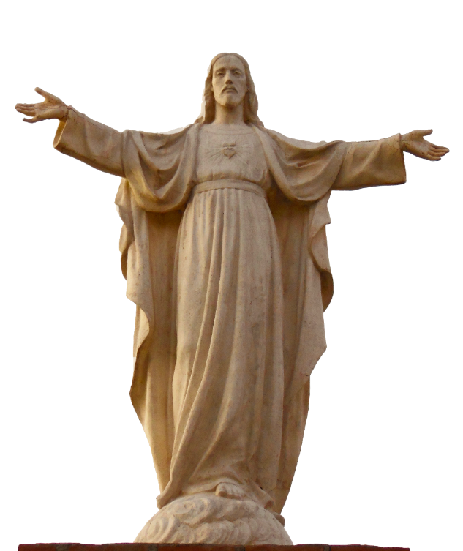
CLOSING PRAYER
A Litany for Healing
The Deacon or other leader introduces the Litany with these or similar words.
Let us name before God those for whom we offer our prayers. The people offer names either silently or aloud.
The Leader continues Let us offer our prayers for God’s healing, saying, “Have mercy.”
Holy God, source of health and salvation, Have mercy.
Holy and Mighty, wellspring of abundant life, Have mercy.
Holy Immortal One, protector of the faithful, Have mercy.
Holy Trinity, the source of all wholeness, Have mercy.
Grant your grace to heal those who are sick, we pray to you, O God, Have mercy.
Give courage and faith to all who are disabled through injury or illness, we pray to you, O God, Have mercy.
Comfort, relieve, and heal all sick children, we pray to you, O God, Have mercy.
Give courage to all who await surgery, we pray to you, O God, Have mercy.
Support and encourage those who live with chronic illness, we pray to you, O God, Have mercy.
Strengthen those who endure continual pain, and give them hope, we pray to you, O God, Have mercy.
Grant the refreshment of peaceful sleep to all who suffer, we pray to you, O God, Have mercy.
Befriend all who are anxious, lonely, despondent, or afraid, we pray to you, O God, Have mercy.
Restore those with mental illness to clarity of mind and hopefulness of heart, we pray to you, O God, Have mercy.
Give rest to the weary, and hold the dying in your loving arms, we pray to you, O God, Have mercy.
Help us to prepare for death with confident expectation and hope of Easter joy, we pray to you, O God, Have mercy.
Give your wisdom and compassion to health care workers, that they may minister to the sick and dying with knowledge, skill, and kindness, we pray to you, O God, Have mercy.
Uphold those who keep watch with the sick, we pray to you, O God, Have mercy.
Guide those who search for the causes and cures of sickness and disease, we pray to you, O God, Have mercy.
Jesus, Lamb of God, Have mercy.
Jesus, bearer of our sins, Have mercy.
Jesus, redeemer of the world, Have mercy.
Compassionate God: You so loved the world that you sent us Jesus to bear our infirmities and afflictions. Through acts of healing, he revealed you as the true source of health and salvation. For the sake of your Christ who suffered and died for us, conquered death, and now reigns with you in glory, hear the cry of your people. Have mercy on us, make us whole, and bring us at last into the fullness of your eternal life. Amen.
May the God who goes before you through desert places by night and by day be your companion and guide; may your journey be with the saints; may the Holy Spirit be your strength, and Christ your clothing of light, in whose name we pray. Amen.

