Slide 1
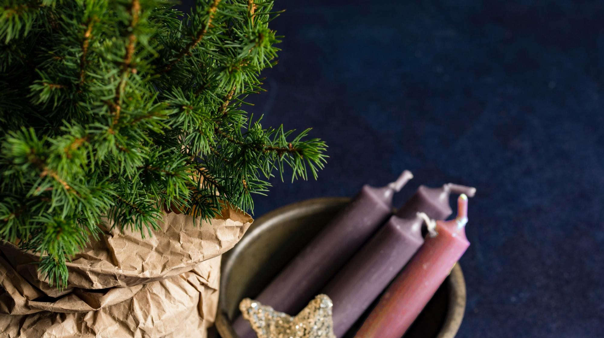
^{Families Forming Disciples}
Lesson 3 – Week 3

Slide 2
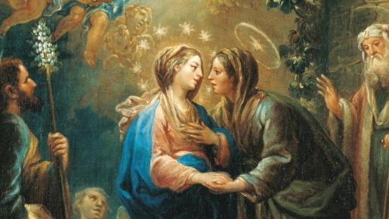
TOPIC: Preparing for Advent & The Spiritual ^{& Corporal Works of Mercy}
GOALS:
Families will make a plan for Advent by considering how Mary experienced the first Advent and how she prepared for the birth of Jesus.
Families will reflect on the Second Joyful Mystery of the Visitation of Mary to Elizabeth.
Families will make a plan to practice the Spiritual and Corporal Works of Mercy during Advent.

Slide 3
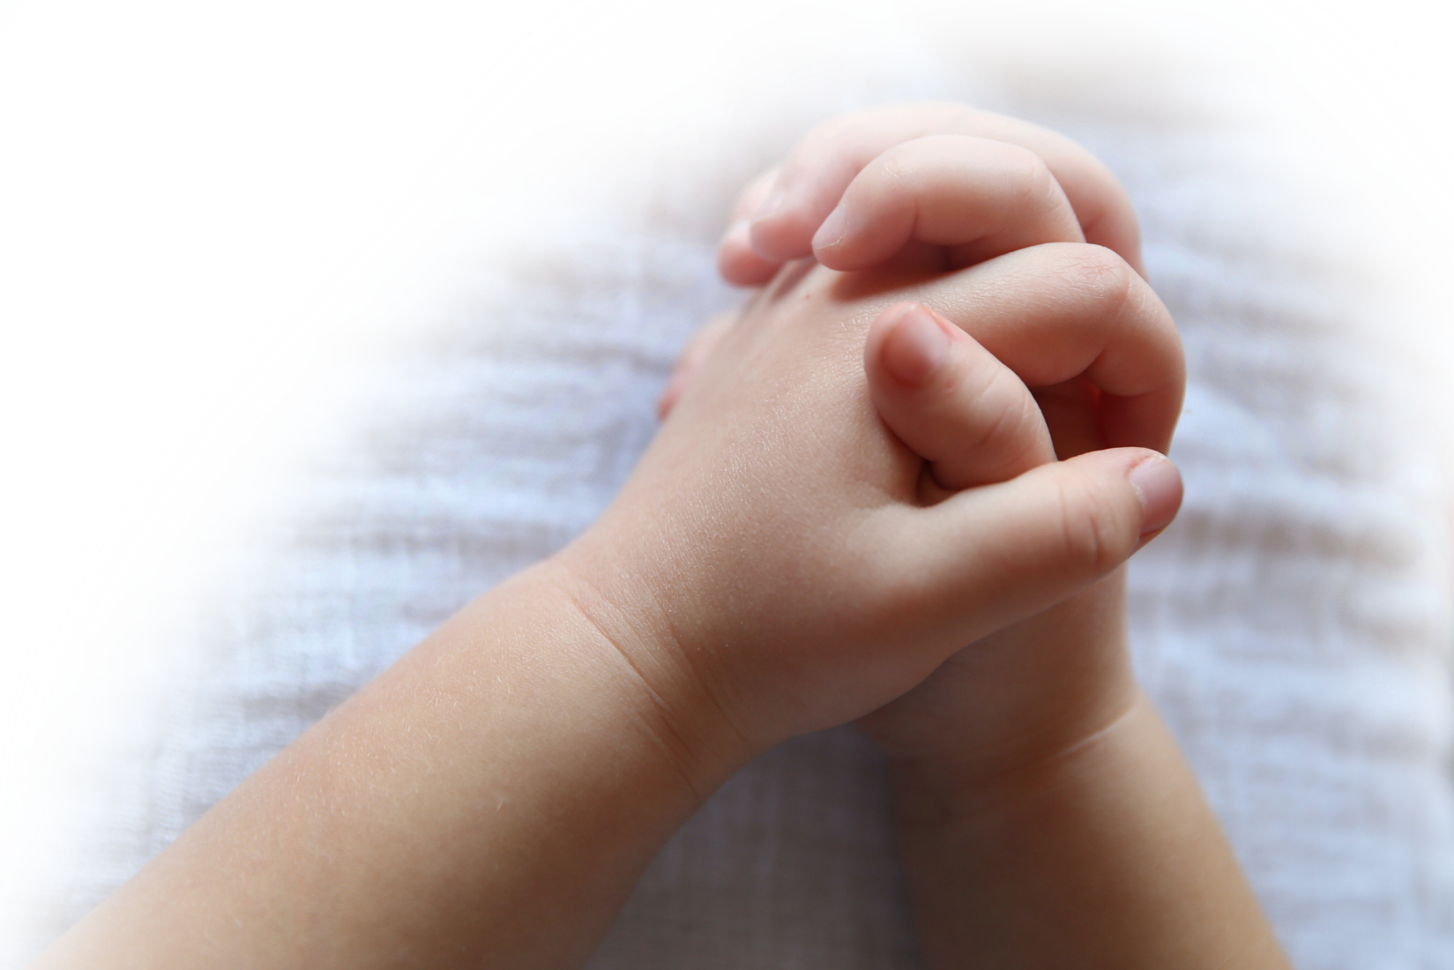
^{Opening Prayer}
Come, O Comforter, bless us and grant us the grace of recognizing and responding with love when others are in need or are suffering from injustice or abuse. May we be ready to help them find safety and shelter. Glory be…
(adapted from Catholics For Family Peace)

Slide 4
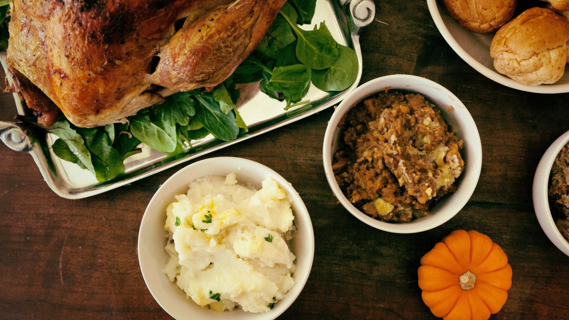
^{ICE BREAKER}
What Thanksgiving food is your favorite, or is the most unusual?
^{Or}
Go and grab your favorite snack, show it to the group and tell why it’s your favorite.

Slide 5
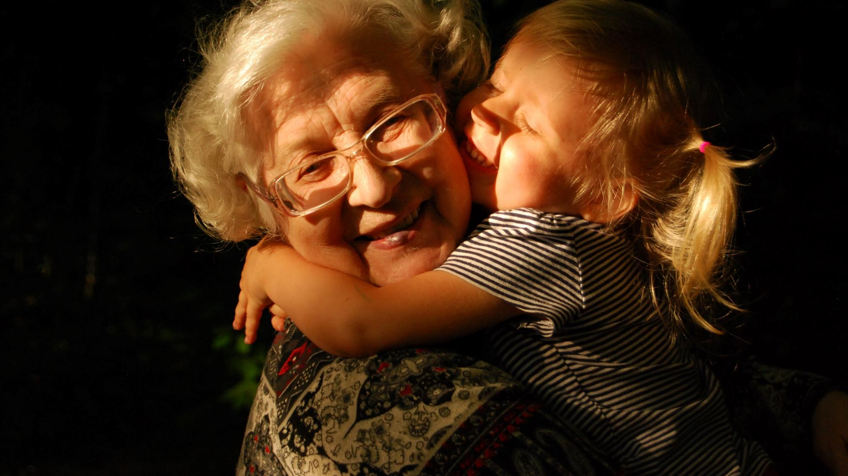
Family Sharing
Please share about your Senior Sharing experience by explaining who you interviewed and what he/she shared about their favorite memories of Advent when they were growing up.
Explain: The Senior Sharing was a beautiful work of mercy!
How did you feel about your experience?

Slide 6
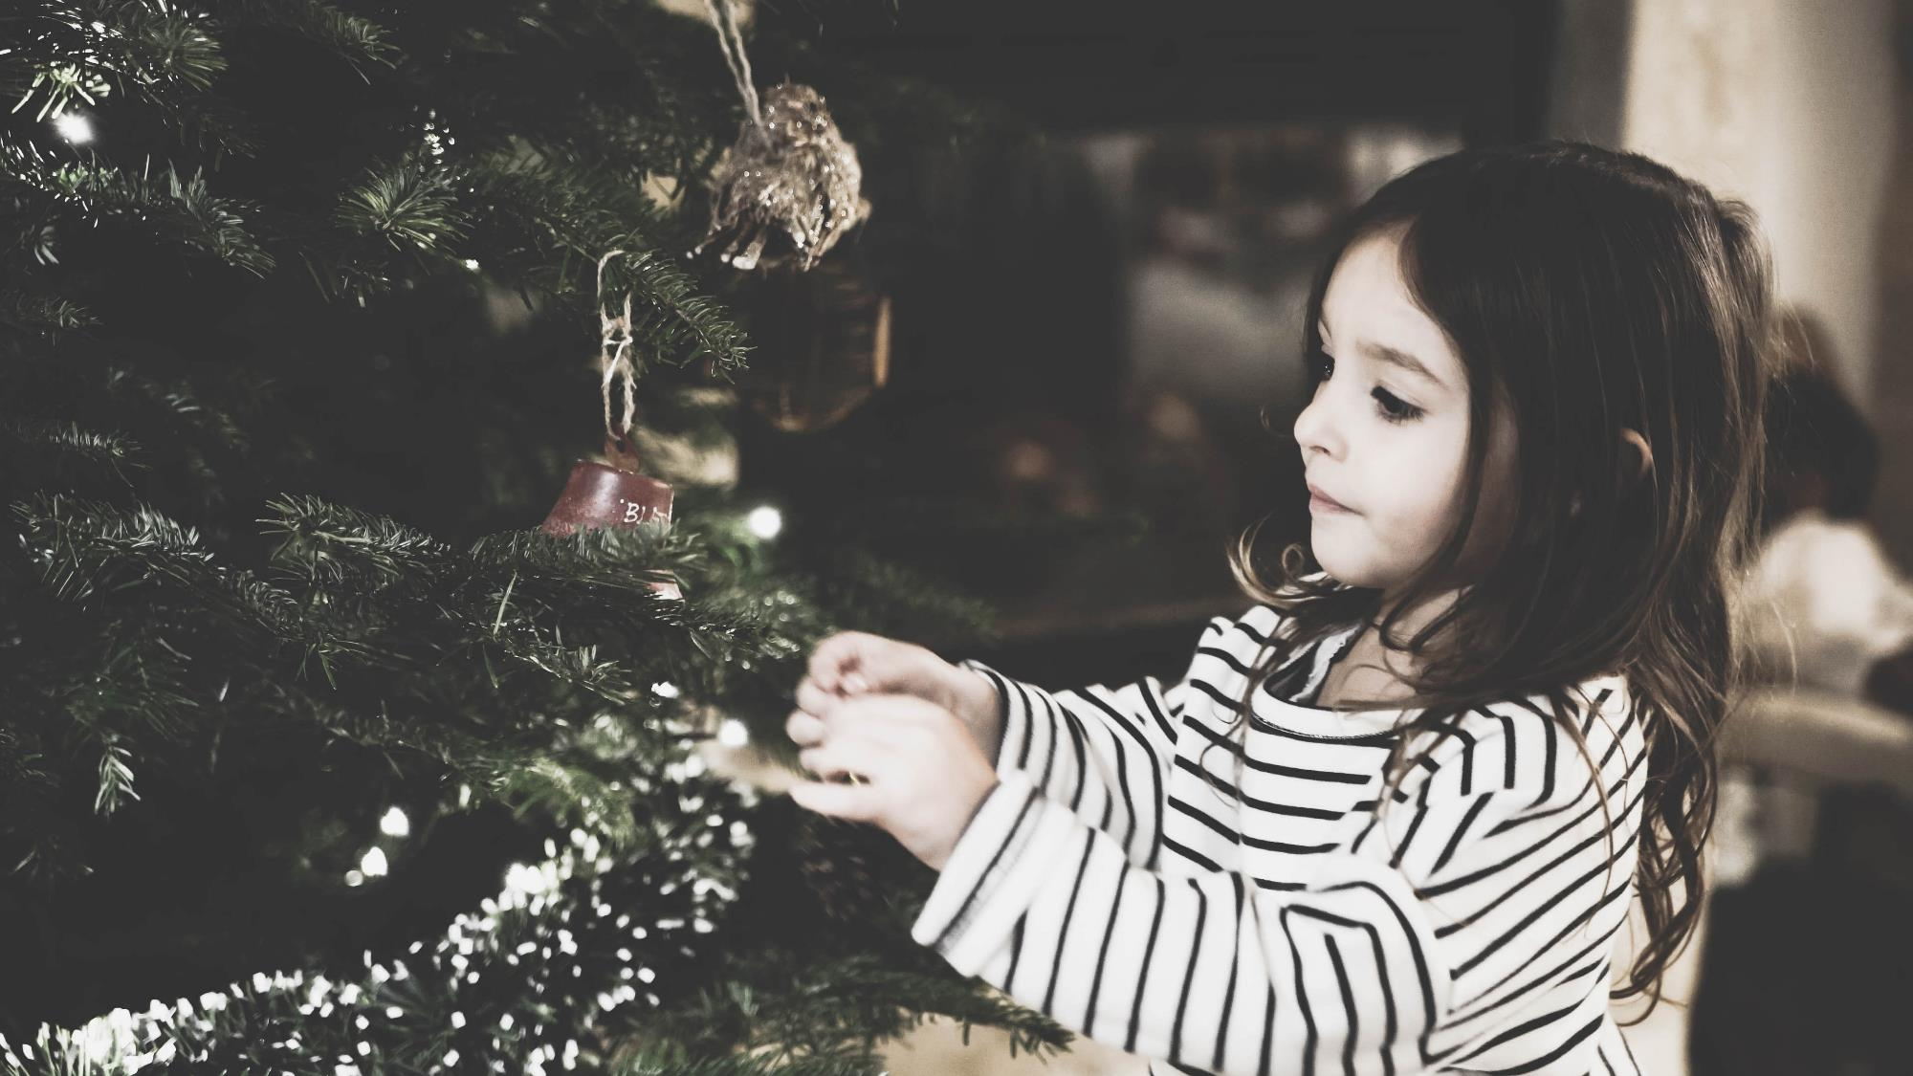
^{Review Main Concept}
Corporal and Spiritual Works of Mercy
^{Preparing for Advent with Mary}

Slide 7
FAMILY SHARING
^{Please} share about your Family Advent Plan and how it relates to the Spiritual and Corporal Works of Mercy.

Slide 8
Content: The Visitation

Slide 9
^{Family Sharing}
Guidelines for Family Sharing
a. Respectfully listening to each family member as he/she is sharing his/her reflection is very important.
b. Avoid interrupting or even correcting what another is saying (we’re
looking to listen, not critique).
c. When each family member has had an opportunity to share his/her reflections
on the Visitation, signal by raising your hand.
d. Please continue to sit quietly while we wait for the other families to finish.

Slide 10
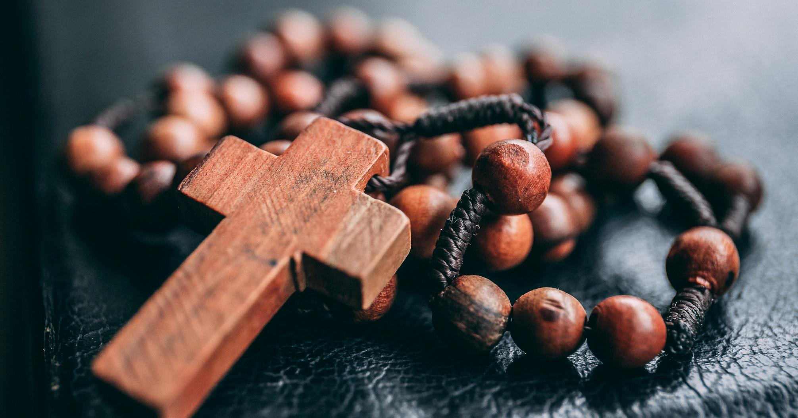
Prayer
Look at their Rosary for Children booklets/pamphlets and open up to the Second Joyful Mystery of the Visitation.
Explain: In October we talked about how when we say one of the prayers on the rosary, we are giving Mary a spiritual rose and asking her to pray for whatever is on our hearts. At the end of the Rosary, we have given her an entire bouquet.
Any special intentions for which you would like the group to pray?
Explain: When we say each prayer, we are also thinking about the life that Jesus and Mary lived together on earth. Those moments are called mysteries, and in our hearts we put ourselves there with Jesus and Mary in that mystery moment with them. Today, we will think about the story of the Visitation of Mary to Elizabeth and put ourselves there with them in that moment while we pray.
Pray: We will use the Rosary for Children pamphlets/booklets and we will pray one decade of the rosary together.

Slide 11
^{REMINDER}
^{Next meeting date and time.}
Upcoming Solemnity of Christ the King, the last Sunday of the Church year before Advent begins.
If you are planning to do Lesson 4’s, Going to the Beach with Jesus meditation, ask families to bring their beach or lawn chairs to the next gathering.
Christ our King, may you reign in our homes and hearts!

